Slide 1
Trapping Light, Tracking Proteins
Enhancing Time Resolution for Electron Paramagnetic Resonance Spectroscopy Studies of Protein Motion Using Fabry-Pérot Capillaries
Seda Peacher, Johanna Schubert and Mark Sherwin
Notes:
Hello, my name is Seda Peacher, and I am working with the Sherwin Group in Driven Quantum and Biological Matter and my graduate student mentor Johanna to trap light and track proteins, or, more specifically, to enhance the time resolution for electron paramagnetic resonance spectroscopy studies of protein motion using fabry-perot capillaries.

Slide 2
Background Information
Notes:
I will start out with background information on my summer project.

Slide 3
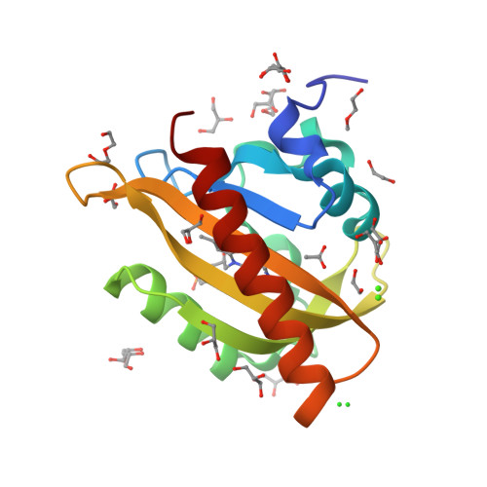
Proteins
The fundamental building blocks of all life
Protein Data Bank
AsLOV2 (Light-Oxygen-Voltage (LOV)2 domain of Avena sativa (oat) phototropin 1)
Dietler J, et al., Signal transduction in light-oxygen-voltage receptors lacking the active-site glutamine. Nat Commun. 2022 May 12;13(1):2618. doi: 10.1038/s41467-022-30252-4. PMID: 35552382; PMCID: PMC9098866.
Notes:
Protein motions drive nearly every process of life. Given their importance, they have attracted considerable research attention. One of the ways this has manifested is the Protein Data Bank, which has over 200,000 protein structures catalogued using tools that can analyze static proteins, notably x-ray crystallography, cryo electron-microscopy, and nuclear magnetic resonance spectroscopy.
Sherwin Lab has been studying AsLOV2, pictured here from the protein data bank and obtained using x-ray diffraction. AsLOV2 is a light sensitive protein domain in oats that allows the plant to turn and face the sun.

Slide 4
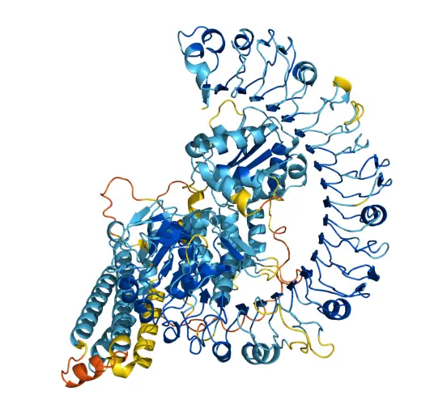
AlphaFold
AI trained by data bank
Predict protein structure
https://alphafold.ebi.ac.uk/
Notes:
One of the ways that we’ve taken advantage of the protein data bank is AlphaFold, a new AI tool trained on Protein Data Bank and developed by google that recently won the chemistry Nobel Prize. It can predict the 3D structure of the protein given a linear 2D sequence of amino acid residues, which define the primary level of protein structure. These images and 3D structures are currently the cutting edge of protein research, but…

Slide 5
Images Are State of the Art
Movement is essential to understanding protein function
Notes:
movement is essential to our understanding of proteins. Many proteins undergo conformational changes, which simply means that they move, and this movement is directly related to their function. We currently don’t fully understand how proteins move, and due to the protein’s nanometer scale size and rapid timescales involved we can’t directly film them with traditional microscopy techniques. This means we need to find another way to track protein motion in real time.

Slide 6
Technique
Notes:
I will now move on to a discussion of the technique we use.

Slide 7
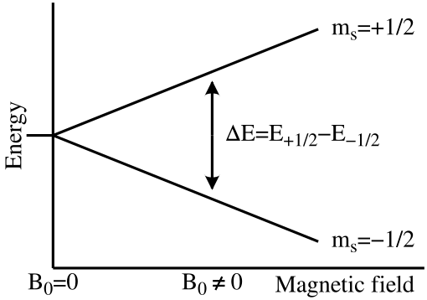
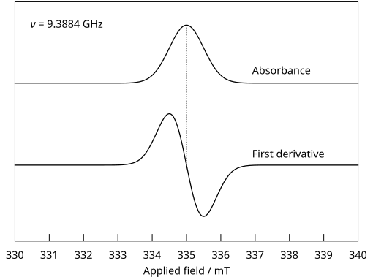
EPR (Electron Paramagnetic Resonance)
https://en.wikipedia.org/wiki/File:EPR_splitting.svg
https://en.wikipedia.org/wiki/File:EPR_Signal_Harmonics.svg
Notes:
To “film” proteins in motion, we use something called electron paramagnetic resonance, or EPR. EPR takes advantage of the quantum mechanical behavior of materials that have unpaired electrons. These electrons have spins that can exist in one of two states: spin-up or spin-down.
We sweep the magnetic field through a resonant value determined by the microwave frequency, because more electron spins occupy the lower-energy (spin-down) state near the resonant magnetic field due to the Maxwell-Boltzmann distribution. As the magnetic field is swept through, a net absorption of microwave energy occurs, which can be translated into an EPR spectrum.
Since EPR relies on detecting small changes in microwave absorption as the magnetic field is swept, we record the first derivative. The derivative signal sharpens the features, making resonance positions easier to identify, reduces noise, and suppresses background or non-resonant microwave absorption to highlight only the rapid changes associated with spin transitions.

Slide 8
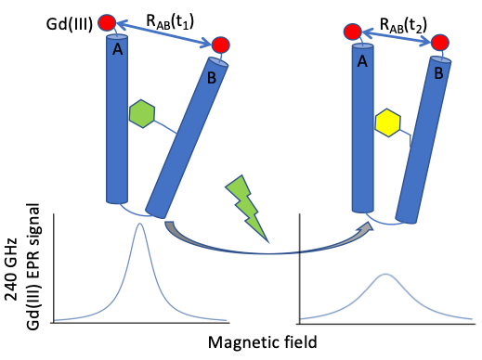
EPR and Proteins
Proteins do not contain unpaired electrons
Once added, EPR can “film” protein movement
https://sherwingroup.itst.ucsb.edu/research/gd3/
Notes:
Proteins generally do not naturally contain unpaired electrons, so paramagnetic spin labels with unpaired electrons are introduced at specific sites within the protein. EPR lineshape depends on the distance between spin labels, so as the proteins move, the distance between the selected sites change and we can track the changes in the spectrum over time.

Slide 9
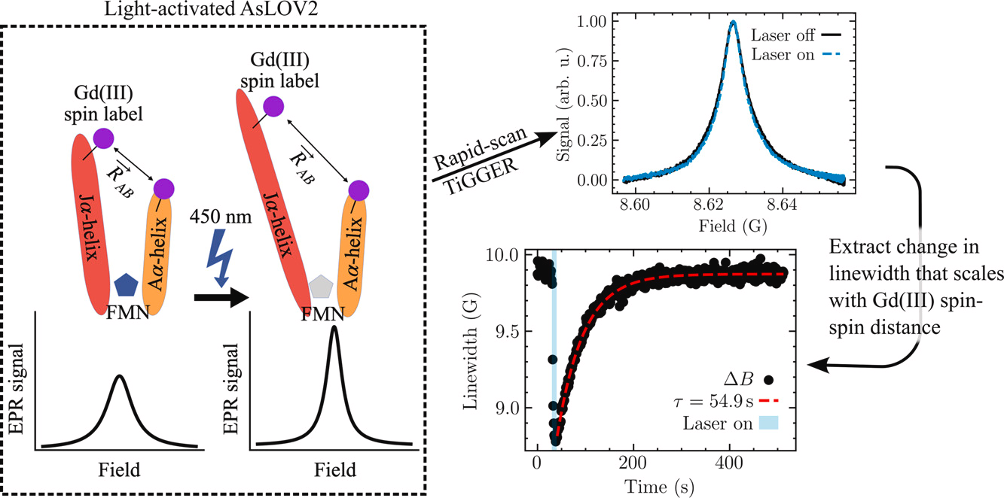
AsLOV2
Brad D. Price, Antonín Sojka, Shiny Maity, I. Marcelo Chavez, Matthieu Starck, Maxwell Z. Wilson, Songi Han, Mark S. Sherwin, Field-domain rapid-scan EPR at 240GHz for studies of protein functional dynamics at room temperature, Journal of Magnetic Resonance, Volume 366, 2024, 107744, ISSN 1090-7807, https://doi.org/10.1016/j.jmr.2024.107744.
Notes:
The Sherwin Lab has already successfully used EPR to analyze AsLOV2, the oat protein domain I mentioned in the introduction. Since AsLOV2 is light sensitive, when hit with a 450nm blue light laser, the protein is activated and undergoes a reversible conformational change.
The J-alpha helix, that red oval you can see on our graph here, unfolds in under 1ms, and then re-folds over about a minute. We have tracked the re-folding, but our current time ceiling is about 10ms, so we can’t see it unfold. We need to increase the signal to noise ratio to be able to see behaviors that occur on a smaller timescale…

Slide 10
My Project
Notes:
and that is where my project comes in!

Slide 11
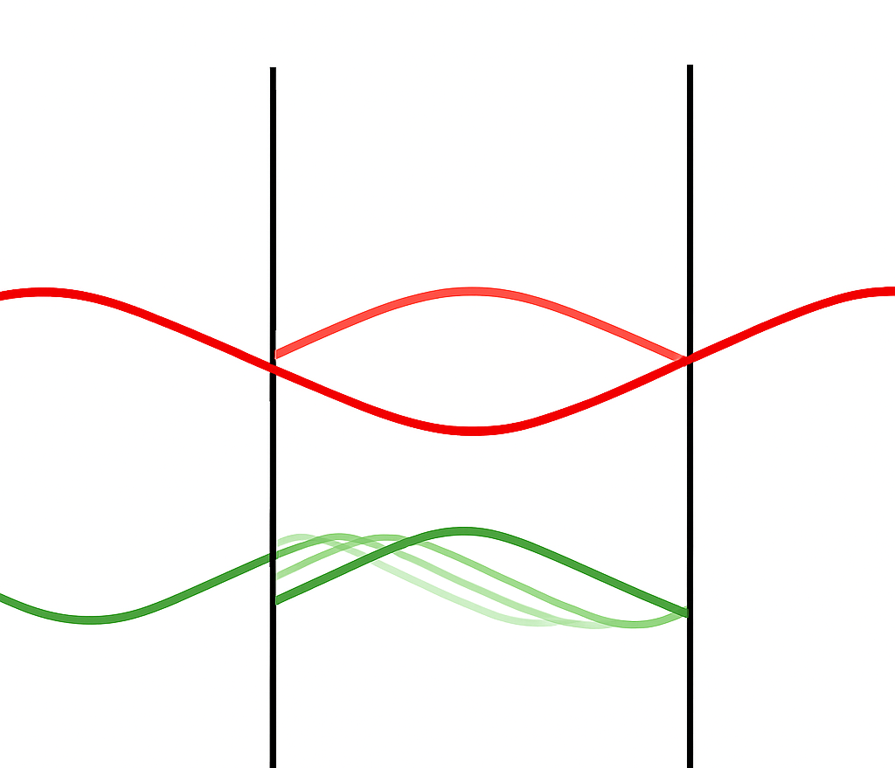
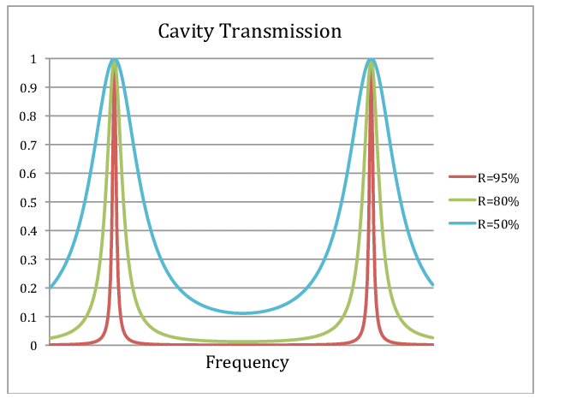
Fabry-Pérot Cavity
Wharton, K.. (2011). Quantum Theory without Quantization.
Notes:
Improving SNR increases time resolution because once the signal stands out clearly from the noise, it can be measured more accurately over shorter time intervals, preserving fine temporal structure instead of averaging it away. One strategy for trying to increase our signal to noise ratio and therefore improve our time ceiling is to add a resonator. Many other labs that do similar work already have one implemented, because again EPR gives a very weak signal, especially at lower fields. The Sherwin Lab works at very high field, so it hasn’t been as necessary, but since we have hit our time ceiling it is time to implement one!
We’ve chosen to use a Fabry-perot cavity. Fabry-perot cavities are optical cavities made from two semi-reflective surfaces facing one another with a specified distance in between them. Only resonant frequencies can pass through these surfaces and out to be detected. The red wave on the left is the resonant signal that undergoes constructive interference and can then exit the cavity, and the green wave is the noise that undergoes destructive interference and is trapped in the cavity. This should mean that noise is filtered out, and the signal is amplified. This graph on the left shows how the cavity selects specific resonant frequencies, and the mirror reflectivity controls how selective it is about which frequencies get through.

Slide 12
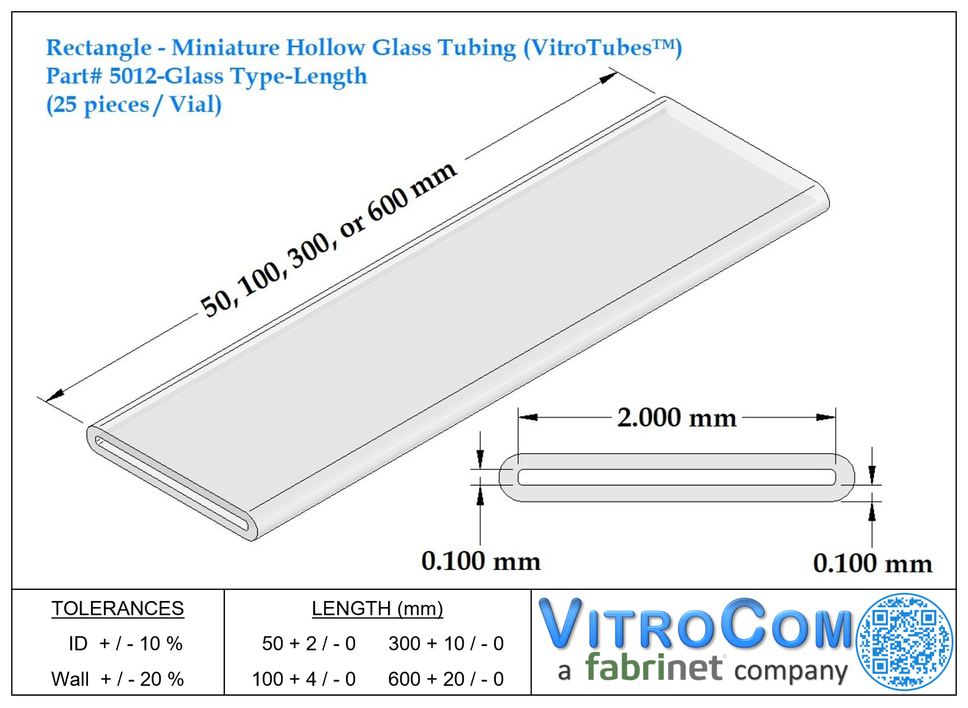
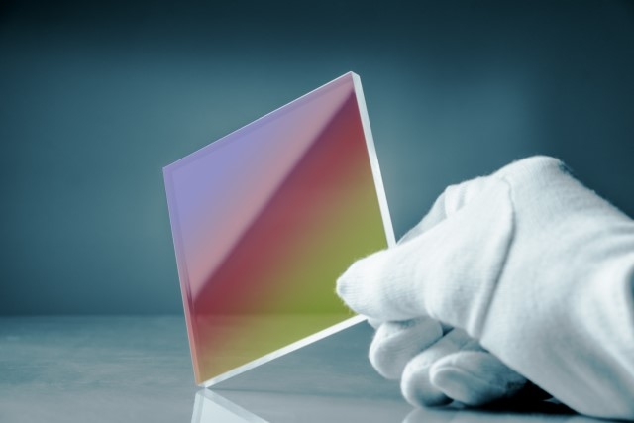
ITO Deposition on Borosilicate Glass Capillaries
Notes:
Our strategy for creating a fabry-perot cavity is to deposit indium tin oxide (ITO) onto the top and bottom of these rectangular borosilicate glass capillaries.

Slide 13
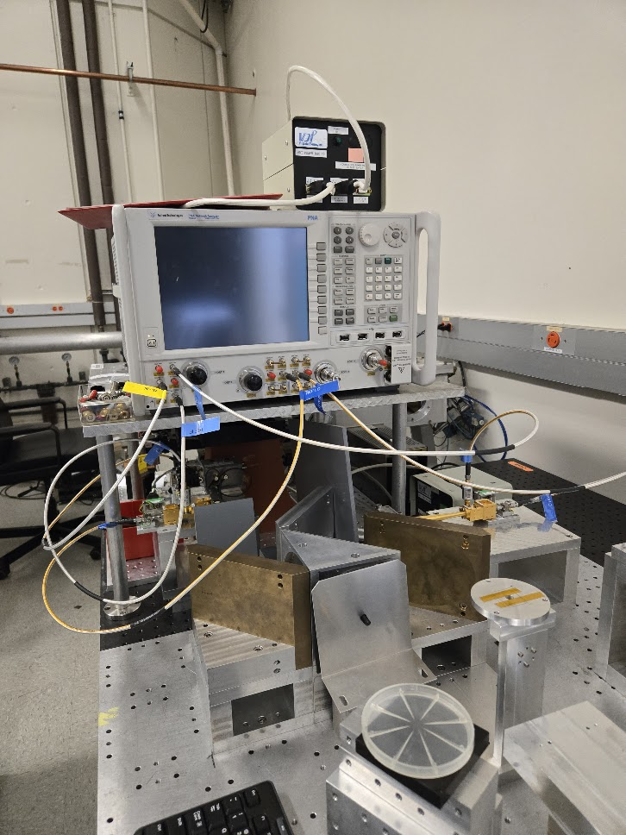
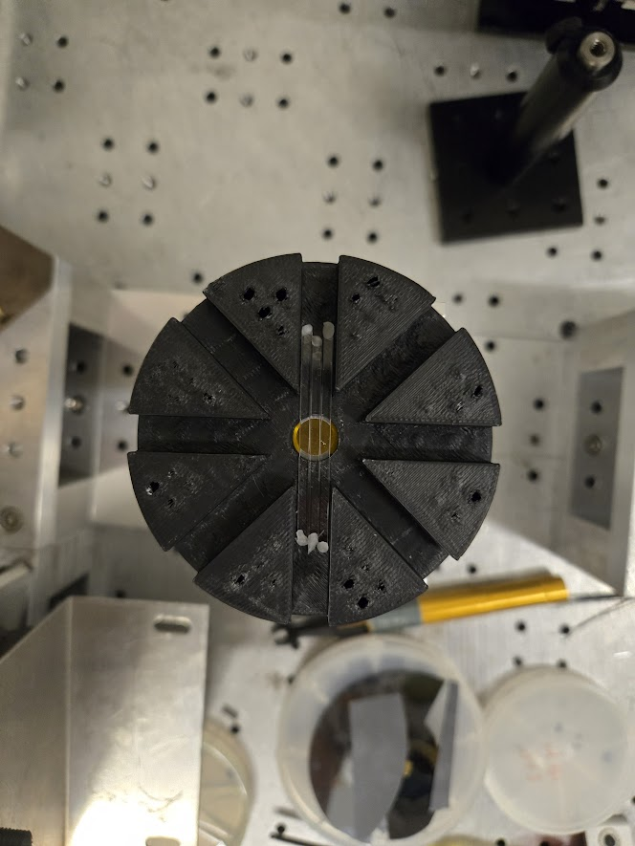
Vector Network Analyzer (VNA)
Sample Stage
VNA
Notes:
To perform preliminary measurements on the components of the cavity, I used a Vector Network Analyzer, or VNA. A VNA is used in EPR to characterize the microwave properties of resonators and components within the spectrometer setup. It measures S-parameters, or scattering parameters, which describe how signals behave when they encounter a device (reflection, transmission, loss) and are critical for tuning the resonant cavity used in EPR.
For our purposes we want to examine the S11 parameter, or the reflective parameter. By analyzing S11, the VNA helps determine the cavity’s resonant frequency and quality (Q) factor, which is the ratio of the initial energy stored in the cavity to the energy lost, both of which affect sensitivity and resolution.
In this second photo you can see our measurement setup. The area we take our measurements over is too large for a singular capillary, so we set three capillaries next to one another to take our measurements. In order to keep the angle constant and hold the three capillaries together, I designed and 3D printed an angle jig that fits exactly 3 capillaries.

Slide 14
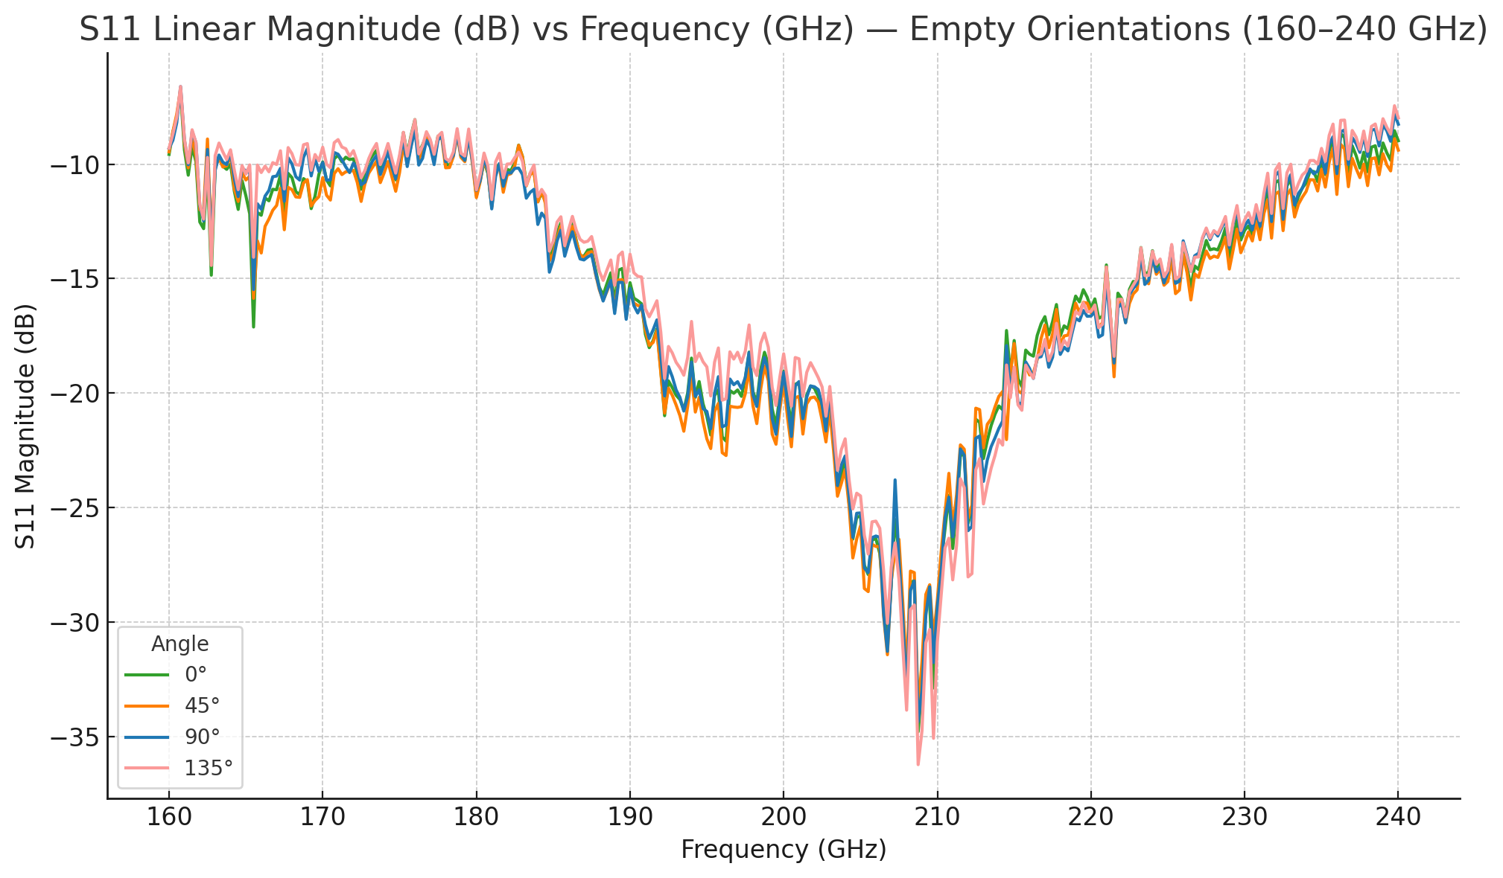
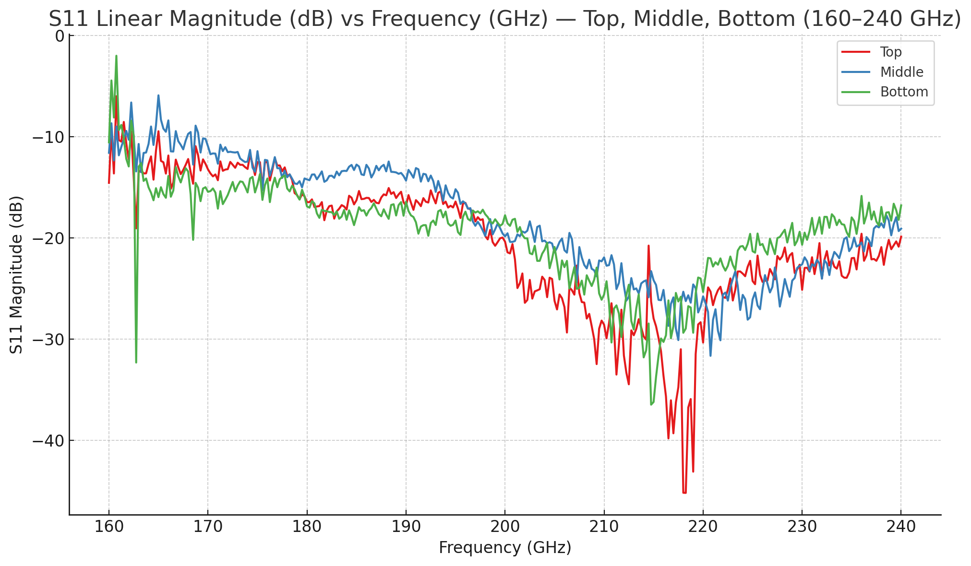
Orientation vs Position
Notes:
As I just mentioned, we must use 3 capillaries set side by side, and so we wanted to make sure that the angle we set them at in the jig didn’t have a bearing on our results. As you can see in the graph on the left, the angle does not affect the position of the minimum or the magnitude.
However, turning to the graph on the left, as we measure different locations along the length of one capillary the position of the minimum is shifted, and the index of refraction is different when fit. This means that the thickness of the glass must be variable along the capillary.
This is a bit of an experimental challenge, because we have to tune the thickness of the ITO to get fabry perot resonance and if the glass thickness is variable then that ITO deposition thickness would need to be different every time. There would be no simple or reliable way of knowing what it would be each time. However, we still want to be able to model and understand our experimental results, so we will move on to…

Slide 15
Modeling and Simulation
Notes:
the modeling techniques I used this summer.

Slide 16
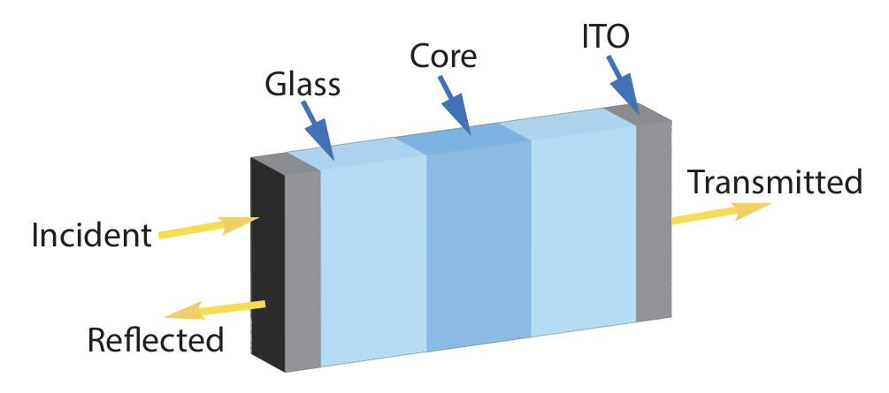
Transfer Matrix Method
Notes:
To start, I used the transfer matrix method (TMM), which consists of characterizing each material and interface with a matrix. The I’s are the interface matrices, and the P’s are the propagation matrices. These matrices are multiplied together to obtain a global transfer matrix.

Slide 17

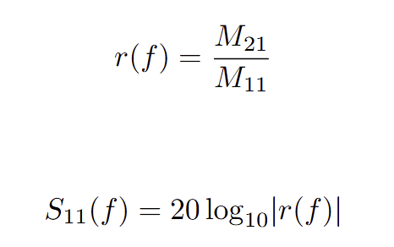
Transfer Matrix Method, Cont.
Notes:
This global transfer matrix can then be used to calculate the reflection coefficient, and converted to decibels to create a model of the S11 from the VNA.

Slide 18
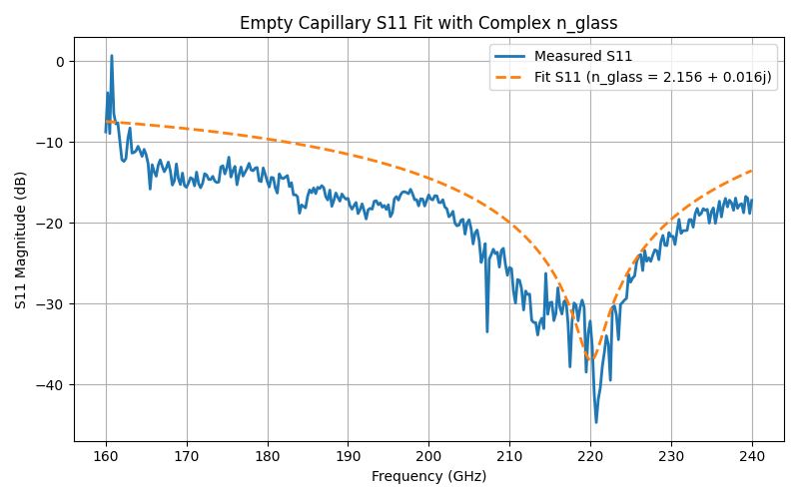
TMM on Empty Capillary
Notes:
I used the transfer matrix method to fit the refractive index of glass, allowing it to be complex because borosilicate glass isn’t perfectly lossless and absorbs some of the incoming light.

Slide 19
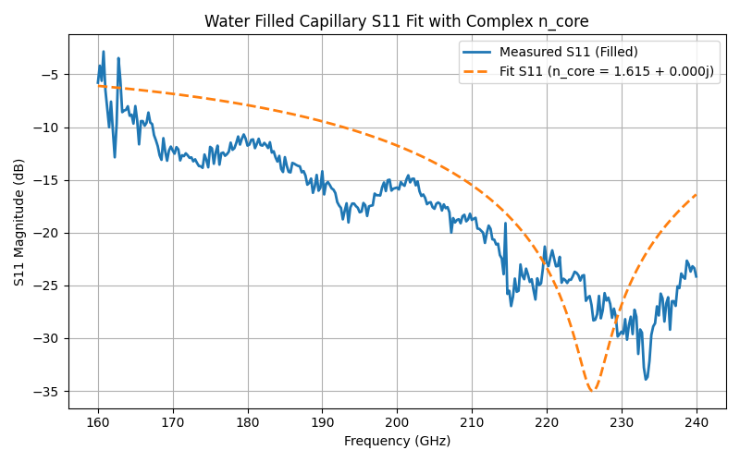
Application to Water
Notes:
When we take measurements of proteins, we will need to fill the capillaries with a liquid buffer. We started by modeling water, which is a bit simpler. I tried to use the same model I used for the empty capillaries on the water filled capillaries but as you can see in the graph, the model didn’t work well. We hypothesize that this is because water is lossy in THz to GHz range and we need more considerations in light of that.

Slide 20
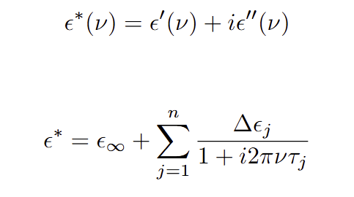
Complex Dielectric Function
N. Q. Vinh, Mark S. Sherwin, S. James Allen, D. K. George, A. J. Rahmani, Kevin W. Plaxco; High-precision gigahertz-to-terahertz spectroscopy of aqueous salt solutions as a probe of the femtosecond-to-picosecond dynamics of liquid water. J. Chem. Phys. 28 April 2015; 142 (16): 164502. https://doi.org/10.1063/1.4918708
Notes:
We decided to use a form of the complex dielectric function to allow for more factors to be taken into consideration. This top equation is the complex dielectric function in its simplest form. The function itself quantifies how a material responds to an electric field with a certain frequency. It has a real part, epsilon prime, which has to do with the storage of electrical energy within the material, and an imaginary part, epsilon double prime, which has to do with the dissipation of energy by the material, whether it is through absorption or scattering.
This function can also be written in terms of debye relaxations, which are a way to describe how fast molecules respond to changes in an electric field, especially when the field is changing rapidly, like in terahertz radiation. This expansion is for particulates in some medium, or a solution. In this equation, epsilon infinity is the permittivity at the high frequency limit, ∆ε is the weighted contribution of each Debye process to the total relaxation, τ is the relaxation time of each Debye process, and ν is the frequency of the incoming radiation.
The complex index of refraction is the square root of the complex dielectric function, so we can use our results to create a more accurate simulation of the water filled capillary using that index of refraction we get and the transfer matrix method.

Slide 21
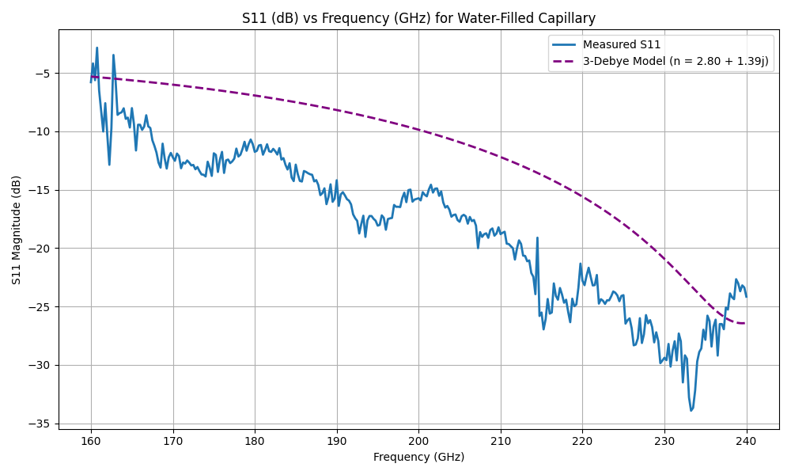
Modeling of Water-Filled Capillaries
Notes:
This graph here is the measured S11 fit with the dielectric function of water and the transfer matrix method. In the top right corner you can see our n, which is the modeled index of refraction of water. We can then move on to modeling the buffer.

Slide 22
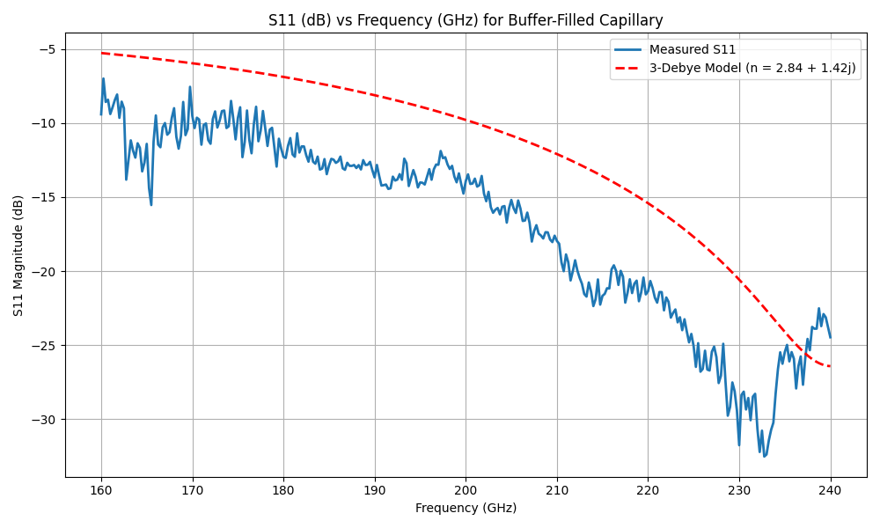
Modeling of Buffer-Filled Capillaries
Notes:
Buffer is a mixture of a buffer to keep our pH fairly consistent, and salt to make sure the proteins move in the way that we expect them to. The salt binds to the extra charges on parts of the protein that could lead to unexpected motion. This is an interesting measurement for our lab, because we didn’t know the index of refraction of buffer previously. As you can see both from the data and the simulation results, the buffer isn’t very different from water. The buffer is pH 7.5, and only has 150 millimoles of salt added, so this is in line with our predictions. Now that we have successfully modeled both the glass and the core, we can move on to analysis of the ITO.

Slide 23
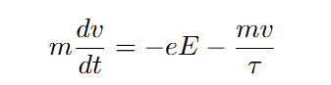
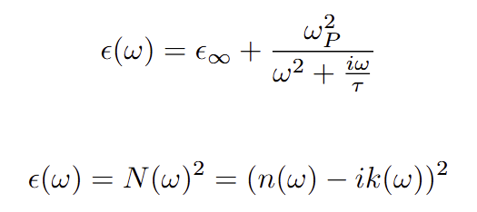
Drude Free Electron Model
C. -W. Chen, Y. -C. Lin, C. -H. Chang, P. Yu, J. -M. Shieh and C. -L. Pan, "Frequency-Dependent Complex Conductivities and Dielectric Responses of Indium Tin Oxide Thin Films From the Visible to the Far-Infrared," in IEEE Journal of Quantum Electronics, vol. 46, no. 12, pp. 1746-1754, Dec. 2010, doi: 10.1109/JQE.2010.2063696.
Notes:
To simulate the ITO, we needed to find a way to calculate the refractive index of ITO in the frequency range we are working with. Based on the literature, we decided to use the Drude (drude-uh) Free Electron Model. This top equation is Drude Free Electron model equation of motion for the average electron velocity in the presence of an electric field.
Its frequency-domain solution is another rewriting of the complex dielectric function that models electrons in a metal as a gas of randomly-moving particles that do not interact with one another. This comes from applying classical equations of motion to electrons modeled as small balls in a sort of dense soup driven by an electric field.
Epsilon infinity is again the permittivity at the high frequency limit, and the second term arises from the free carriers for which τ is the momentum relaxation time, ωP is the characteristic plasma frequency, and w is the frequency of the field. Once we got this result using values from the literature, we were able to take the square root of this to get the complex index of refraction, and model the ITO.

Slide 24
ITO Simulations
Where are we looking?
Measuring at 240GHz
What are we looking for?
Deep minima
Narrow linewidth
Why?
Resonant mode
Q factor
Notes:
Before we take a look at the results, I will clarify exactly what we are looking for. We are looking specifically at 240 GHz, because that is the frequency our EPR setup measures at, and we are looking for deep minima that are sharp, or have narrow linewidths. We want the minima to occur at 240GHz, because that means we have resonance where we are measuring, and we want sharp minima because the narrower the linewidth the better the Q, or quality, factor.

Slide 25
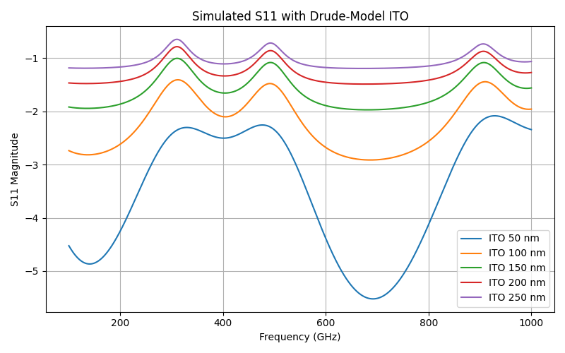
ITO Simulations
Notes:
And here’s our simulation result for an empty, ITO coated capillary. 50 nm is the thinnest we can apply the model to, as ITO is not very reflective in the sub 50 nm regime. If we go any thicker, the ITO would likely be opaque.
As you can see, we do not possess any of the qualities we had been looking for. We have wide minima, and more importantly no minimum at 240GHz, meaning there is no resonance there.
Once we fill the capillaries, the location of the minima will shift because our optical length will change, but that isn’t our only issue. We hypothesize that another contributing factor is that the path of the light is more complicated than the fabry-perot figure I showed at the beginning suggests.

Slide 26
Different ITO Interfaces
Notes:
If we take a look at the path of the light again, we can see that there isn’t just the two reflective layers, we have glass and the core filling to account for. As the light is transmitted through the system, it is partially absorbed by and reflected off of each layer, causing more complicated wave interactions than we originally assumed.
In particular, we hypothesize that one of the issues is that in the initial light-ITO interaction, the interface is with air, but in the second interaction the interface is with glass. We can’t deposit the ITO on the inside to mitigate this issue, so we decided to try varying the thickness of the second layer instead.

Slide 27
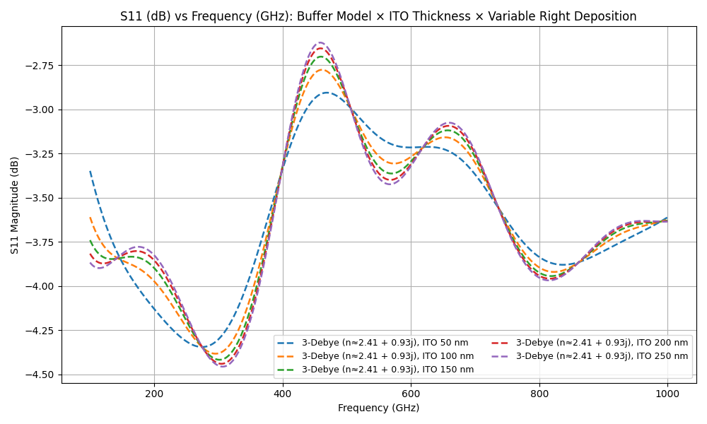
Filled ITO-Coated Capillary Simulation with Variable Thickness
Notes:
This here is our result with the filled the capillary and varied the ITO deposition on the second layer. As you can see, the quality of the minima is better, and the location is much closer to the 240 GHz.
Unfortunately, while we might be able to see fabry-perot like enhancement with this setup we cannot create a true resonator because there is not enough room within the capillary to create a standing wave for resonance.
Additionally, the capillaries cannot be reused, as they cannot be appropriately cleaned, and the liquid inside evaporates quickly. This is a problem particularly because as I mentioned at the beginning, deposition thickness would need to vary with every capillary, which would make experimental setup tedious and hard to keep consistent.

Slide 28
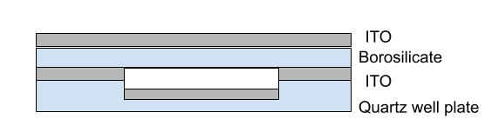
Next Steps
Model functional setup
Deposit ITO
Analyze ITO with VNA
Test cavity
Credit: Johanna Schubert
Notes:
In light of that, our next step is to create a model of a functional setup. As I mentioned, we need to create more space between ITO layers, and one of our options to do so is pictured below. We could use well plate geometry as a potential solution to enable resonance at 240GHz.
Once we have a functional setup modeled, we will deposit the ITO using e-beam evaporation, which uses a focused beam of electrons to evaporate a material, in our case ITO, which then is deposited as a thin film on a substrate.
We will then analyze the setup with the VNA to confirm agreement with the simulation results, and test the cavity with EPR spectroscopy.

Slide 29
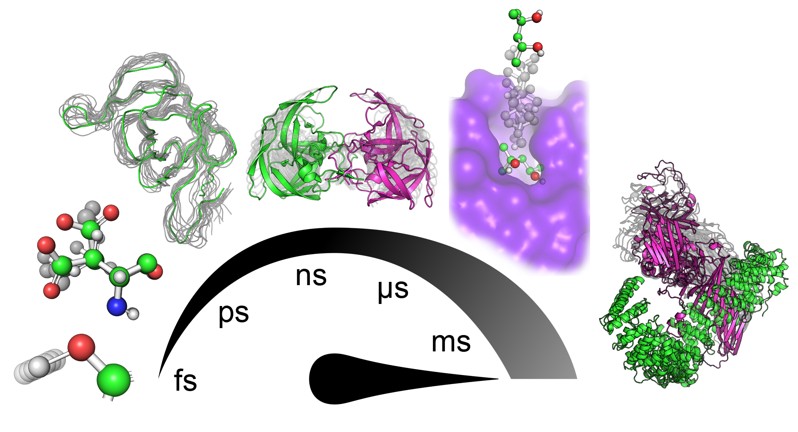
Conclusions
We struggle to resolve fast protein motions with current EPR setup
A Fabry–Pérot cavity enhances signal-to-noise ratio
Can detect more rapid conformational changes
Paves the way for Sherwin Lab to resolve faster protein dynamics
https://encyclopedia.pub/entry/607
Notes:
Again, resolving fast protein motions remains difficult with existing techniques.
A fabry-perot cavity would enhance the signal to noise ratio, and improving SNR increases time resolution because once the signal stands out clearly from the noise, it can be measured more accurately over shorter time intervals.
This increased signal to noise ratio would pave the way for Sherwin Lab and our EPR spectroscopy to resolve faster protein dynamics and track never before seen protein motion in real time.

Slide 30
Mark Sherwin
Nick Agladze
Qile Wu
Moonsuk Jang
Johanna Schubert
Alex Giovannone
Juan Gaitan
Casey Bernd
Wei-Hsu (Wish) Lin
Seda Peacher
Jackson Mance
Leo Yang
NSF REU grant PHY-2349677
Notes:
Thank you so much for your time. I will now take any questions.

