Slide 1
Analysing Position Based Effects of the MilliQan Slab Detector
Lukas Kiekover
Montana State University
August 11, 2025

Slide 2
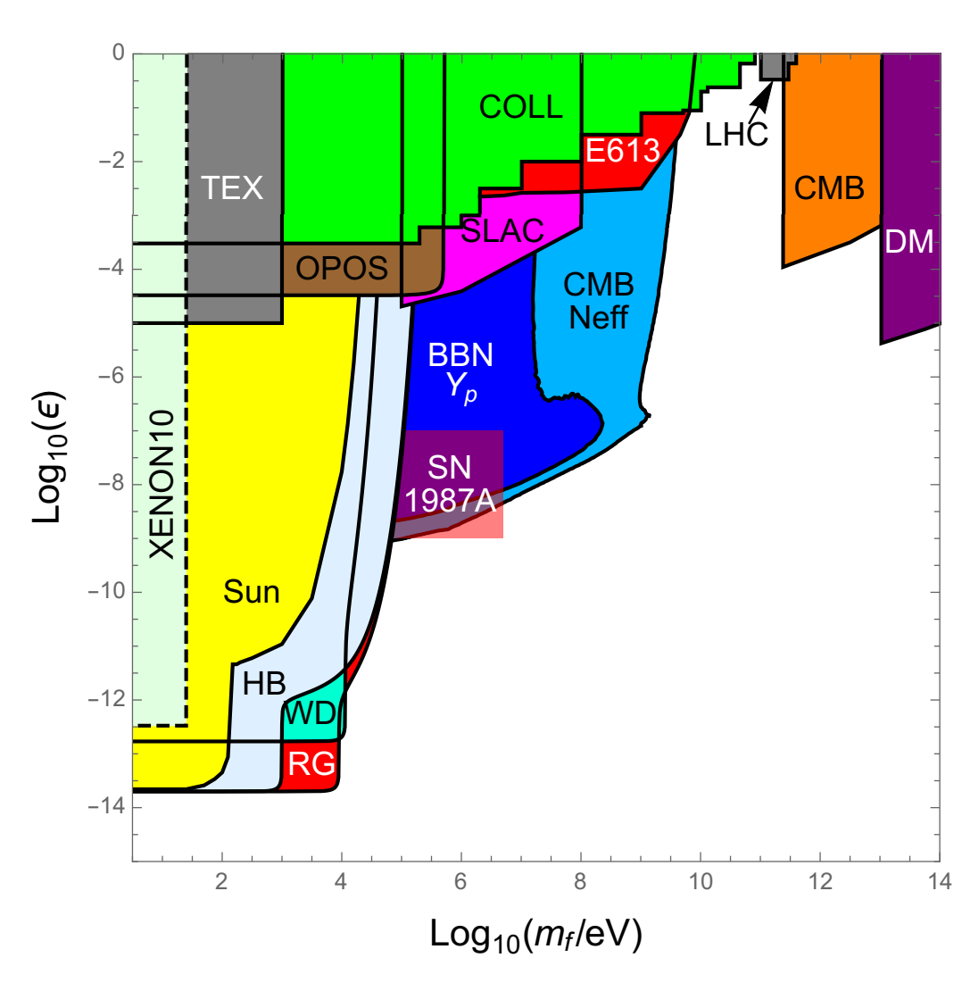
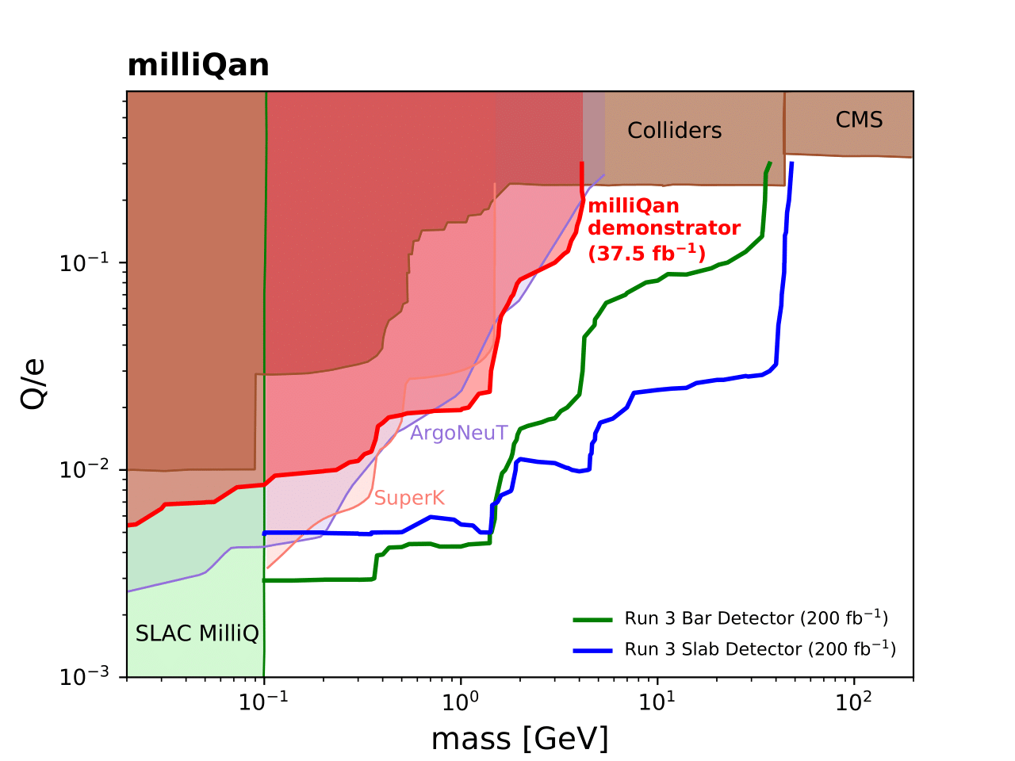
Why Millicharged Particles?
arXiv:1511.01122v2
~85% of matter in the universe is dark matter
  Very feebly interacting, if interacting at all
  What actually is it?
Dark Photon Portal
  There is some dark sector force that weakly couples with the electromagnetic force
  Theory predicts particles with suppressed electric charge (~10⁻³ e)
Phys. Rev. D 104, 032002
Notes:
Cut down to just briefly mentioning DM and for mCPs something like “a dark photon mixes with the SM photon and gives the DM a suppressed electric charge”. No need to say Run 3. May be nice to mention LHC-> highest energy collisions -> can create high mass particles.

Slide 3
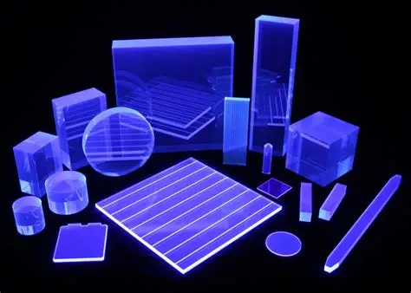
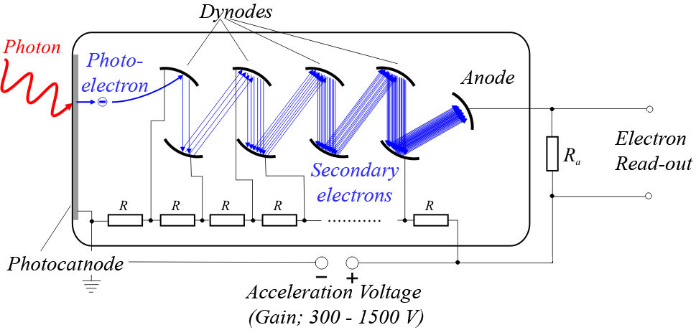
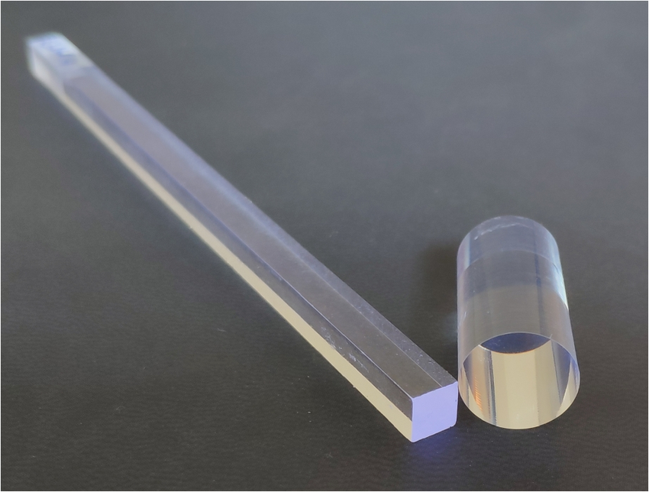
How do we find them?
Scintillators and PMTs!
physicsopenlab.org
eljentechnology.com
Notes:
High energy particles -> ionizing particles

Slide 4
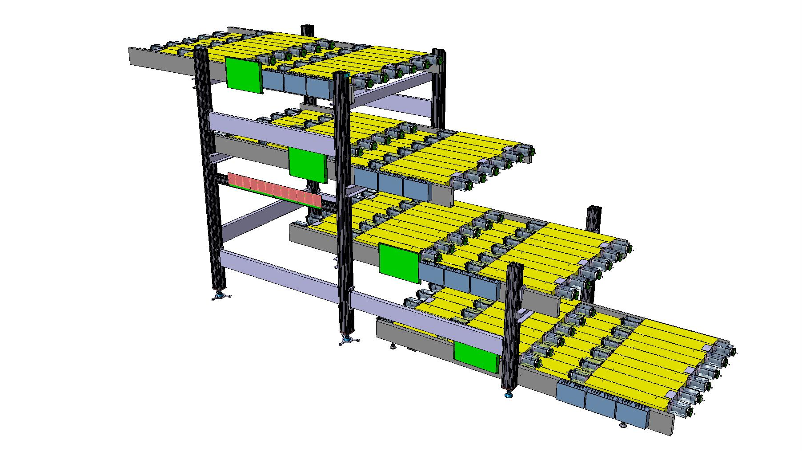
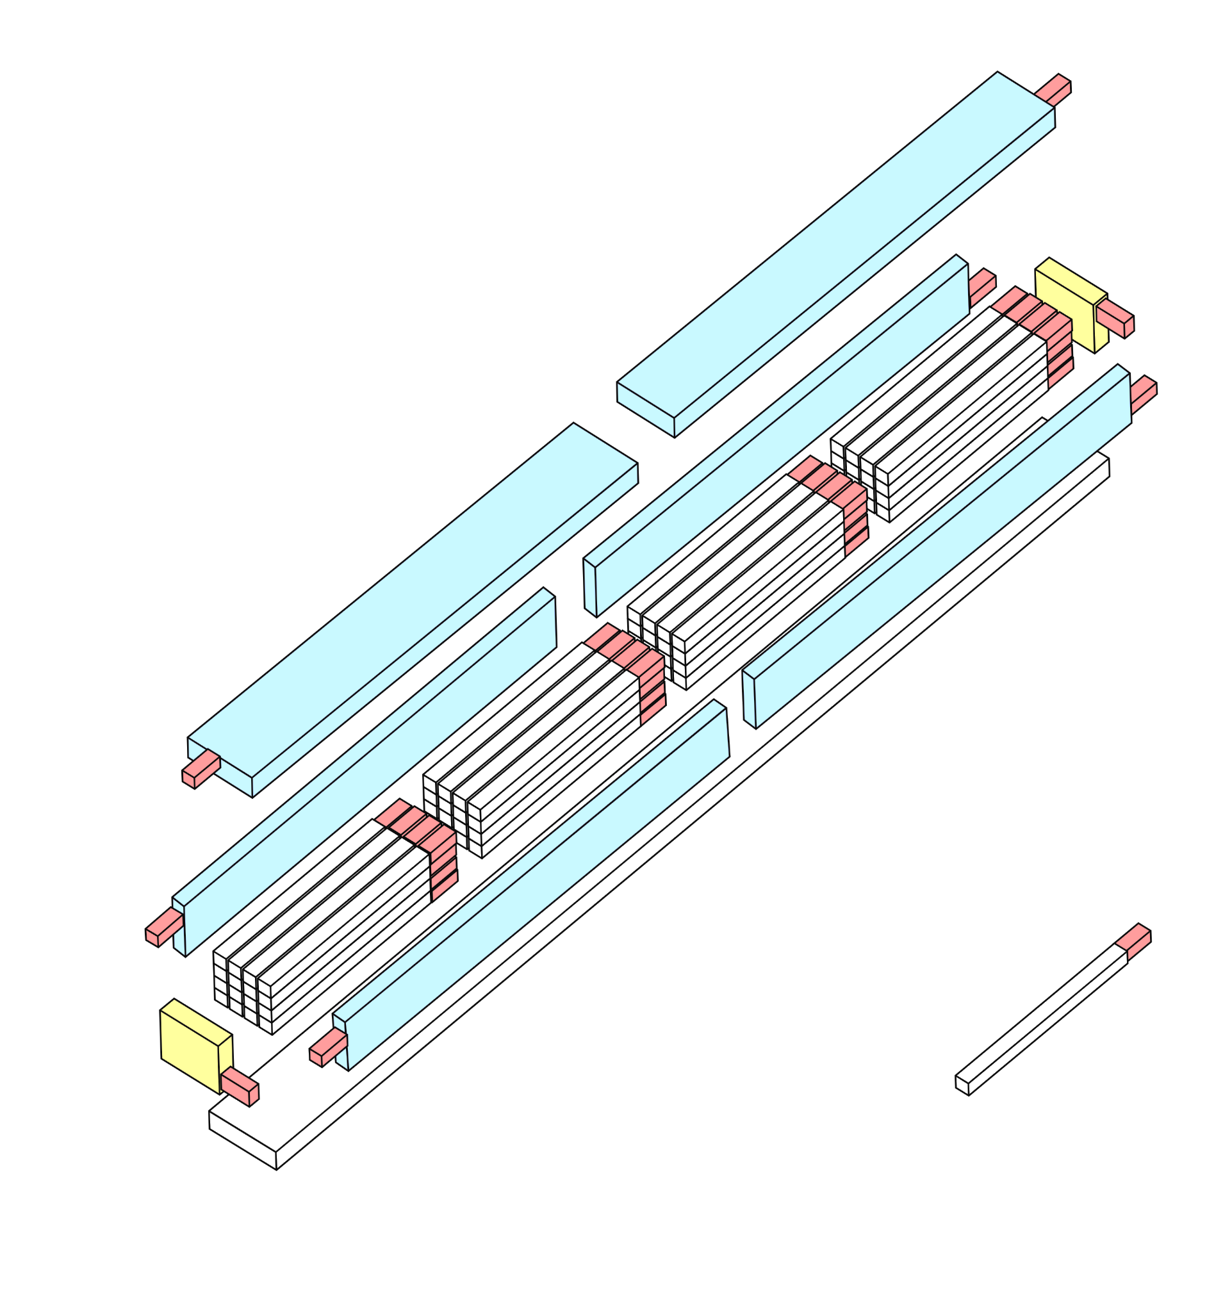
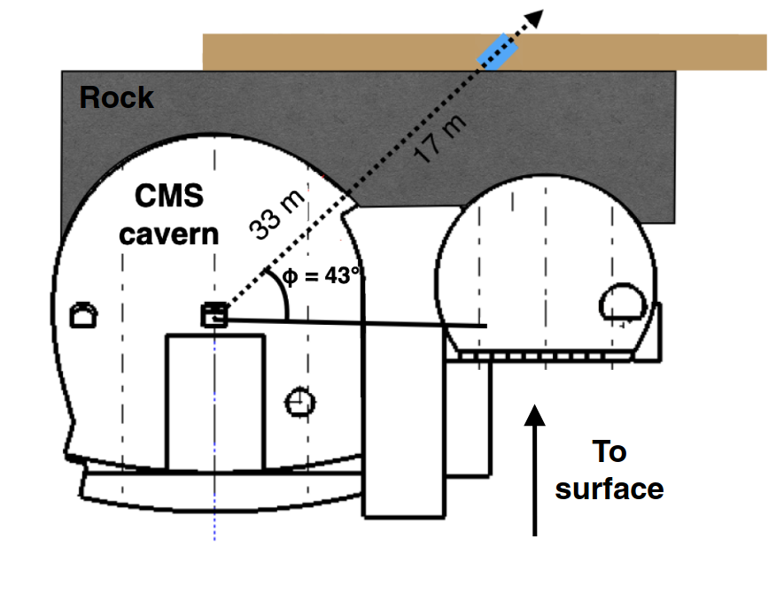
The Premise
Place detectors in drainage gallery 33m away from CMS
  17m of rock shields from most background
2 Detectors: Bar and Slab
  Bar covers lowest charges
  Slab covers higher mass

Slide 5
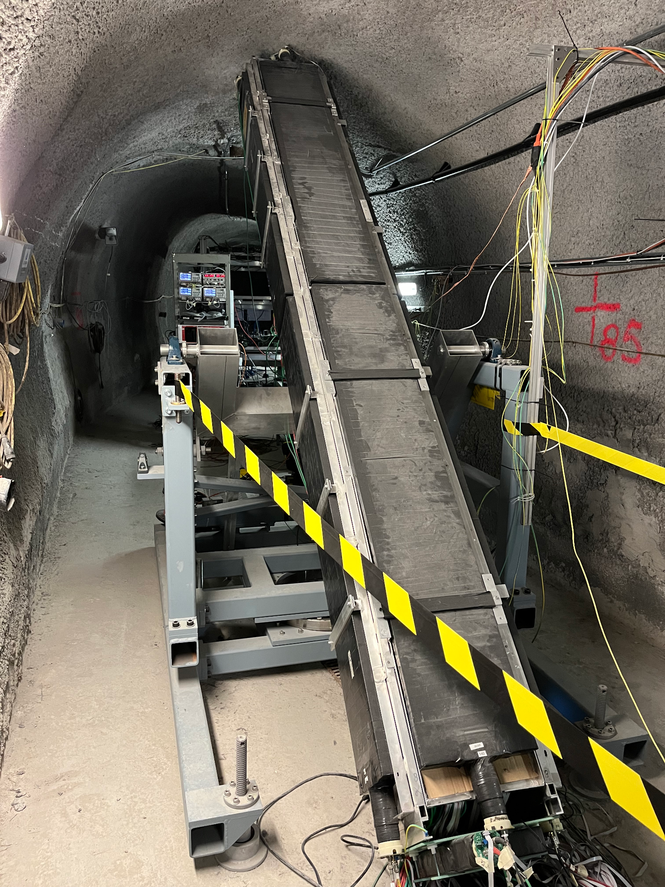
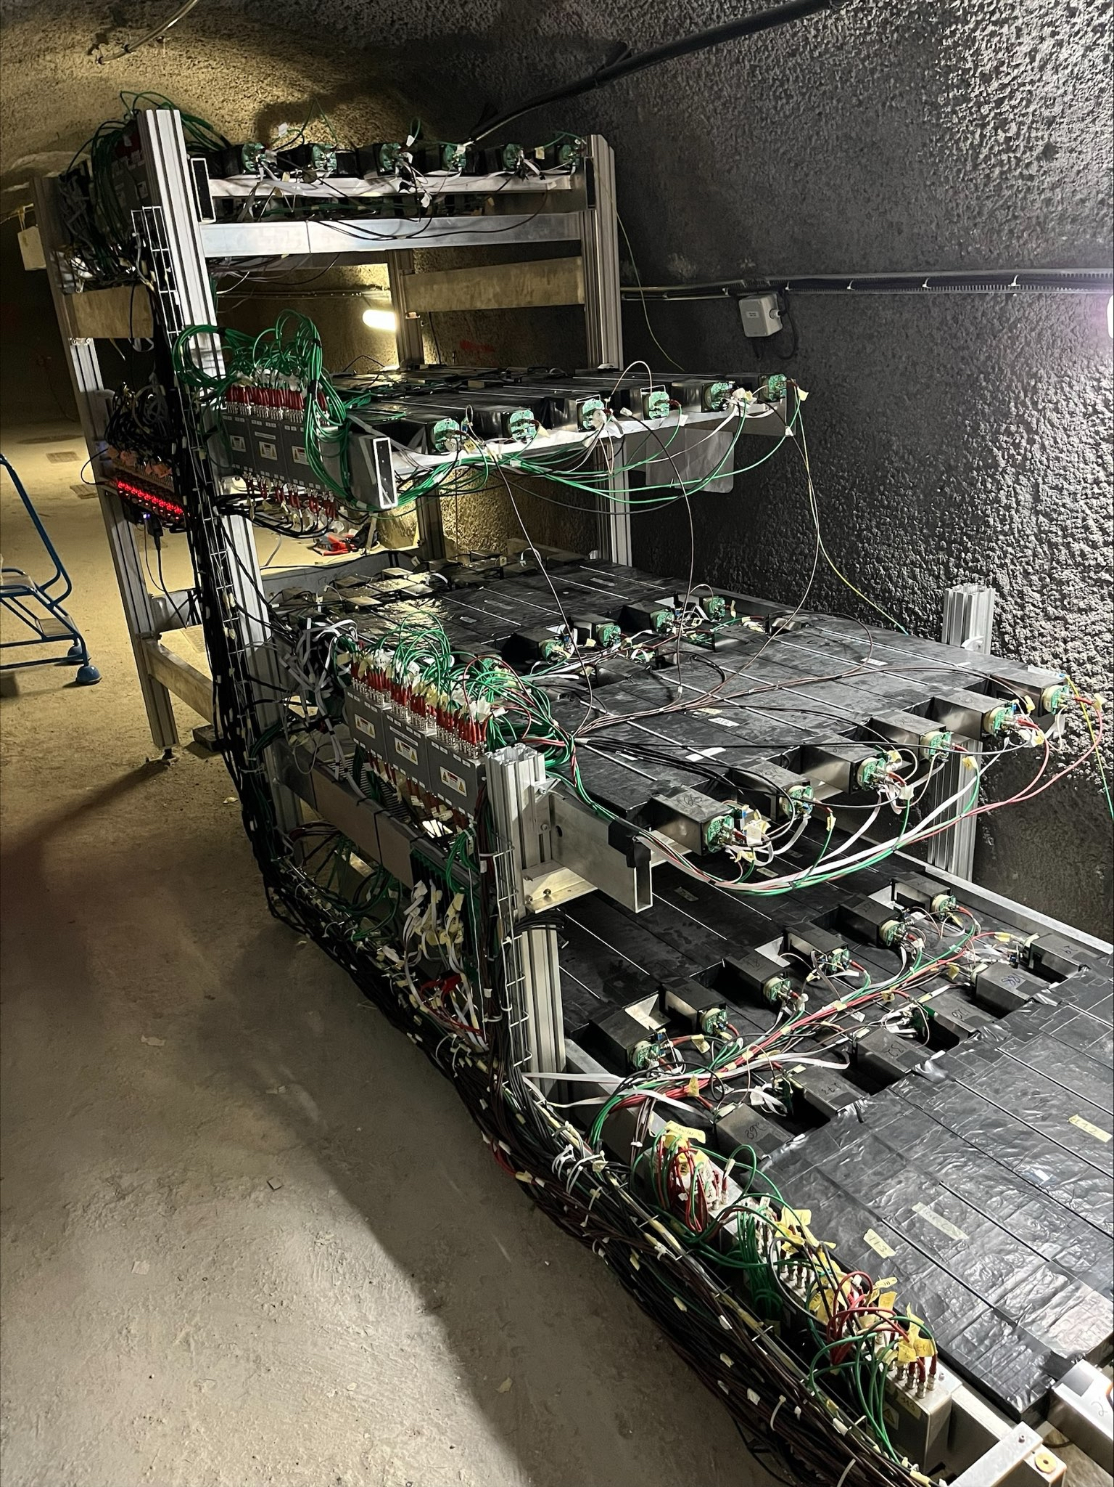
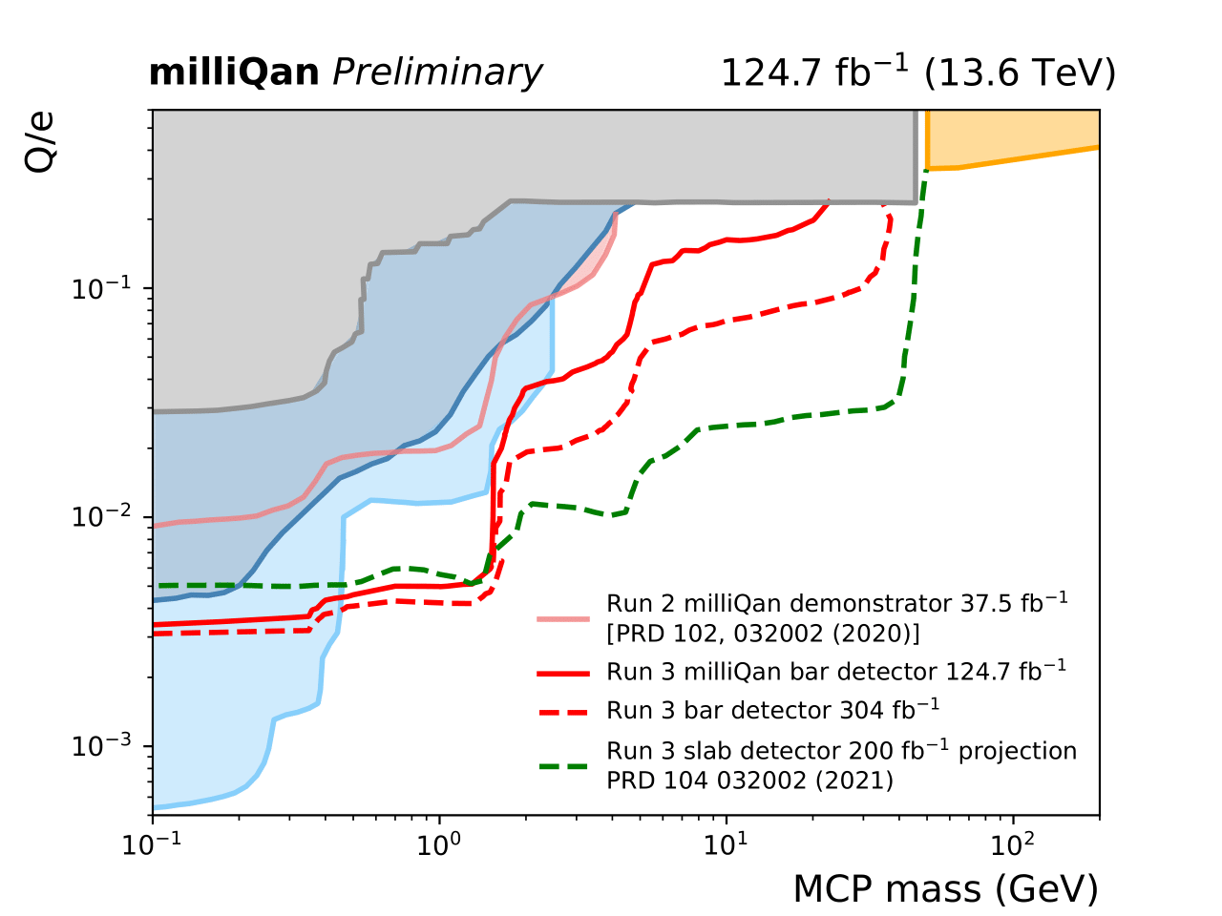
The Real Thing
Notes:
No run3, just say “end of lifetime”

Slide 6
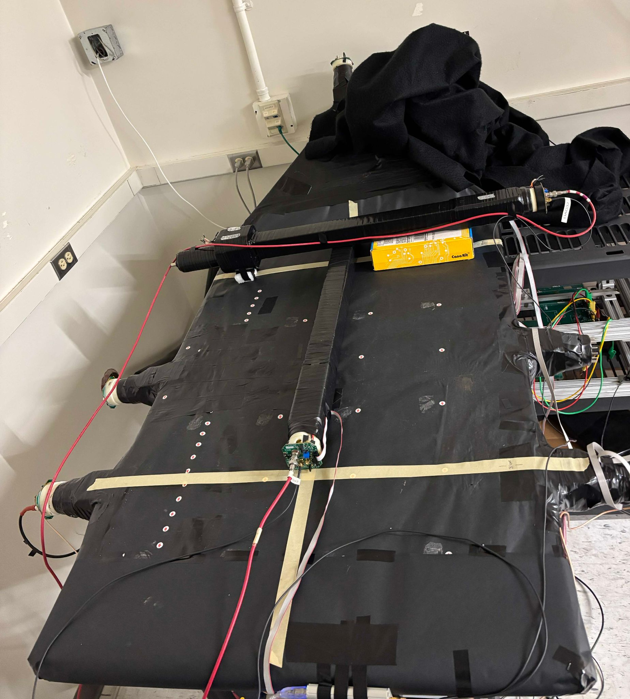
Personal Involvement
Mapping cosmic ray response in Broida
  Calculate PMT response as a function of incident angle of light
  Understanding position based effects is necessary for analysis of slab detector data
Developing simulation for slab detector
  Use the information from the mapping to configure
  Make a simulated map and compare

Slide 7
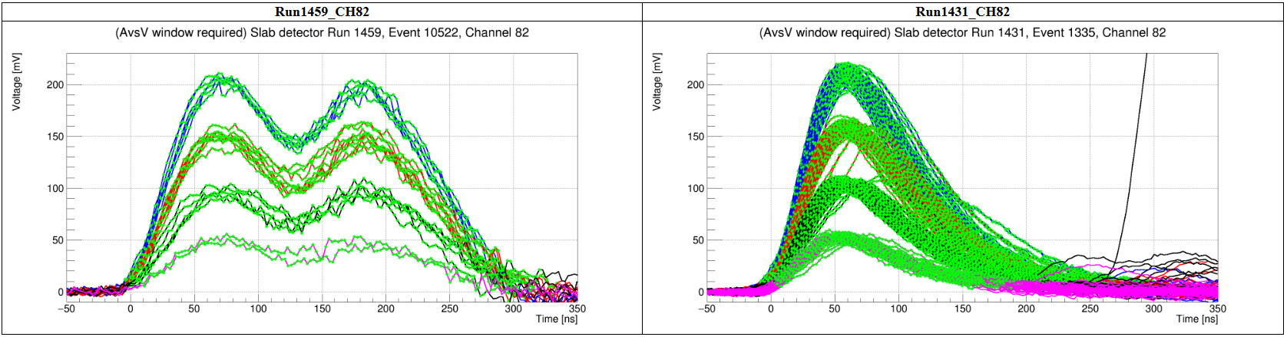
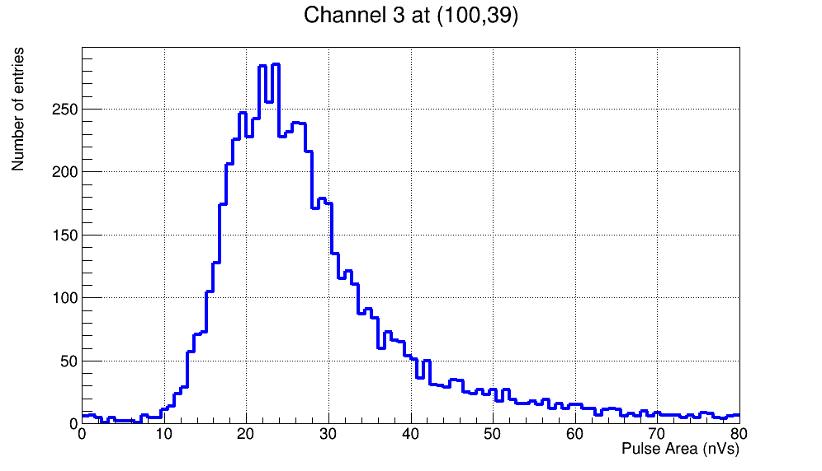
What am I analyzing?
Main target: how much light gets to PMT
  Presents itself in pulse area histograms
Factors that affect peak position:
  Position on slab
  Electronic gain
  High Voltage
Small issue in analysis
  We don’t want HV dependent data
Notes:
Can reduce time here.

Slide 8
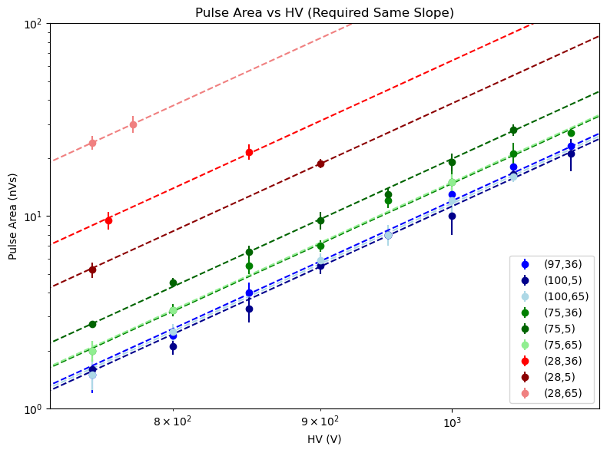
High Voltage response
Took multiple runs at 9 points, each on different HV
Fit requires same slope
Being closer to PMTs makes position matter more
These fits can be applied to previous data!

Slide 9
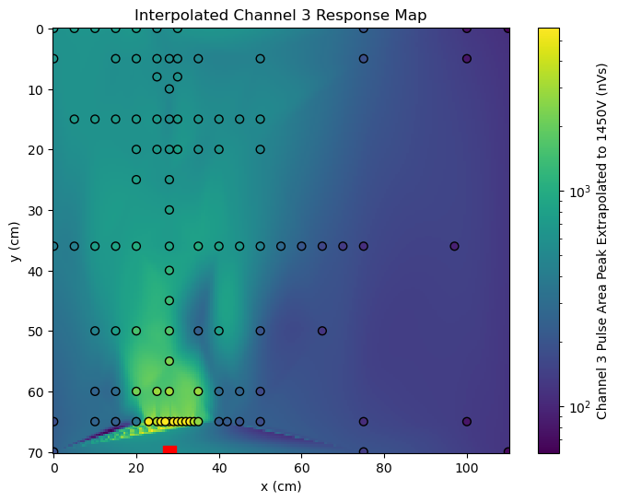
Rough Map
Extrapolated A vs V fits to 1450V
  Operating voltage on slab detector
Further away means less light
Angular dependence to light collection efficiency
PMT

Slide 10
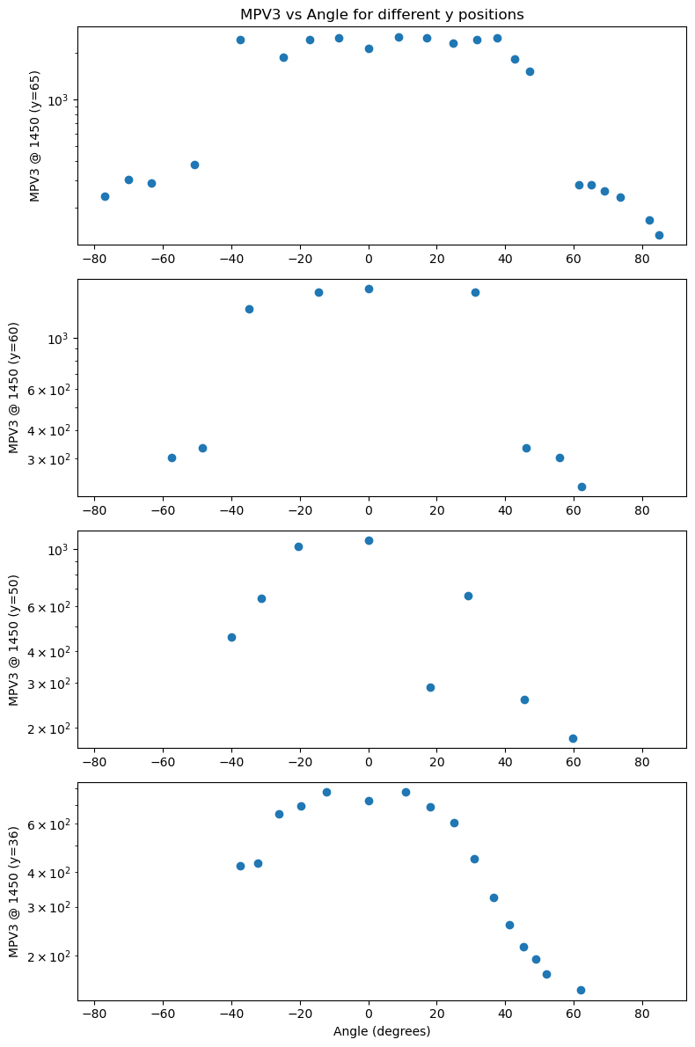
Cutoff Angle
Closer to PMT
We have an approximate angle for the cutoff
  ~40°
  Matches PMT documentation
Cutoff smooths out further from PMT
Qualitative vs Quantitative
  Limits of the scanning method
Further from PMT

Slide 11
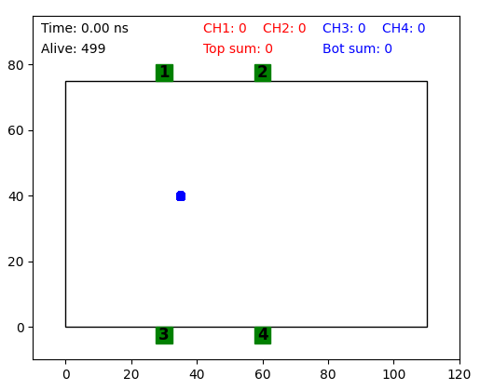
Simulation Development
Currently simple 2D
  Focused on getting basic physics right
    Total Internal reflection
    Attenuation length
    Surface roughness
  Many more factors to include
Notes:
Talk about the actual physics you’ve baked into this sim! Not even worth talking about computation time. New version of gif?

Slide 12
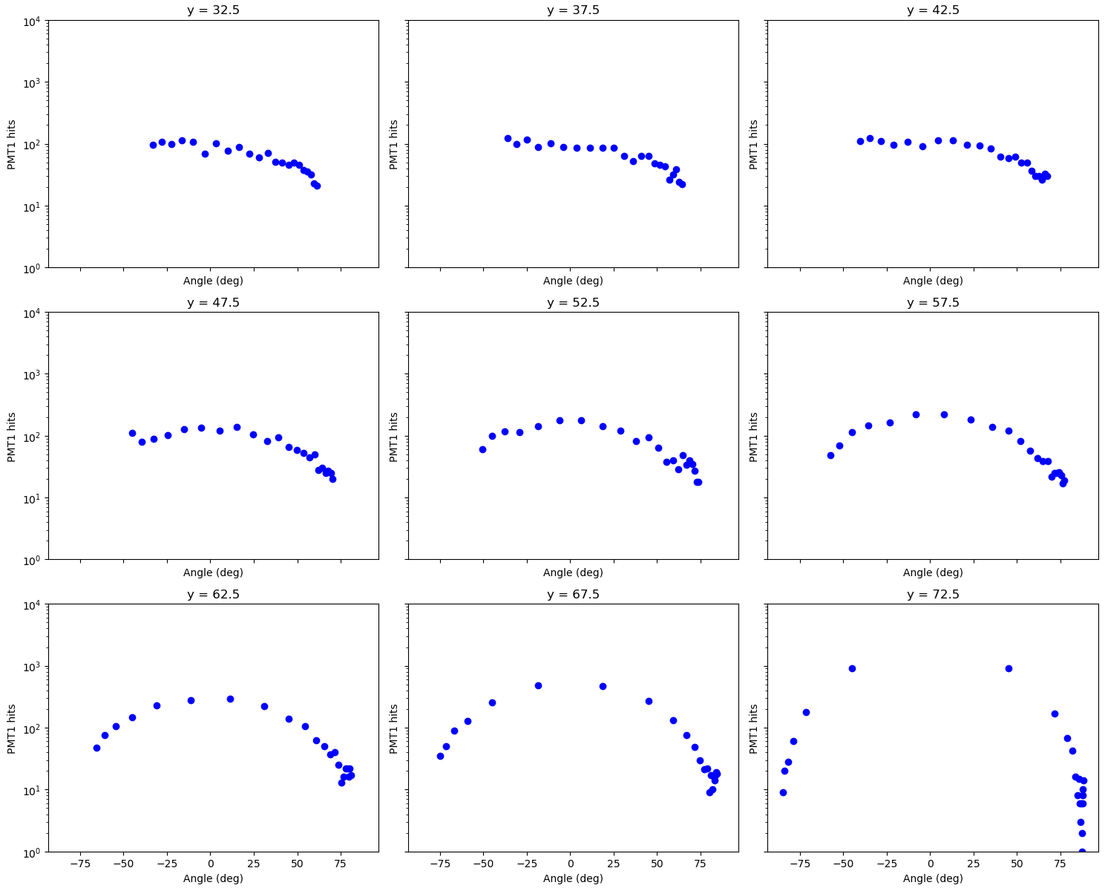
Comparison to Real Data: Cutoff Angle
Closer to PMT
We want to see the exact same features in the simulation as we do with real data
But we don’t
  Why?
Can adjust the simulation to match data
Further from PMT
Further from PMT
Closer to PMT

Slide 13
What does this mean? Where do we go from here?
The cutoff angle is a feature that should exist on the slab detector at CERN
  It should depend on distance to the PMT in simulation
  A complete understanding of our sensitivity requires we incorporate physical effects
    Take more data
We have the skeleton of a well understood simulation
  It serves as our transfer tool between Broida slab and in situ slab detector
  Necessary upgrades
    Match data
    3D
    Pulse injection

Slide 14

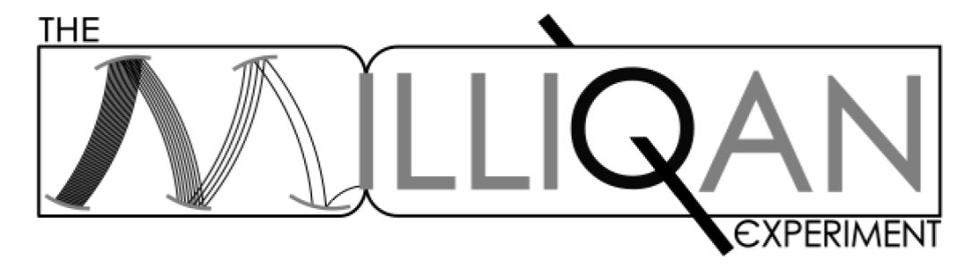
Thank You!
A Special Thanks to:
David Stuart: Faculty Advisor
Dariush Imani: Graduate Mentor
Eliott Schaffer
Sathya Guruswamy: REU Director
This work is supported by NSF REU grant PHY-2349677

Slide 15
Extra Slides

Slide 16
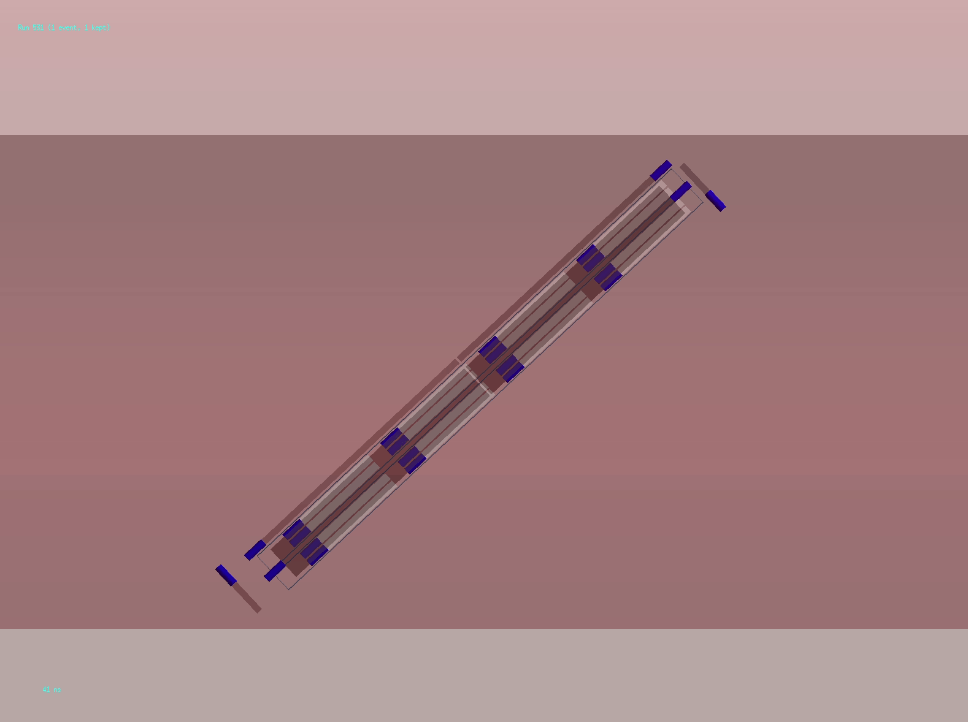
Visualizing the Bar Detector: Desired Signal
Millicharge Particle
Charge: 0.01e
Animation made by Ryan Schmitz

Slide 17

Visualizing the Bar Detector: Background
Beam Muon
Charge: e
Animation made by Ryan Schmitz

Slide 18
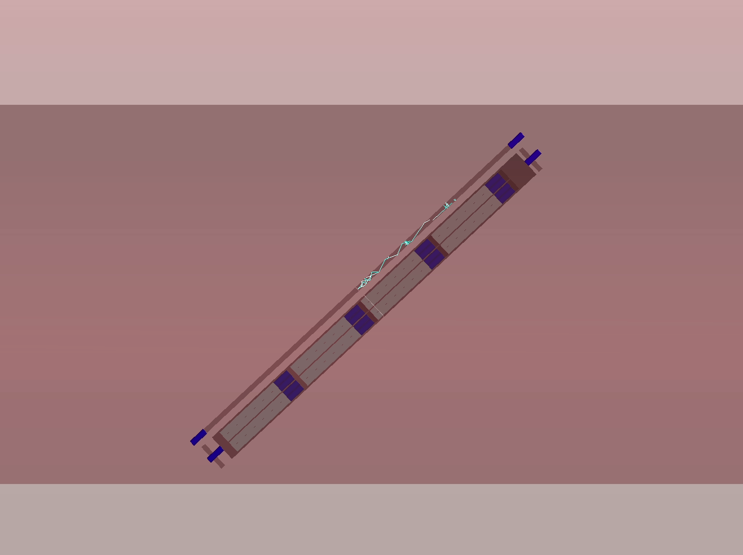
Visualizing the Bar Detector: Background
Cosmic Rays
Animation made by Ryan Schmitz

Slide 19
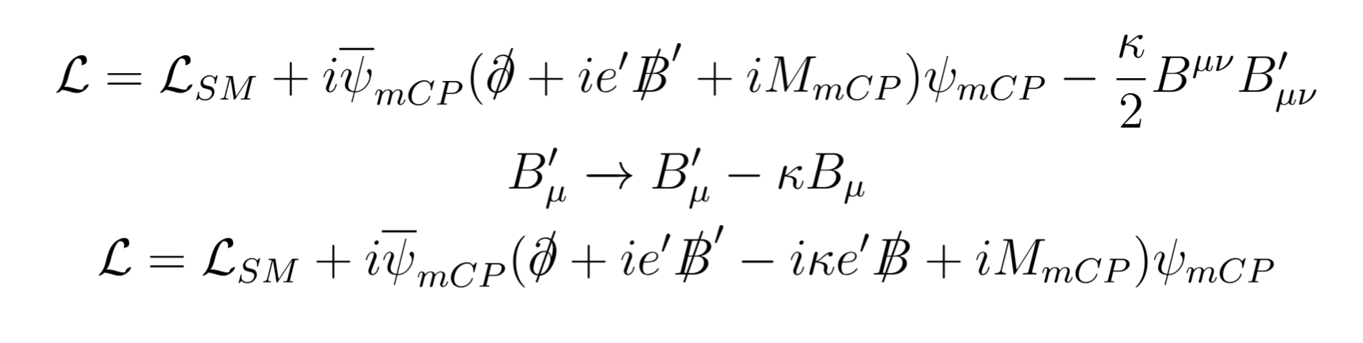
Dark Matter
“Dark Photon” coupling
Mass term
“Mixing” between Dark Photon and SM Photon
Field redefinition:
Coupling to SM photon suppressed by k!

Slide 20
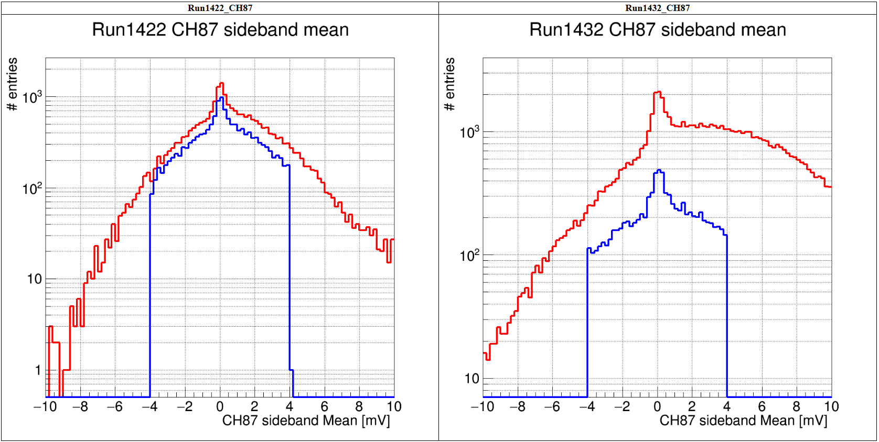
Slab Detector Analysis

