Slide 1
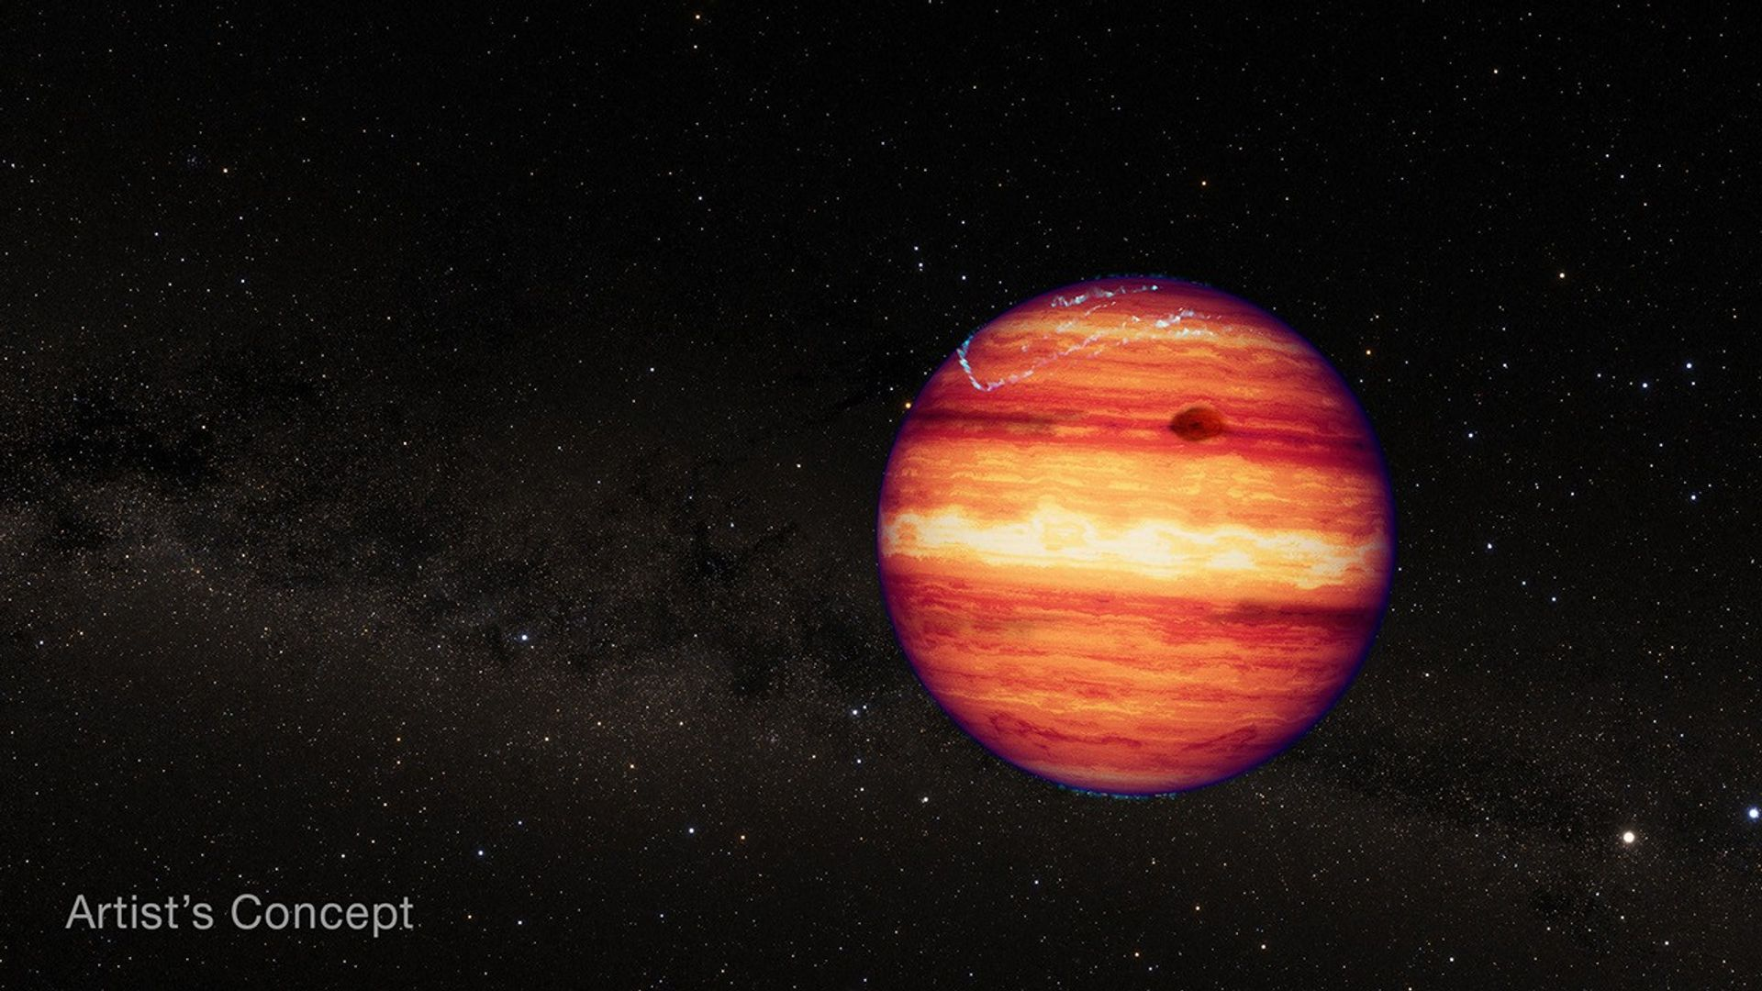
Investigating the 3D Atmospheric Structure of a Free-Floating Exoplanet Analog through Spectrophotometric Variability
Logan Bennett
The College of New Jersey, Department of Physics
From NASA

Slide 2
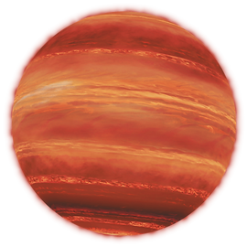
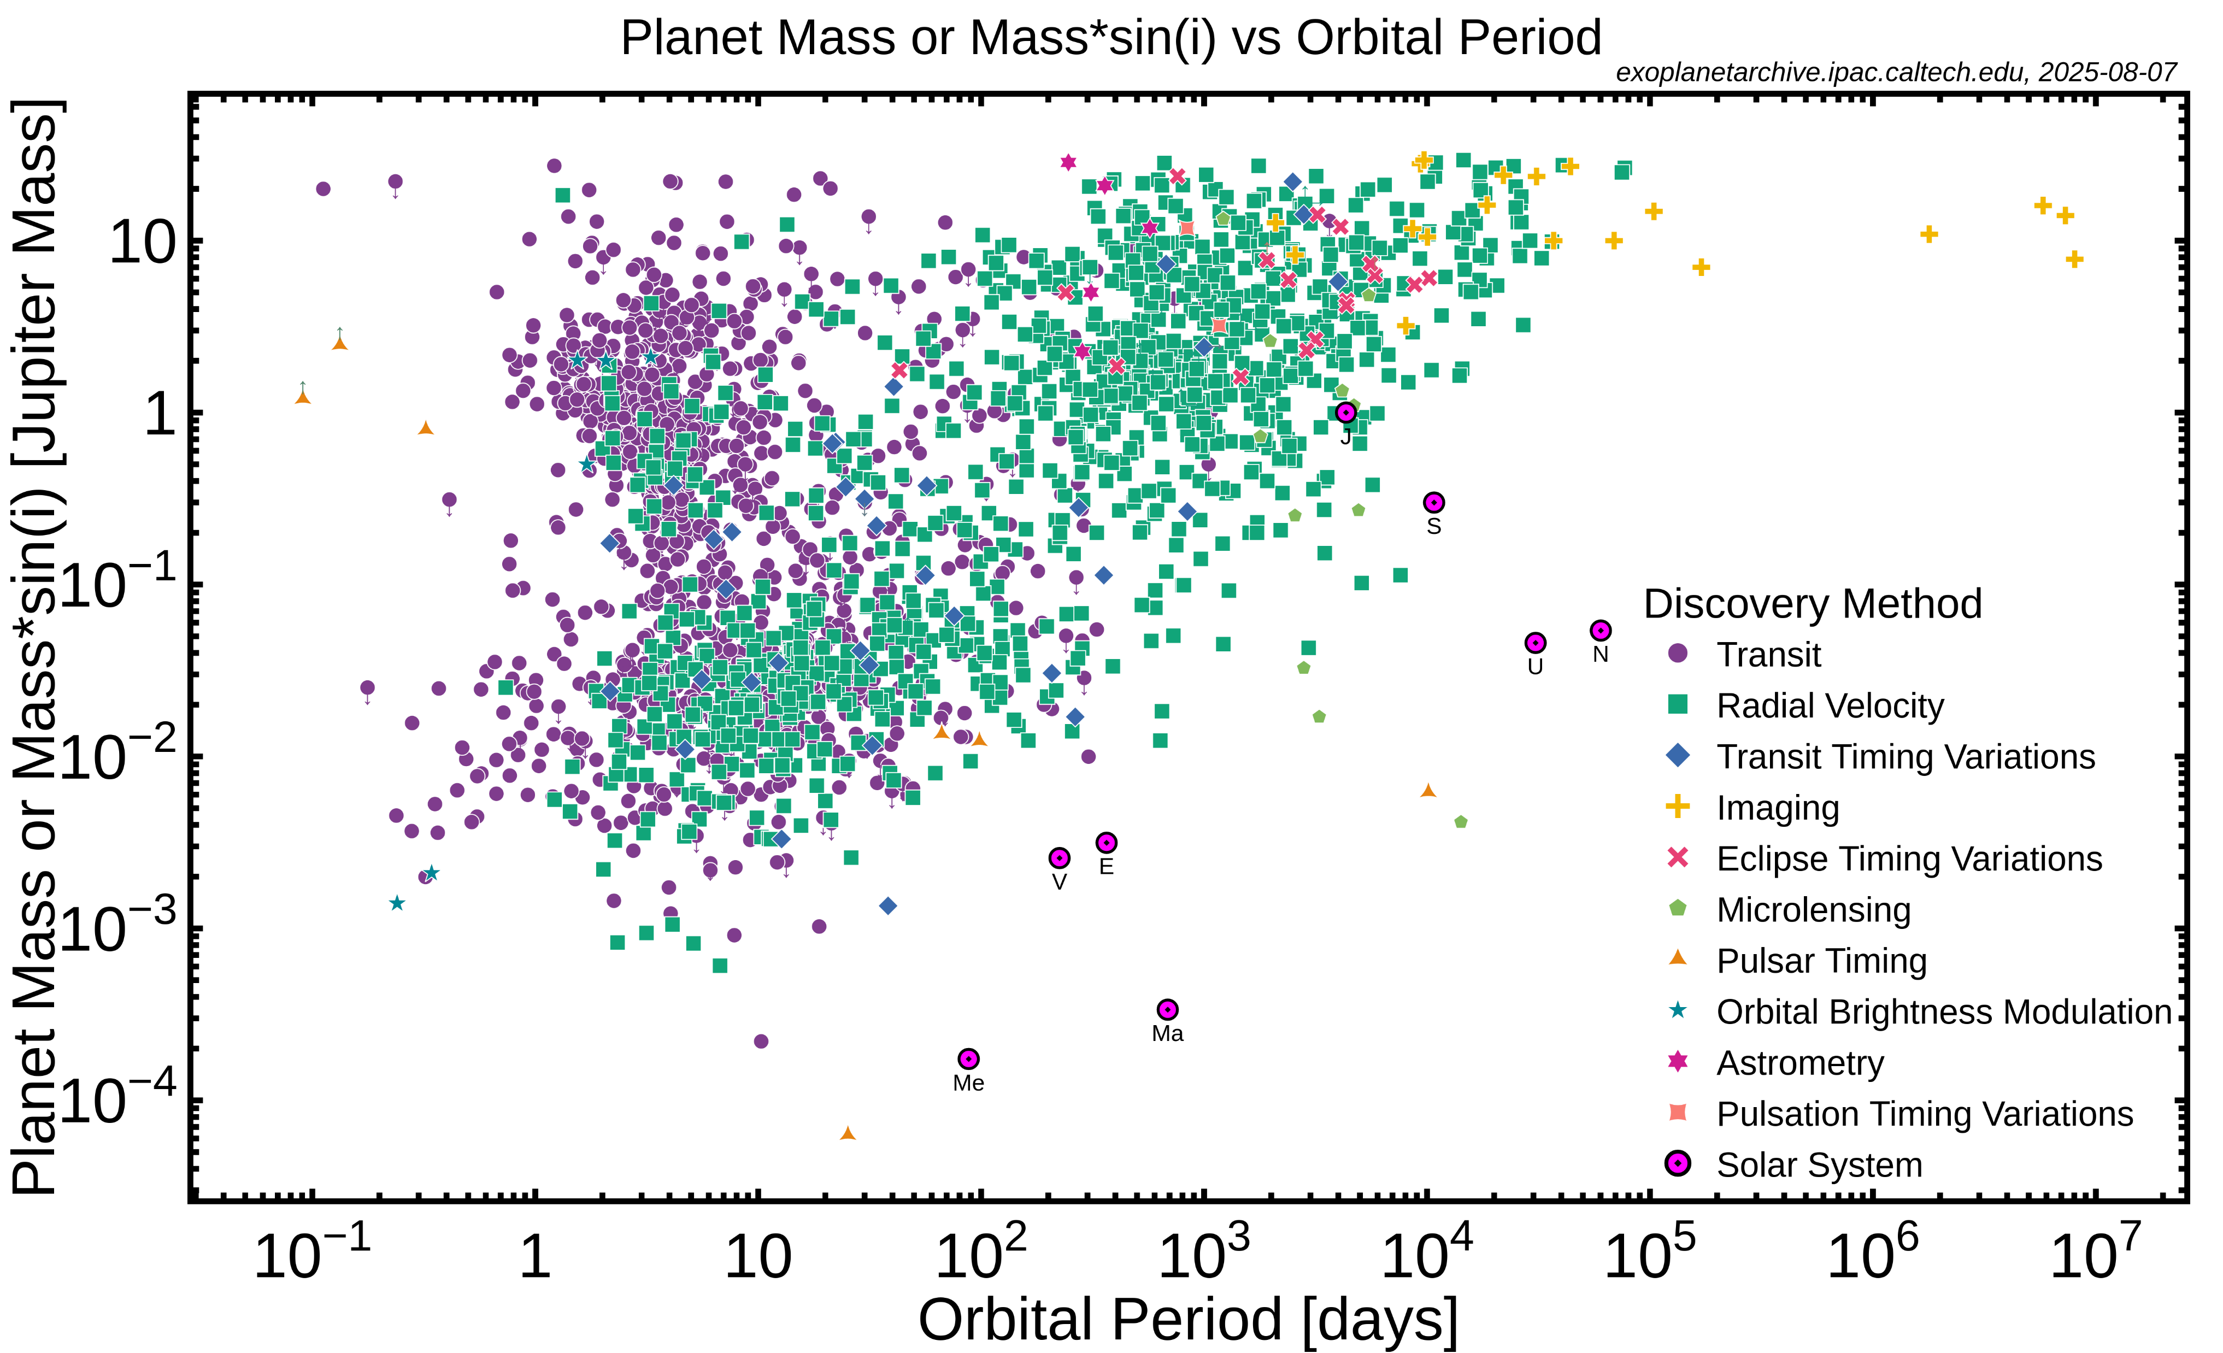

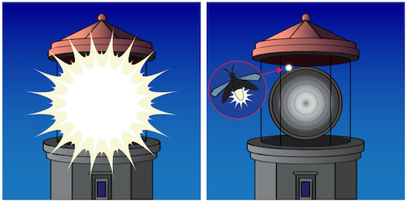
1
UCSB
Physics
(NASA)

Slide 3
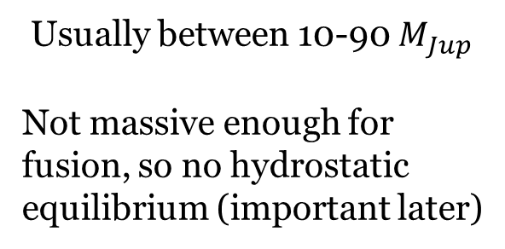
Brown Dwarfs (BD)
2
UCSB
Physics
Gas Cloud
Gravitational
Collapse
Brown Dwarf
Usually between 10-90 $M_{Jup}$
Not massive enough for fusion, so no hydrostatic equilibrium (important later)

Slide 4
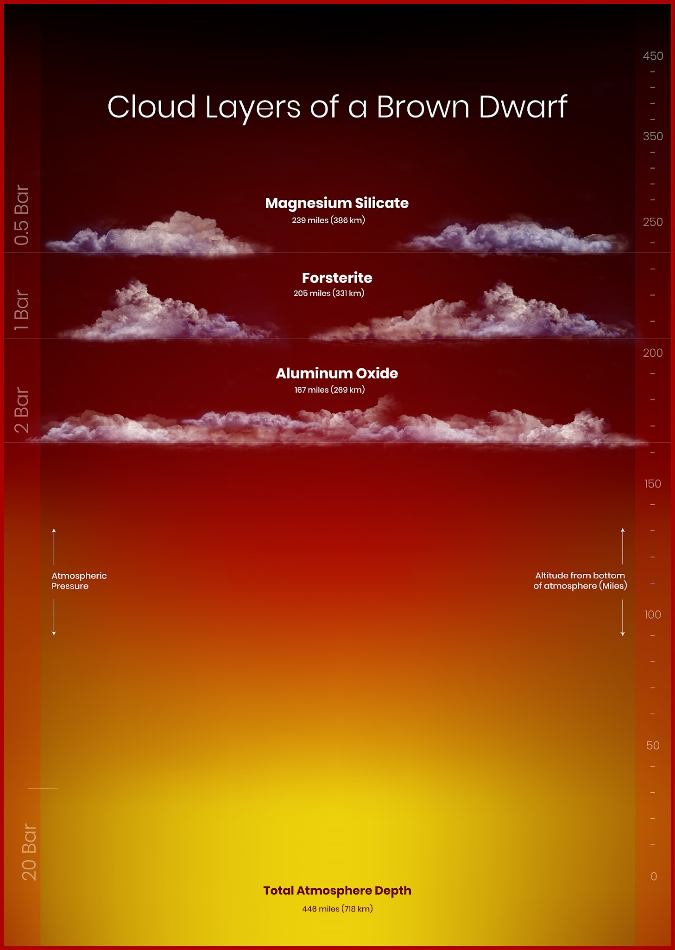
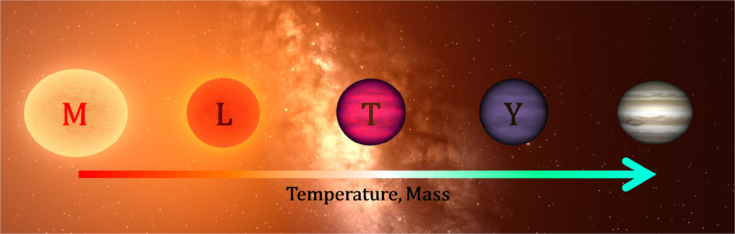
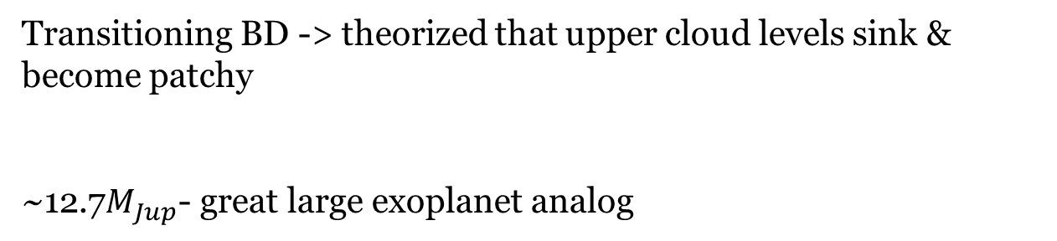
SIMP0136
SIMP - Sondage Infrarouge de Mouvement Propre
3
UCSB
Physics
Transitioning BD -> theorized that upper cloud levels sink & become patchy
~12.7$M_{Jup}$- great large exoplanet analog

Slide 5
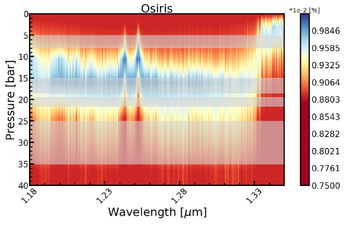
Spectrophotometric Variability
4
UCSB
Physics
Spectral lines
- different pressure levels -> different absorption
Sum counts across wavelength ranges -> flux changing throughout the night = variability
Previously observed variability in J-band
- something may be happening in the atmosphere
No Variability
Variability Across
Multiple Heights
Continuum → 15-20 bar
KI lines → 2-8 bar
Some Variability

Slide 6
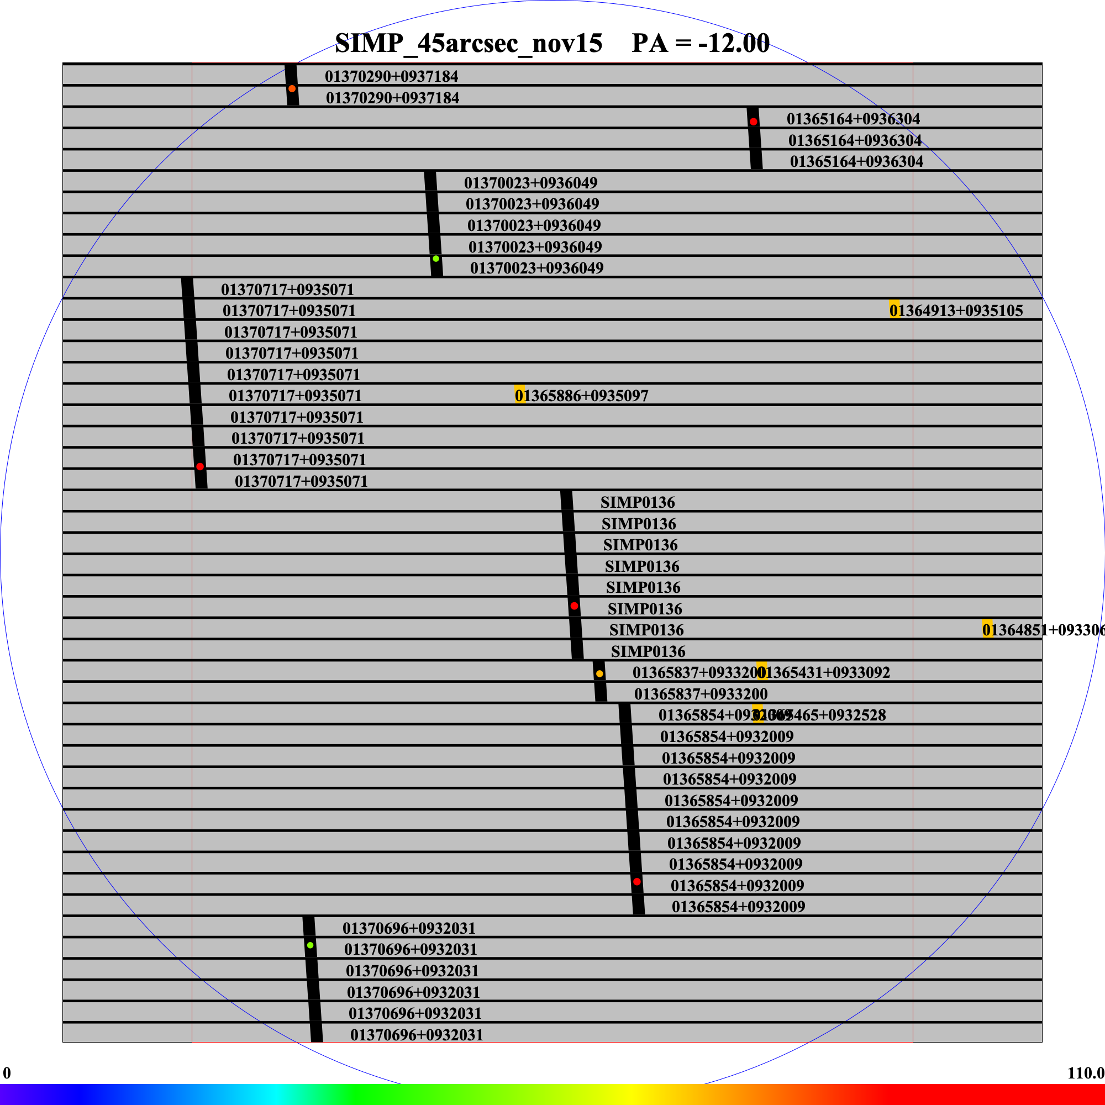
2024 Observations
5
UCSB
Physics
09/18 & 11/16 – Around 13 hours of observations
Taken on the wide view MOSFIRE (multi-object spectrograph) on the Keck telescope
-adjustable mask for data on multiple slits
- slit width ~= resolution
-wider slits to ensure objects remain inside
First ran through pypeit to create useable images

Slide 7
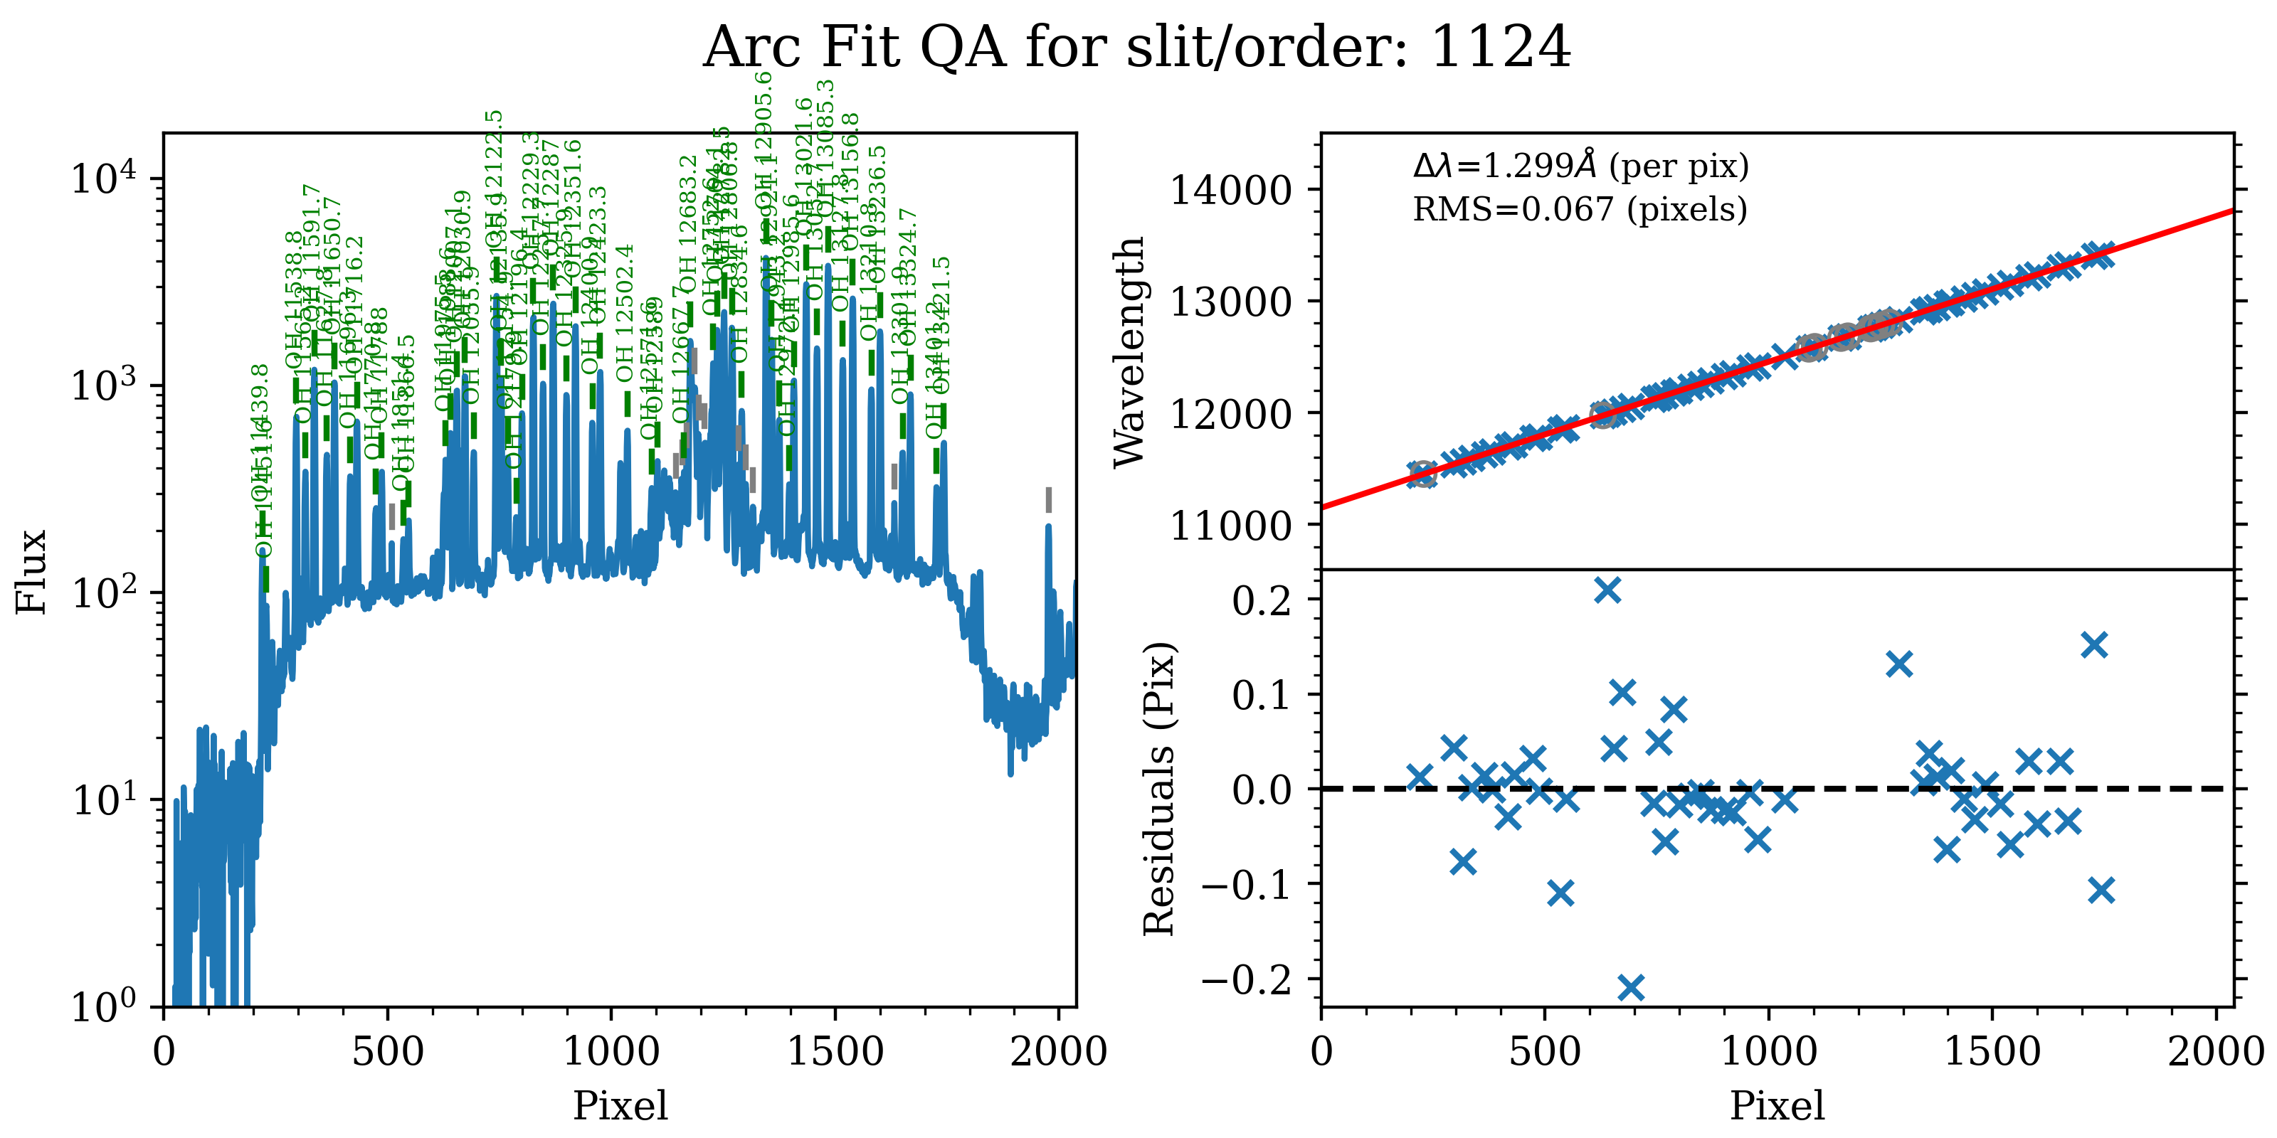
Fixing the Wavelength Solution
6
UCSB
Physics
Narrow slits have a higher spectral
resolution
We implant the smaller slit data frames into
the wider slit calibration file
- Using only the small slit data for arc,tilt calib
The new fit is over 10x better!

Slide 8
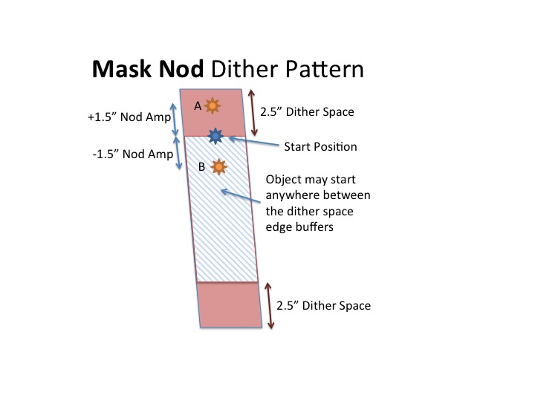
7
UCSB
MOSFIRE Uses Dithering
Physics
Starts neutral → Moves to A, takes an exposure
→Moves to B, takes an exposure → Back to A
Good for
Subtraction of background noise
Enhancing spectral resolution
However:
- Causes back and forth motion between spectra
We need to coadd the AB pairs

Slide 9
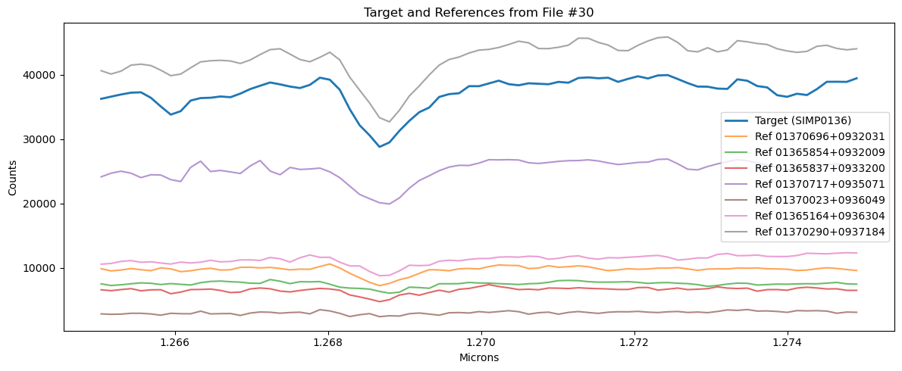
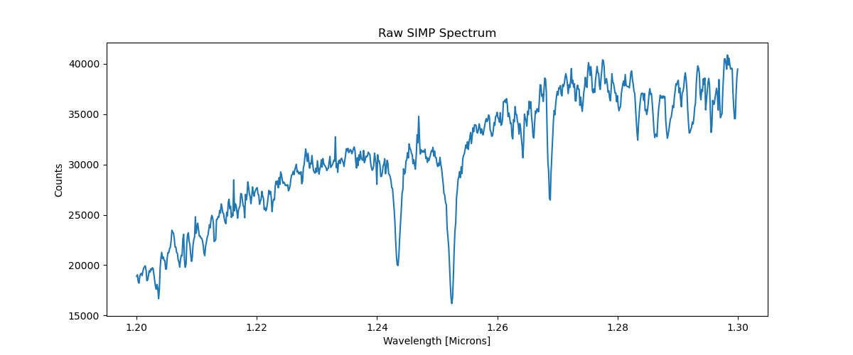
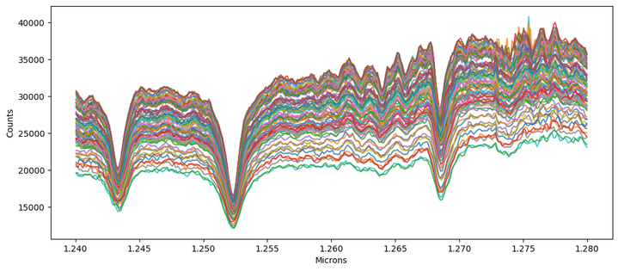
After Coadding the Pairs (Thanks Pypeit)
8
UCSB
Physics
Much better but spectra are still “drifting” and did not solve the matching within each frame
We interpolate to a common grid and cross-correlate
- first to their own SIMP, then to the first frame SIMP

Slide 10
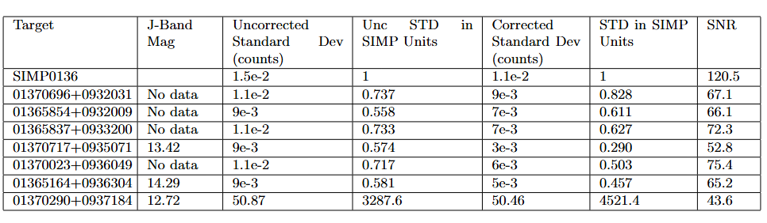
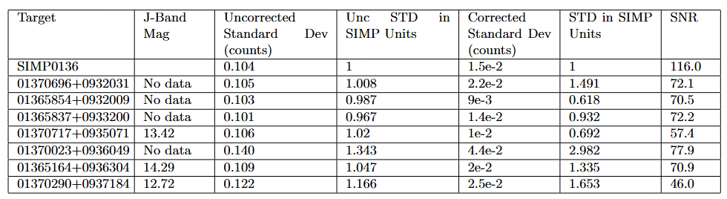
9
UCSB
Removing Bad Reference Stars
Physics
Next: BIC (Bayesian Information Criterion)
Fits sine vs flat to determine variability(bad)
Positive deltaBIC prefers sine
Negative prefers flat

Slide 11
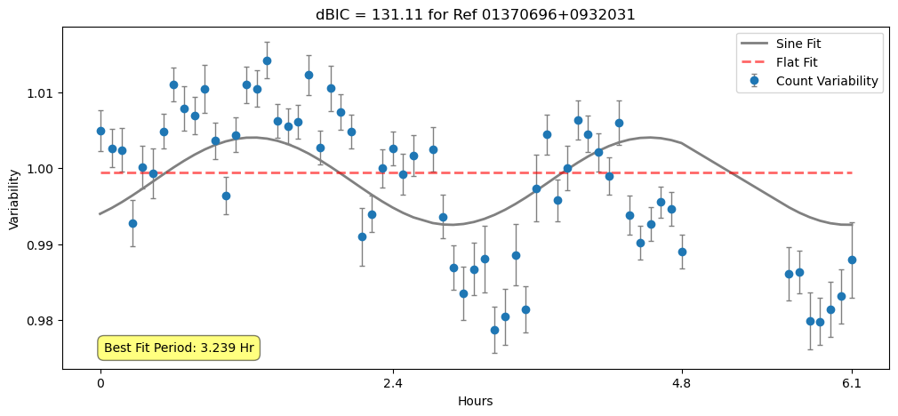
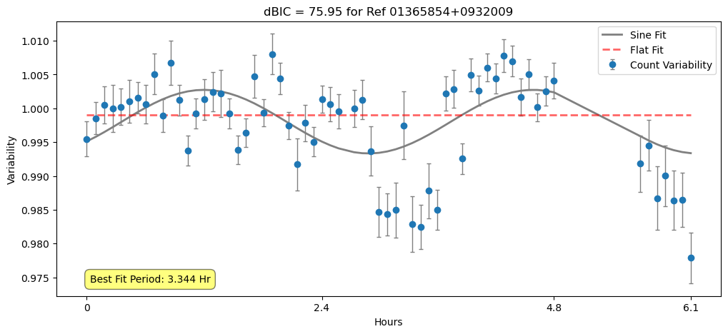
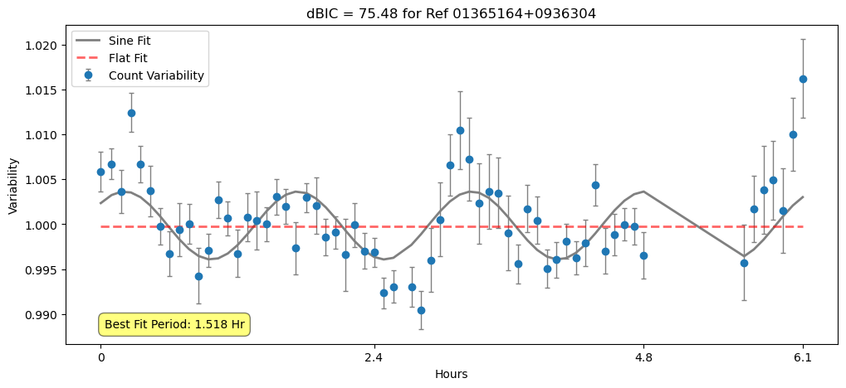
10
UCSB
Physics

Slide 12
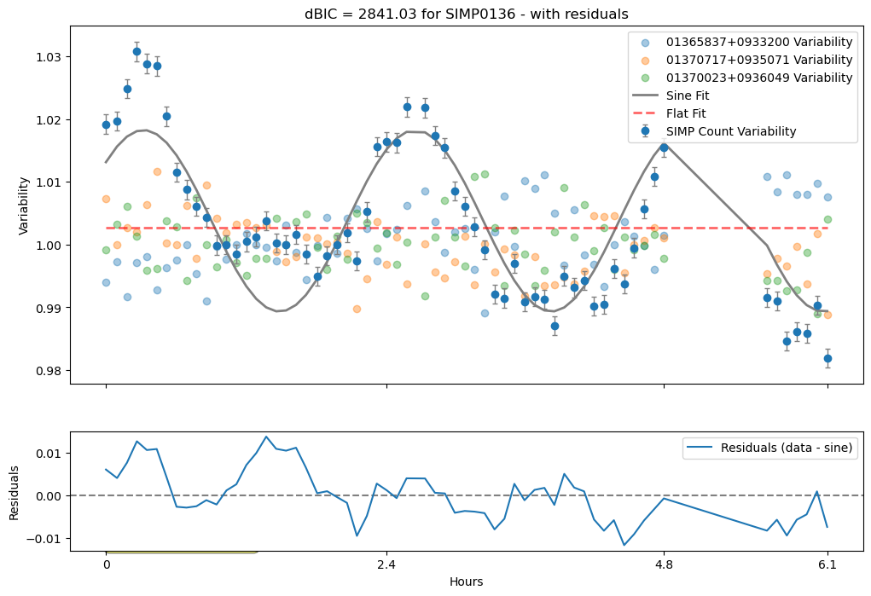
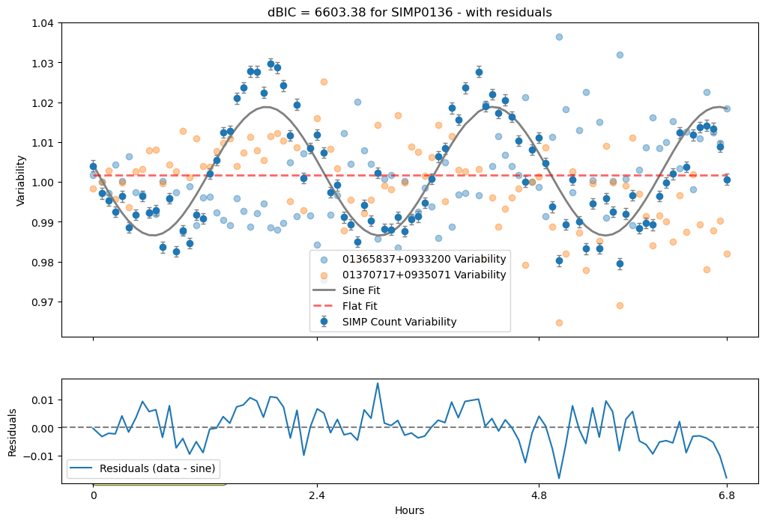
11
UCSB
Physics
September
November
Best Fit Period: 2.31 Hr
Best Fit Period: 2.45 Hr

Slide 13
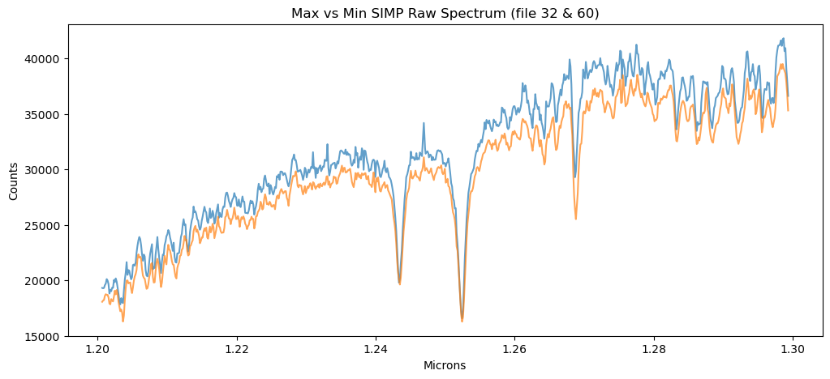
12
UCSB
Evidence of Variability
Physics
September
SIMP First Peak-Peak Amplitude: 0.03578 ± 0.00217 counts
SIMP Second Peak-Peak Amplitude: 0.03482 ± 0.00215 counts
November
SIMP First Peak-Peak Amplitude:
0.04470 ± 0.00204
SIMP Second Peak-Peak Amplitude:
0.04822 ± 0.00192
Notes:
Use the max min to explain immediate promise for variability and showing the features we are focusing on

Slide 14
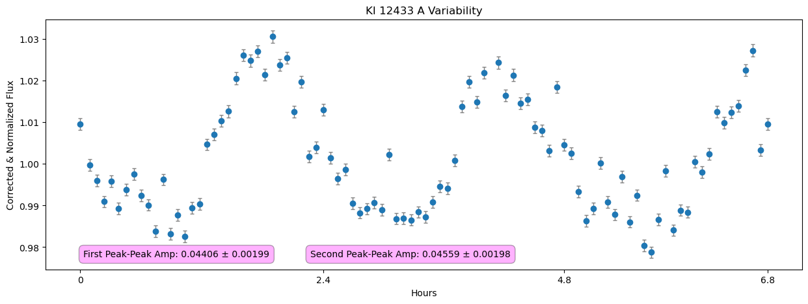
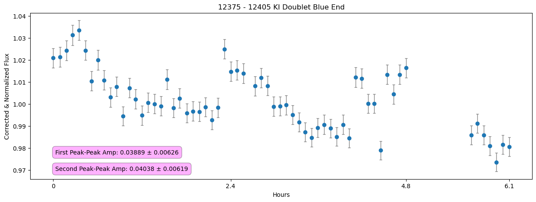
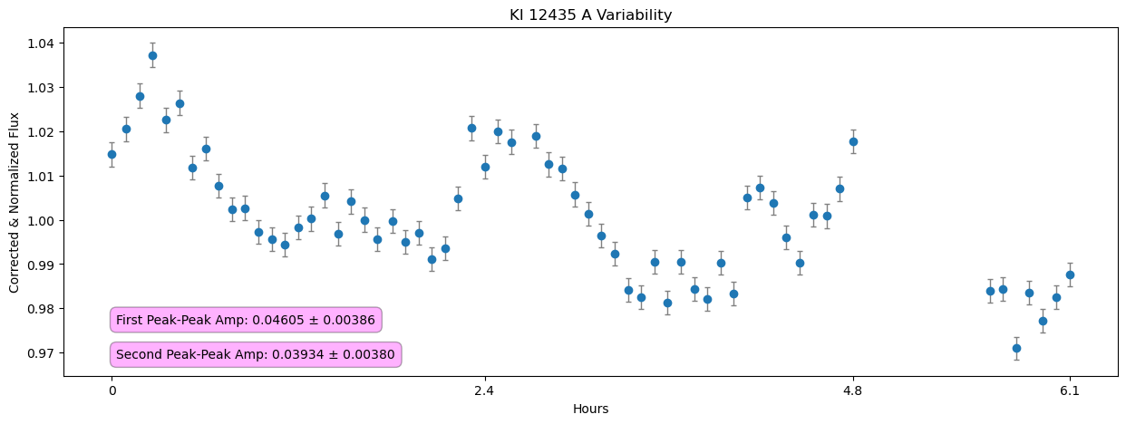
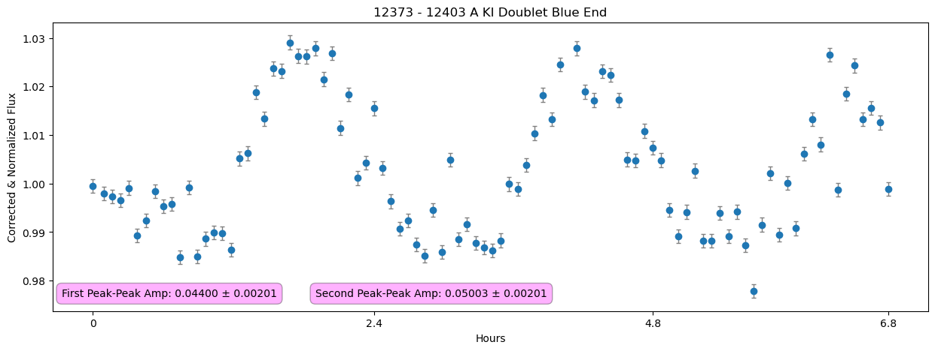
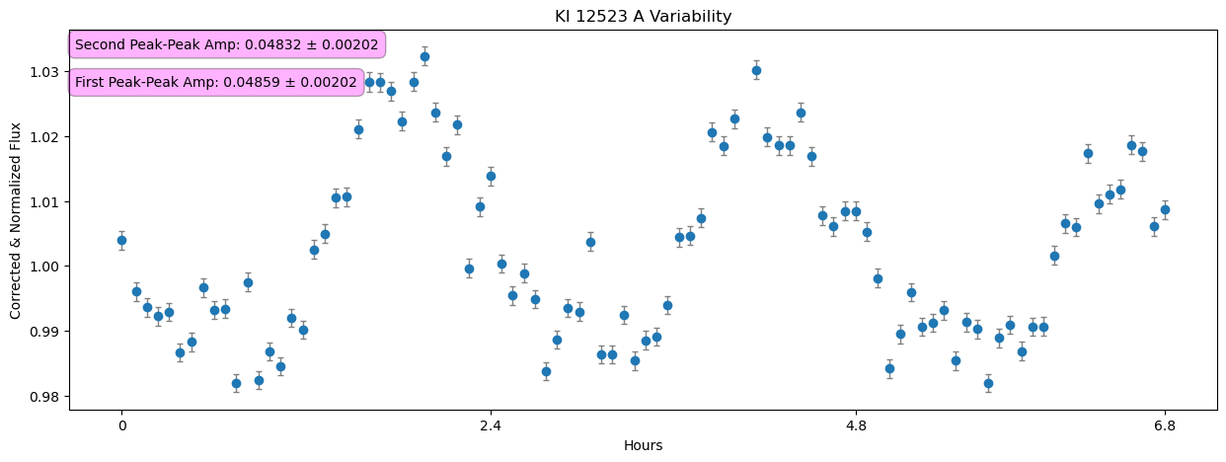
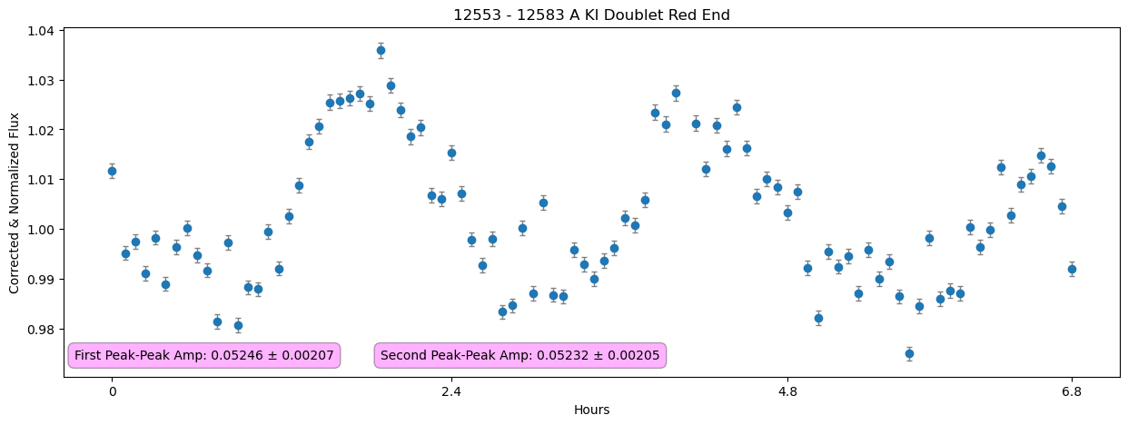
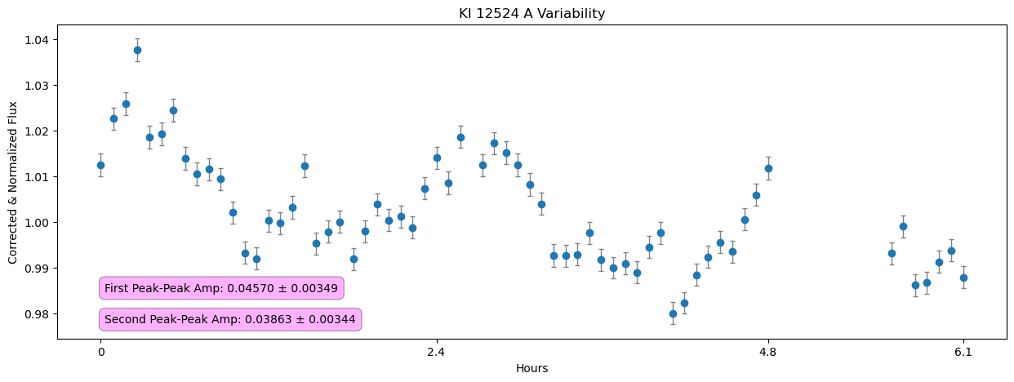
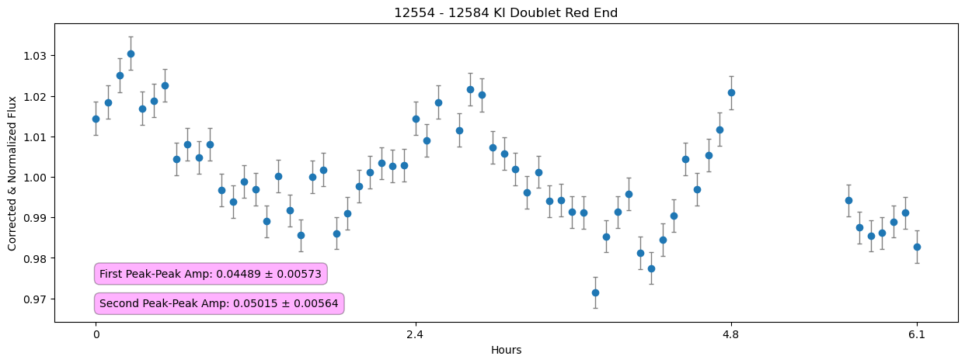
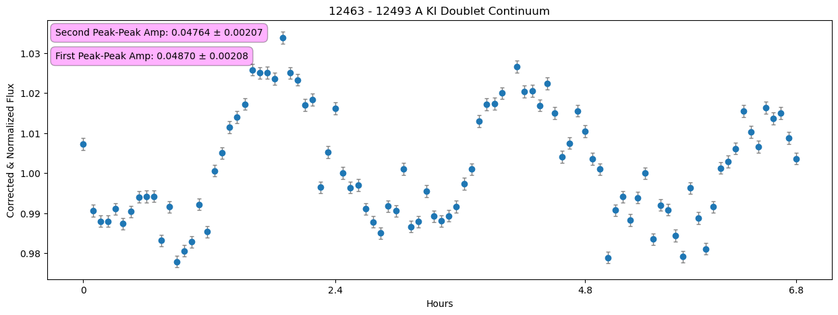
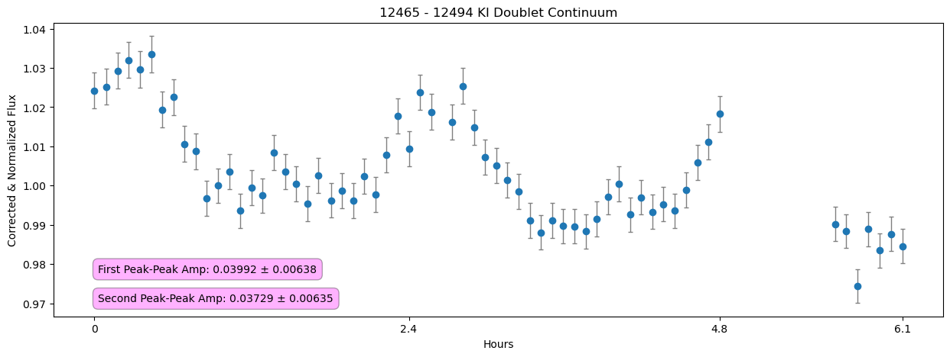
13
UCSB
Physics

Slide 15
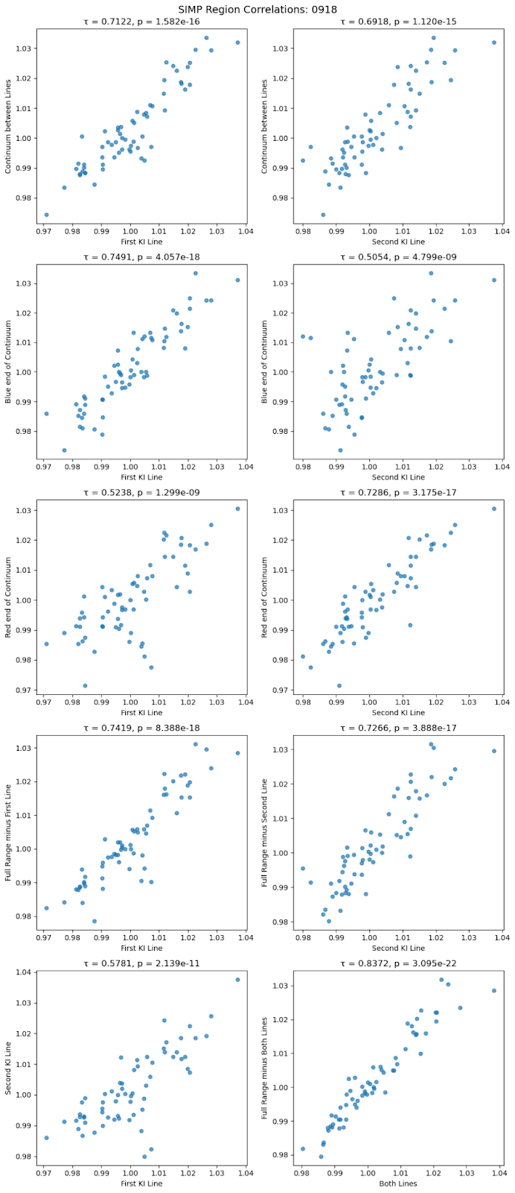
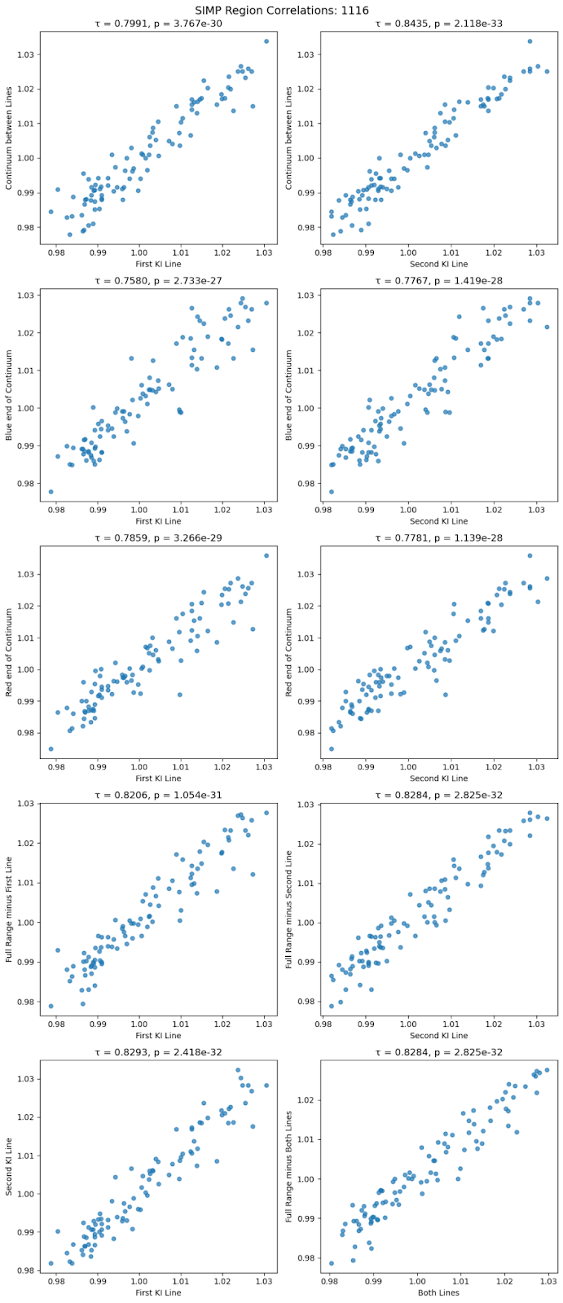
14
UCSB
Physics
Difference in Avg 1.2-1.3 variability:
-0.00992 +/- 0.00293
Difference in Avg First K I Line variability:
-0.00603 +/- 0.00452
Difference in Avg Second K I Line Variability:
-0.00419 +/- 0.00419
Interpretations?

Slide 16
For the Future
15
UCSB
Physics
Consult with atmospheric modelers
Apply this knowledge to BD in similar transitions
Integrate techniques into large exoplanet studies

Slide 17
SIMP0136 is definitely variable (3.5-4.5%)
Variability seems to be mostly uniform across the wavelength range (cloud decks are not separate)
Increase in J-band variability by ~1% in 2 months
From NASA

Slide 18


Thank You to:
Professor Max Millar-Blanchaer
Professor Sathya Guruswamy
Connor Vancil
The UCSB Department of Physics
This work is supported by NSF REU grant PHY-2349677
From NASA

