Slide 1
Can Superbubbles and Superwinds be Distinguished Spectroscopically?
A Direct Test Using High-resolution Imaging
By: Ishan Deb
Faculty Advisor: Dr. Crystal Martin
Graduate Mentor: Zixuan Peng

Slide 2
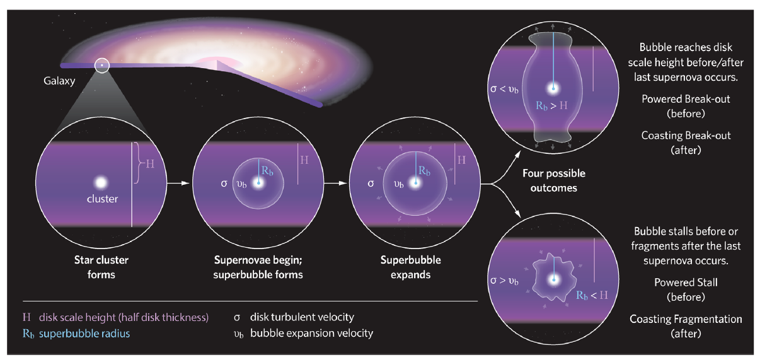
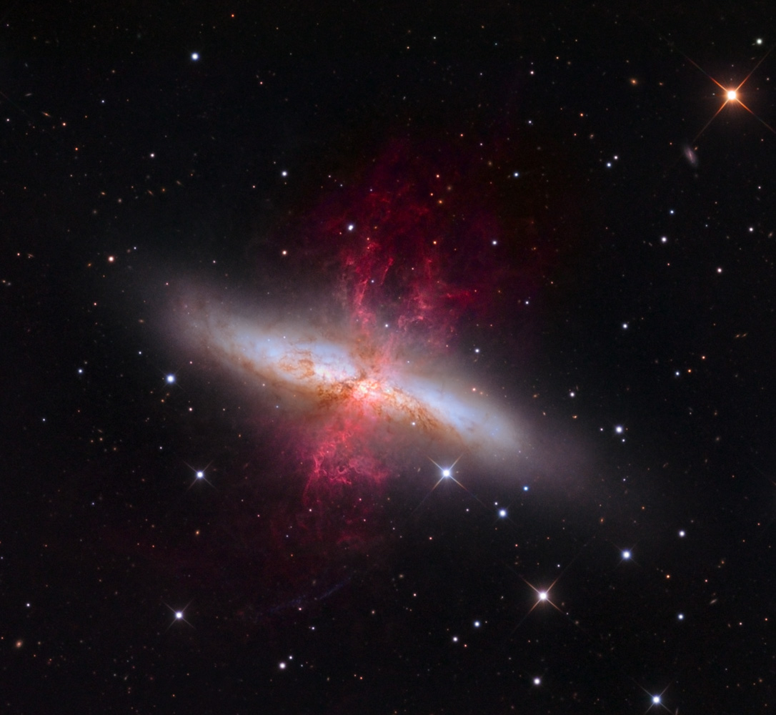
Superbubbles and Superwinds
Figure 1 in Orr et al. 2022
Wikipedia
Notes:
In starburst galaxies, clustered supernovae from young star clusters carve out large, expanding cavities in the interstellar medium—these are superbubbles. As the hot gas pushes outward, the shell can break out of the galactic disk if the bubble grows larger than the galaxy’s scale height. At this point, instabilities like Rayleigh-Taylor fragmentation cause the shell to rupture—this is called blowout. Once this happens, the gas can accelerate into the halo or escape entirely, forming a large-scale galactic outflow called a superwind. These winds transport metals and energy into the circumgalactic medium, and they play a major role in regulating star formation and galactic evolution—kind of like the water cycle in the galaxy. So in essence, superbubbles are the launching pads for superwinds.

Slide 3
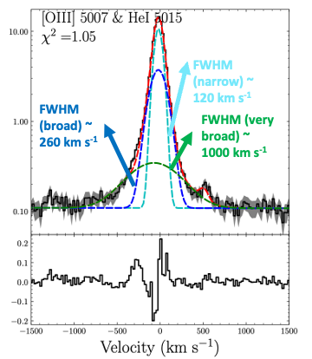
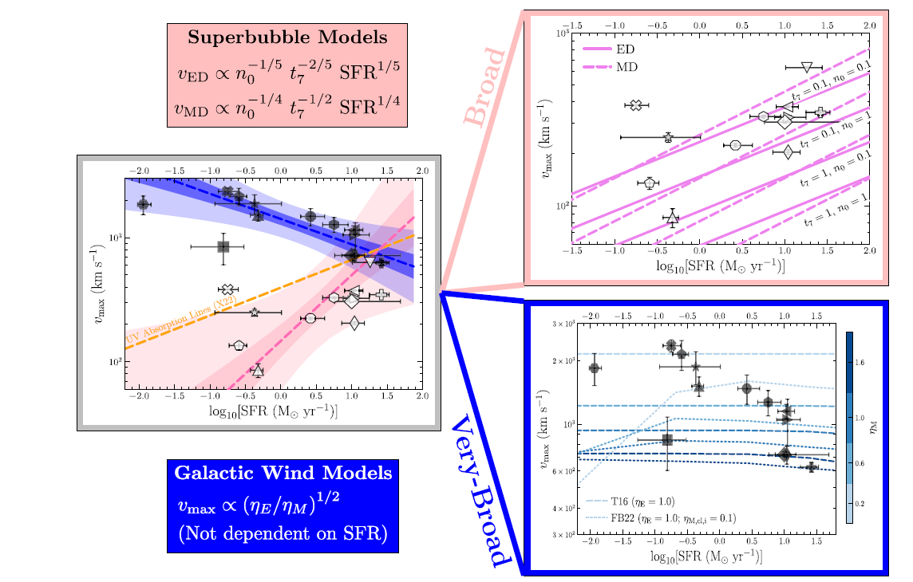
Outflows vs Winds Spectroscopically
Broad vs. Very Broad Components
Peng et al. 2025
Notes:
This slide shows how we distinguish superbubbles from superwinds using spectral line profiles.
On the left is a fit to an emission line with three components. The narrow one traces regular gas. The broad component—around 260 km/s—is consistent with a superbubble expanding in the disk. The very broad one—up to 1000 km/s—indicates a superwind, gas escaping into the halo or beyond.
On the right, we see how these components relate to theory. The pink models show how superbubble velocities depend on star formation rate, while the blue models show superwinds that are less SFR-dependent.
My goal is to connect these spectral components to structures we can actually see in high-resolution HST images.

Slide 4
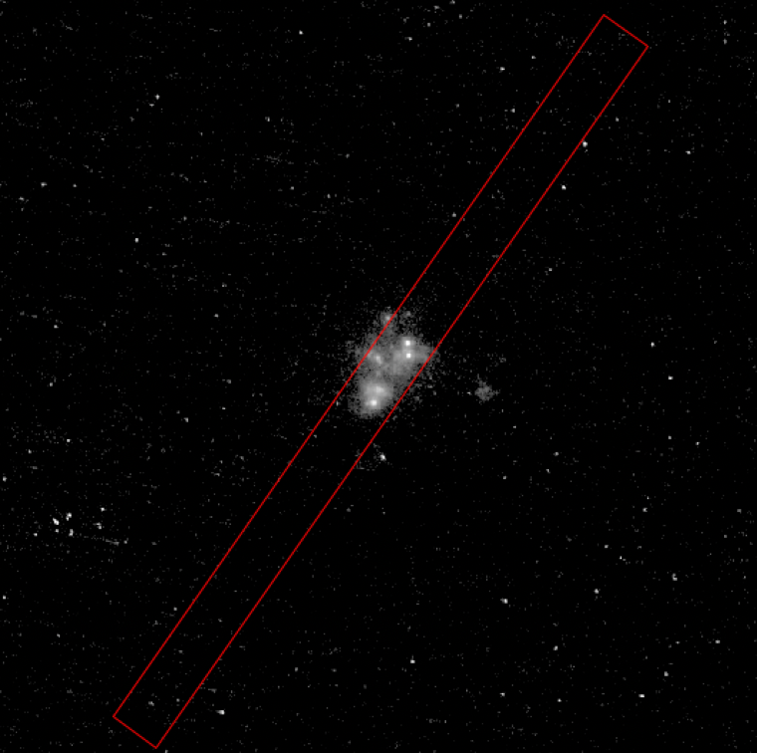
Shells with Higher Spatial Resolution
Hubble Space Telescope (HST): Full image
Using images to see morphological evidence
0.05 arcsecond resolution
Keck: Red slit
Region of line profile
1.25 by 20 arcseconds
Notes:
This is a Hubble Space Telescope OFF-band image of one of the target galaxies. Since it’s taken in an OFF-band filter, it shows mostly continuum light from stars, not ionized gas emission like H-alpha.
Overlaid in red is the Keck/ESI spectroscopic slit, which is about 1.25 by 20 arcseconds. This is the region where we have line profile measurements, like the ones we discussed earlier.
But compared to Keck, HST has much higher spatial resolution — about 0.05 arcseconds, which corresponds to roughly 10–20 parsecs, depending on the galaxy’s distance. That allows us to see fine structure in the galaxy that would be blurred out in ground-based observations.
My goal is to use this resolution advantage to search for visible shells or bubble-like structures — signatures of superbubbles or outflows. These features won’t appear clearly in starlight alone, which is why I’ll later subtract the OFF-band image from an ON-band image to isolate H-alpha emission from the gas.

Slide 5
Creating Emission Line Images

Slide 6
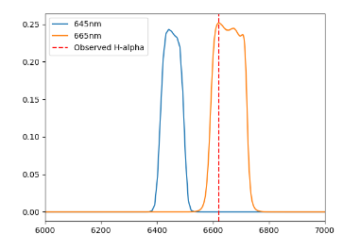
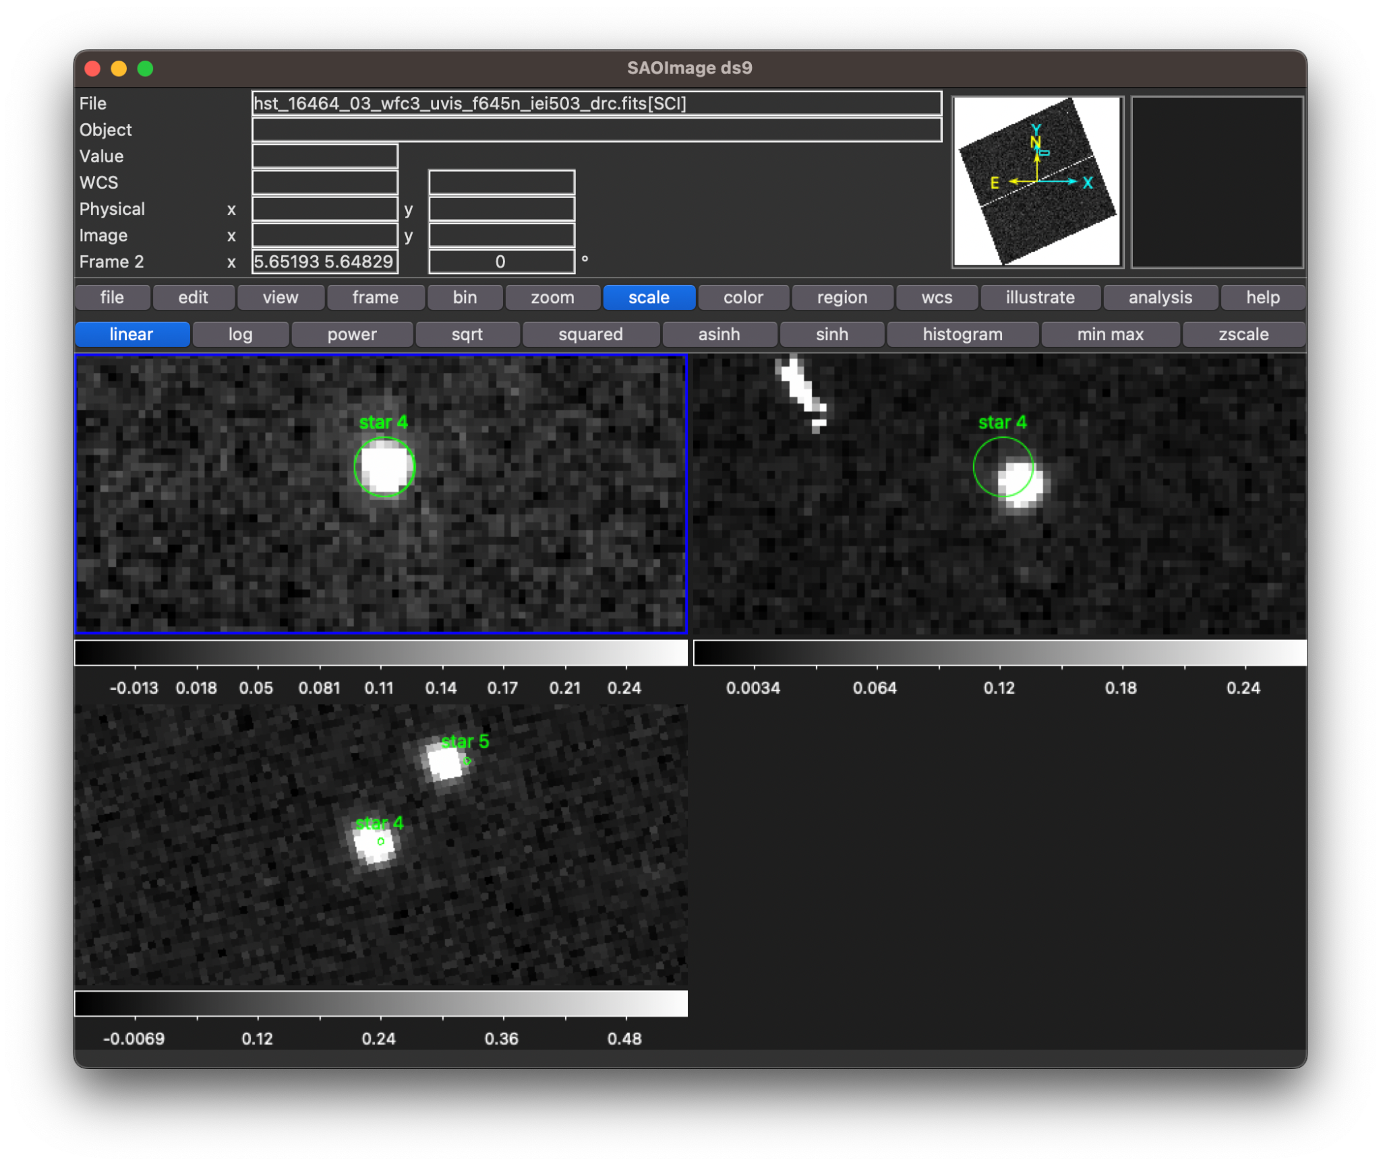
Creating Emission Line Images
Throughput Graphs
Alignment
Filter Throughput
Wavelength Å
Notes:
To isolate H-alpha emission, I first selected a pair of narrow-band filters for each galaxy — one ON-band filter centered on the redshifted H-alpha line, and one OFF-band filter capturing only continuum emission.
The plot on the left shows the throughput curves of an example filter pair. The red dashed line marks the observed wavelength of H-alpha at the galaxy’s redshift. You can see that the ON-band filter captures both line and continuum emission, while the OFF-band is offset to sample only the continuum.
Once the filters were chosen, I aligned the ON and OFF images using bright stars visible in both frames. The screenshot on the right shows this process in DS9, where I matched centroids of the same stars across both filters to ensure sub-pixel registration before subtraction

Slide 7
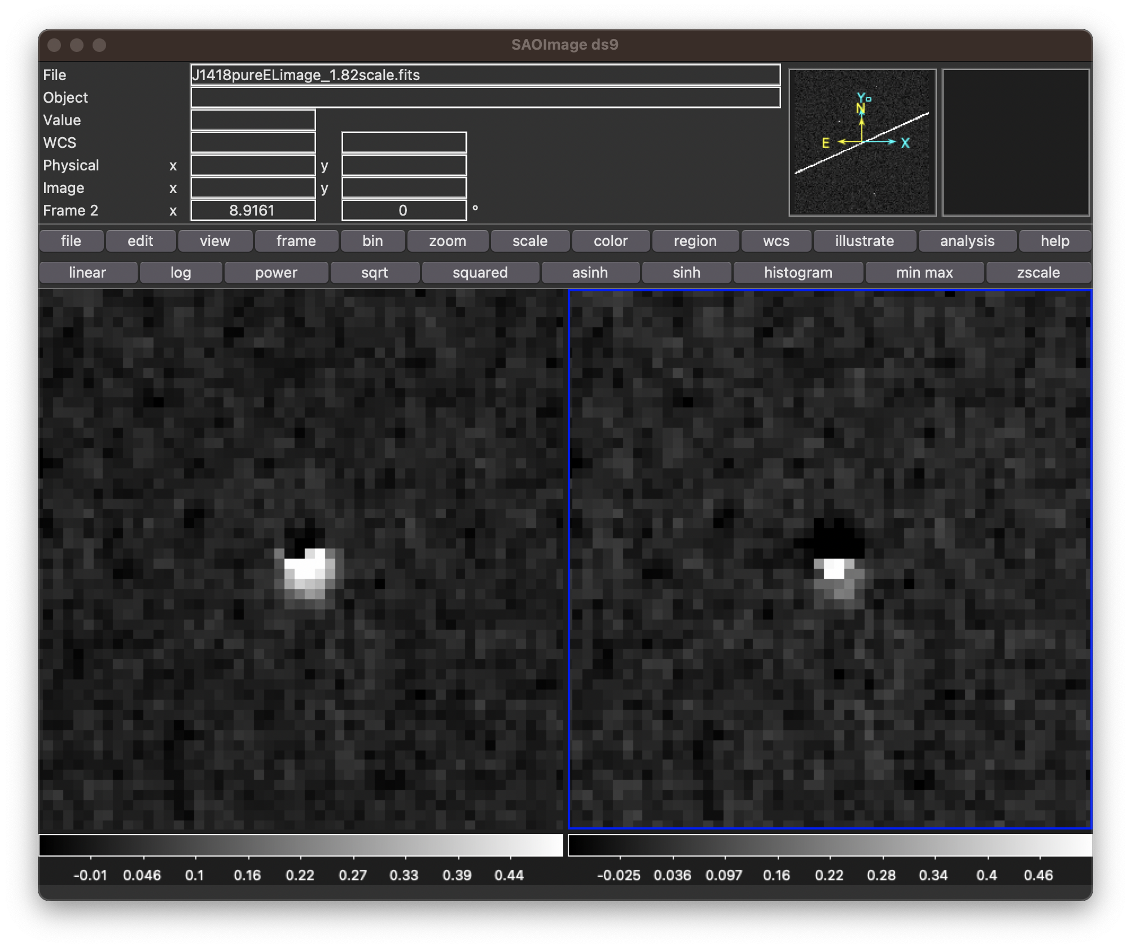
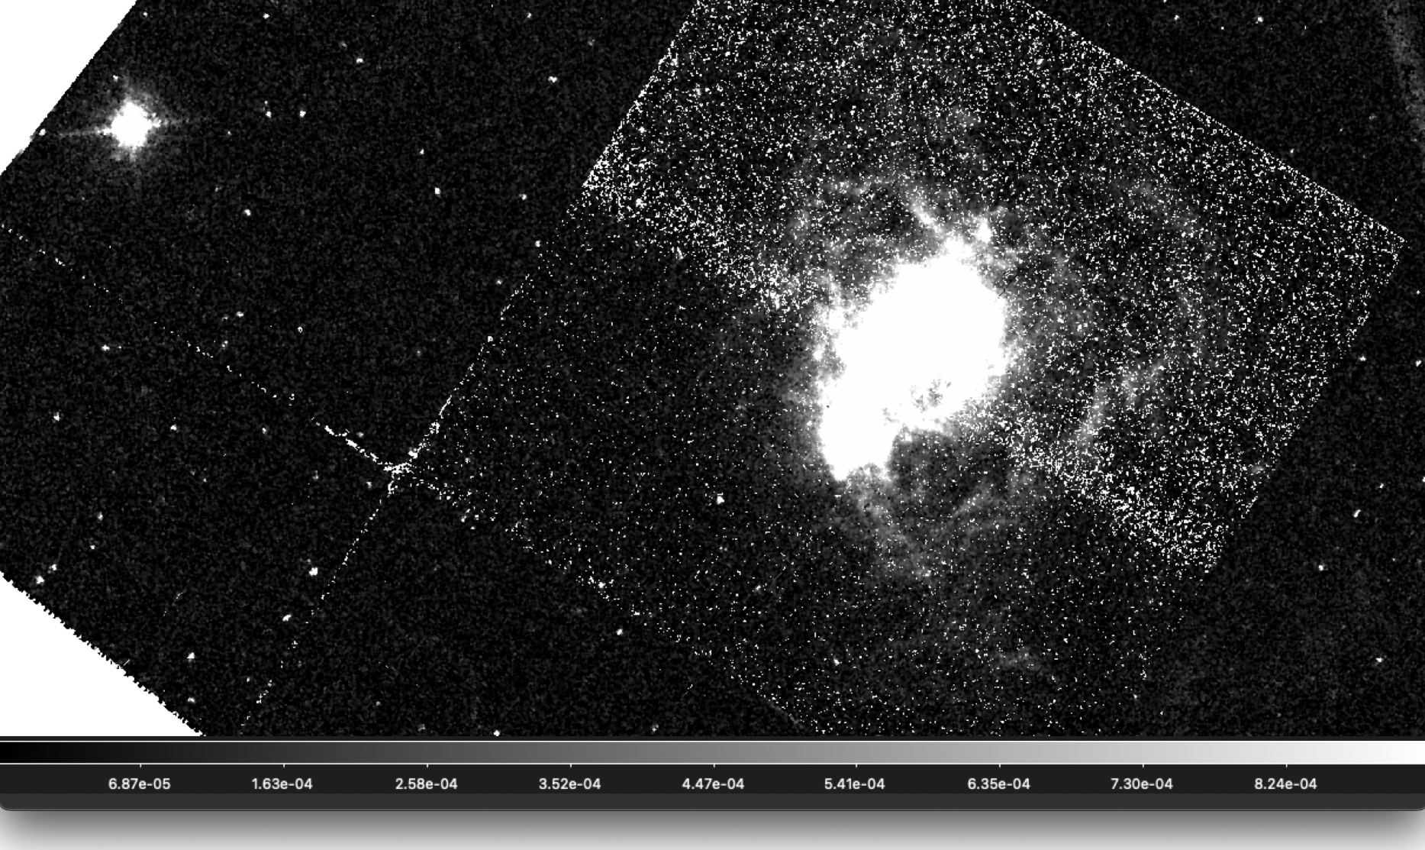
Creating Emission Line Images
Subtraction
Signal To Noise Ratio
DIFF image = ON - scale factor * OFF
J0934 emission line image with threshold of 1.0 and correct scale
1.0 scaling factor
1.82 scaling factor
Notes:
After alignment, I subtracted a scaled version of the OFF-band image from the ON-band image to isolate the emission line signal.
The subtraction equation is shown conceptually on the left — the DIFF image equals the ON-band image minus a scale factor times the OFF-band. This scaling factor accounts for differences in exposure time and filter throughput.
I tested a range of scale factors to find the one that best canceled the continuum, as shown in the example here. A scale of 1.82 removed the stellar continuum more effectively than 1.0.
On the right is an example of the final emission line image of galaxy J0934, with a signal-to-noise threshold of 1.0 applied. This image now isolates H-alpha emission, allowing me to identify and measure superbubble features for further analysis.

Slide 8
Model Predictions and Constraining Variables

Slide 9
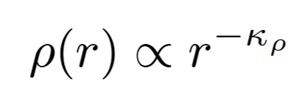
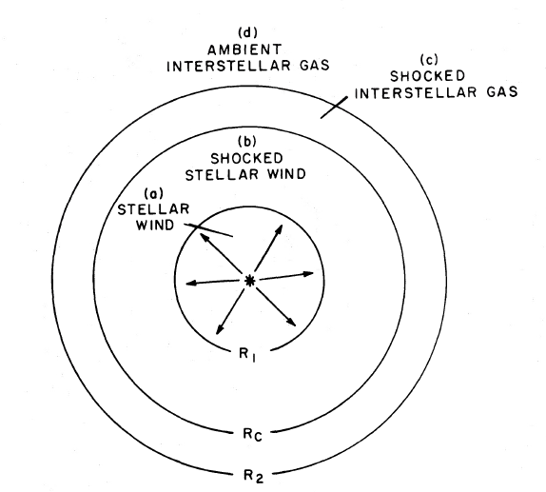
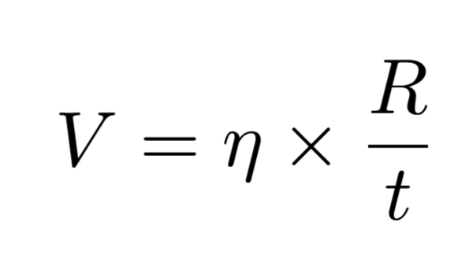
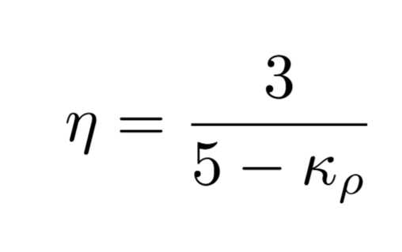
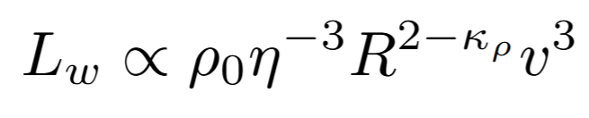
κ_{ρ}: density gradient
ρ: ambient density
L_{w}: mechanical luminosity
η: expansion index
Figure 1 from Weaver et al. 1977
Notes:
A young cluster injects mechanical power—stellar winds and supernovae—into the ISM. That energy thermalizes, drives a hot, over-pressured cavity, and sweeps up a thin shell. For today, I assume two things:
Constant energy injection: the total power from the cluster is roughly steady over the short expansion time, so L_w is constant.
Adiabatic, energy-driven phase: no strong radiative cooling in the hot interior, so the expansion is set by pressure work, not momentum loss.
Under these assumptions the model predicts simple power-law scalings: the bubble radius grows as a power of time, and the velocity is the time-derivative of radius. If the ambient density is uniform you get the classic Weaver solution; if density declines with radius (ρ ∝ r^{-kρ}), the slope changes, but the intuition is the same: early, fast expansion that gradually slows as the shell sweeps up mass. I’ll use this framework to interpret my images and to compare with spectroscopy.”

Slide 10
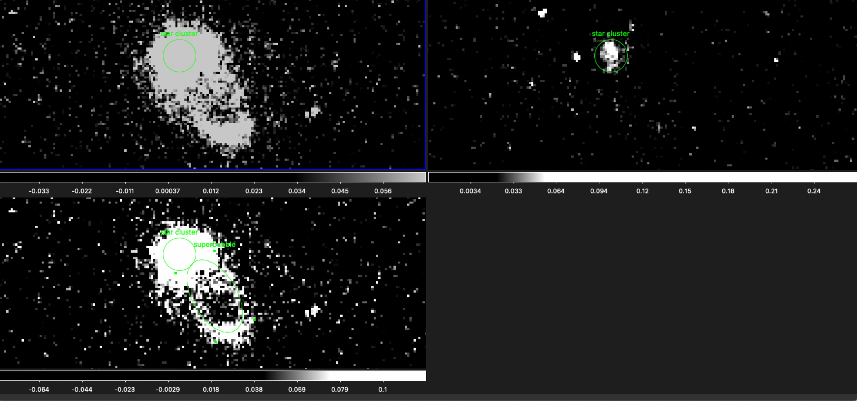
Finding Superbubble Radii
J1418
ON band
Emission line image
Used to find superbubbles
OFF band
Used to find star clusters
Notes:
Once I had emission-line images, I moved to identifying the actual superbubbles. This is J1418, an emission line image that did truly subtract continuum and is my poster child for superbubbles.
On the right, I used the OFF-band image to locate bright star clusters. On the left, you in the ON band and subtraction I looked for extended, shell-like structures surrounding the clusters, which are likely to be superbubbles formed by clustered supernova explosions.
In DS9, I used elliptical regions to trace these features and measured their major axis in pixels. These pixel measurements are the basis for converting to physical radii, which I’ll use in the next step to estimate bubble ages and compare to spectral predictions.

Slide 11
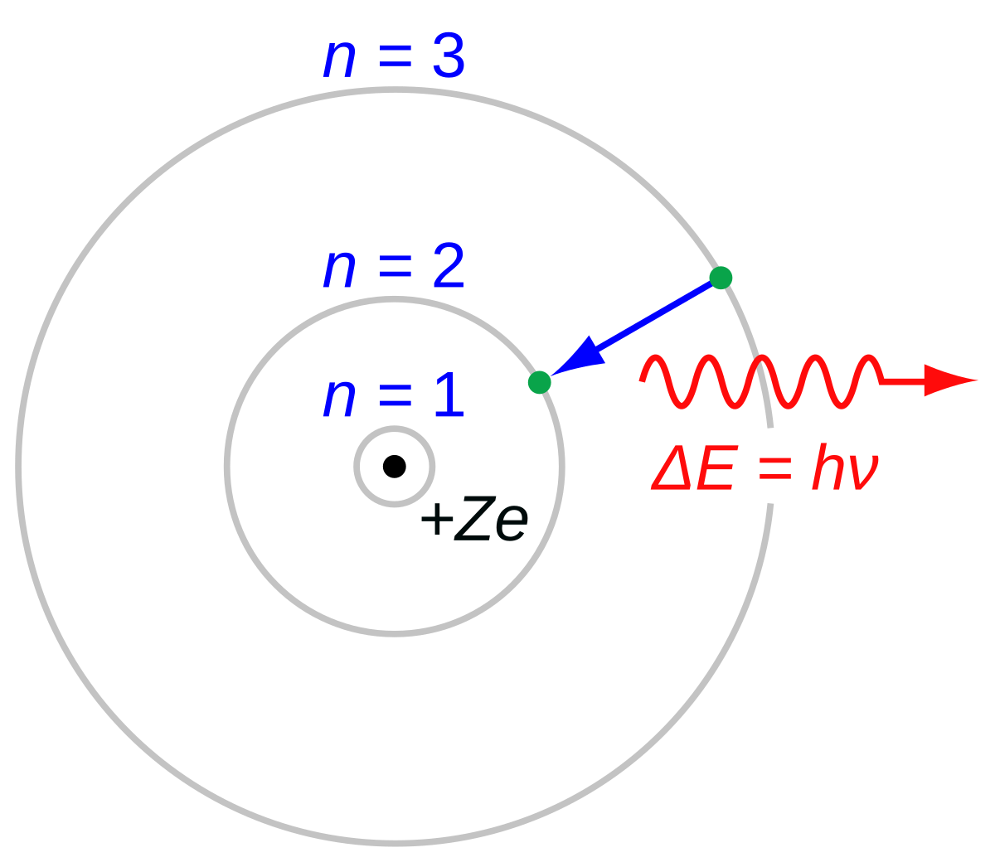
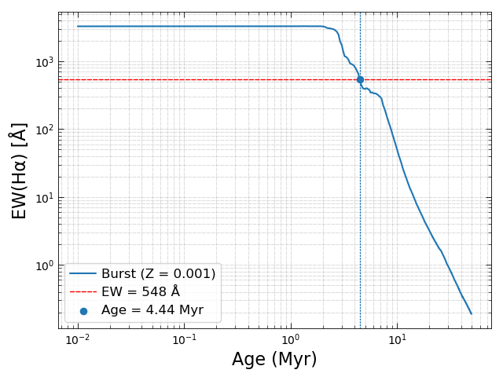
Hα Equivalent Width and Starburst99 for Age
J1418
Wikipedia
Notes:
The way I am constraining the expansion time is by finding the age of the star clusters by looking at the strength of their H-alpha emission. Young star clusters produce lots of very energetic photons. These photons ionize hydrogen in the surrounding gas. As the gas recombines, it emits H-alpha photons. The younger the cluster, the more ionizing photons it produces, so the stronger the H-alpha emission will be.
We measure this strength using the equivalent width of H-alpha. On the plot here, the equivalent width decreases with age. By matching the measured value — shown with the red line — to stellar population models from Starburst99, I can tie a specific equivalent width to a cluster age.
For this example galaxy, J1418, the measured H-alpha equivalent width corresponds to an age of about 4.4 million years.

Slide 12
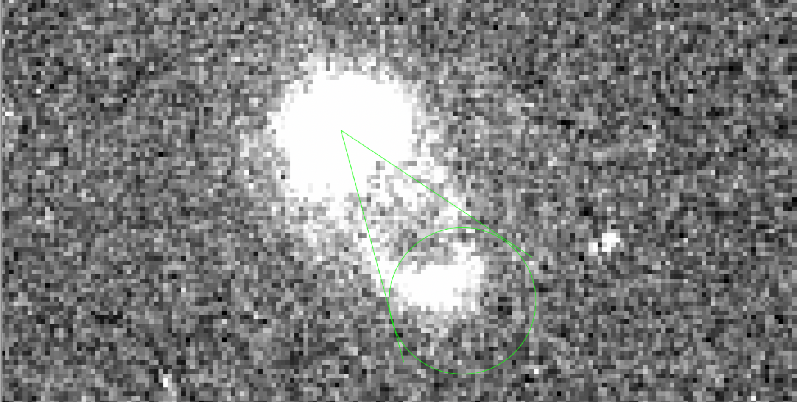
Ambient Density Calculations
Hα Flux → Luminosity L_{Hα} = 4π * D² * F_{Hα}
Luminosity → Recombination Rate Q(H⁰) ∝ L_{Hα}
Q(H⁰) is the ionizing photon production rate
Assume Uniform Cone Volume V ≈ ⅓ R²h
Density Estimate n = N_{H}/V
N_{H} is number of ionized hydrogen atoms
Assumptions:
Assume fully ionized hydrogen (n_{e} ≈ n_{p})
ISM is treated as uniformly distributed, but images show that bubbles expand into inhomogenous density
Notes:
Here’s how I estimate the ambient density around the bubble. First, from the pure H-alpha image I sum the flux inside the green aperture and convert it to luminosity with the distance: LHα=4πD2FHα. Under Case B recombination at T∼10000K, and T ~ 20000K, the H-alpha luminosity traces the recombination rate: it’s proportional to​ times the effective recombination coefficient and the photon energy. Assuming fully ionized hydrogen, ne≈np, I solve for the average density:
For the volume, I approximate the bright segment we see as a cone / thin-shell wedge with V≈13πR2hV \approx \tfrac{1}{3}\pi R^2 hV≈31​πR2h; hhh is the shell thickness and f is a filling factor to allow for clumpiness.
So, operationally: flux → luminosity → recombination physics → density. The main systematics are the Hα extinction correction, the geometry and thickness hhh, the filling factor fff, and the temperature used for αHαeff​. I propagate those to get the error bars. Finally, note the model assumes a locally uniform medium, but the images show anisotropy—so the nnn I quote is an average for this region, and that motivates testing different kρ​ in the expansion model.

Slide 13
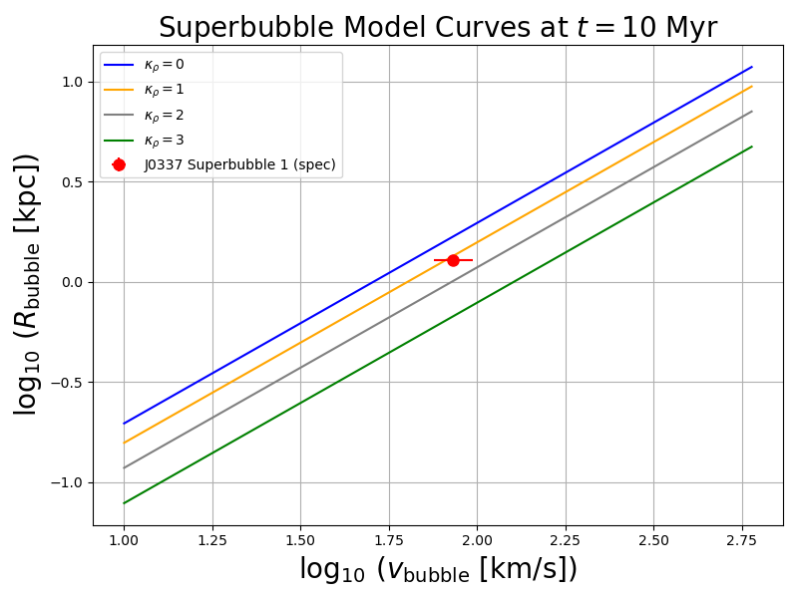
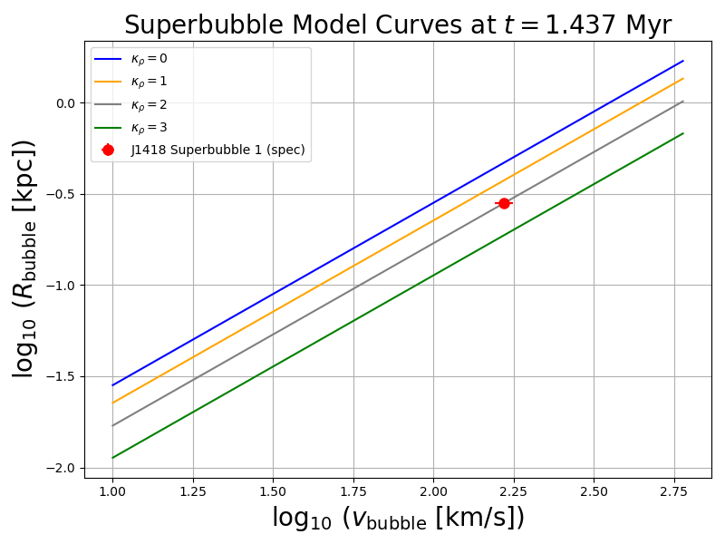
Results
Notes:
Here I’m comparing my observations with the superbubble model. Each colored curve corresponds to a different density gradient, with steeper slopes meaning stronger gradients. The red points are the spectroscopic measurements for J1418 and J0337.
What we see is that the bubbles don’t expand uniformly in all directions. Instead, they align better with models where the density is decreasing most steeply. This suggests superbubbles preferentially expand along the path of least resistance

Slide 14
Results
J1418
K_{p} | L_{w} (erg/s)
0 | 1.65E+41
1 | 2.10E+41
2 | 2.69E+41
3 | 2.69E+41
J0337
K_{p} | L_{w} (erg/s)
0 | 1.19E+41
1 | 1.51E+41
2 | 1.93E+41
3 | 1.93E+41
Core-collapse supernovae (CCSNe) inject ~3*10⁴¹ erg/s of mechanical energy (Peng et al. 2025)
Measured superbubble mechanical luminosities correspond to a significant fraction of that energy over Myr timescales
Implies that almost all of the injected energy is retained as mechanical expansion of the bubble, with comparatively less lost to radiative cooling
Notes:
Core-collapse supernovae provide about 3*10^41 erg of energy each. When we look at the mechanical luminosities I’ve derived—around 104110^{41}1041 erg per second—that corresponds to a substantial portion of the supernova energy budget over a few million years. The fact that these values line up shows that the bulk of the injected energy is actually going into driving the expansion of the superbubble. In other words, radiative cooling is not dominating the energy balance here; instead, feedback remains energy-driven.

Slide 15



Acknowledgements
Special thanks to:
Dr. Crystal Martin, Faculty Advisor
Zixuan Peng, Graduate Student Mentor
Dr. Sathya Guruswamy, REU Program Director
Katherine Kudla and all my fellow REU students for their consistent help
This work was supported by the National Science Foundation through REU grant PHY-2349677.

