Slide 1
Low temperature characterization of Ta/InAs and Al/Si Josephson junctions with single crystalline barriers
Graduate Advisor: Teun van Schijndel
PI: Chris Palmstrøm
PALMSTRØM GROUP Darius Vera UC SANTA BARBARA

Slide 2
Potential applications to quantum computing
Systems we study in the PalmstrØm lab have qubit applications
Quantum computing has the power to revolutionize computing
Faster computation times
Ta/InAs and Al/Si/Al junctions
2/17
PALMSTRØM GROUP UC SANTA BARBARA
Notes:
I’m sure that most of you know by now, but the systems that we study in the Palmstrom lab have potential applications to quantum computing and particularly to superconducting qubits.
As im sure most of us know, quantum computers have the potential to revolutionize computing because of its computational power.

Slide 3
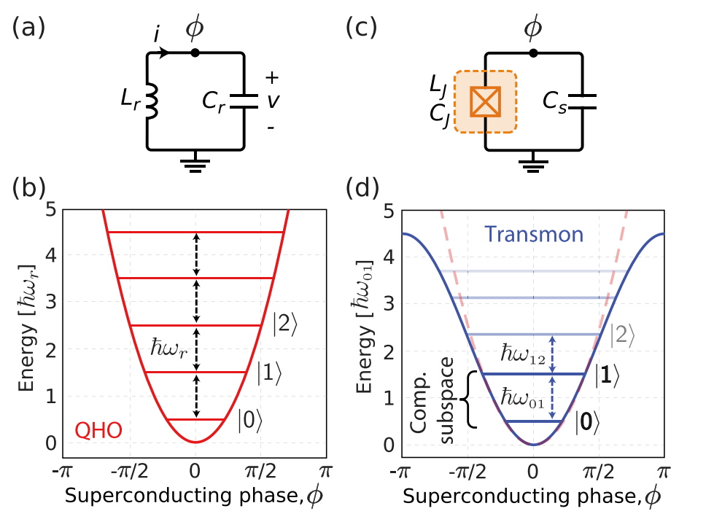
Superconducting LC circuits
SC
Barrier
SC
Superconducting qubits (top right) are promising as they provide essential nonlinearity (JJ)
Allows for the creation of a distinct computational subspace.
Ordinary superconducting LC circuits (top left) pose problems
Equal spacing of energy levels
Ta/InAs and Al/Si/Al
Single crystalline barrier
[1]
3/17
[1]. P. Krantz. Appl. Phys. Rev. (2019)
PALMSTRØM GROUP UC SANTA BARBARA
Notes:
Before I start, I want to give a little bit of background on superconducting LC circuits, and why JJs are essential components of these systems. On the top left you’ll see a superconducting LC circuit and on the top right you will see a transmon qubit (essentially a superconducting LC circuit where the linear inductor has been swapped with a nonlinear inductor (JJ).
The energy diagram for a superconducting LC circuit is very similar to that of a QHO where the energy levels are equally spaced. The energy diagram for the transmon is anharmonic where the energy levels are unequally spaced. A JJ allows for unequal spacing of the energy levels and the creation of a distinct computational subspace of the ground and the first excited state
Most of the junctions I have talked about up until now require the use of this external capacitor as you can see here in the top right. While these types of qubits are promising, there are issues. The interfaces and surfaces of the external surfaces of the capacitor can introduce loss to the qubit. You can for example increase the size of the capacitor to dilute this loss for example, but this poses issues to scaling. There is a promising avenue to resolve this issue where the external capacitor and junction are merged in to a single device → MET (merged element transmon).

Slide 4
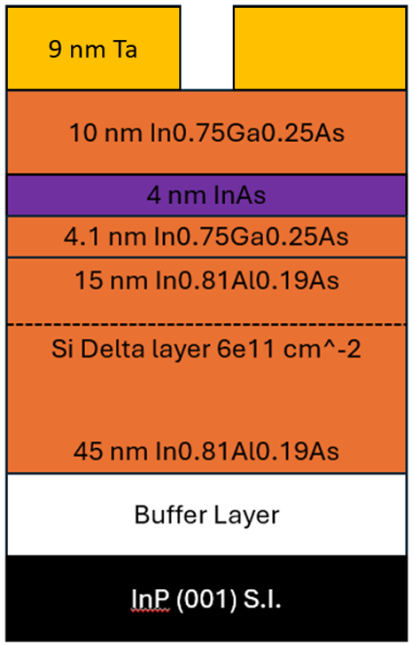
Ta/InAs Josephson junction with crystalline barrier
~ 300 nm
õ*
Unique superconductor-semiconductor system
Tunability in semiconductor region with gate voltage, $V_{g}$
Layers are grown epitaxially on top of a substrate via molecular beam epitaxy (MBE)
Quantum well structure
Ballistic/Diffusive transport
õ* Image courtesy of Teun van Schijndel. Quantum well grown by Jason Dong, and tantalum grown by Teun van Schijndel
4/17
PALMSTRØM GROUP UC SANTA BARBARA
Notes:
While the prior slide is helpful to see why JJs are essential components of superconducting qubits, I want to talk about the specific JJ that I have done some work with these past few weeks.
What is MBE: technique that allows for thin-film deposition of single crystals. For example if we want to deposit tantalum on our sample, we can heat it up using a electron gun. We get some vapor (tantalum) coming off the source and it deposits on our sample.
The top layer is Tantalum which serves as the two superconducting islands in our josephson junction. The next trilayer helps form a QM well. The InAs (smaller bandgap) is sandwich between two layers of a larger bandgap which traps the electrons in the InAs layer (analogous to particle in a box). It acts as a quantum well in one dimension while the other two dimensions are a free electron gas (2DEG). The next couple layers below this help confine the potential/minimize growth defects with the Silicon layer donating charge carriers.
You may wonder why these layers have varying thickness. For example, why is it that the first InGaAs layer is about 10 nm. Well one of the requirements of a system like this is to have strong coupling between the superconductor and semiconductor. This can be achieved by having the quantum well “closer” to the superconductor. However, if we make the InGaAs layer to thin, we can introduce scattering at the interfaces. We want to ensure we are not in the diffusive regime were scattering is more prevalent and we have poor electron mobility. Various papers have shown that ~10 nm is a “happy medium” for strong coupling and good electron mobility.
Ballistic transport → less scattering and “good” electron mobility.
I do want to mention that my part of the project does not focus on growth of this structure. Other lab members including my grad advisor Teun grow these samples. I measure them as you’ll see later

Slide 5
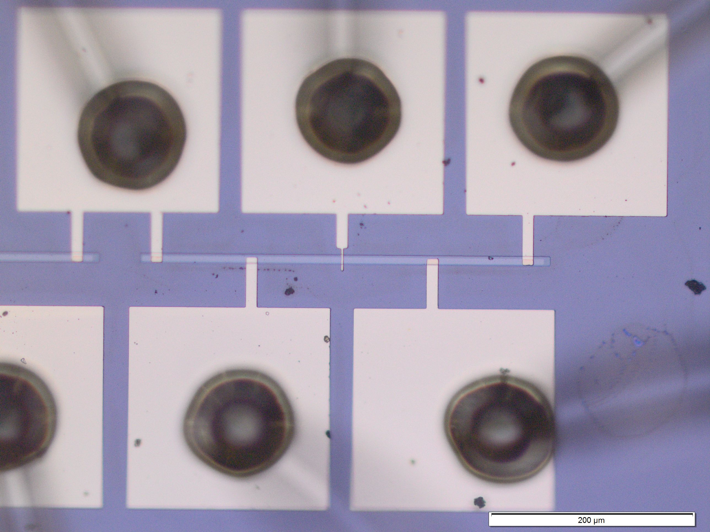
Experimental setup Ta/InAs Josephson junction
õ*
Current bias measurements
Voltage bias measurements
Current bias measurements with gate voltage
$$I_{+}$$
$$V_{g}$$
$$I_{−}$$
Quantum Well
Ta lead
$$V_{+}$$
$$V_{−}$$
Au wires
Ti/Au contact
5/17
õ* Image courtesy of Teun van Schijndel.
PALMSTRØM GROUP UC SANTA BARBARA
Notes:
Before I show some results, I want to talk a little bit about our experimental setup. This picture on the left slide of the PPT, is our sample with various Ti/Au contacts. We have these two regions here which represent our tantalum (the two side of our junction). The gap in between the two sides of our tantalum represents our barrier /quantum well materials. These four tips allow us to define a high and low current, with a high and low voltage. We define the positive direction of current to be from I_high to I_low. We also have a 5th contact that allows us to apply a gate voltage. Maybe mention why we use a 4 point resistance measurement (to avoid contact resistance).
With this setup, we can perform various experiments. Specifically, I’ll talk about data collected from current bias, voltage bias, and current bias with gate voltage measurements. We did this various measurements to help us characterize our Ta/InAs junction

Slide 6
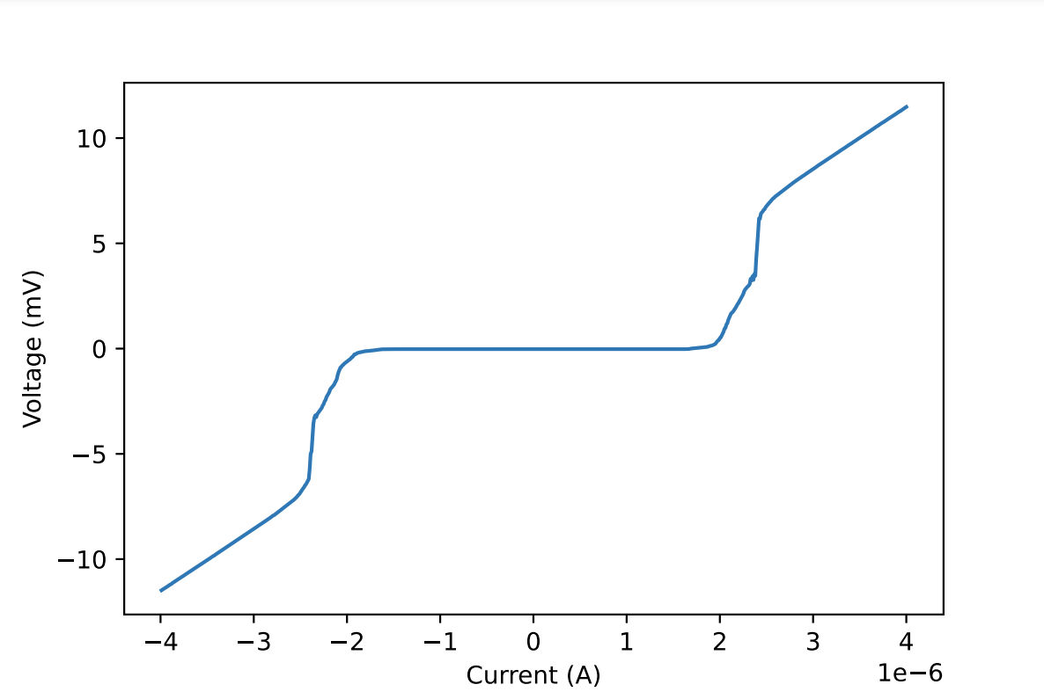
Voltage measurements taken at ~ 70 mK
$I_{c}R_{N}=$4.4 mV
Related to gap by $I_{c}R_{N}=α{Δ_{0}}/ⅇ$ [1].
We find that $I_{c}R_{N}$ is 317% of the diffusive limit → ballistic transport likely
$R_{N} \sim 2.87∗ {10}^{3} \text{Ω}$
$I_{c} \sim 1.5 \text{µ}\text{A}$
$I_{ex}=I−V/R_{N}$ [2].→ $I_{ex}$ ~ 8 nA
$I_{ex}R_{N}=$26 $\text{µ}$V
Related to gap by $I_{ex}R_{N}=α′{Δ_{0}}/ⅇ$ [1].
We find that $I_{ex}R_{N}$ is 2.5% of the diffusive limit
[1]. Mayer, William. Applied Physics Letters. (2019)
[2]. Blonder, G. E. Physical Review B 25.7. (1982)
6/17
PALMSTRØM GROUP UC SANTA BARBARA
Notes:
We can vary the current and measure the voltage. Doing so, we can create this plot that I have shown. You’ll see voltage plotted against current. Immediately you’ll notice this flat part of the graph (indicating zero resistance). From this, we can actually extract a parameter known as the critical current, which is the maximum amount of supercurrent that can flow through the junction. Looking at this graph, we find the critical current to be about 1.5 microA
As we increase current, you’ll notice a nonlinear regime and from about 0 to 5 V, where we have the junction transitioning to a resistive regime. In this part of the graph you’ll notice a the graph has a linear graph, which is what some of us might before more familiar with (because of Ohms law). We can actually extract the value of this resistance from the slope of the graph. Doing so yields a value of about 2.37e+03 Ohms.
A standard figure of merit of a JJ is the product of I_cR_n. For us, we find this product to be about 4.4 mV. We can use this product to determine the quality of the 2DEG (essentially determine if we are in the ballistic or diffusive regime). To do so, you can actually relate this product to the superconducting energy gap of the material as shown by this equation. Alpha is a parameter indicating ballistic or diffusive regime, and delta_0 is the superconducting energy gap (which you can calculate according the BCS theory for our sample). We find that our sample is 317% of the diffusive regime ( I_cR_n > diffusive limit), meaning that ballisitic transport is likely (good quality 2DEG?). Lastly, we can also calculate this value here telling us about the strength of our junction.
We can also calculate the excess current flowing through the junction at high currents, I_ex which we can use in later calculations to tell us about the quality of our super-semiconductor interface (gives us an idea of current flow at this interface). I_exRn will help us determine this because we can related it to essentially the same formular but with different values of alpha depending on whether we are in the diffusive or ballistic regime. We find this product to be 2.5% of the diffusive limit (product < diffusive limit). This seems to tell us that we have bad interface quality, but we don’t believe this to be true.

Slide 7
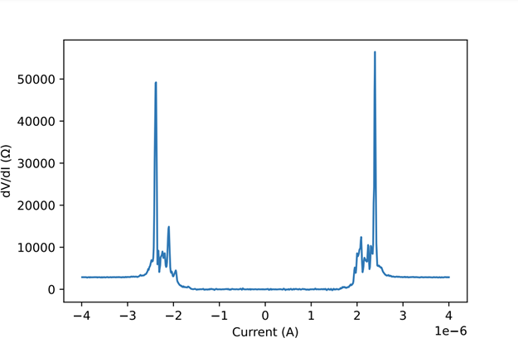
$dV$ measurements taken at ~ 70 mK
Tantalum transition
Tantalum can exit superconducting regime at high enough current
Explains low value of $I_{ex}$
Multiple andreev reflections typically only seen in high quality junctions
Andreev reflection peaks
7/17
PALMSTRØM GROUP UC SANTA BARBARA
Notes:
This plot was created from our current bias measurements, but we have differential resistance plotted against current. You’ll notice these sharp peaks occurring at the same current values of which there was a nonlinear regime in the IV plots. You’ll notice there are two very sharp peaks, and then smaller peaks next to these large peaks. We believe that these sharp peaks are actually the tantalum transition out of the superconducting regime. With a high enough current, you can exit a superconducting regime, and we believe this peak is evidence for tantalum exiting the superconducting regime. This would explain our fairly low value of I_ex. Normally when you pass the critical current you have superconducting cooper pairs and single electrons tunneling through your barrier, but we believe that since we have exited the superconducting regime, that only single electrons are tunneling through the barrier leading to a low value of I_ex.
We believe these smaller peaks to be Andreev reflections which are typically only seen in high quality junctions. Later I’ll show a plot confirming our suspicions that these peaks are indeed Andreev reflections.

Slide 8
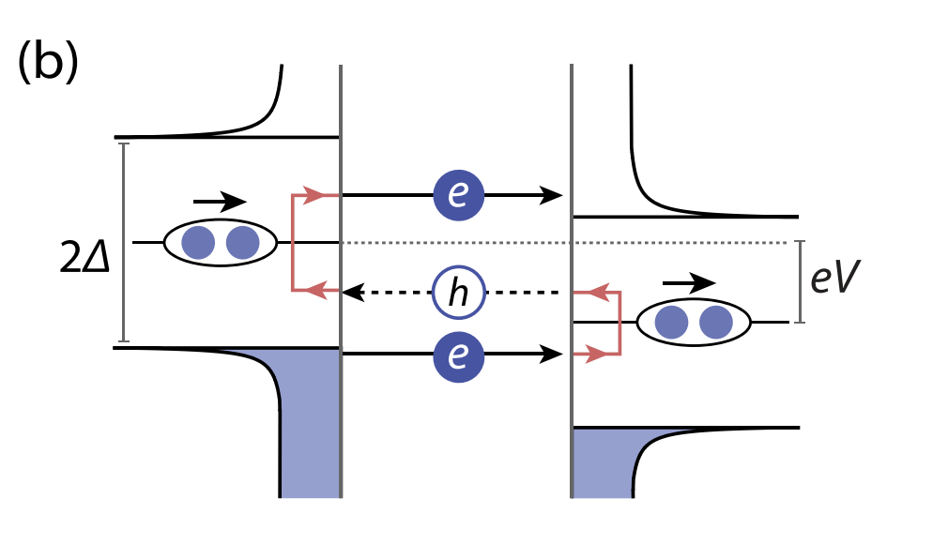
Multiple Andreev Reflections (MAR)
Incident electron → forms cooper pair in superconductor with hole of opposite momentum
Incident electron at energies less than twice superconducting gap
Happens multiple times → MAR
Manifests as peaks and dips in differential conductance plots [1].
[1]
8/17
[1]. Kjærgaard. Physical Review Applied 7.3. (2017)
PALMSTRØM GROUP UC SANTA BARBARA
Notes:
I mentioned on a previous slide that we may have observed Andreev Reflections, and I would like to explain the phenomena of Andreev reflections before I show a graph and say we see them. Andreev reflections occur at the interface of a metal and superconductor (in our case a semiconductor and a superconductor). Its involves and incident electron at energies less then twice the superconducting energy gap. The incident electron forms a cooper pair in the superconductor and there is a consequent hole with opposite momentum and spin. This is a single Andreev reflection. If this process happens multiple times, then we have MAR
The way you can tell that we have Andreev reflections are through differential conductance plots. They manifest has peaks and dips in these plots.

Slide 9
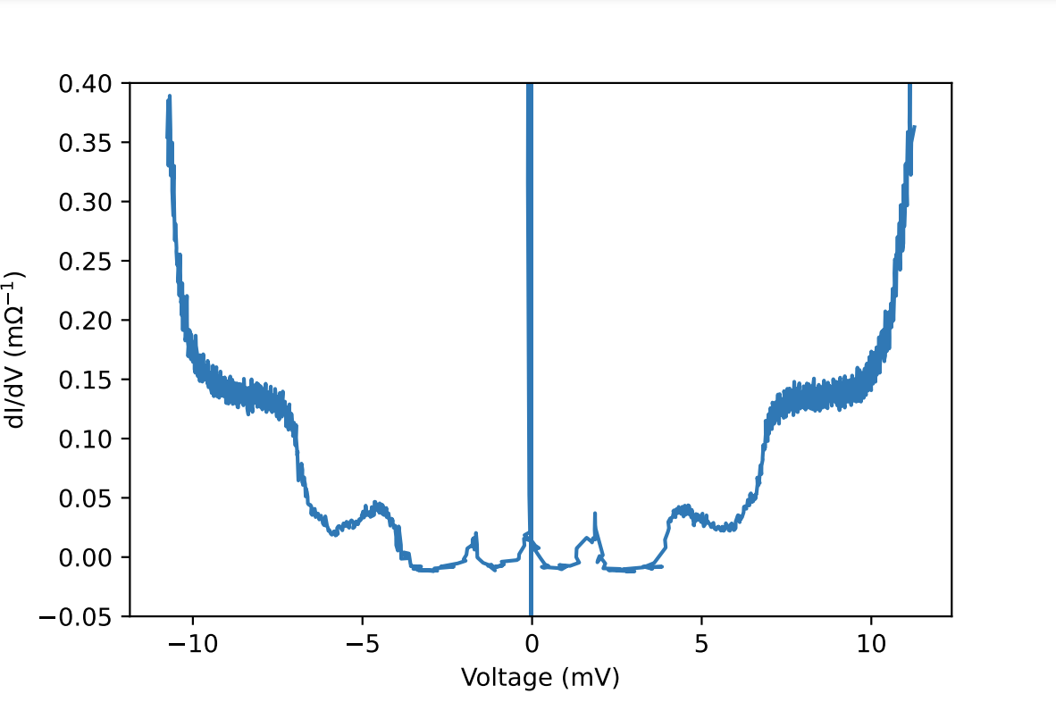
Current and $dI$ measurements taken at ~ 65 mK
4 voltage peaks, equally spaced between -5 and 5 mV
Voltage peaks at peaks $V=2{Δ_{0}}/{(ⅇ}n)$ [1]
Calculate superconducting gap according to peaks. $Δ_{0}$ ~ 1-4 meV
BCS theory predicts $Δ_{0}$ ~ 0.6 meV where $T_{c}$ ~ 4.4 K for tantalum [2].
Ta transition peak, and confirmation of MAR process
n = 1
n = 2
[1]. Kjærgaard. Physical Review Applied 7.3. (2017)
[2]. Levy. Physical Review 132.3. (1963)
9/17
PALMSTRØM GROUP UC SANTA BARBARA
Notes:
One way to be sure that we are witnessing Andreev reflections is through voltage bias measurements. With voltage bias measurements, we can obtain differential conductance and plot it is a function of bias voltage. That is exactly what we have plotted here. You can see we have evenly spaced peaks, which is enough for us to say that we are witnessing Andreev reflections. You can relate Andreev reflections to the superconducting gap via this equation given here where delta is the superconducting energy gap and n is an integer corresponding to the peaks in our plot. We can calculate the superconducting energy gap with our peaks and values of n, which yields values from about 1-4 meV.
I also calculated the value of the superconducting peak according the BCS theory where it takes into account the critical temperature of your material. Doing so yields a value of about 0.6 meV
So what does this mean about the supposed bad interface quality I mentioned earlier? Well Andreev reflections are typically only seen in high quality junctions, and so we believe that the calculations we did earlier led us to a false conclusion that we have bad interface quality whereas in reality we have good quality because of our observation of Andreev reflections.

Slide 10
A new product, $I_{ⅇx}^{∗}R_{N}$
Define $I_{ⅇx}^{∗}=I^{∗}−$ $V^{∗}/R_{N}$ [1].
$I^{∗}$ and $V^{∗}$ chosen from 2-2.5 $\text{µ}\text{A}$, from the Andreev regime
$I_{ⅇx}^{∗}$ = 2 $\text{µ}\text{A}$
$I_{ⅇx}^{∗}R_{N}=5.7$ mV
$I_{ⅇx}^{∗}R_{N}=α′{Δ_{0}}/ⅇ$ → $I_{ⅇx}^{∗}R_{N}$ 517% of diffusive limit
Full picture
Good quality S-Sm interface
10/17
[1] Formula adapted from Blonder et al.
PALMSTRØM GROUP UC SANTA BARBARA

Slide 11
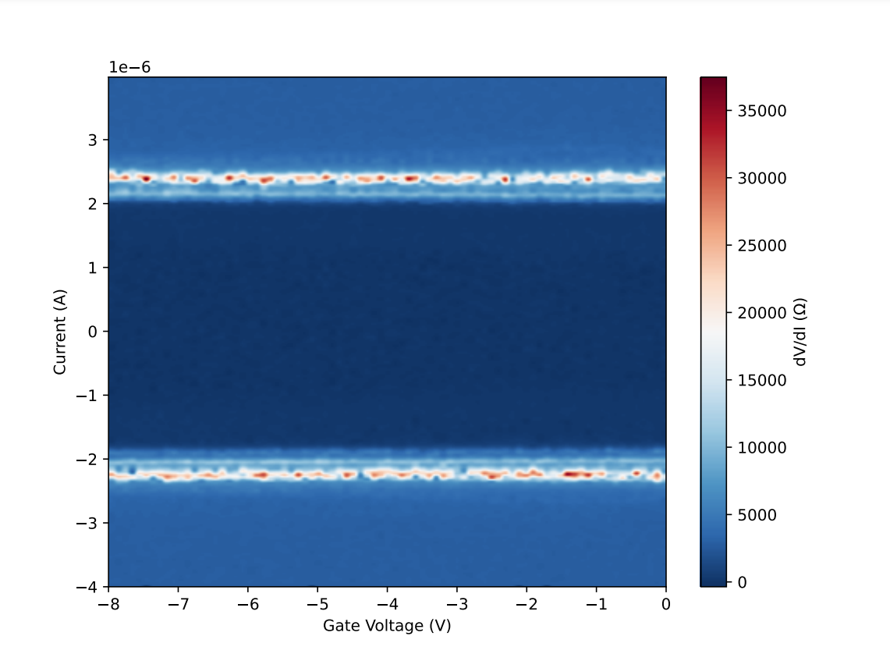
Current bias with varying gate voltage
No control over the critical current
No qubit frequency control
No closure of the superconducting regime
No evidence of tunability
RHEED → In rich top layer
11/17
PALMSTRØM GROUP UC SANTA BARBARA
Notes:
Varying the current at different gate voltages we can generate a plot as shown here. This just involves actually using the 5th contact point from the diagram a few slides ago Current is plotted on the y axis, gate voltage is plotted on the x axis and the color corresponds to differential resistance. Immediately, you’ll notice this dark region in the center corresponding to zero resistance. This is telling us that we are in the superconducting regime. Once we get to higher currents you’ll notice rapid variations in our resistance (this corresponds to the nonlinear regime that I mentioned in the previous plot I showed). This is the transition region, where we are exiting the superconducting regime to a resistive regime. At higher currents past this you’ll notice a somewhat constant resistance (something some of us might be more familiar with according to Ohms law)
We made this plot in an effort to show tunability (we can essentially cut of the junction by depleting the charge carriers in the semiconductor region). You might not be able to tell, but there is no evidence of depletion in this plot. A graph that does show depletion would something like this plot shown on the right. We can essentially see the superconducting regime “closing” (reduction of critical current) at higher gate voltages.
We are currently investigating why we didn’t see any depletion in this plot. Hypothesis: on the In/As layer, the surface of this layer may be more indium rich, essentially screening the electric field that would deplete the region. The gate voltage generates an E field, and this indium layer essentially screens it. I’ved talked to Teun and he’s going to try going samples where the surface is As rich, and should give is better results (we’re hopeful)

Slide 12
Ta/InAs takeaway
High quality 2DEG
Ballistic Transport
Transparent S-Sm interface
No tunability
12/17
PALMSTRØM GROUP UC SANTA BARBARA

Slide 13
Al/Si/Al Josephson junction with single crystalline barrier
Õ*
Si${\text{N}}_{\text{x}}$
Si fin on order of ~ 10 nm → both capacitive and tunneling properties
Al
Al
Fabrication begins with Si substrate
Si${\text{N}}_{\text{x}}$ hard mask → selective etching to create fin
Further thinning to reduce thickness of fin to ~ 10 nm
Angled MBE Al deposition
Si (substrate)
* Fabrication by Teun van Schijndel. Image adopted from A. Goswami. Applied Physics Letters (2022).
13/17
PALMSTRØM GROUP UC SANTA BARBARA

Slide 14
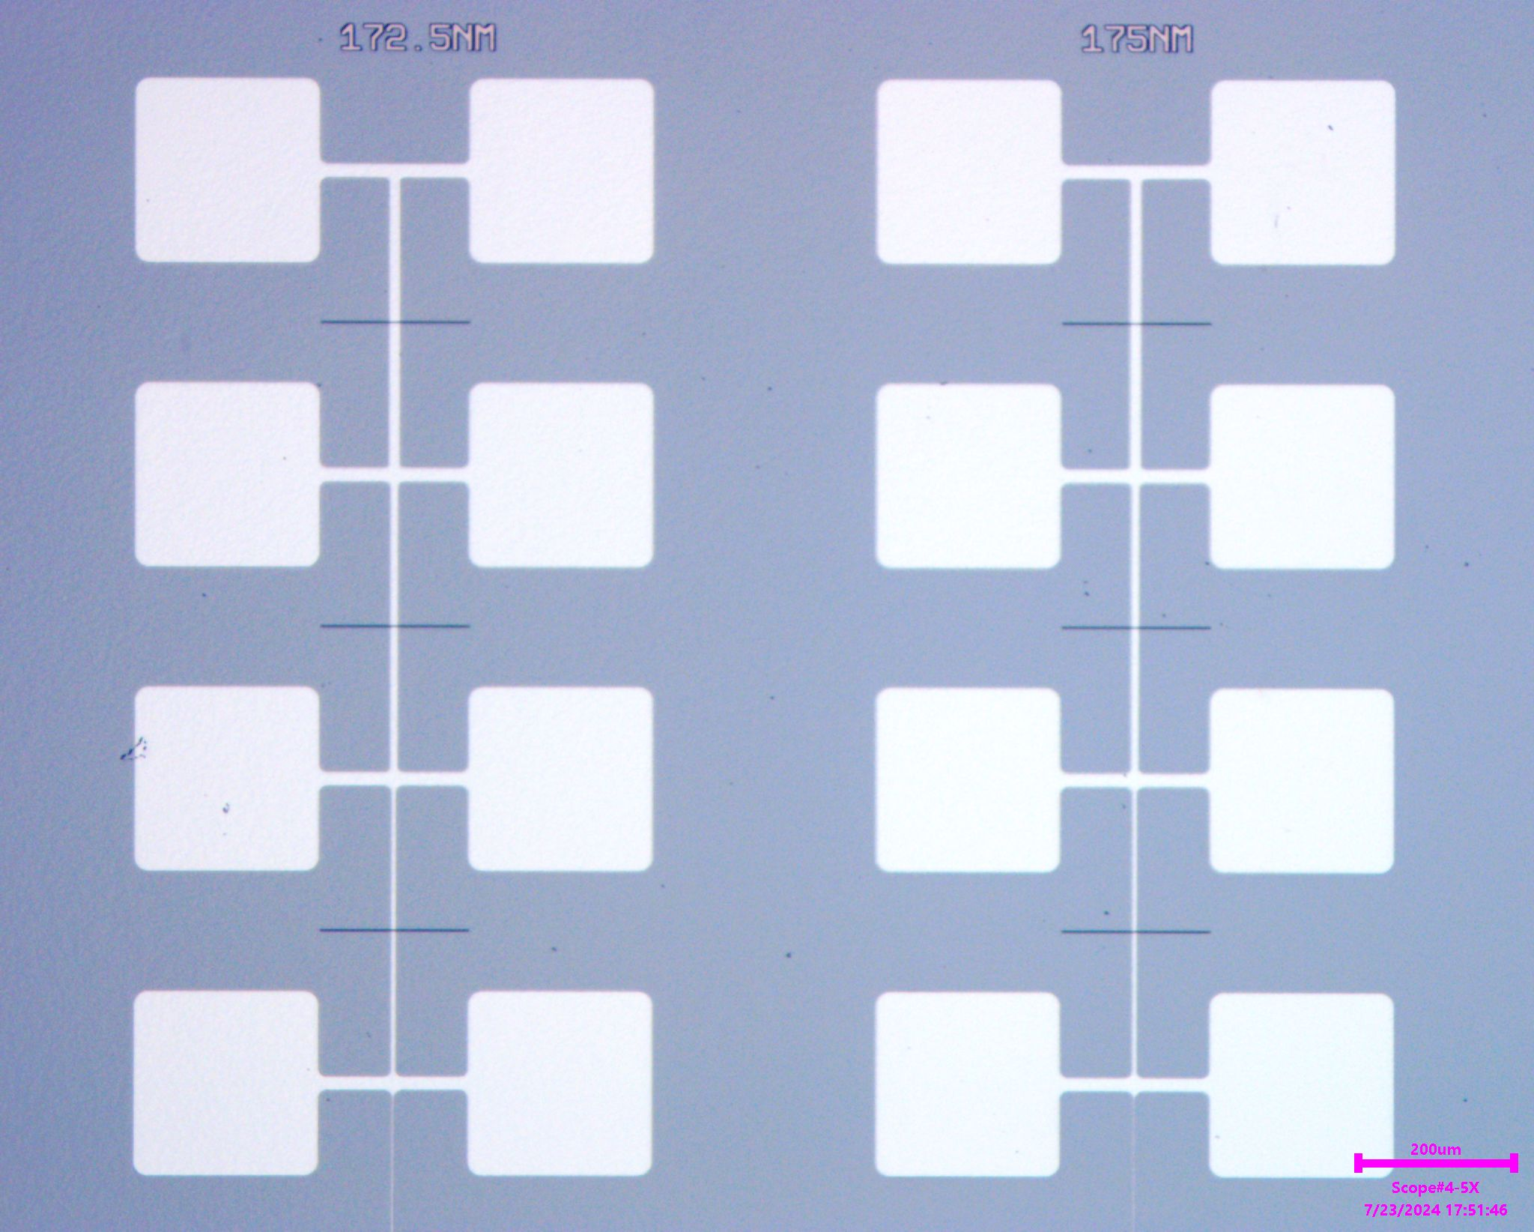
Experimental setup Al/Si/Al Josephson junction
*
Ti/Au contact
$$I_{+}$$
$$V_{+}$$
Current bias measurements
Probe tunneling
Si fins approximately same thickness
Various junction areas
Si fin
$$I_{−}$$
$$V_{−}$$
Al
* Images courtesy of Teun van Schijndel.
14/17
PALMSTRØM GROUP UC SANTA BARBARA

Slide 15
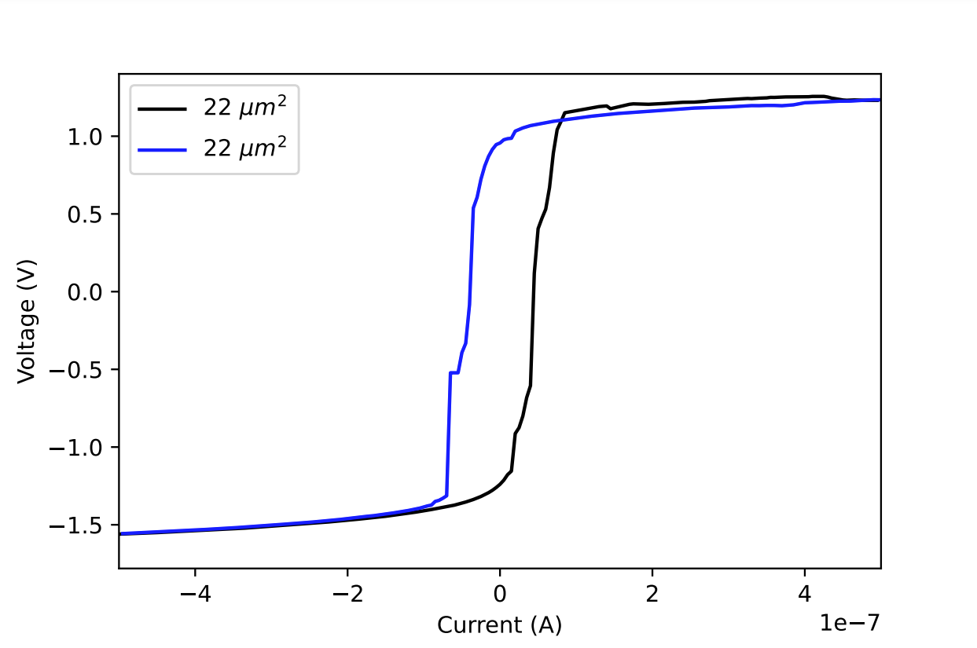
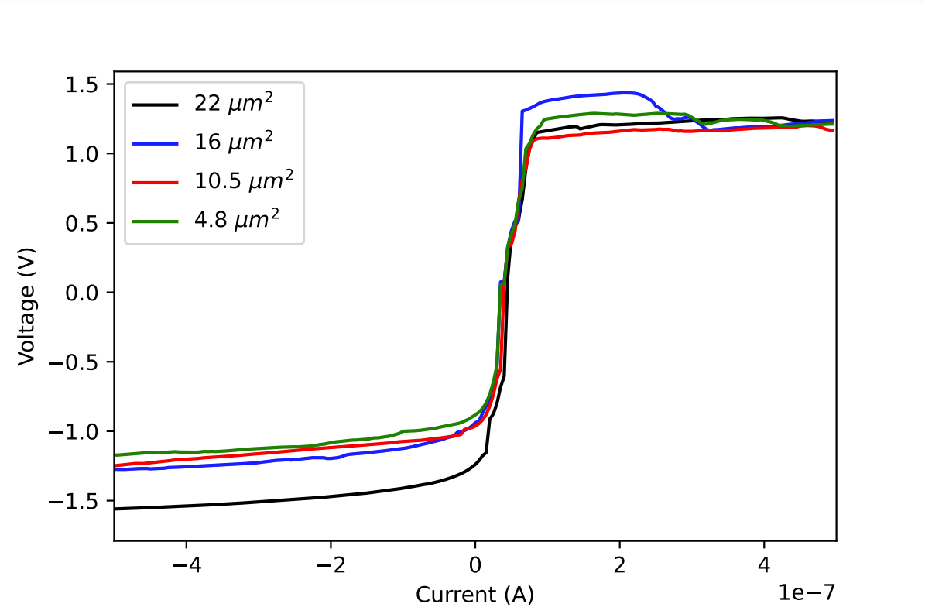
Current bias measurements at ~ 120 mK
Conclusion: No evidence of tunneling in our samples
15/17
PALMSTRØM GROUP UC SANTA BARBARA
Notes:
As I have been saying, we want to test the capacitive and tunneling properties of our junctions, and so we created some IV plots based on current bias measurements. On the left, we have an IV plot of voltage against current bias for our thickest junction. You’ll immediately notice that there are no flat (zero slope) parts of the graph, indicating that we are not in the superconducting regime. The two differences in these plots are due to an up sweep of current, and a down sweep of current. There is some hysteresis which I think is bad for a capacitor. Other then the hysteresis, looks like a standard plot for capacitor.
On the right, I have the IV plots for various junction areas. Areas span from about 20 um^2 to only a few um^2. You can see that for all samples measured, there is no evidence of tunneling in our samples. We believe that the Si was on the order of 20 nm for these samples, which is too thick for tunneling. Based on calculations, it needs to be on the order of 10 nm.
Even though we see no tunneling, we can still try to extract some data from these samples. One thing that we can do is verify that our capacitance scales with area (I think this would make sure we don’t have a leakage current or something in our samples)

Slide 16
Outlook
Alternative sample preparation of Ta/InAs sample
As rich top layer → tunability?
More IV plots with Al/Si junctions with thinner Si barriers
Evidence of tunneling/capacitive properties
Si${\text{N}}_{\text{x}}$
Al
Al
Si (substrate)
16/17
PALMSTRØM GROUP UC SANTA BARBARA

Slide 17
Acknowledgements
Special thanks to
Professor Chris Palmstrøm
Teun van Schijndel
Professor Sathya Guruswamy
Palmstrøm Lab
Work supported by NSF REU grant PHY-2349677
17/17
PALMSTRØM GROUP UC SANTA BARBARA

