Slide 1
Tracking the Directionality of Nuclear Recoils in Gaseous Argon
By: Nathan Pando (UC Irvine)
Advisor: David Caratelli

Slide 2
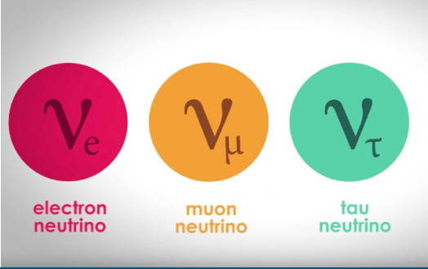
What are Neutrinos?
Very light weakly interacting particles
Only interact via weak force and gravity
Difficult to detect
3 types each corresponding to a different lepton

Slide 3
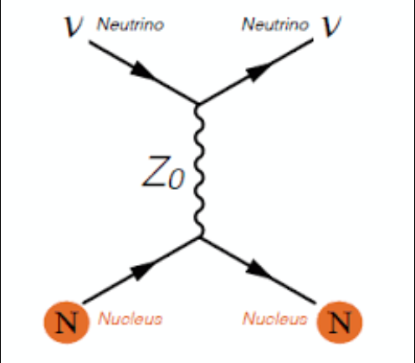
CE𝝂NS
Interaction
Coherent Elastic Neutrino Nucleus Scattering (pronounced “sevens”)
Neutrinos interact with an entire atomic nucleus via exchange of Z boson
Nucleus recoils at energies ~(10-100) keV

Slide 4
Why Study CE𝝂NS?
CE𝝂NS is predicted by the standard model and has been detected before only recently, but we’re not able to track its directional dependence
Can lead to a better understanding of neutrino physics
Can directly measure the energy spectrum of neutrinos
Scattering could be mediated by non standard model particles
Could be used to probe the existence of sterile neutrinos
Astrophysical neutrinos serve as a background in dark matter searches
Can also potentially probe neutron distribution of atoms
Notes:
Large cross section compared to other neutrino interactions.
Some have proposed that perhaps unknown intermediate bosons could mediate cevns
Cevns happens among all neutrino flavors
At notice the rates that cevns occurs at certain distances and energy scale

Slide 5
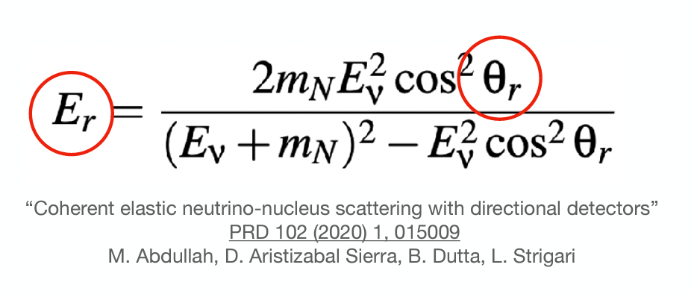
Recoil energy as a function of scattering angle and neutrino energy
CE𝝂NS differential cross section as a function of nuclear recoil energy
Term proportional to proton charge drops out in weak nuclear charge

Slide 6
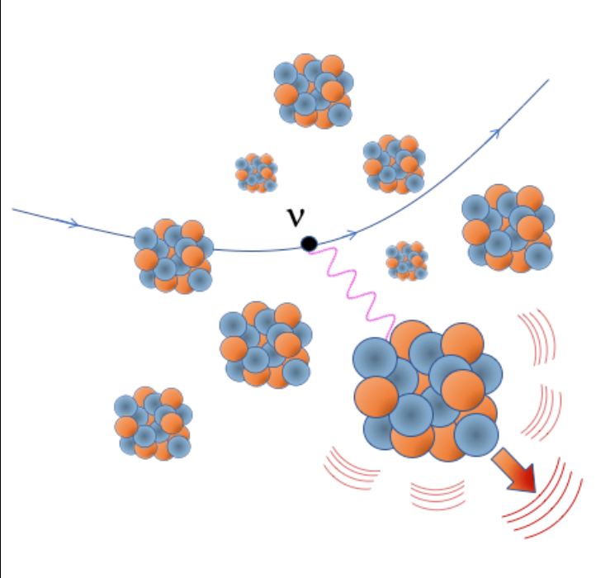
Detecting CE𝝂NS
CE𝝂NS produces an observable signature in the form of the energy deposited into the target material by the recoiling atom
Energy can go into creating secondary recoils, phonons (heat), and photons

Slide 7
Goals for this Project
To analyze how the initial recoil distributes its energy into the target
We specifically want to create a map of ionization charge deposition points as the nuclear recoil moves through the target medium
The Stopping and Range of Ions in Matter (SRIM) simulation tool provides information about how the energy from the initial recoil is distributed into the target
This information will give us insight into what kind of detector we should build to detect the directionality of CE𝝂NS

Slide 8
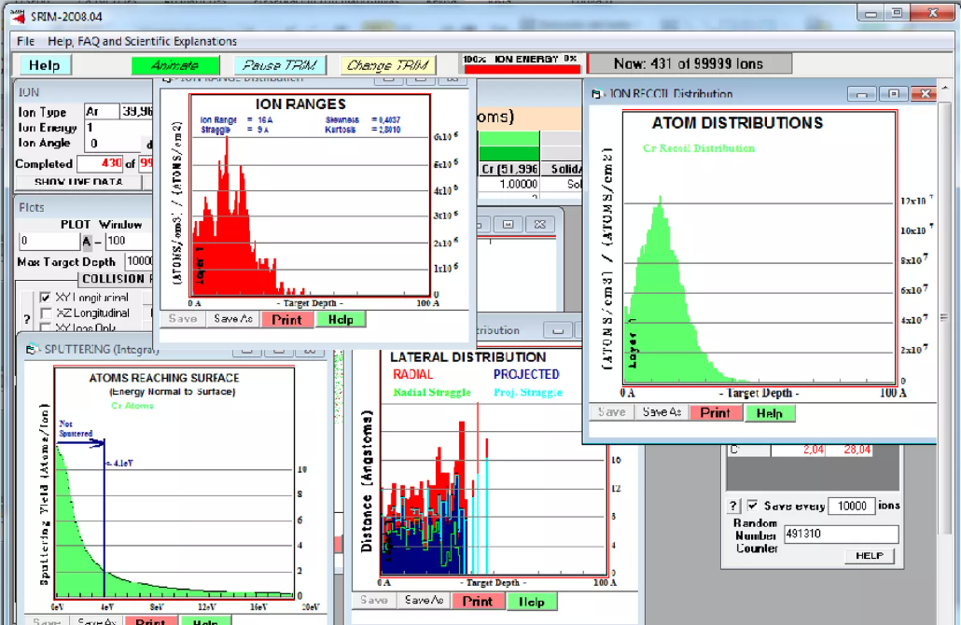

Slide 9
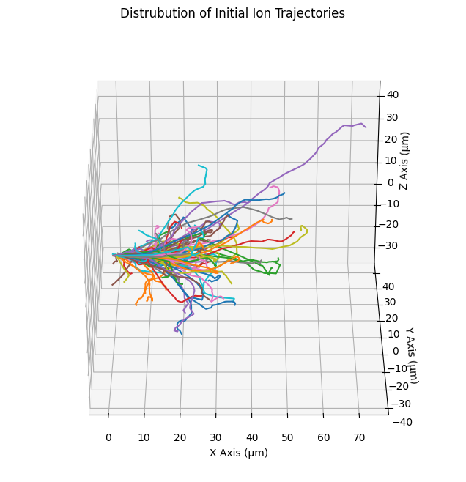
Initial recoil doesn’t follow definite path
Important to first get a sense of the spread of the distribution of trajectories
The example on the right is for an initial recoil at 10 keV for 100 events
Each line represents an individual recoil simulation

Slide 10
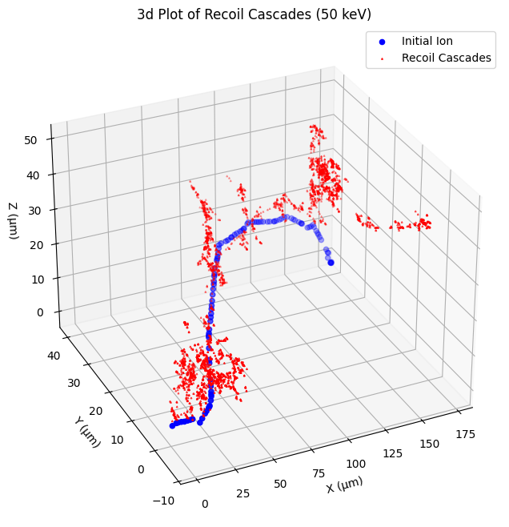
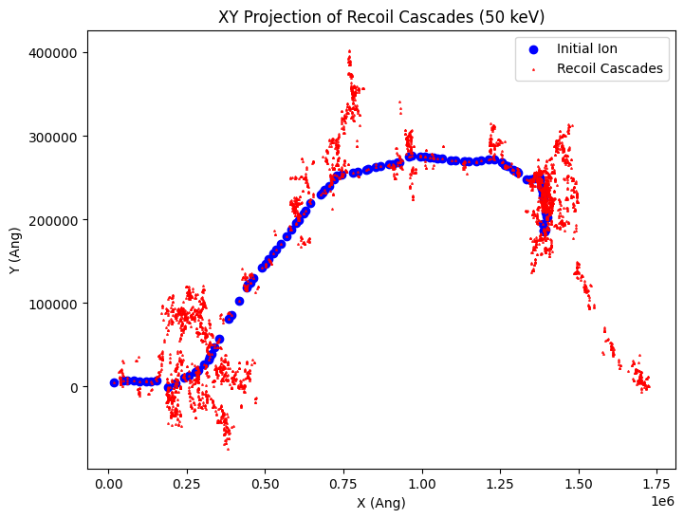
Tracking Nuclear Losses
end
start

Slide 11
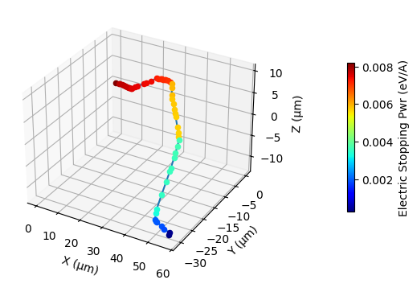
Electronic Energy Losses
In order to get a readout from the detector, tracking the energy deposition into target electrons is key
SRIM can provide information about how energy is deposited into the target electrons
Demonstrates that most electronic energy loss occurs the beginning
Example plot of Ionization energy
(incident ion 40 keV)

Slide 12
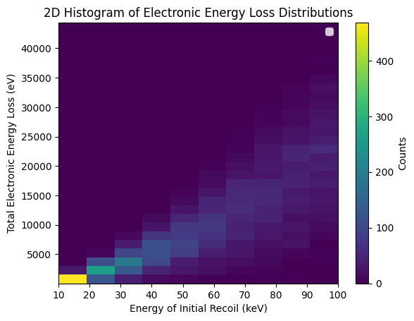
Energy Resolution Studies
2d distribution of total integrated energy losses per initial recoil energy
Each column follows a normal distribution
Standard deviation gets larger as the energy increases

Slide 13
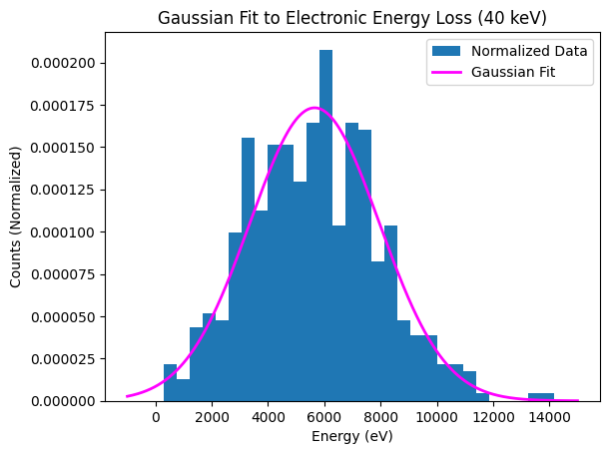
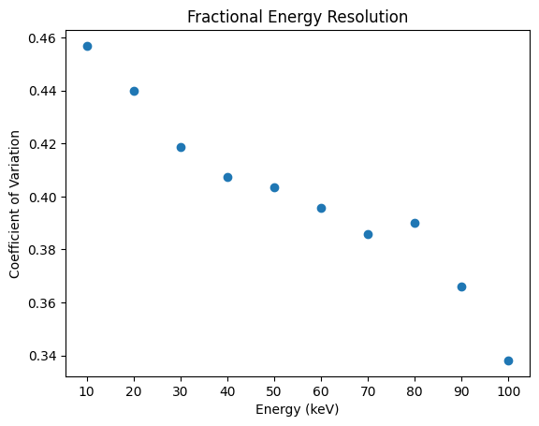

Slide 14
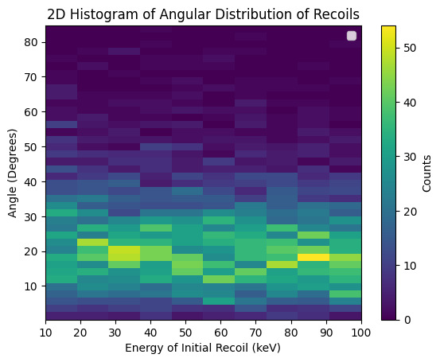
Angular Resolution Studies
At what angle does the recoil deflect for each energy?
Seems to peak at around 20-25 degrees for each energy
Angle between weighted vector sum and initial direction

Slide 15
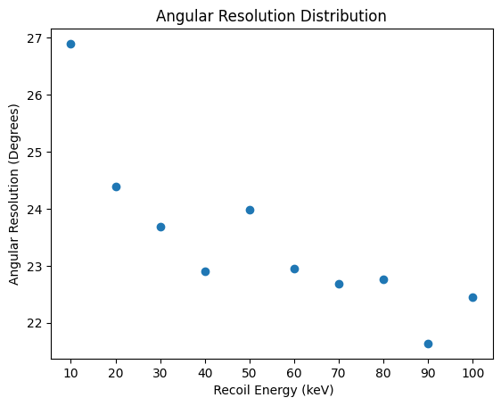

Slide 16
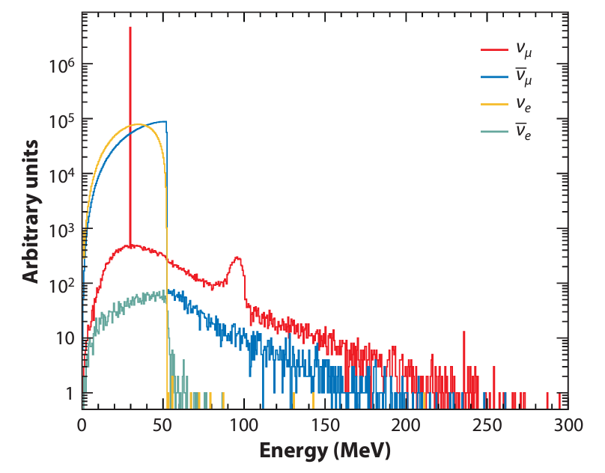
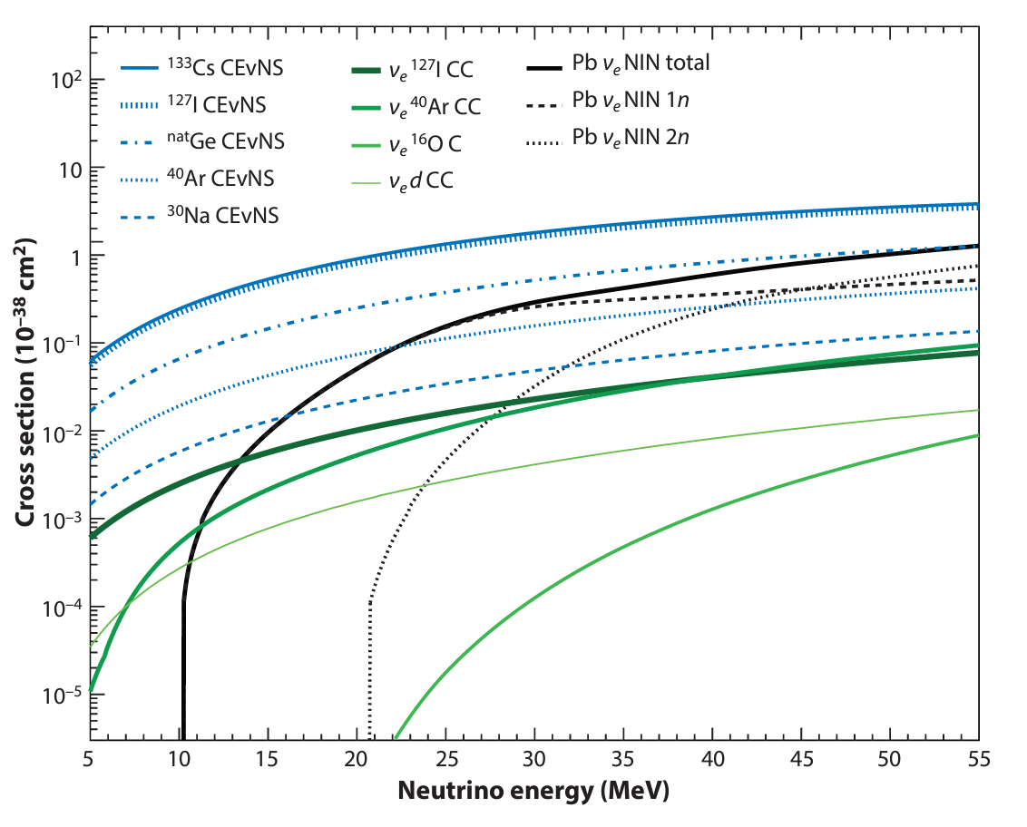
Calculation of Recoil Spectrum
It's useful to do a preliminary calculation to see how many recoils we get for a given recoil energy

Slide 17
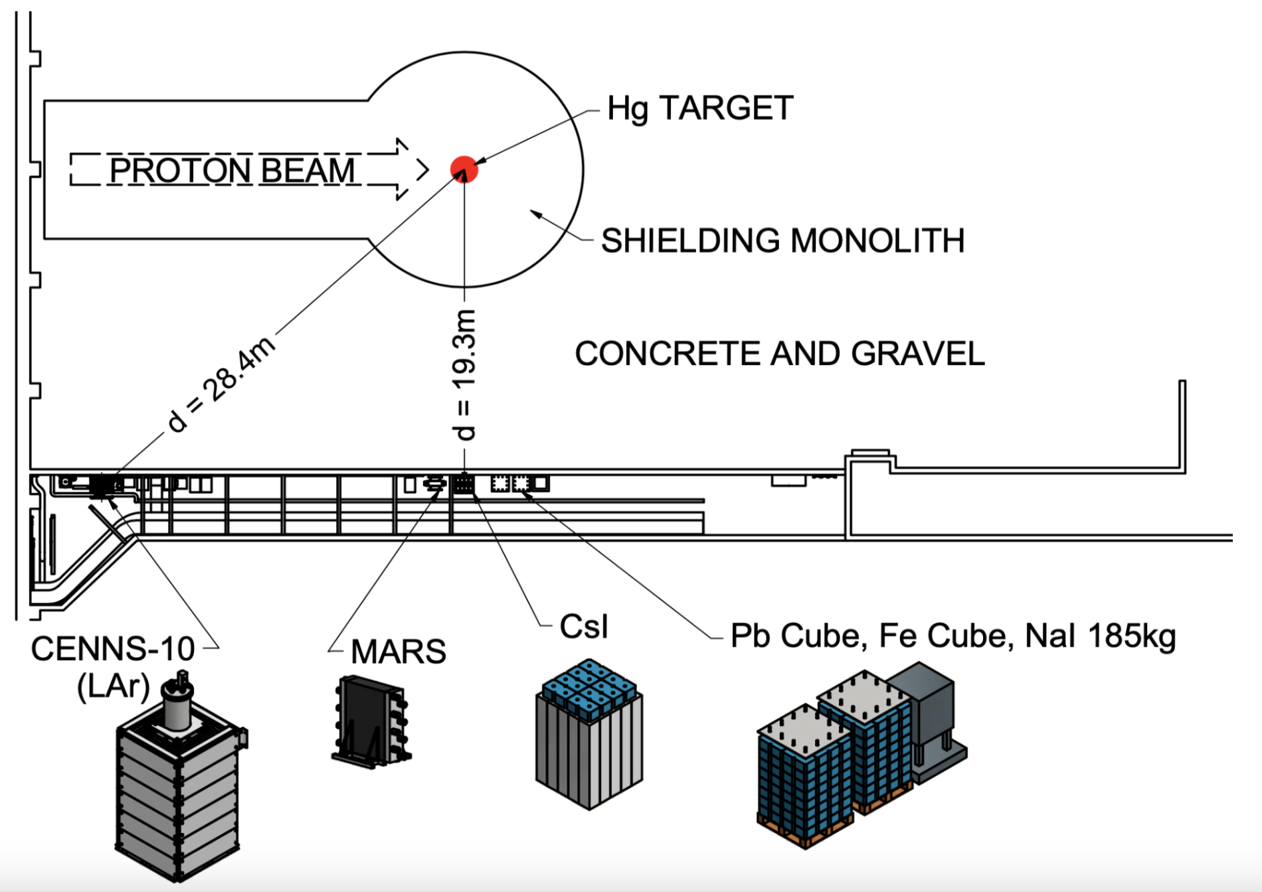
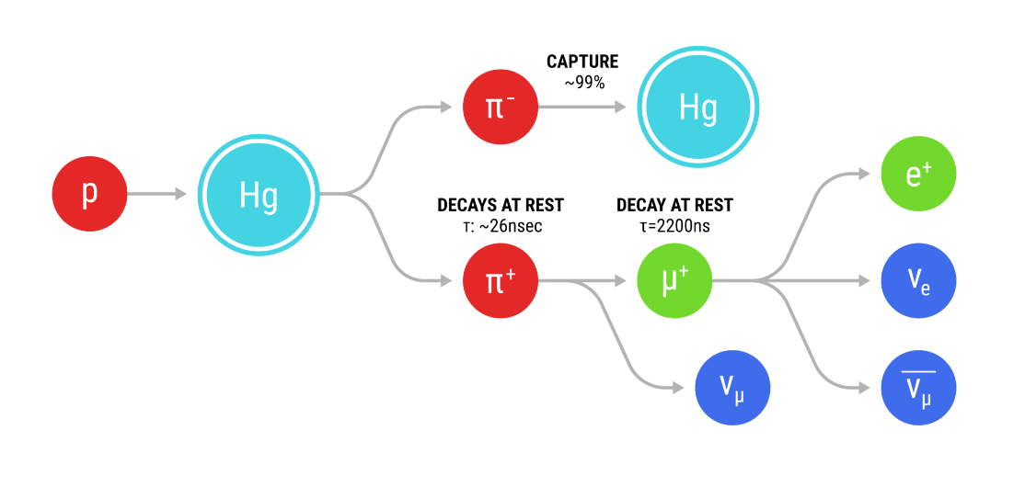
Neutrino Source
Spallation Neutron Source (SNS) at Oak Ridge National Laboratory
Fires protons at a liquid mercury target
Produces pions which decay at rest into an antimuon and muon neutrino
The antimuon then later decays into a positron, electron neutrino and a muon antineutrino

Slide 18
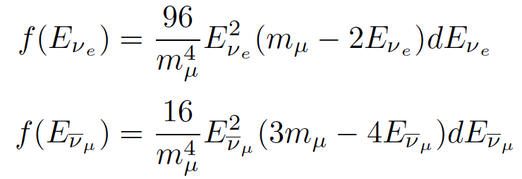
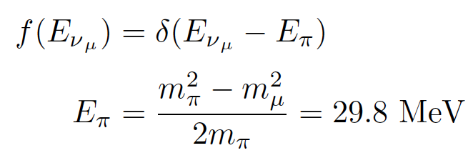
Essential Formulas
C ~ 10^7 neutrinos/cm^2/sec (at a target 20m away)
N_{t} - Varies by detector size and medium

Slide 19
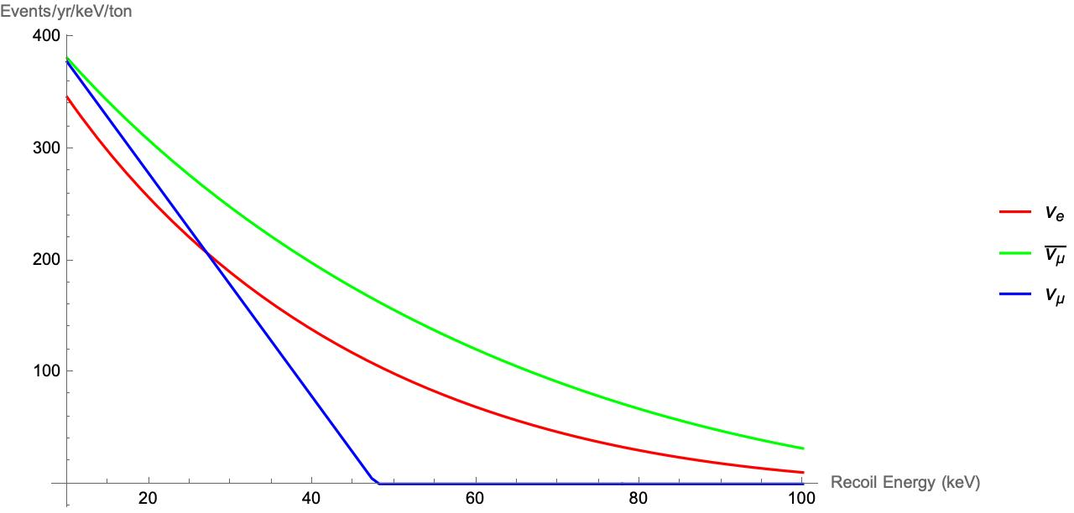
Event Rate Plot

Slide 20
Acknowledgements
Prof. David Caratelli, Faculty Advisor
Alexander Antonakis, Graduate Student Mentor
Prof. Sathya Guruswamy, REU Coordinator
This work was supported by:
National Science Foundation (NSF) REU grant PHY-2349677

