Slide 1
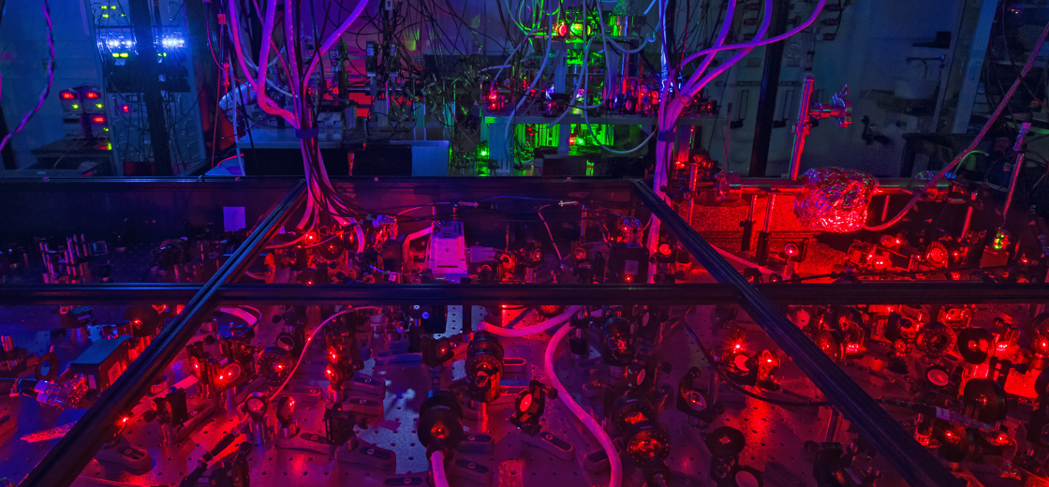
Simulating High-Harmonic Generation with Ultracold Atoms
Daniel Harrington, Tufts University
UC Santa Barbara, Department of Physics – David Weld Group

Slide 2
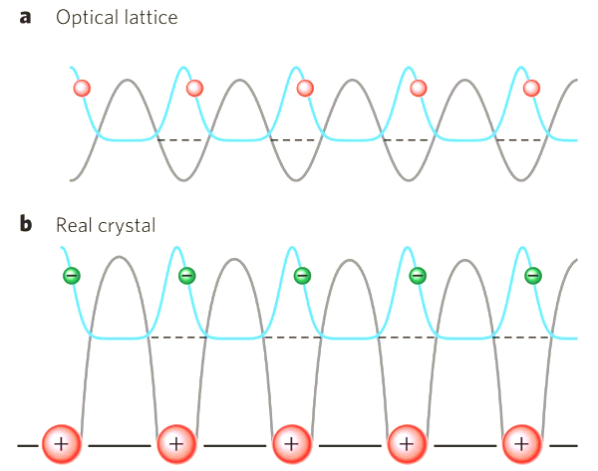
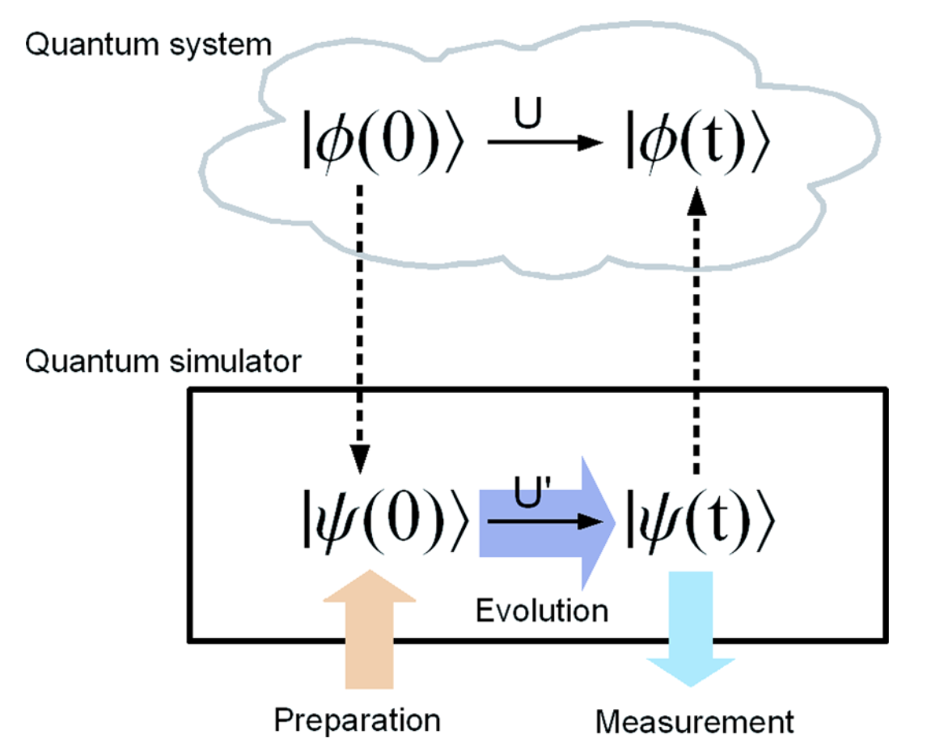
Quantum Simulations with Ultracold Atoms
Simulating physics with atoms
Same Hamiltonian
Same physics
I. M. Georgescu, S. Ashhab, and Franco Nori. Rev. Mod. Phys. 86, 153
Greiner, M., Fölling, S. Nature 453, 736–738 (2008).

Slide 3
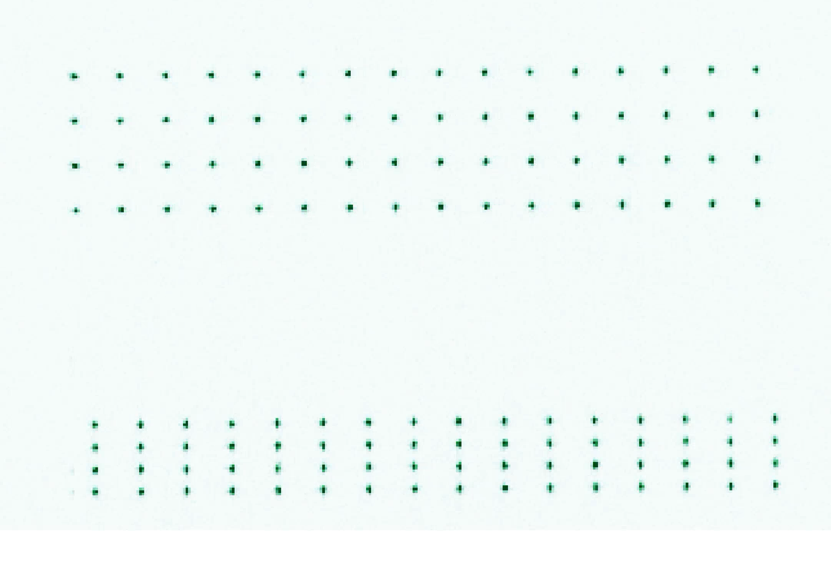
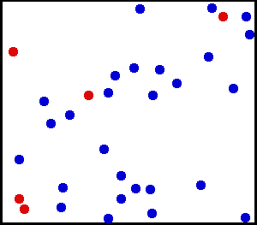
Quantum Simulations with Ultracold Atoms
Why cold atoms?
Hot. T ~ room temp.
High energy, cannot trap or control.
Rb cooled to T = 20 μK. Precise trapping and control.
3
https://en.wikipedia.org/wiki/Kinetic_theory_of_gases
Bluvstein, D. et al. Nature 626, 58–65 (2024)

Slide 4
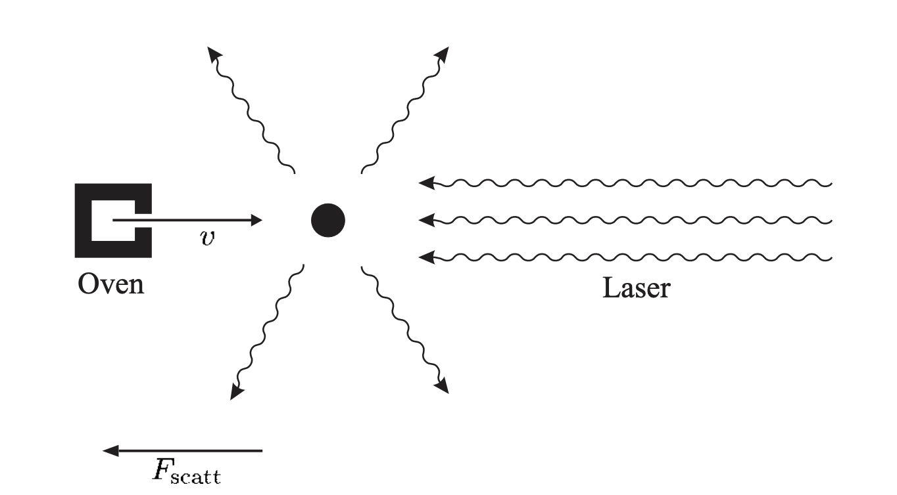
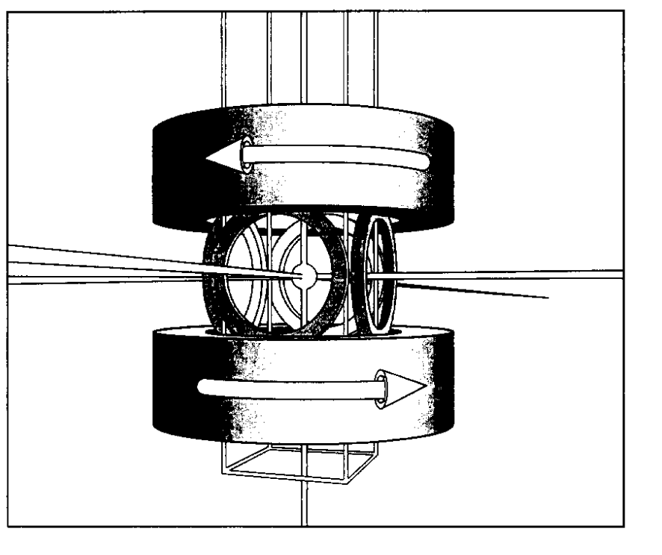
Quantum Simulations with Ultracold Atoms
Cooling and trapping
(1) Slow down hot, high-speed atoms
(2) Trap and cool further (various methods)
Magneto-optical trap (MOT)
4
Foot, C. Atomic Physics. (Oxford University Press, 2005).
Wieman, C. E. American Journal of Physics 64, 847–855 (1996).

Slide 5
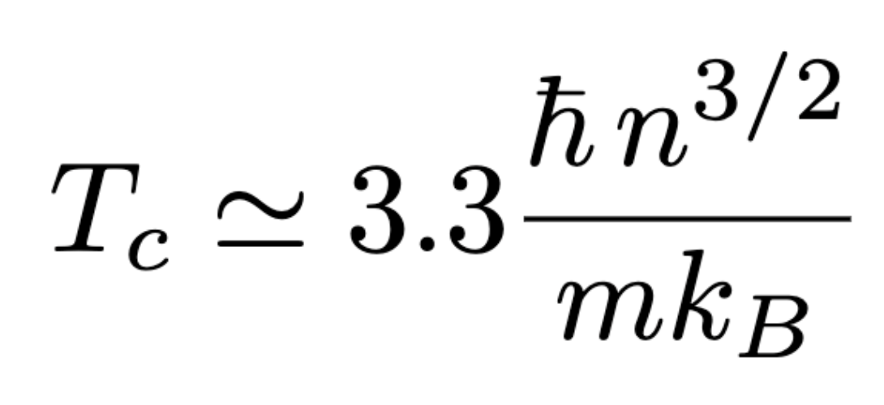
Quantum Simulations with Ultracold Atoms
Bose–Einstein condensation
When cold enough (T < T_{C}), atoms all “condense” to the same ground state due to Bosonic nature
Momentum distributions
Group of atoms described by a single macroscopic wavefunction
Easy experimental access to fast, complex quantum phenomena
Decreasing temperature
5
Schroeder, D. V. An Introduction to Thermal Physics. (Addison Wesley Longman, 2000).
Wieman, C. E. American Journal of Physics 64, 847–855 (1996).

Slide 6
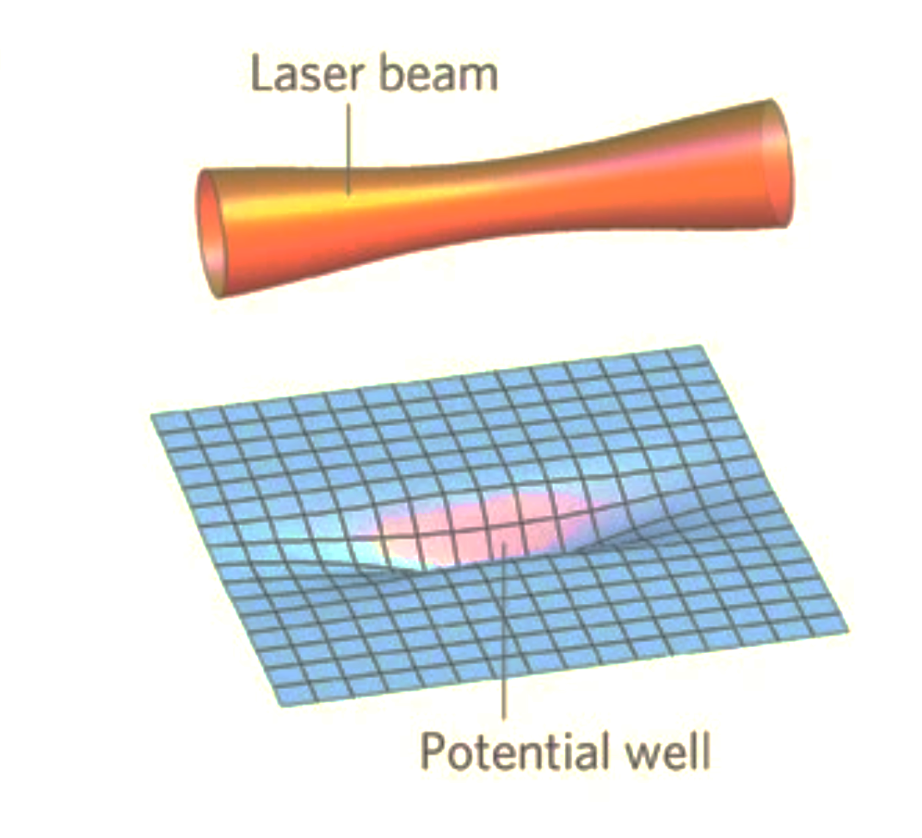
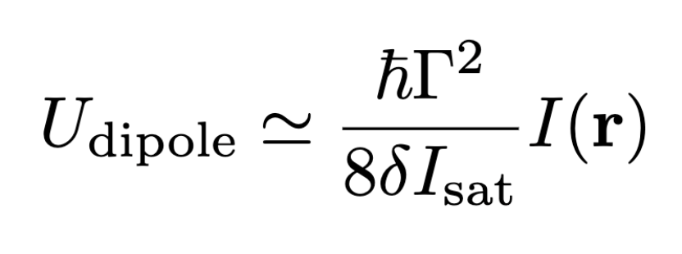
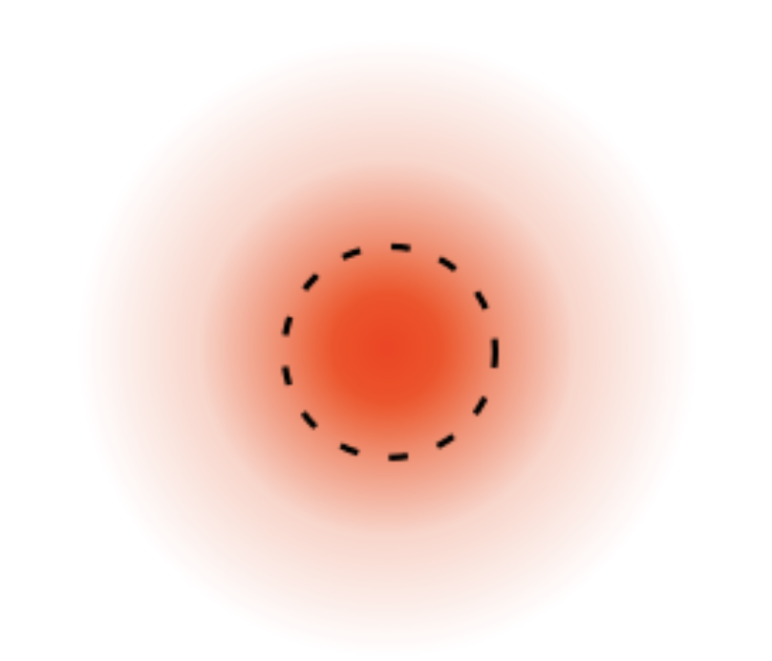
Quantum Simulations with Ultracold Atoms
Forces from light
Optical Dipole Force – potential energy U depends on light intensity I
depends on atom,
transition, light freq.
Beam intensity, I
Used for trapping and to simulate forces in nature
6
Foot, C. Atomic Physics. (Oxford University Press, 2005).
Greiner, M., Fölling, S. Nature 453, 736–738 (2008).

Slide 7
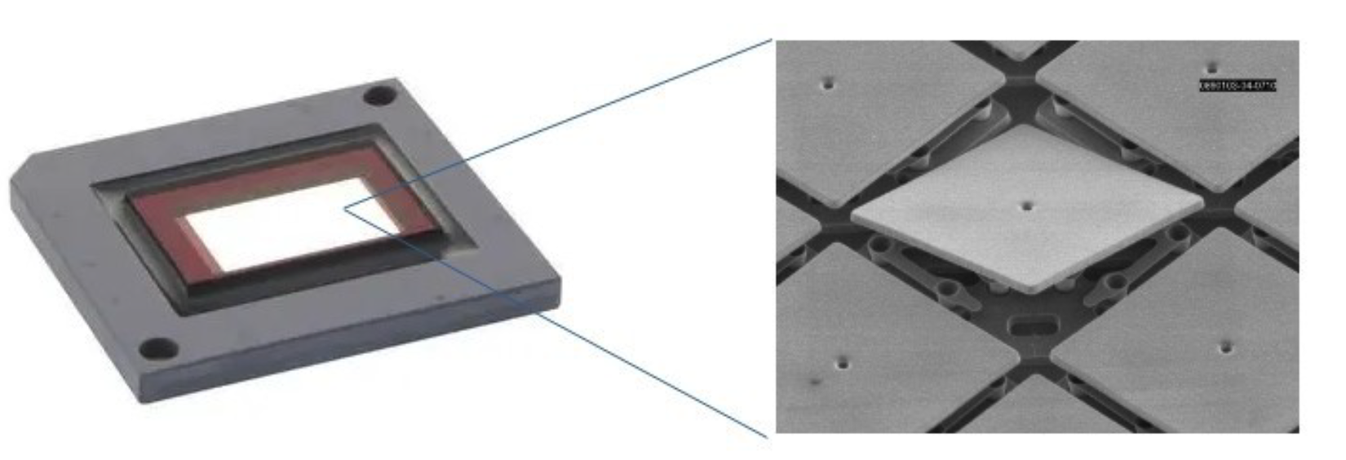
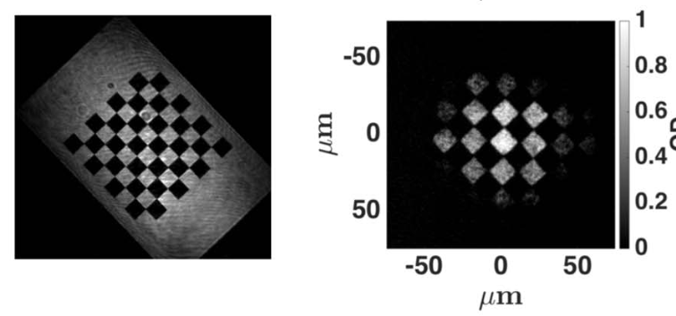
Quantum Simulations with Ultracold Atoms
Configurable optical potentials
Digital micromirror devices (DMDs) can make optical potentials by shaping reflected light
Projected light
Atom density
Laser input
Image output
DMD
7
Gauthier, G. et al. Optica 3, 1136–1143 (2016).
https://www.evosens.fr/digital-micromirror-device/

Slide 8
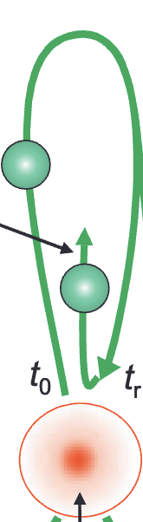
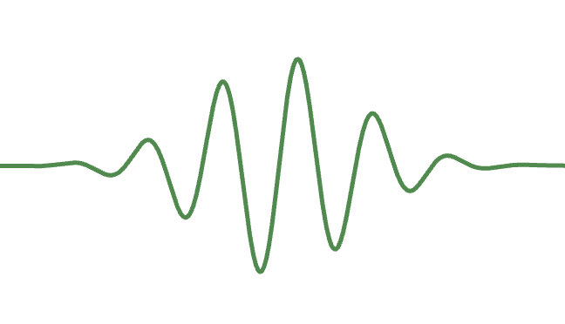
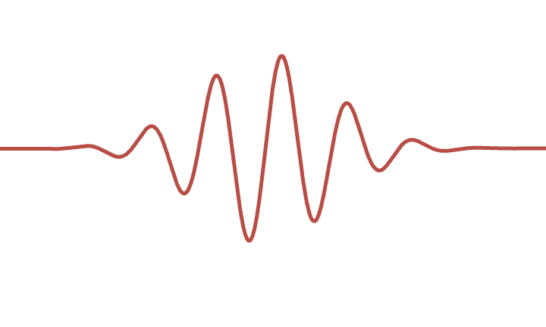
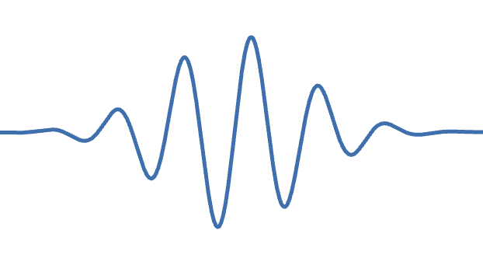
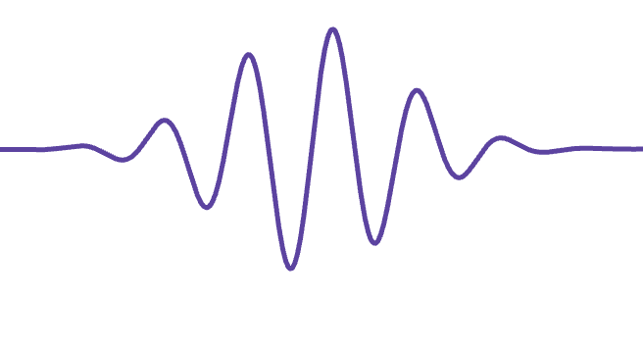
Quantum Simulations with Ultracold Atoms
Single atoms in intense laser fields
Ionized electron
High harmonic generation (HHG)
High intensity light
Atom
…
Goal: Simulate with cold atoms
8
Krausz, F. and Ivanov, M. Rev. Mod. Phys. 81, 163 (2009).

Slide 9
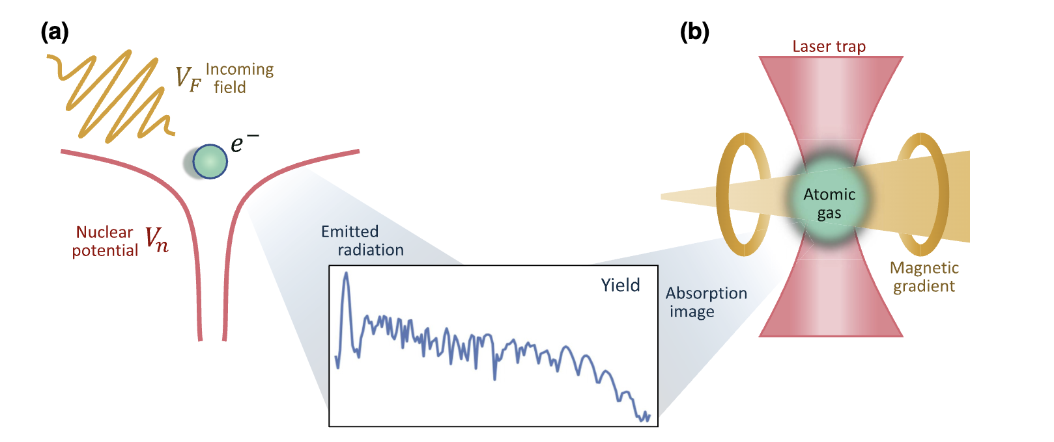

Quantum Simulations with Ultracold Atoms
Single atoms in intense laser fields
Optical gradient
Intensity
High Harmonic Generation: Dynamics to be simulated
Our simulation experiment
9
Argüello-Luengo, J. et al. PRX Quantum 5, 010328 (2024). [fig. modified]

Slide 10
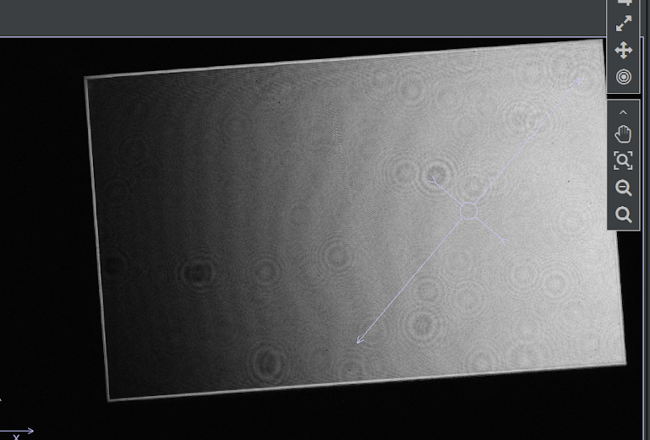
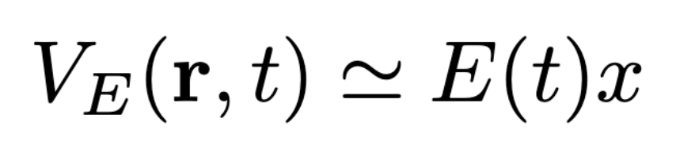
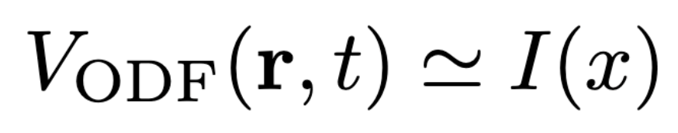
Configurable Optical Potentials
Implementation and progress
Want to simulate: Electron-light interaction
In our simulation experiment:
Raw DMD test output image
⁸⁴Sr Atoms
Laser
DMD
Imaging/Detection
10

Slide 11
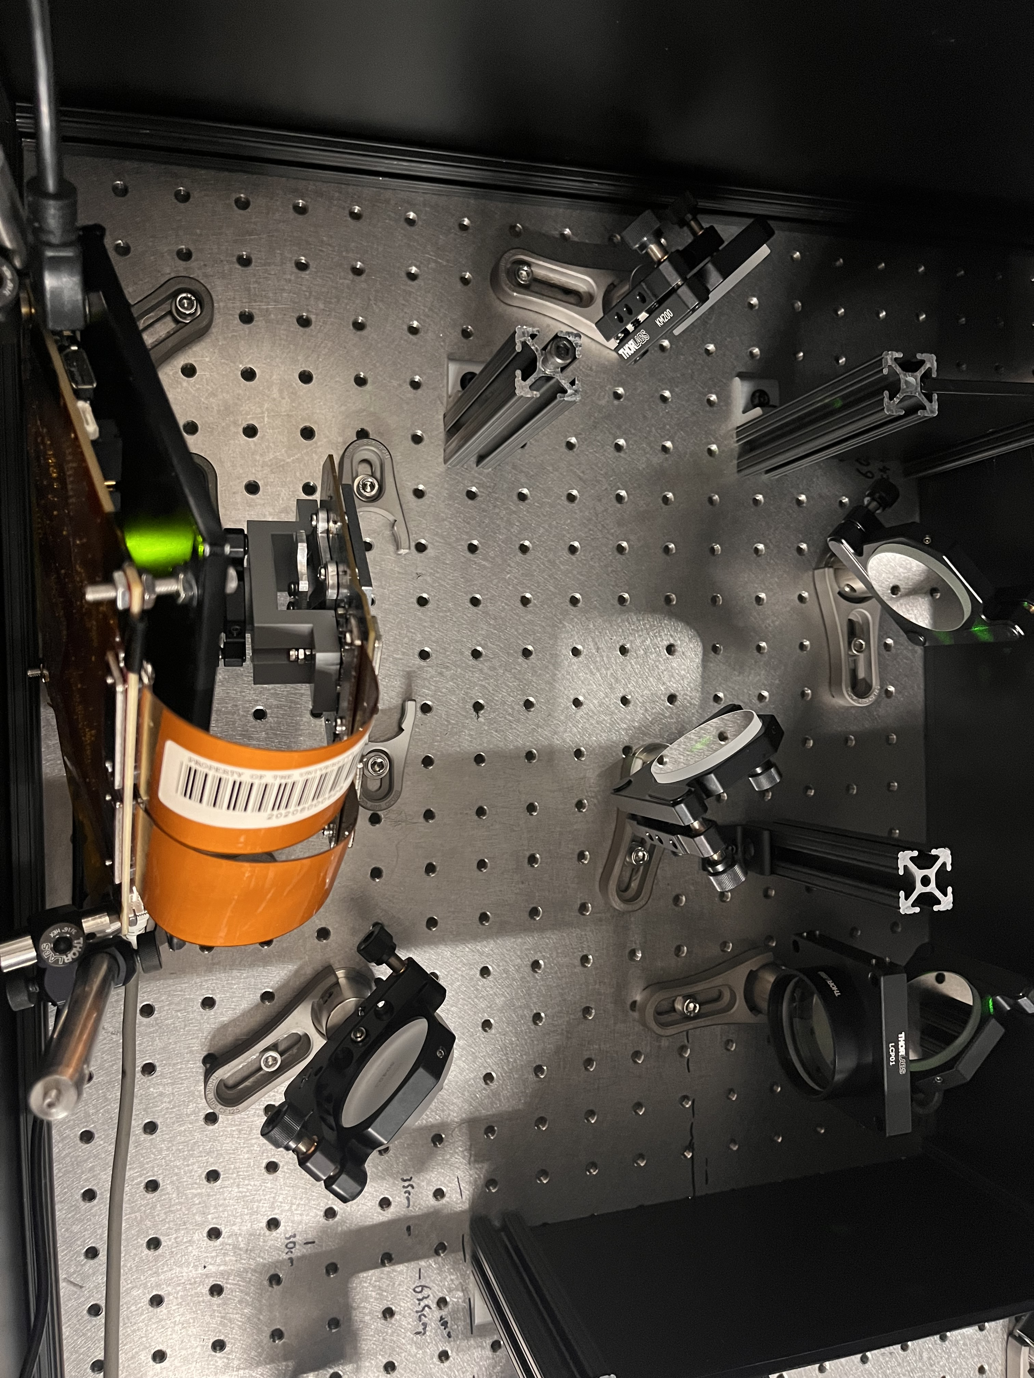
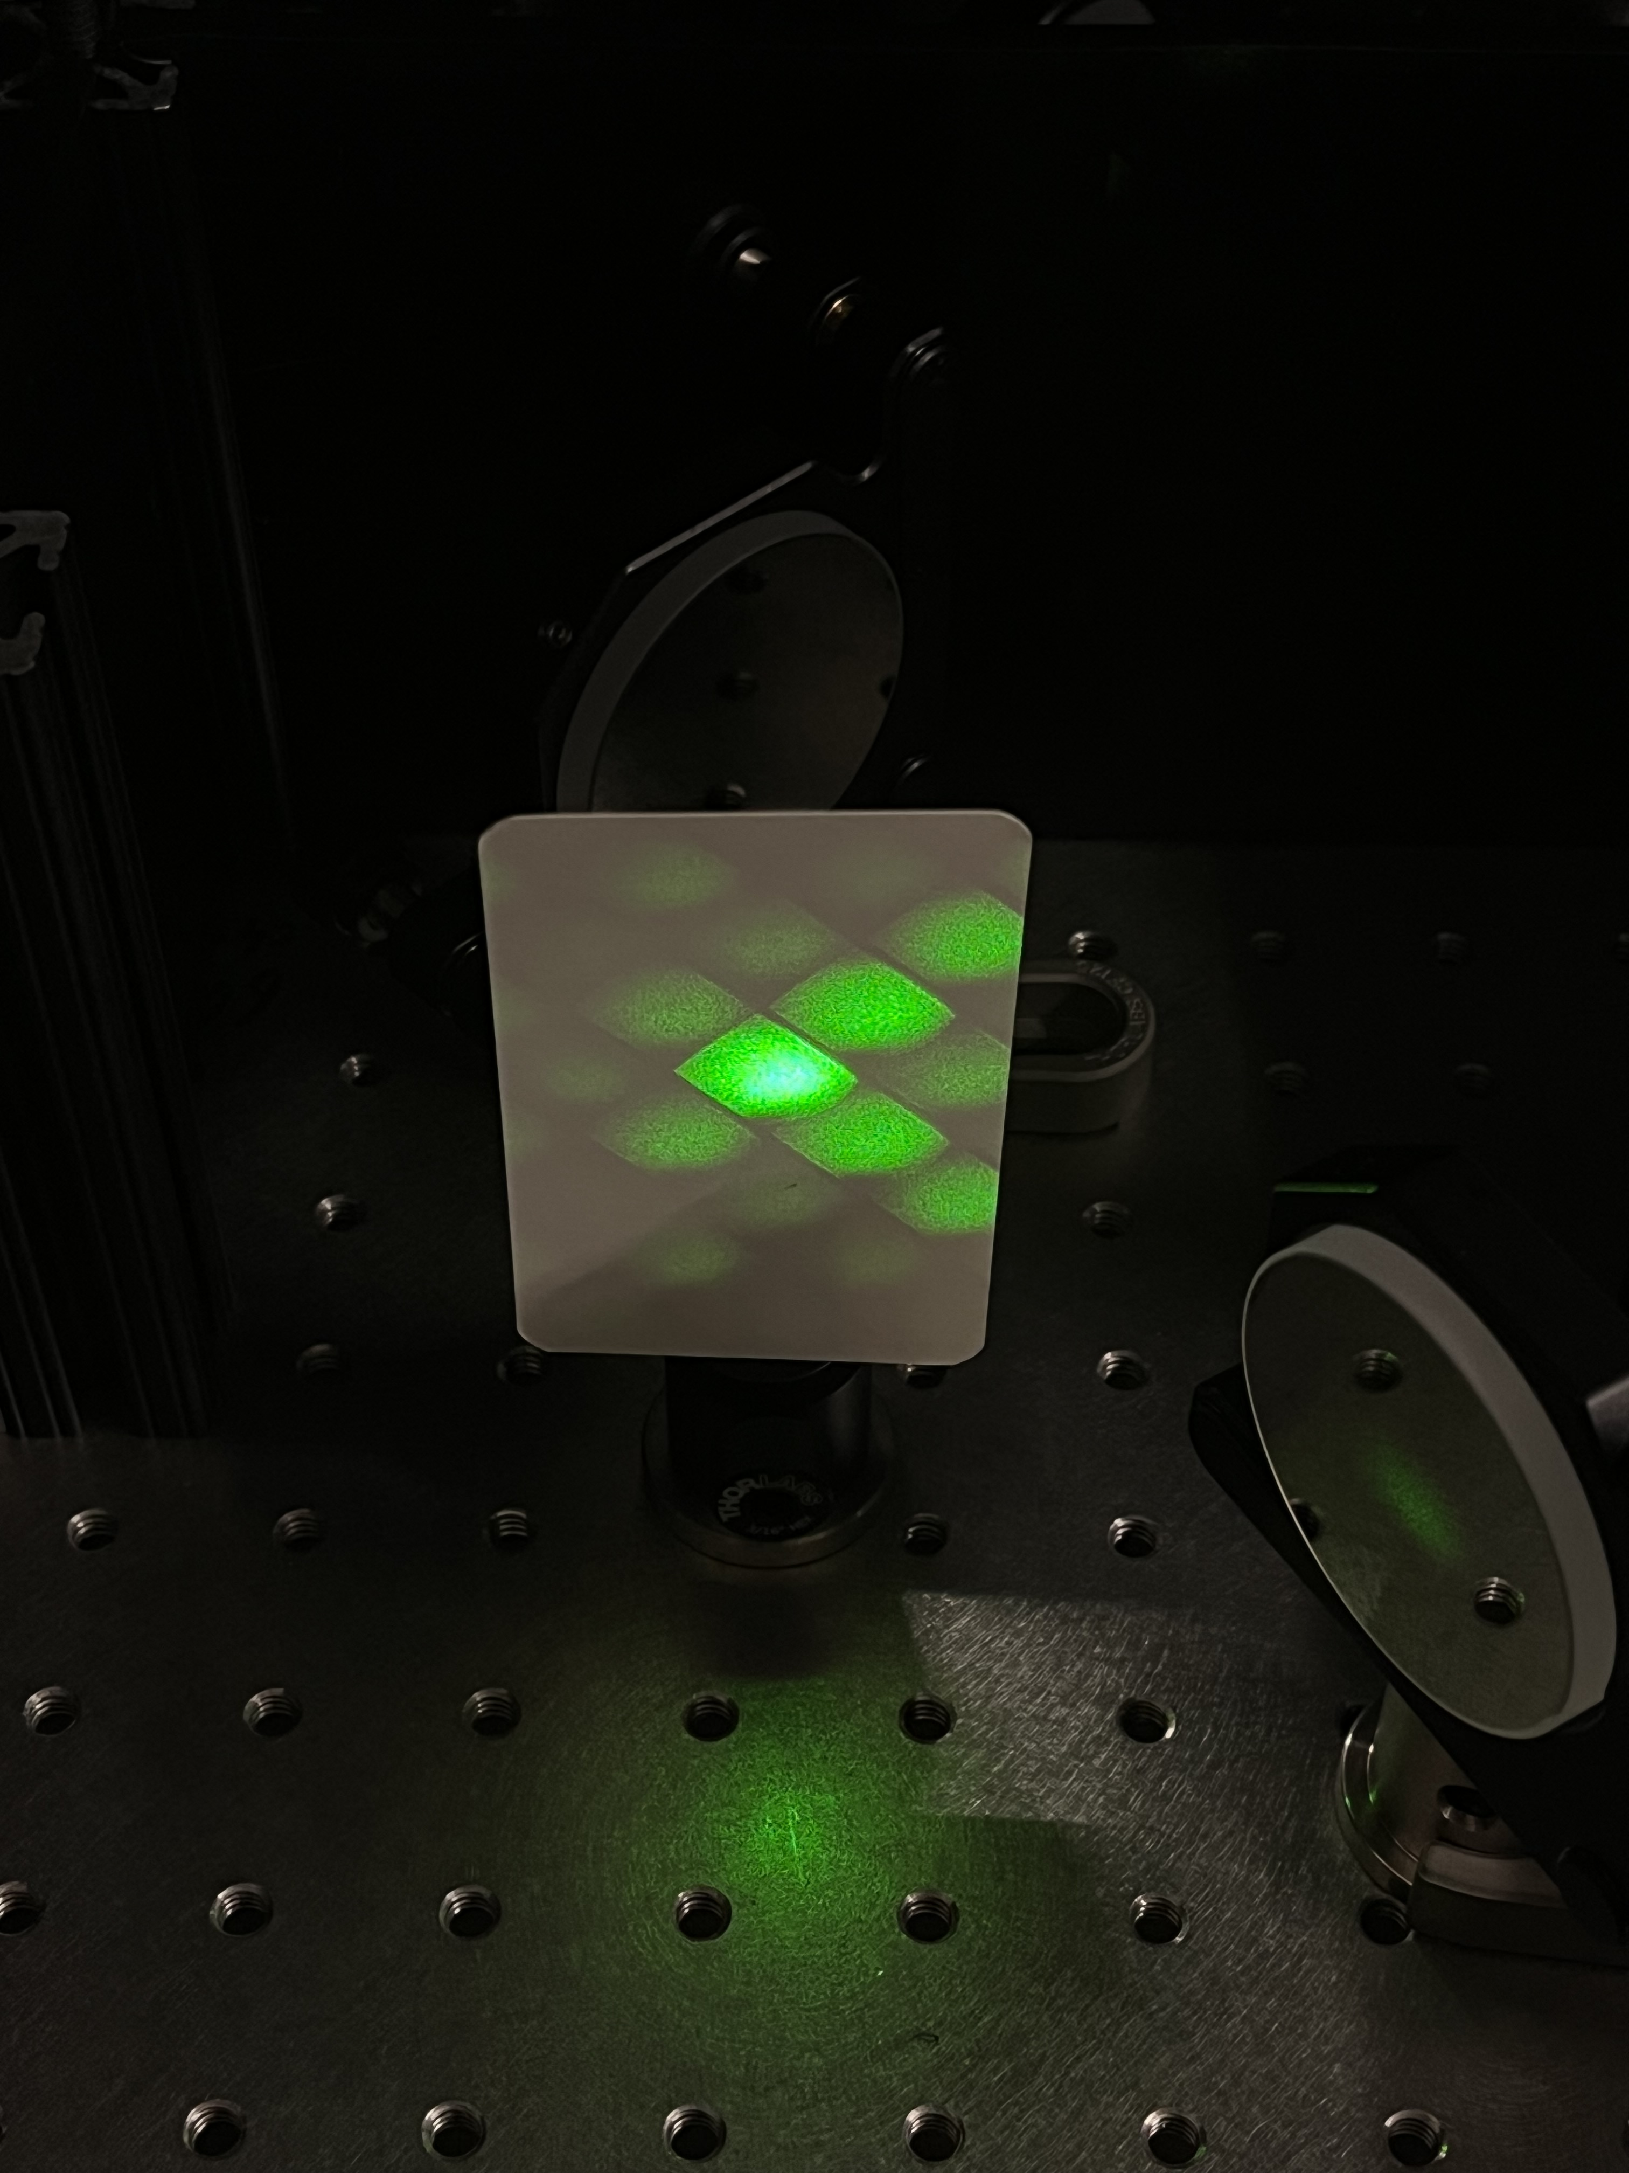
Configurable Optical Potentials
Experimental setup
DMD (bottom)
Diffraction lobes from DMD
11

Slide 12

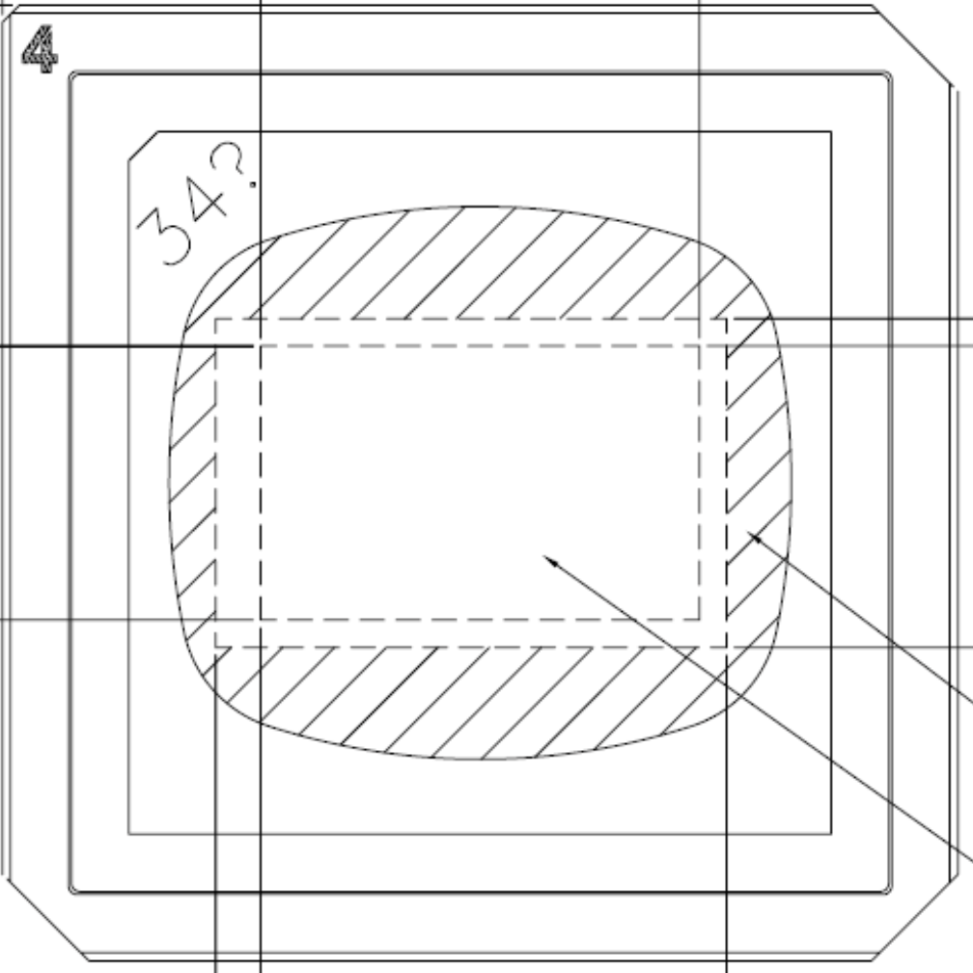
Configurable Optical Potentials
Dithering
Convert 8-bit image to binary values for DMD display
Input (continuous)
Dithered (binary)
DMD pixel status
12
https://en.wikipedia.org/wiki/Dither

Slide 13
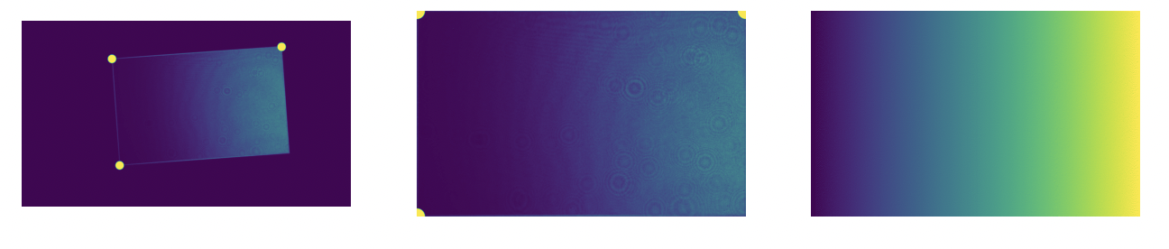
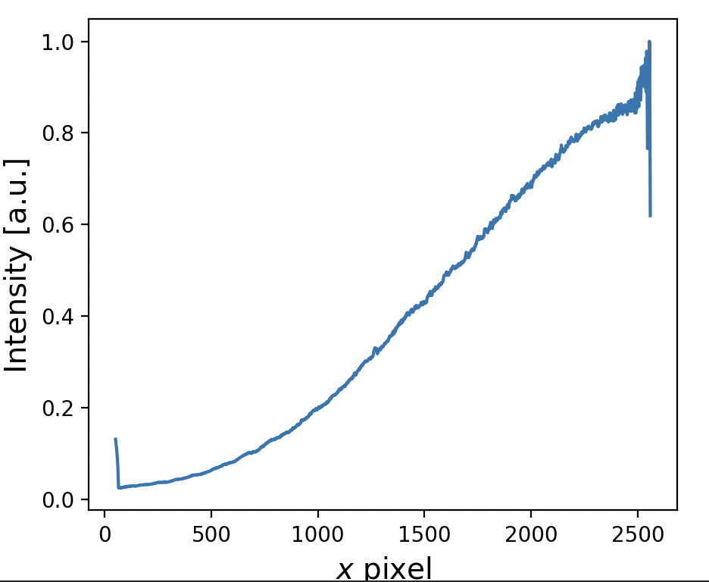

Configurable Optical Potentials
Image processing
From camera
Transformed
Target
Integrated x intensity
Transformed / solid field
13

Slide 14
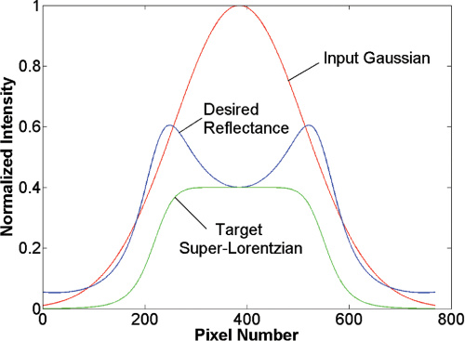
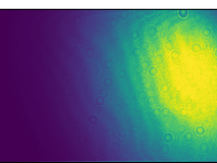
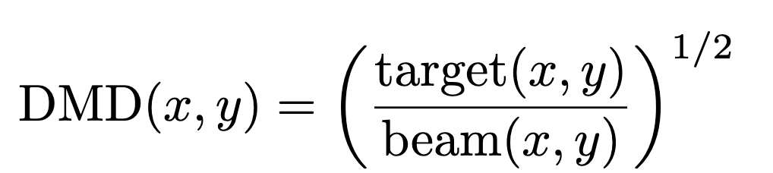
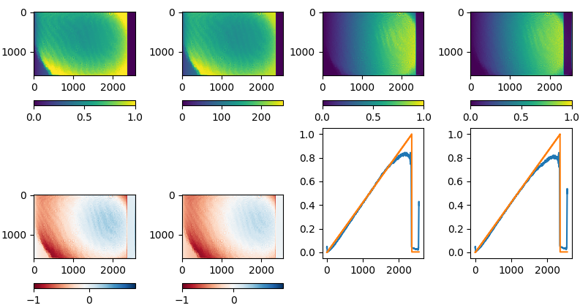
Configurable Optical Potentials
Beam corrections
Beam (x, y)
Target (x, y)
Measured intensity
14
Liang, et al. Appl. Opt. 48, 1955-1962 (2009)

Slide 15
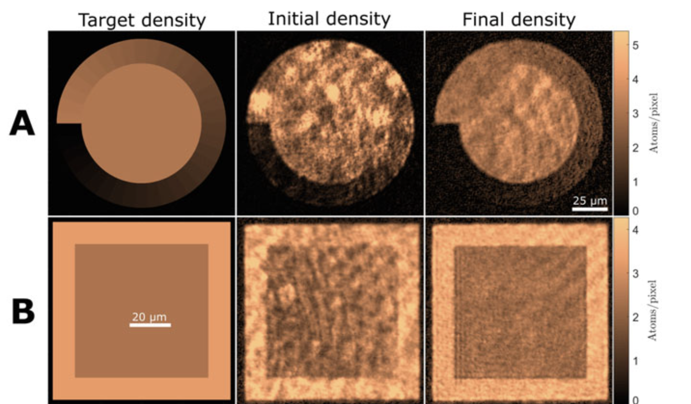

Configurable Optical Potentials
Feed forward optimization
Set DMD
Capture image
Make new pixel map
Compute error
DMD pixel state updating to account for
imperfections in optics or beam drift
15
Guillaume, Gauthier. PhD Thesis, Springer Nature (2020)

Slide 16
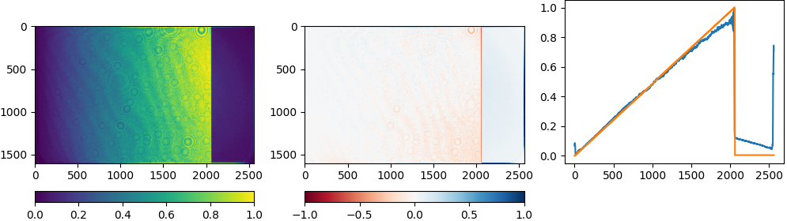
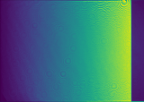
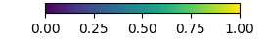
Configurable Optical Potentials
Feed forward examples
Error
Measured image
Without feed forward
With feed forward
16

Slide 17
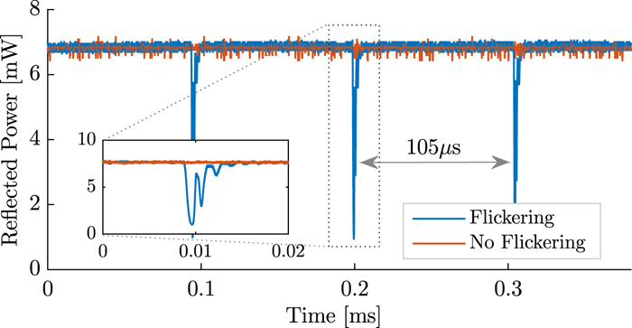

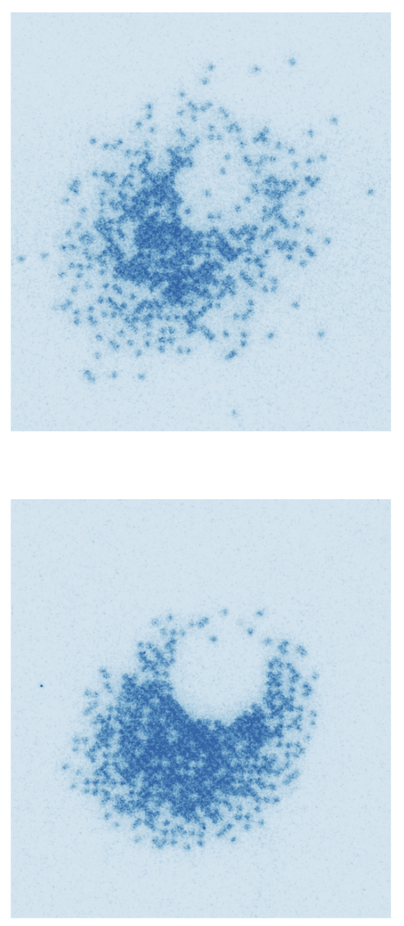

Configurable Optical Potentials
DMD mirror noise
With noise
Mirror motion noise
Without
DMD Controller
Mirror pulse
Interrupter circuit
DMD
17
Hueck, et al. Rev. Sci. Instrum. 88, 016103 (2017)
Mazurenko, Anton. PhD Thesis (2016)

Slide 18
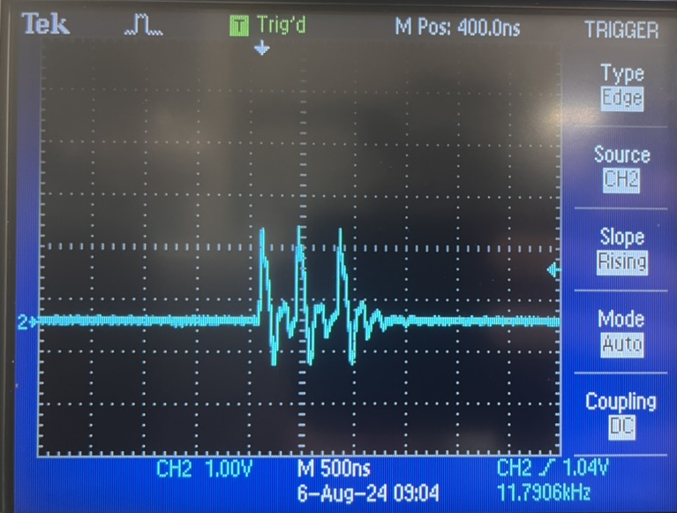
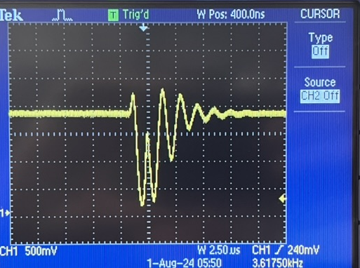
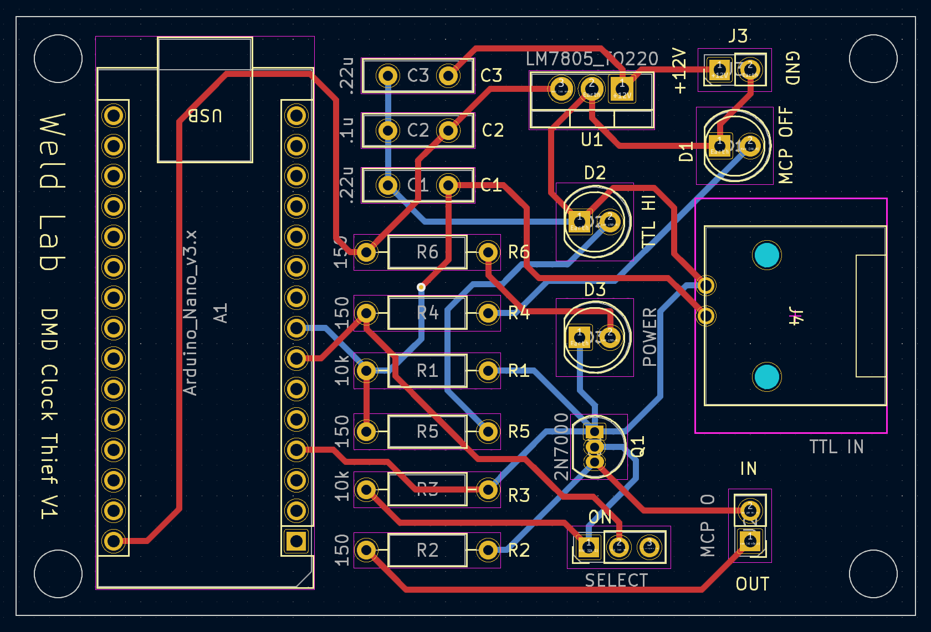
Configurable Optical Potentials
Ongoing progress
Mirror pulse
Measured light
DMD image optimization for maximum power
Pulse interrupter circuit
Installation on main machine
Quantum simulation experiments!
Pulse interrupter control circuit
18

Slide 19



Configurable Optical Potentials
Acknowledgments
Graduate Mentor: Anna Dardia
Faculty Advisor: David Weld
Additional thanks to: Yifei Bai, Toshihiko Shimasaki, Siddharth Mukherjee, Sathya Guruswamy
Work supported by NSF REU grant PHY-2349677
19

