Slide 1
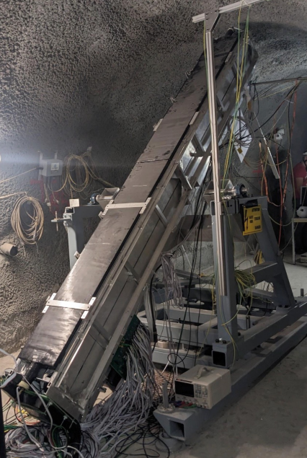
Can milliQan?
A search for millicharged
particles
Christina Dorofeev (University of Oregon)
Faculty Advisor: David Stuart
Postdoctoral Mentor: Sai Neha Santpur
Graduate Mentor: Ryan Schmitz
University of California, Santa Barbara REU
19 August 2024

Slide 2
The Standard Model
Fundamental particles that constitute matter
Fundamental forces of nature:
Electromagnetic force
Weak force
Strong force
CERN, The Standard Model (2024)
u
c
t
g
H
up
charm
top
gluon
Higgs
boson
QUARKS
s
γ
d
b
down
strange
bottom
photon
SCALAR BOSONS
e
μ
τ
Z
GAUGE BOSONS
electron
muon
tau
Z boson
LEPTONS
𝝼
𝝼
𝝼
W
e
μ
τ
electron
neutrino
muon
neutrino
tau
neutrino
W boson
Christina Dorofeev (christina.dorofeev@cern.ch)
2/43

Slide 3
The Standard Model
One of the most successful theories in modern science
Electron Magnetic Moment
“the most precise prediction of the standard model (SM) to 1 part in 10¹²”
doi:10.1103/PhysRevLett.130.071801
Christina Dorofeev (christina.dorofeev@cern.ch)
3/43

Slide 4
Beyond the Standard Model
While successful in many respects, fails to explain:
cosmological CP violation
baryon asymmetry
neutrino mass
gravity
dark energy
dark matter
doi:10.48550/arXiv.1005.1676
Christina Dorofeev (christina.dorofeev@cern.ch)
4/43

Slide 5
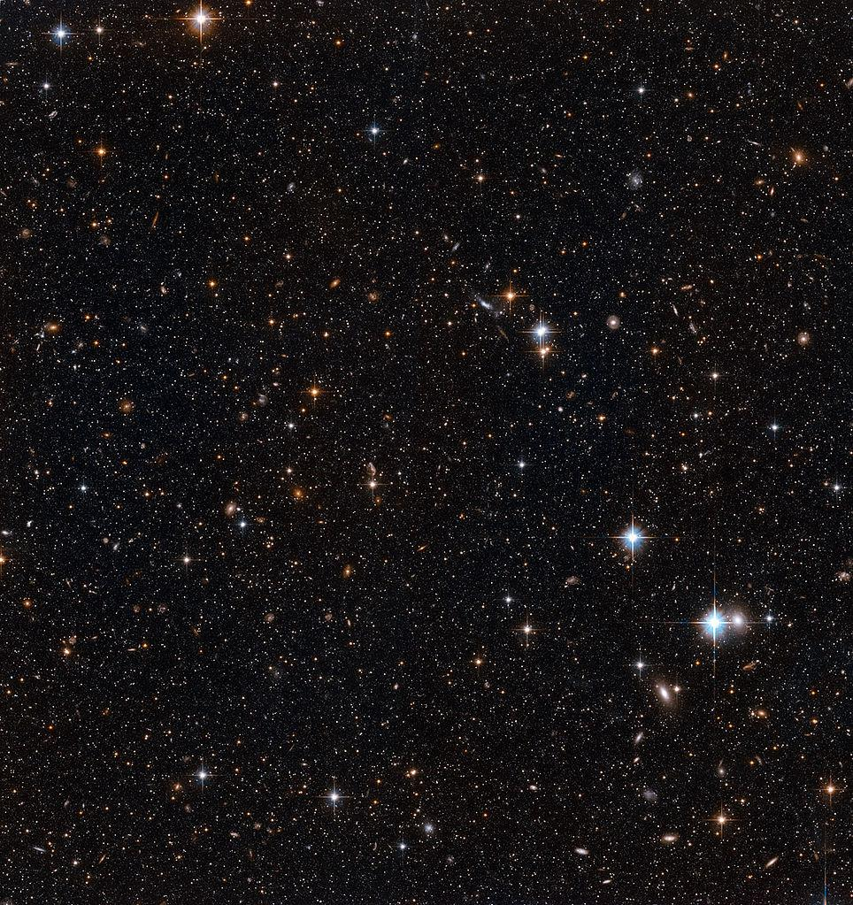
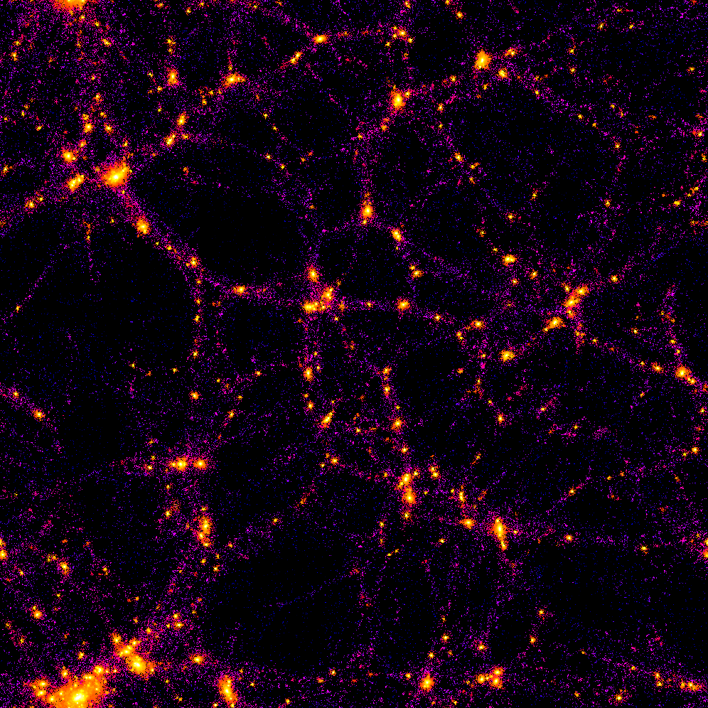
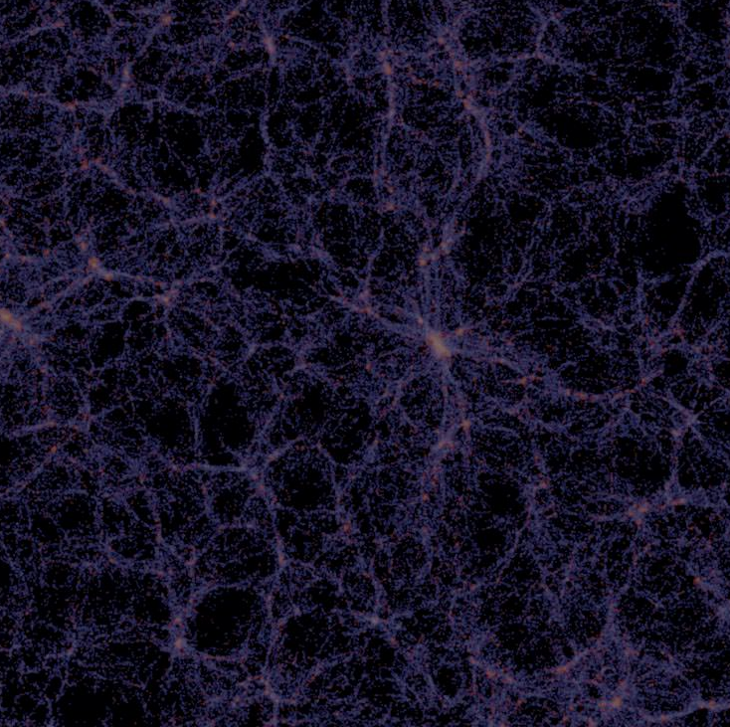
Beyond the Standard Model
While successful in many respects, fails to explain:
cosmological CP violation
baryon asymmetry
neutrino mass
gravity
dark energy
dark matter
Strong gravitational evidence that there exists matter in the universe that does not shine (doesn’t emit photons)
doi:10.1051/0004-6361/201525814
Dark Matter
26.8%
Ordinary Matter
4.9%
Dark Energy
68.3%
Christina Dorofeev (christina.dorofeev@cern.ch)
5/43

Slide 6
Beyond the Standard Model
While successful in many respects, fails to explain:
cosmological CP violation
baryon asymmetry
neutrino mass
gravity
dark energy
dark matter
Strong gravitational evidence that there exists matter in the universe that does not shine (doesn’t emit photons)
What could dark matter be?
doi:10.1051/0004-6361/201525814
Dark Matter
26.8%
Ordinary Matter
4.9%
Dark Energy
68.3%
Christina Dorofeev (christina.dorofeev@cern.ch)
6/43

Slide 7
Dark Sector
doi:10.3390/sym14112238
t
d
c
s
γ
g
u
b
Dark
sector
H
τ
𝝼
W
Z
e
μ
𝝼
𝝼
μ
e
τ
Christina Dorofeev (christina.dorofeev@cern.ch)
7/43

Slide 8
Dark Sector
doi:10.3390/sym14112238
t
d
c
s
γ
g
Portal
u
b
Dark
sector
H
τ
𝝼
W
Z
e
μ
𝝼
Mediator
𝝼
μ
e
τ
Christina Dorofeev (christina.dorofeev@cern.ch)
8/43

Slide 9
Mathematical formulation
ISBN 0-201-50397-2
t
Strong force
Weak force
Electromagnetic force
c
s
SU(3)
SU(2)
U(1)
Christina Dorofeev (christina.dorofeev@cern.ch)
9/43

Slide 10
Mathematical formulation
ISBN 0-201-50397-2
t
Strong force
Weak force
Electromagnetic force
c
s
SU(3)
x
SU(2)
x
U(1)
3x3 matrix
2x2 matrix
1x1 matrix
Christina Dorofeev (christina.dorofeev@cern.ch)
10/43

Slide 11
Mathematical formulation
ISBN 0-201-50397-2
t
Strong force
Weak force
Electromagnetic force
c
s
SU(3)
SU(2)
U(1)
3x3 matrix
2x2 matrix
1x1 matrix
Christina Dorofeev (christina.dorofeev@cern.ch)
11/43

Slide 12
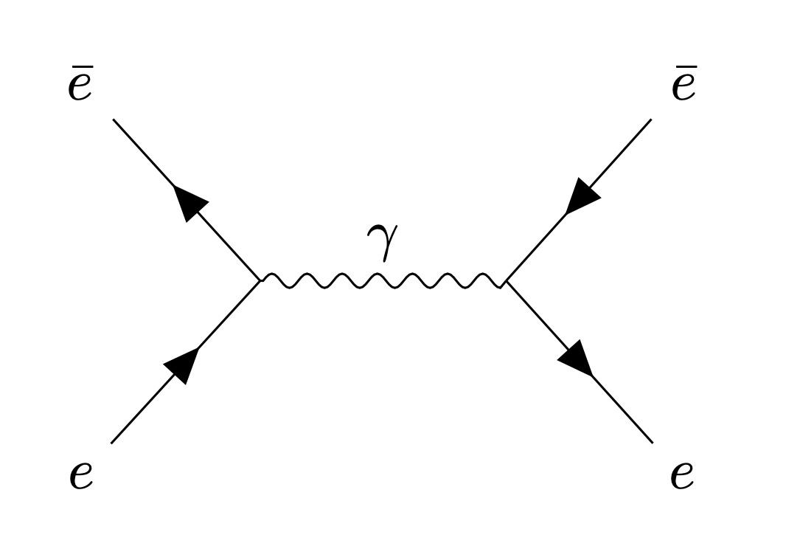
Electromagnetism (Bhabha Scattering)
doi:10.1098/rspa.1936.0046
Christina Dorofeev (christina.dorofeev@cern.ch)
12/43

Slide 13
Electromagnetism (Bhabha Scattering)
doi:10.1098/rspa.1936.0046
strength of interaction at each vertex
in QED: g_{e}² = 4πα
where
α = e²/ℏc ≈ 1/137
Christina Dorofeev (christina.dorofeev@cern.ch)
13/43

Slide 14
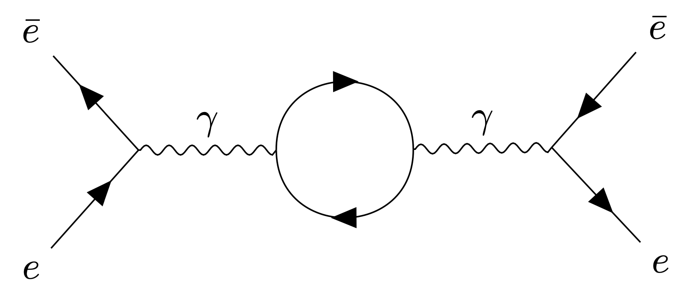
Higher order (loop) diagram
ISBN 0-201-50397-2
Christina Dorofeev (christina.dorofeev@cern.ch)
14/43

Slide 15
SM + Dark Sector mixing
Dark fermions couple to the dark photon with dark charge e’ and couple to the SM hypercharge with charge κe’
doi:10.1103/PhysRevD.92.035014
Christina Dorofeev (christina.dorofeev@cern.ch)
15/43

Slide 16
SM + Dark Sector mixing
Dark fermions couple to the dark photon with dark charge e’ and couple to the SM hypercharge with charge κe’
doi:10.1103/PhysRevD.92.035014
dark photon
interaction strength ~ 1/1000
dark electron
Christina Dorofeev (christina.dorofeev@cern.ch)
16/43

Slide 17
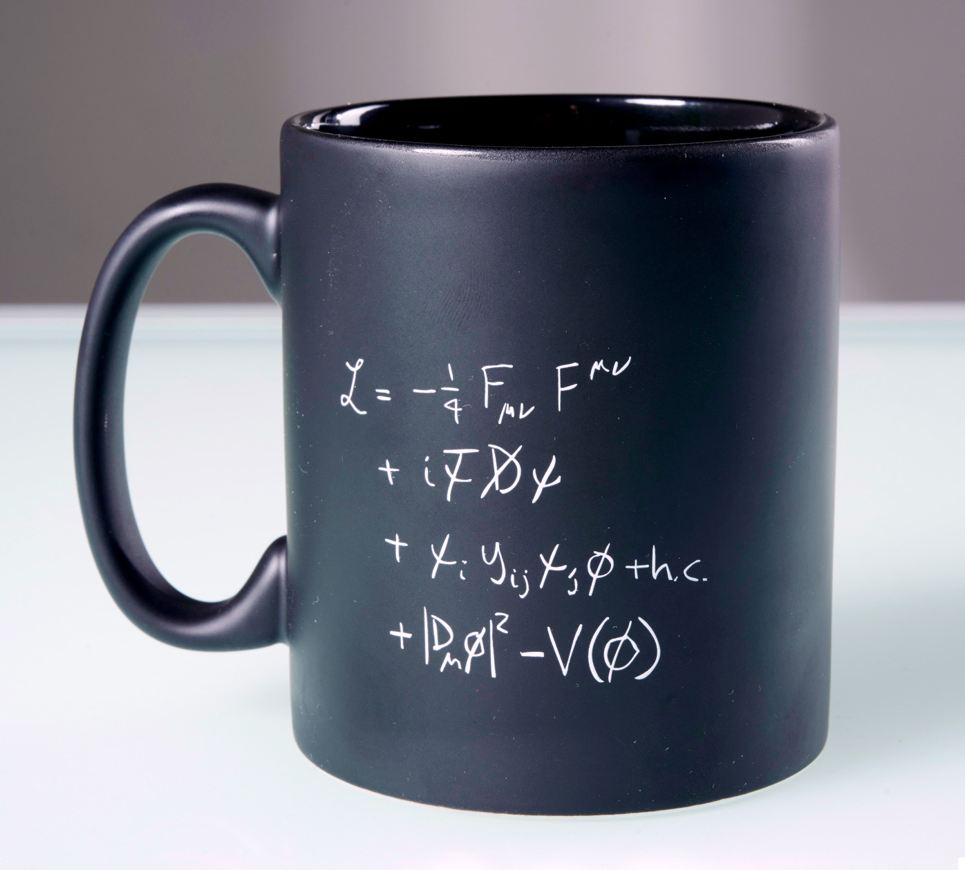
SM + Dark Sector mixing
doi:10.1016/0370-2693(86)91377-8
Christina Dorofeev (christina.dorofeev@cern.ch)
17/43

Slide 18
SM + Dark Sector mixing
doi:10.1016/0370-2693(86)91377-8
dark photon
kinetic mixing
Christina Dorofeev (christina.dorofeev@cern.ch)
18/43

Slide 19
SM + Dark Sector mixing
doi:10.1016/0370-2693(86)91377-8
dark photon
kinetic mixing
Christina Dorofeev (christina.dorofeev@cern.ch)
19/43

Slide 20
SM + Dark Sector mixing
doi:10.1016/0370-2693(86)91377-8
dark photon
kinetic mixing
dark fermion
Christina Dorofeev (christina.dorofeev@cern.ch)
20/43

Slide 21
SM + Dark Sector mixing
doi:10.1016/0370-2693(86)91377-8
dark photon
kinetic mixing
dark fermion
small electric charge
Christina Dorofeev (christina.dorofeev@cern.ch)
21/43

Slide 22
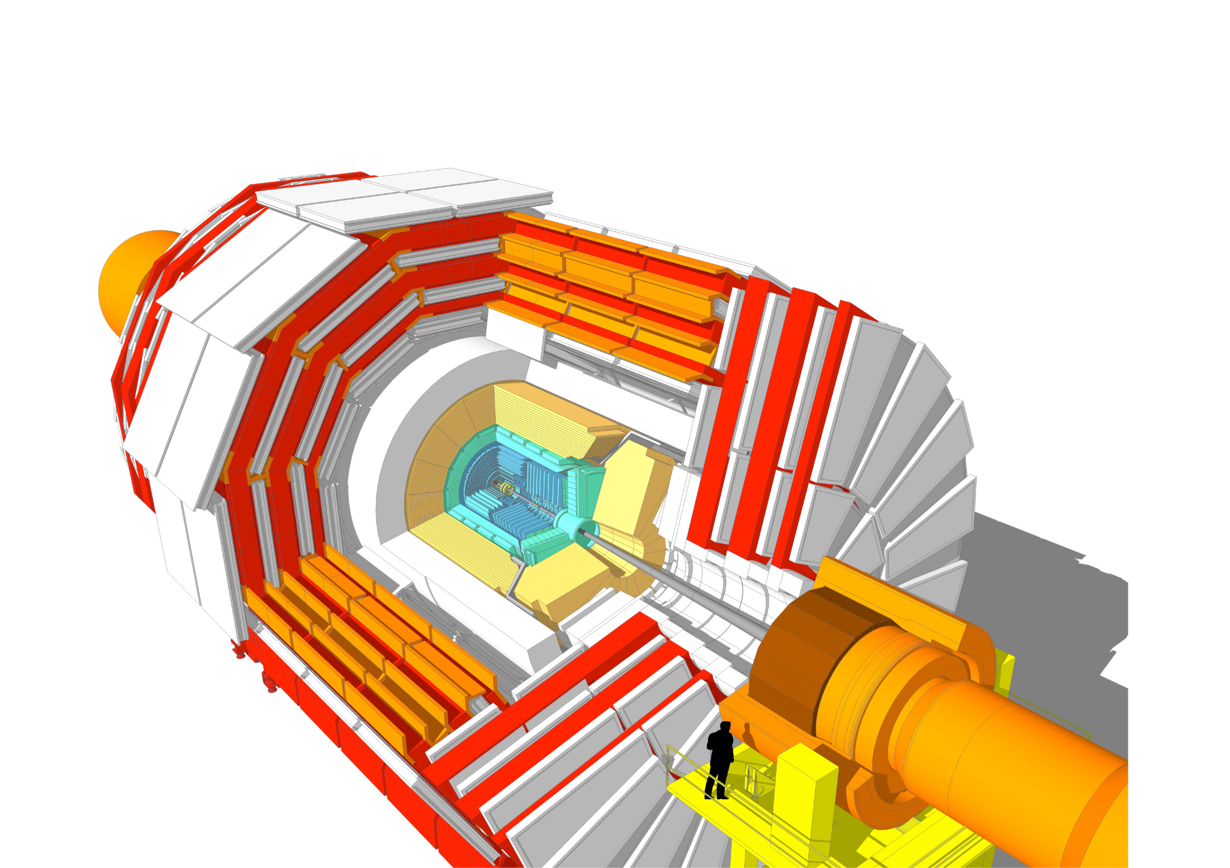
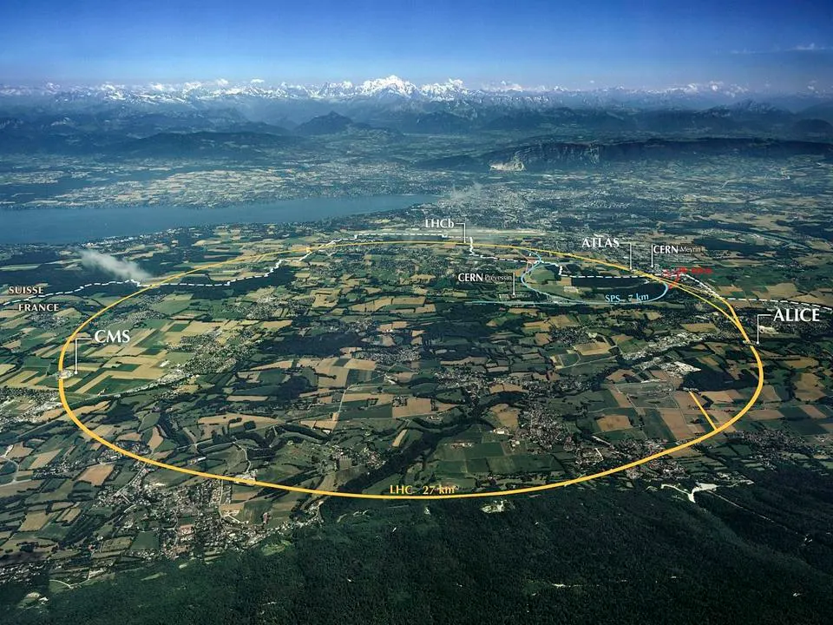
How can we detect millicharged particles?
doi:10.1016/j.physletb.2015.04.062
cds.cern.ch/record/2665537
Image Credit: Maximilien Brice (CERN)
Christina Dorofeev (christina.dorofeev@cern.ch)
22/43

Slide 23
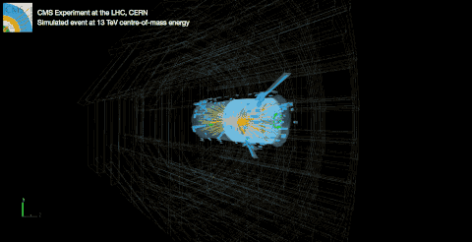
How can we detect millicharged particles?
doi:10.1016/j.physletb.2015.04.062
Image Credit: Maximilien Brice (CERN)
Christina Dorofeev (christina.dorofeev@cern.ch)
23/43

Slide 24
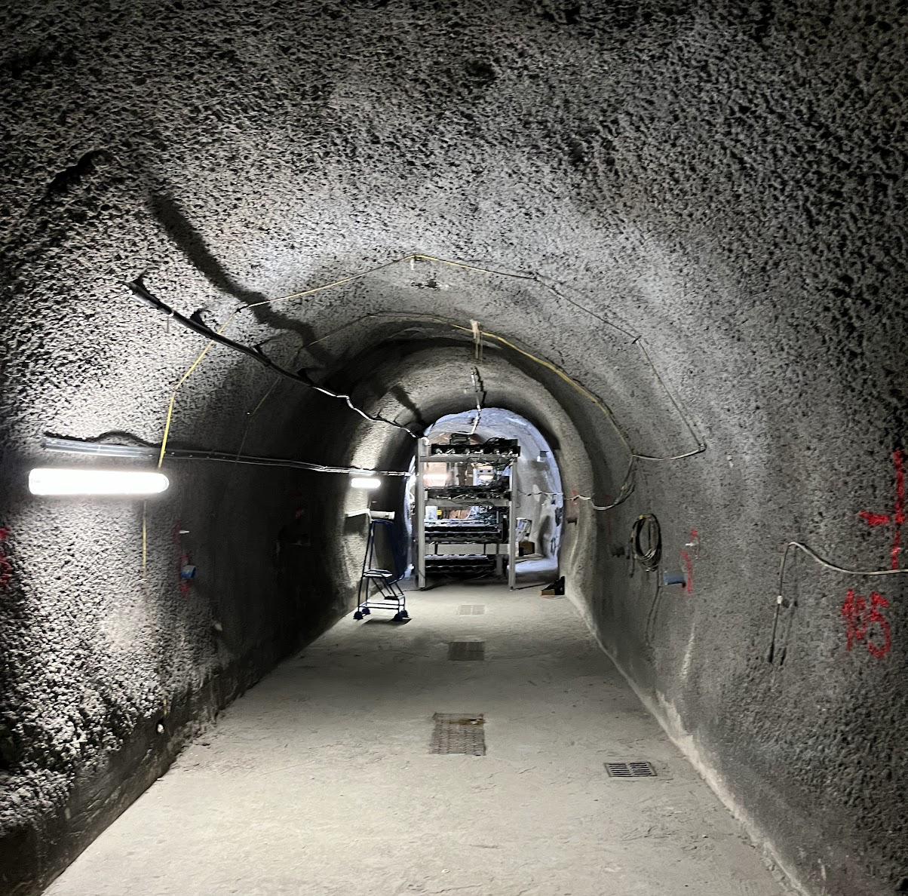
The milliQan Experiment
doi:10.48550/arXiv.1607.04669
Bar Detector
CMS
Cavern
Image Credit: Dariush Imani
Christina Dorofeev (christina.dorofeev@cern.ch)
24/43

Slide 25
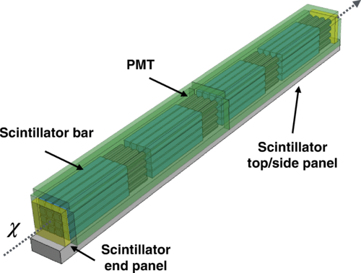
milliQan Bar Detector
Scintillation
Material produces light at a consistent wavelength when charged particles pass through
Photomultiplier Tube (PMT)
Produce electrons from photons through the photoelectric effect
doi:10.1103/PhysRevD.104.032002
Christina Dorofeev (christina.dorofeev@cern.ch)
25/43

Slide 26
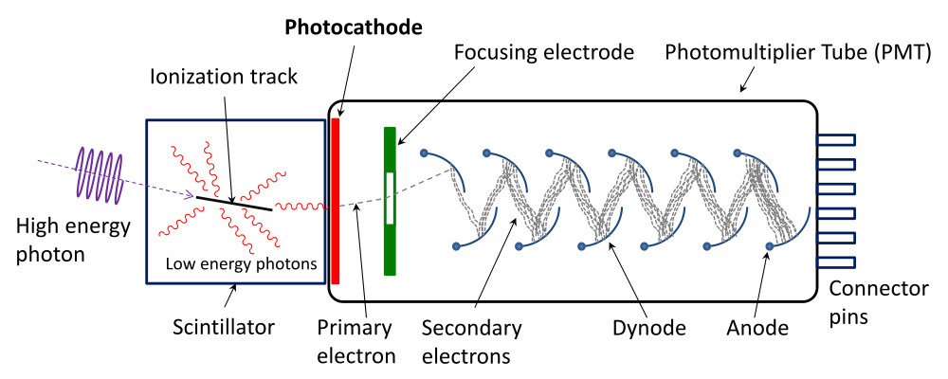
Photomultiplier Tube (PMT)
Photocathode emits electrons when struck by photons; dynodes amplify the signal by successive electron multiplication
Qwerty123uiop, CC BY-SA 3.0, via Wikimedia Commons
Christina Dorofeev (christina.dorofeev@cern.ch)
26/43

Slide 27
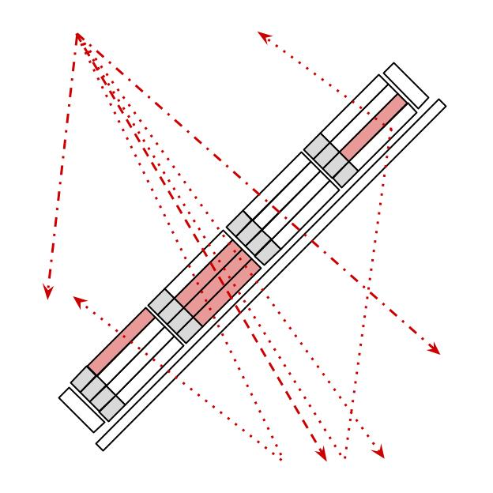
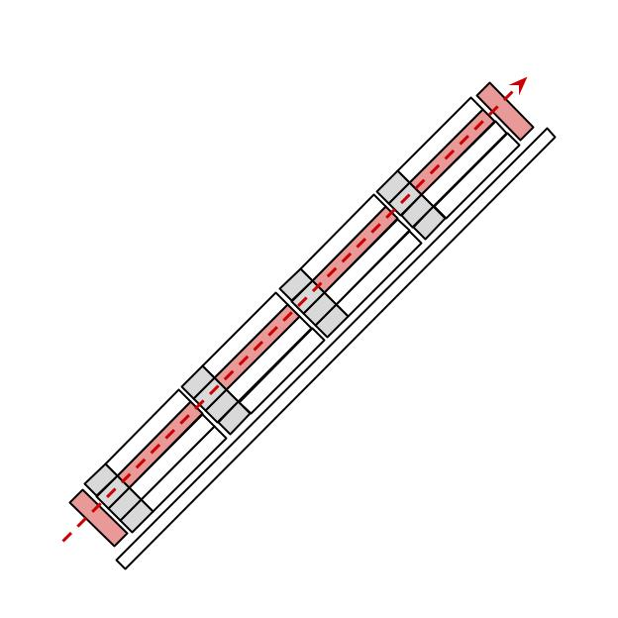
“Who ordered that?”
Main sources of background: cosmic muons, beam muons
Also: light leaks and dark rate
Christina Dorofeev (christina.dorofeev@cern.ch)
27/43

Slide 28
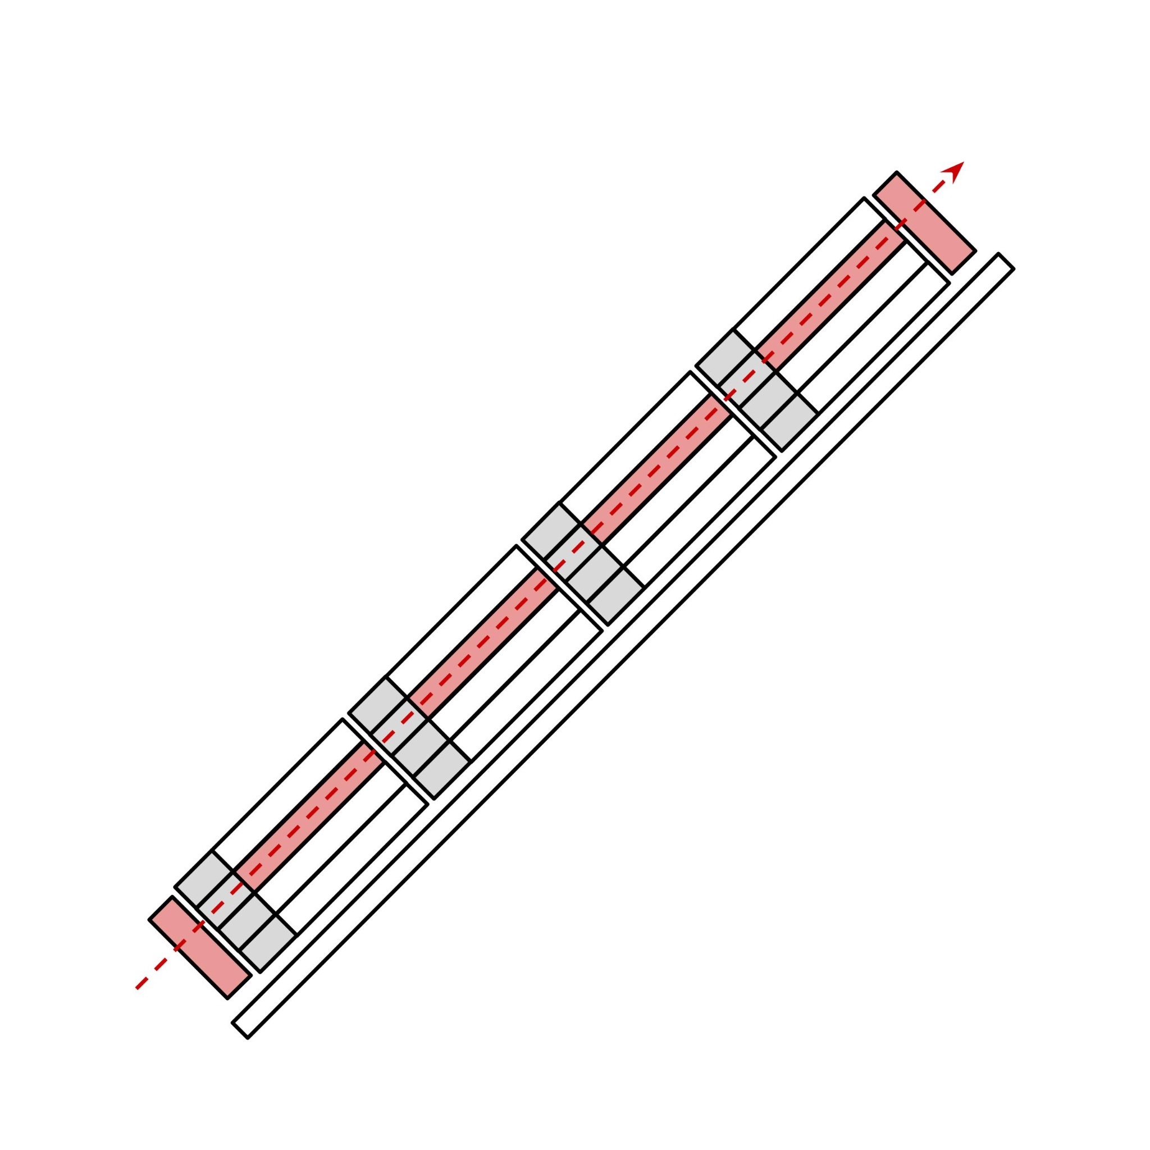
Beam muon selection criteria
High energy muons produced in LHC CMS pp collisions
Follow same trajectory as mCPs → pass through all layers of the detector (possible curvature due to CMS magnetic field)
Selection cuts:
Pulse area
Hits in each layer
Slope
Timing
beam muons
Christina Dorofeev (christina.dorofeev@cern.ch)
28/43

Slide 29
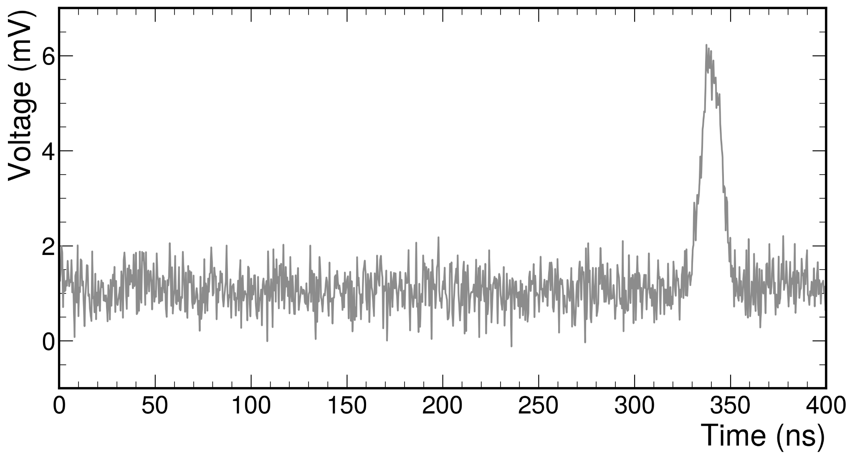
Pulse area
Photoelectrons observed by PMTs produce signal → “pulse”
Pulses characterized by height (voltage), width (time), and area (voltage x time)
Pulse area: integrated area under waveform
Pulse area proportional to number of photoelectrons
Units: [pVs] = [mV] x [ns] = [10⁻³V] x [10⁻⁹s] = [10⁻¹²Vs]
not real data pictured
Christina Dorofeev (christina.dorofeev@cern.ch)
29/43

Slide 30
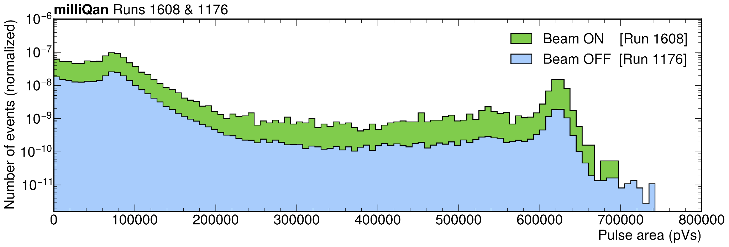
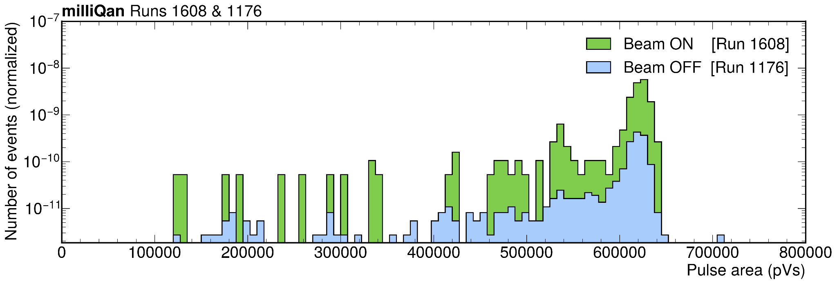
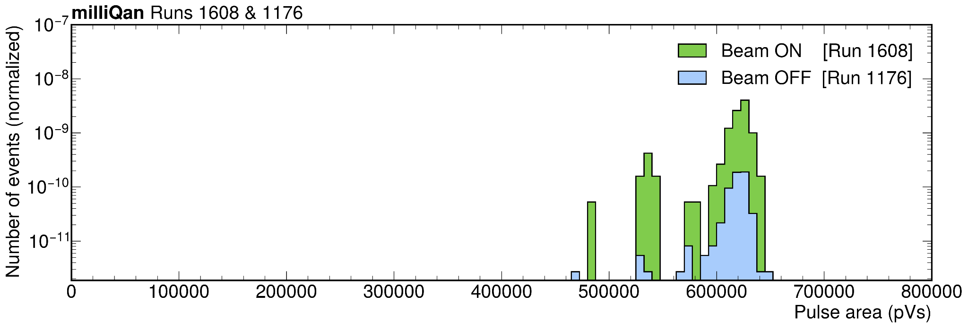
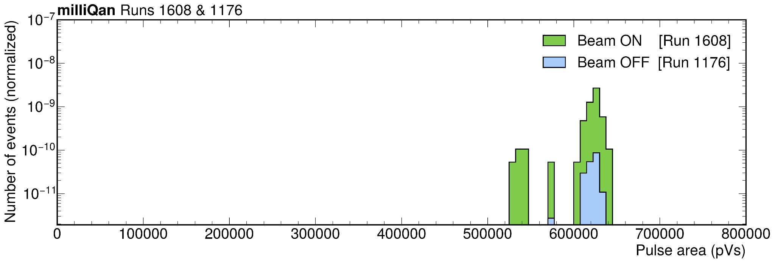
Pulse area
Requirements: area of pulse above threshold and is the largest in its layer
Area threshold → handle on beam muon selection
Pulse area > 0 pVs
Pulse area > 100,000 pVs
Pulse area > 250,000 pVs
Pulse area > 500,000 pVs
Christina Dorofeev (christina.dorofeev@cern.ch)
30/43

Slide 31
Pulse area
Requirements: area of pulse above threshold and is the largest in its layer
Area threshold → handle on beam muon selection
Pulse area > 0 pVs
Pulse area > 100,000 pVs
Pulse area > 250,000 pVs
Pulse area > 500,000 pVs
Christina Dorofeev (christina.dorofeev@cern.ch)
31/43

Slide 32
Hit in each layer
Code (developed by C. Campagnari) skims data and reconstructs tracks
Identify hits within each layer → cluster neighboring hits → construct tracks
Centroid of cluster in each layer cannot move by more than one unit
Layer 0
Layer 1
Layer 2
Layer 3
0
1
4
5
20
21
32
33
36
37
52
row 3 (x=3)
16
17
48
49
53
row 2 (x=2)
2
3
6
7
18
19
22
23
34
35
38
39
50
51
54
55
8
78
28
40
41
45
56
60
row 1 (x=1)
9
12
13
79
29
44
57
61
row 0 (x=0)
14
15
26
27
31
58
62
63
10
11
30
42
43
46
47
59
col 0 (y=0)
col 1 (y=1)
col 2 (y=2)
col 3 (y=3)
Christina Dorofeev (christina.dorofeev@cern.ch)
32/43

Slide 33
Hit in each layer
Code (developed by C. Campagnari) skims data and reconstructs tracks
Identify hits within each layer → cluster neighboring hits → construct tracks
Centroid of cluster in each layer cannot move by more than one unit
Layer 0
Layer 1
Layer 2
Layer 3
0
1
4
5
20
21
32
33
36
37
52
row 3 (x=3)
16
17
48
49
53
row 2 (x=2)
2
3
6
7
18
19
22
23
34
35
38
39
50
51
54
55
8
78
28
40
41
45
56
60
row 1 (x=1)
9
12
13
79
29
44
57
61
row 0 (x=0)
14
15
26
27
31
58
62
63
10
11
30
42
43
46
47
59
col 0 (y=0)
col 1 (y=1)
col 2 (y=2)
col 3 (y=3)
Christina Dorofeev (christina.dorofeev@cern.ch)
33/43

Slide 34
Hit in each layer
Code (developed by C. Campagnari) skims data and reconstructs tracks
Identify hits within each layer → cluster neighboring hits → construct tracks
Centroid of cluster in each layer cannot move by more than one unit
Layer 0
Layer 1
Layer 2
Layer 3
0
1
4
5
20
21
32
33
36
37
52
row 3 (x=3)
16
17
48
49
53
row 2 (x=2)
2
3
6
7
18
19
22
23
34
35
38
39
50
51
54
55
8
78
28
40
41
45
56
60
row 1 (x=1)
9
12
13
79
29
44
57
61
row 0 (x=0)
14
15
26
27
31
58
62
63
10
11
30
42
43
46
47
59
col 0 (y=0)
col 1 (y=1)
col 2 (y=2)
col 3 (y=3)
Christina Dorofeev (christina.dorofeev@cern.ch)
34/43

Slide 35
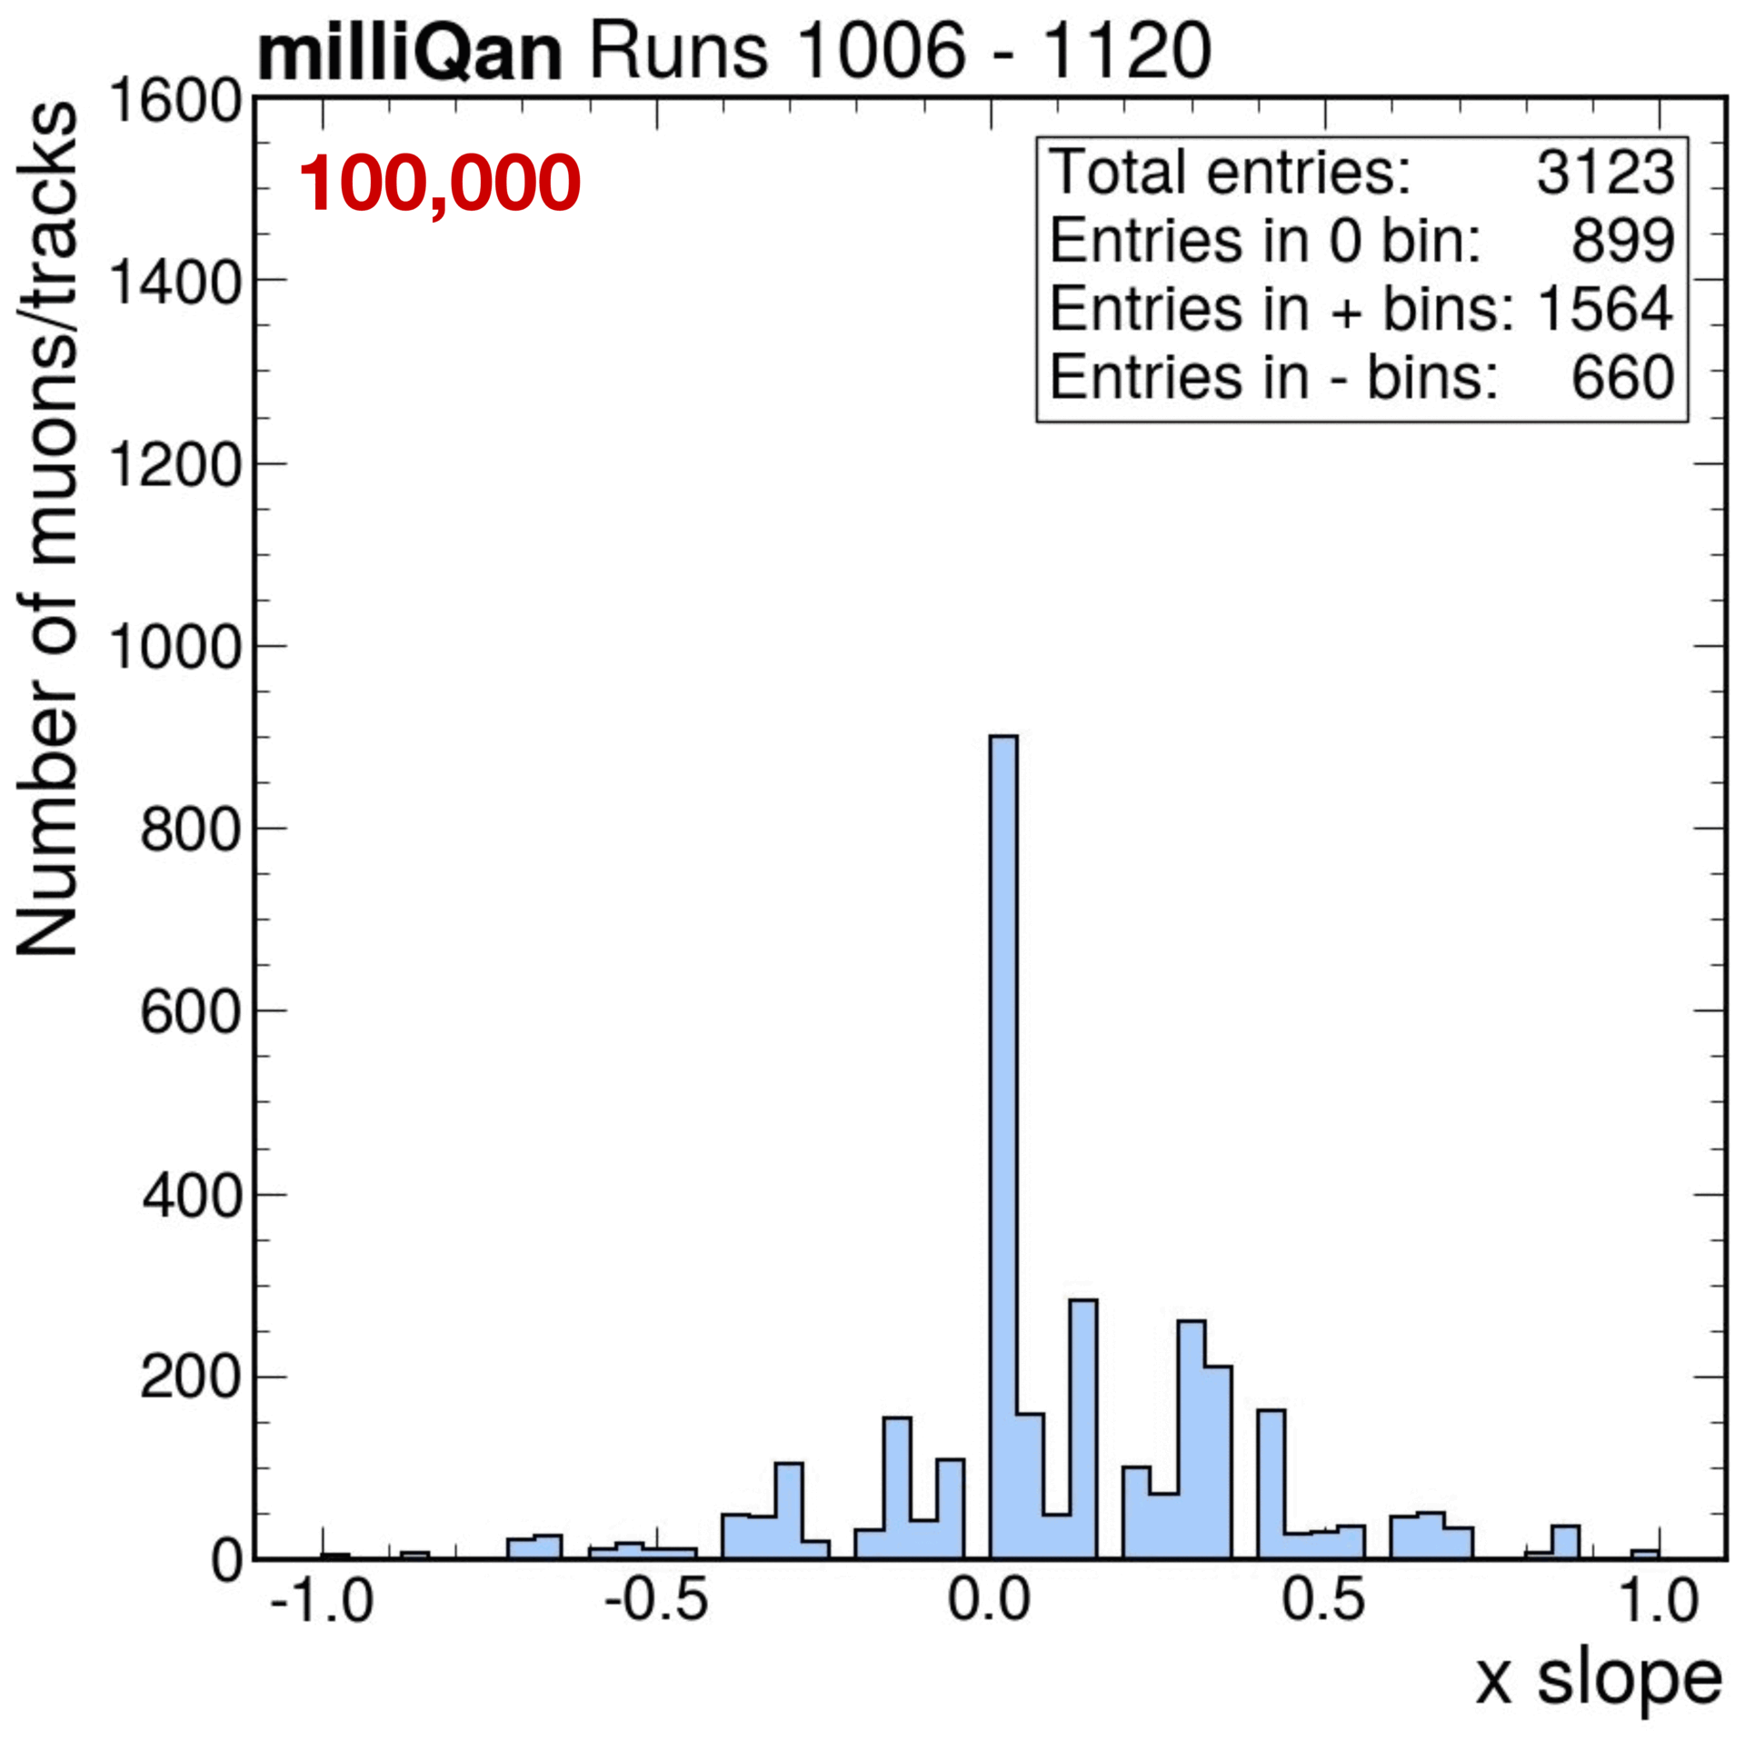
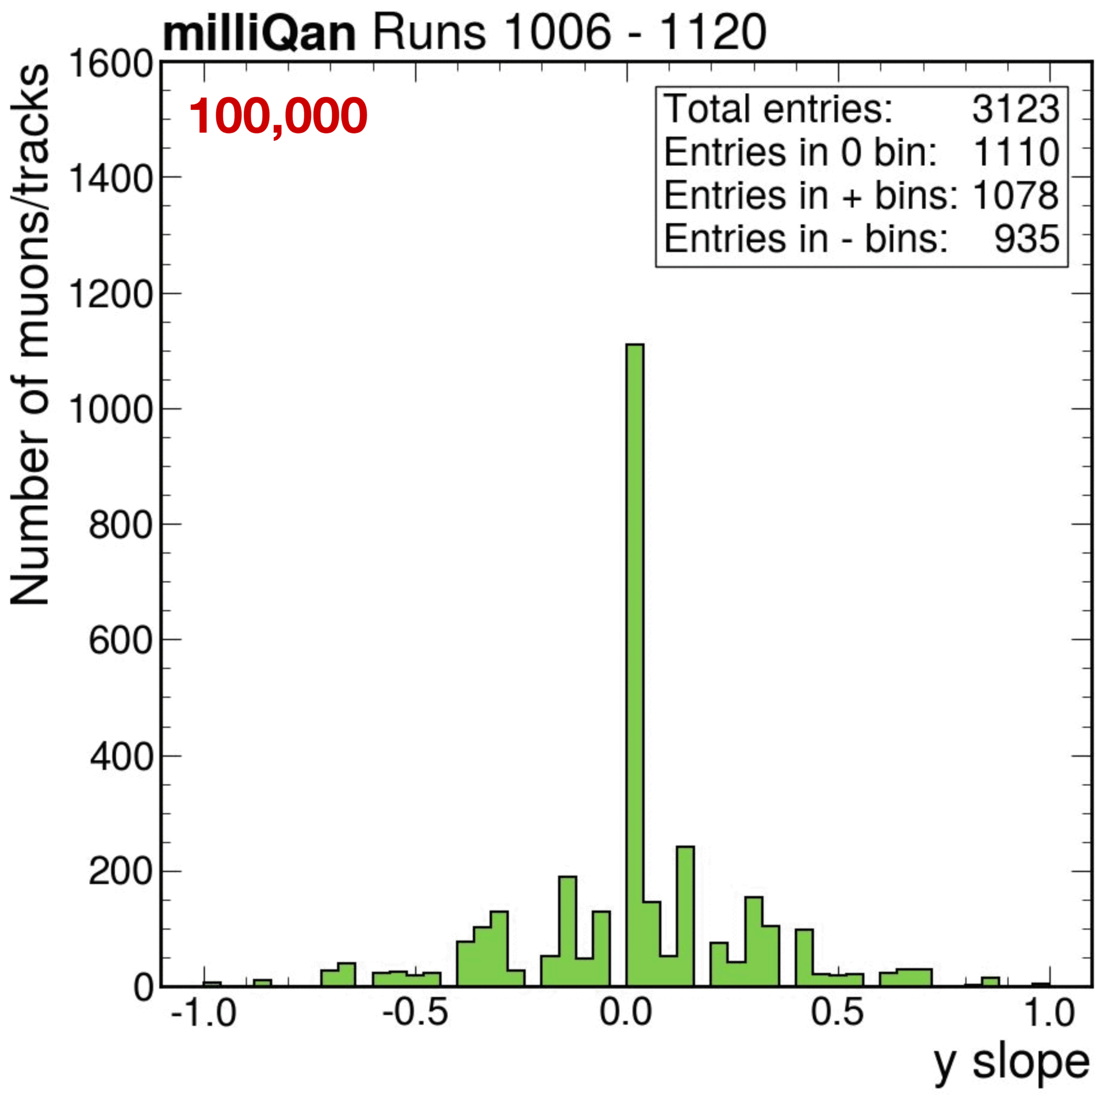
Slope
Criteria: hit in each layer + clustering/tracking + beam on + timing window (15 ns) + area threshold (in red)
Christina Dorofeev (christina.dorofeev@cern.ch)
35/43

Slide 36
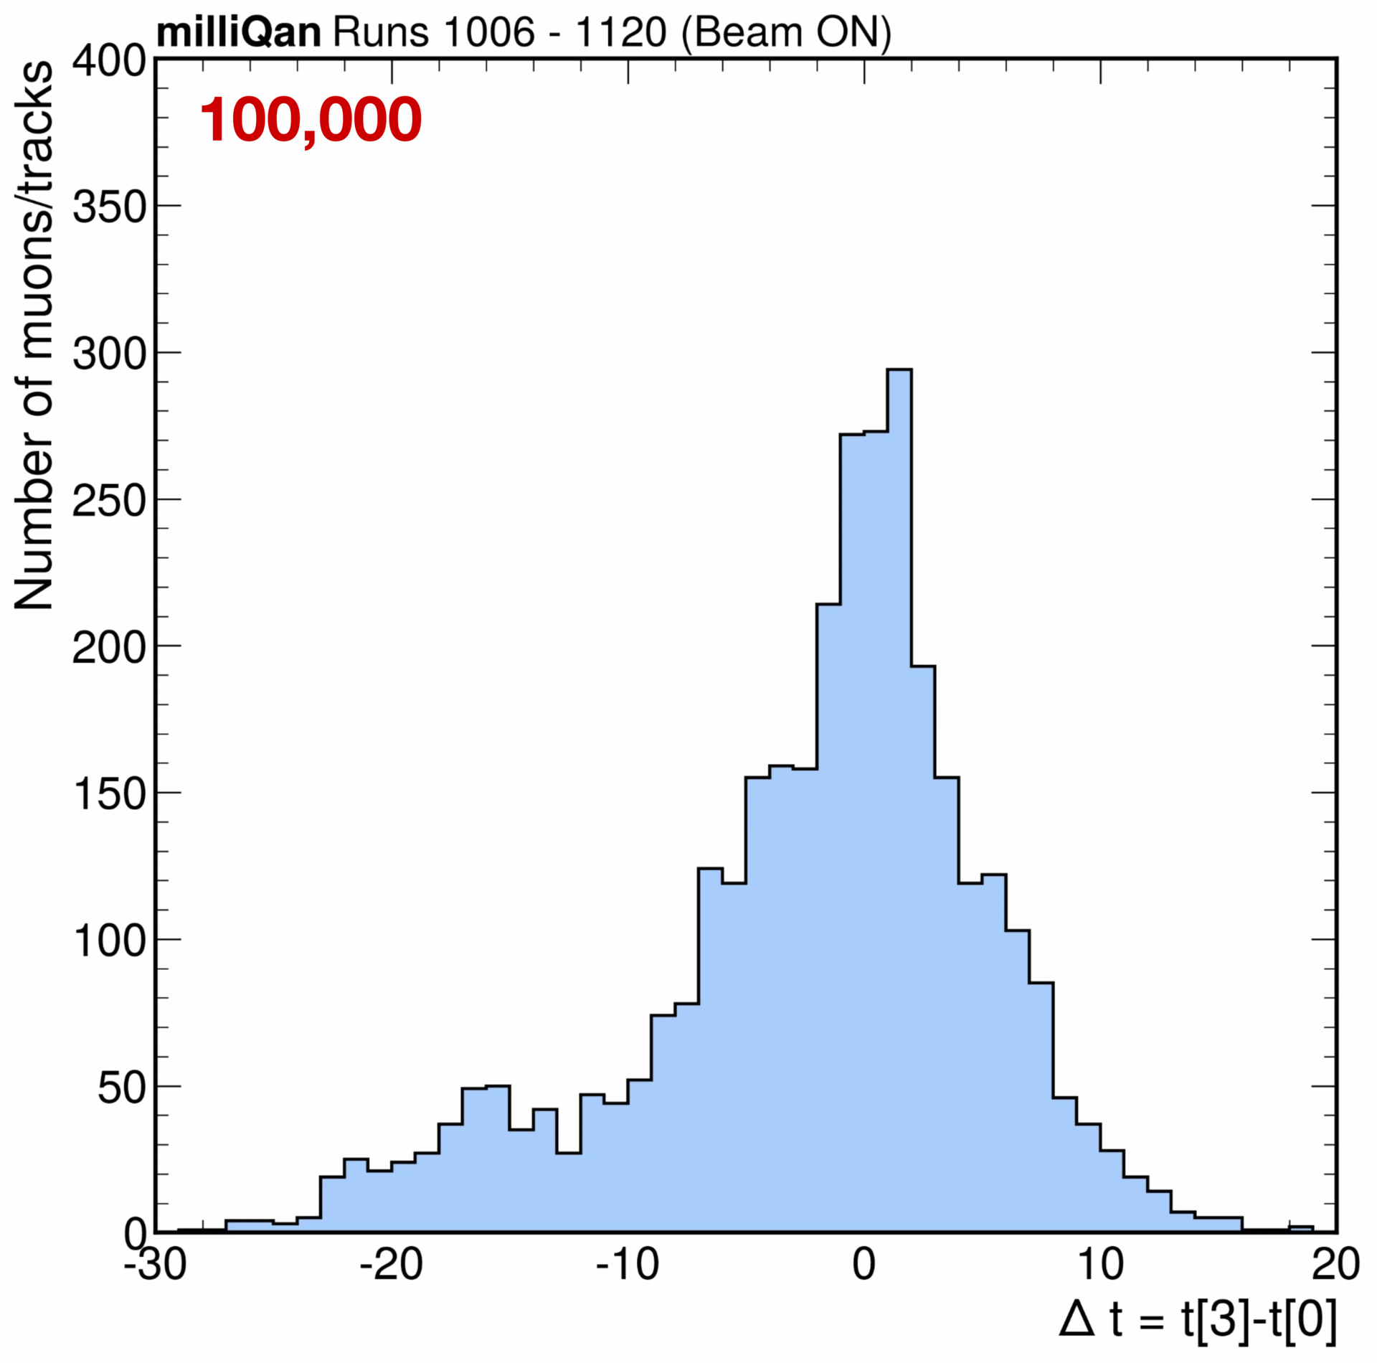
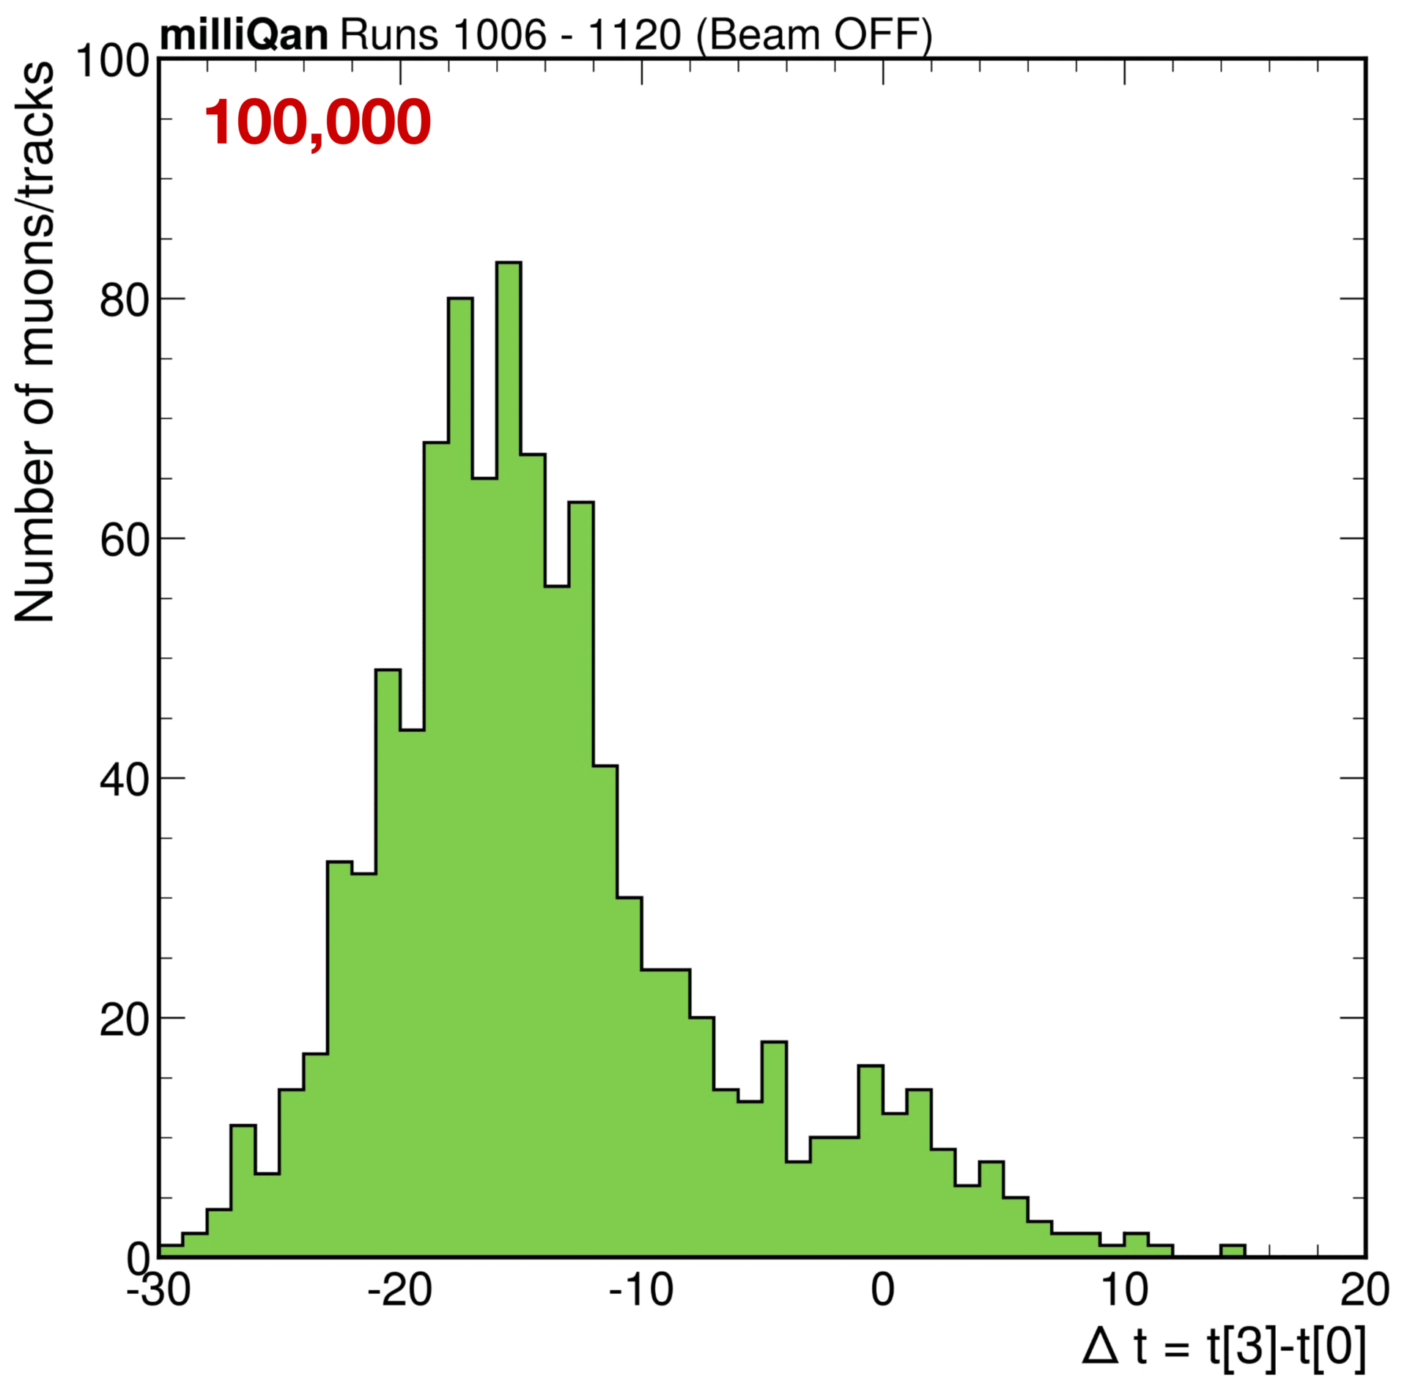
Timing
Timing between hits in last layer (layer 3) and first layer (layer 0)
Christina Dorofeev (christina.dorofeev@cern.ch)
36/43

Slide 37
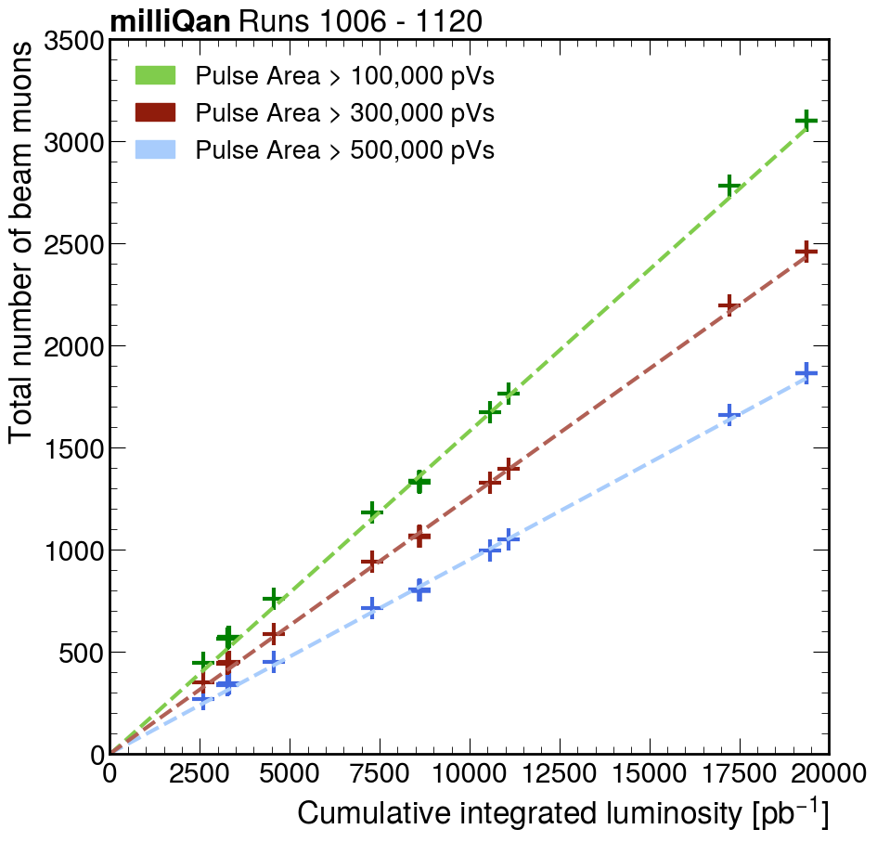
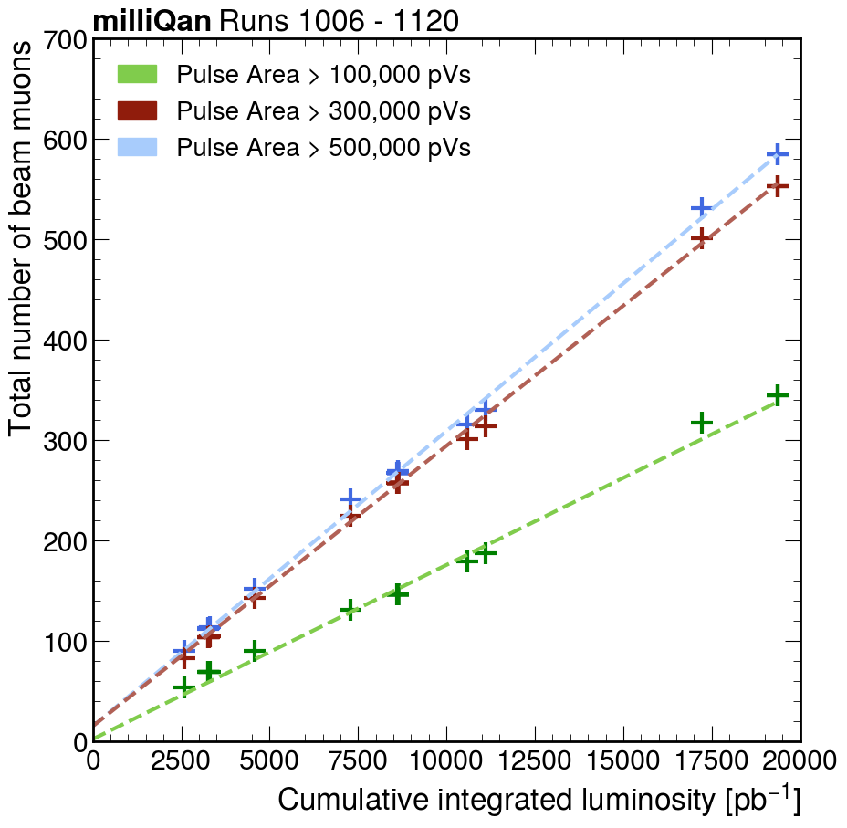
Beam muons vs. luminosity
Number of beam muons as a function of the cumulative collision rate over time
No slope requirement
500,000 pVs:
0.095/pb⁻¹
300,000 pVs:
0.126/pb⁻¹
100,000 pVs:
0.158/pb⁻¹
x and y slope requirement (0)
500,000 pVs:
0.029/pb⁻¹
300,000 pVs:
0.028/pb⁻¹
100,000 pVs:
0.017/pb⁻¹
Christina Dorofeev (christina.dorofeev@cern.ch)
37/43

Slide 38
Key takeaways
Optimized area threshold (300,000 pVs)
Apply selection criteria to reduce background → cleanest identification of beam muons
Understood detector response to large saturating signal
Confirmed detector alignment and calibration
Allows us to explore signal-like trajectories in the detector
Used beam muons as a proxy for millicharged particles
Christina Dorofeev (christina.dorofeev@cern.ch)
38/43

Slide 39
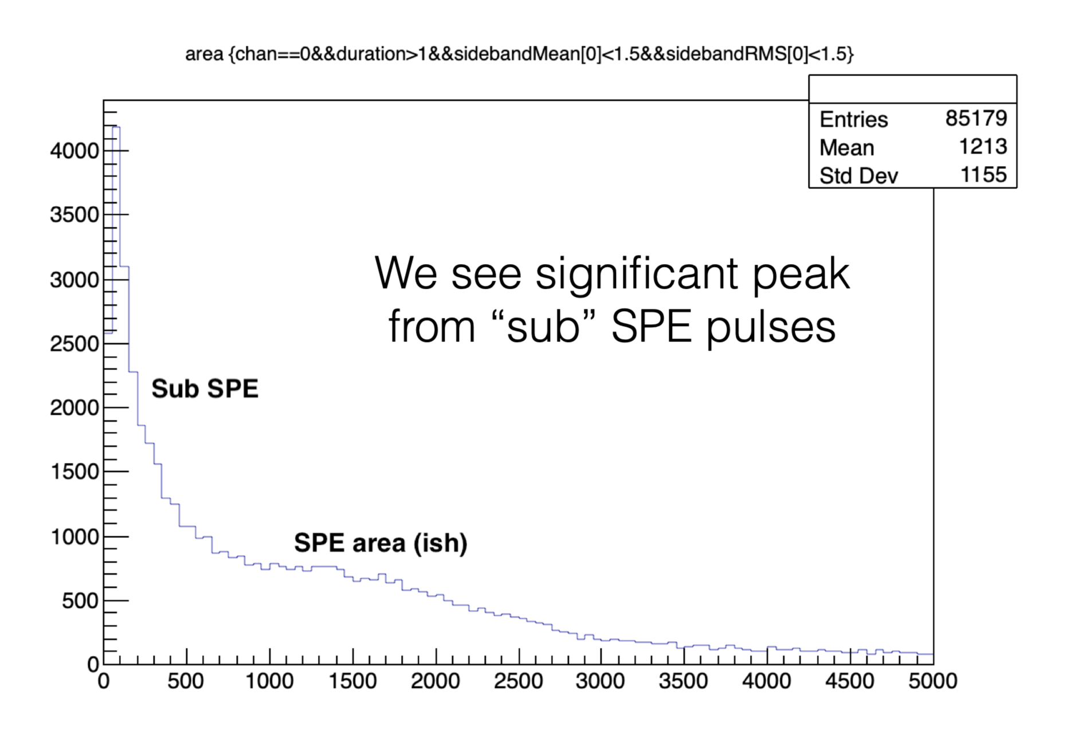
What about millicharged signals?
Now let’s take a look at the other end of the spectrum → single photon response
sub-SPE pulses observed by M. Citron (figure below)
??
Christina Dorofeev (christina.dorofeev@cern.ch)
39/43

Slide 40
PMT dark rate
PMTs produce small output current (signal) called anode dark current even in total darkness (when no photons have been detected)
Christina Dorofeev (christina.dorofeev@cern.ch)
40/43

Slide 41
PMT sub-SPE pulses
sub-SPE contribution observed in PMTs in lab setup
Two hypotheses:
Dynode dark rate
Failed trajectory photoelectrons
Christina Dorofeev (christina.dorofeev@cern.ch)
41/43

Slide 42
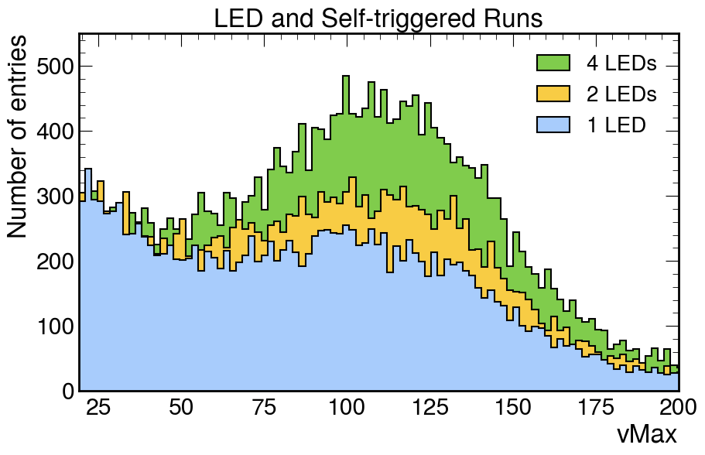
Dynode dark rate
Dynode dark rate hypothesis supported by data from runs
Response varies for different PMTs
Christina Dorofeev (christina.dorofeev@cern.ch)
42/43

Slide 43
Summary & outlook
Compelling theoretical basis for millicharged particles
milliQan detector provides unique sensitivity
Selection criteria for tagging beam muons → observed rate consistent with expectation
Support for dynode dark rate hypothesis → improved understanding of sub-SPE background
Further steps: cosmic muons, simulation, dynode dark rate temperature dependence
Can milliQan? Will milliQan? Stay tuned!
Christina Dorofeev (christina.dorofeev@cern.ch)
43/43

Slide 44
Special thanks to
Faculty mentor David Stuart
Postdoctoral mentor Neha Santpur
Graduate mentor Ryan Schmitz
REU director Sathya Guruswamy
The milliQan collaboration
This work is supported by NSF REU grant PHY-2349677

Slide 45
Back Up

Slide 46
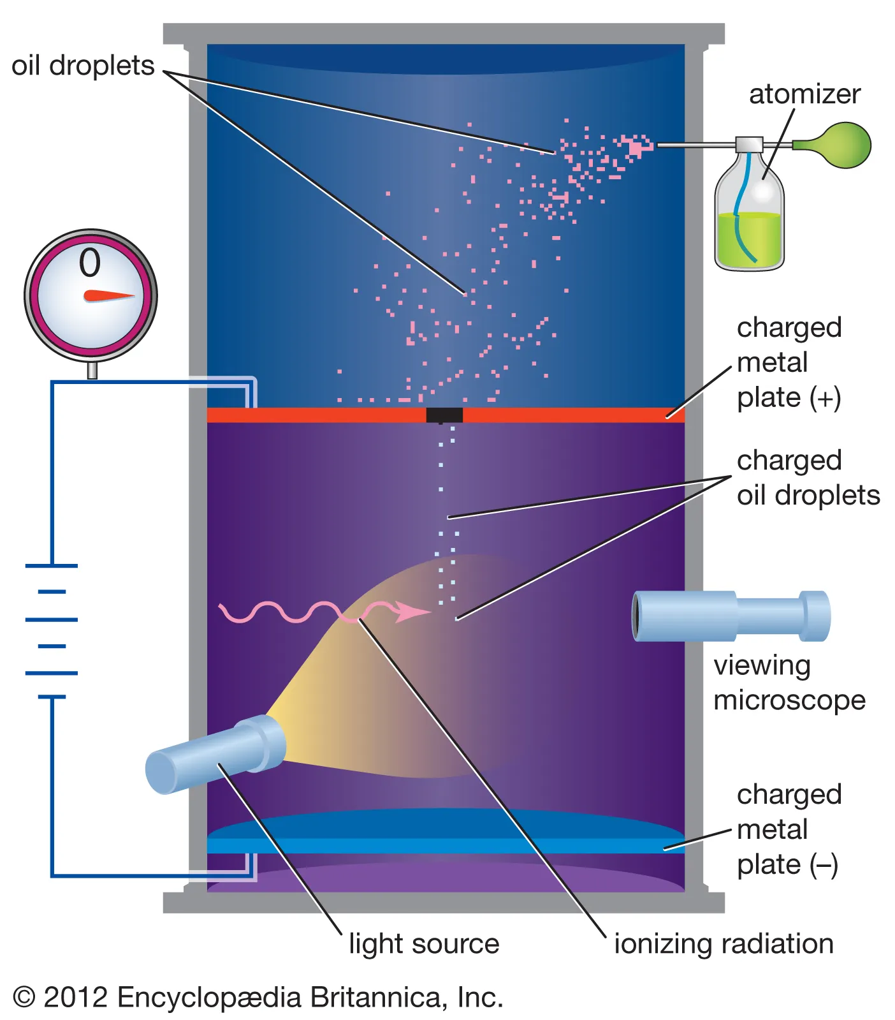
Millikan Oil Drop Experiment
Christina Dorofeev (christina.dorofeev@cern.ch)

Slide 47
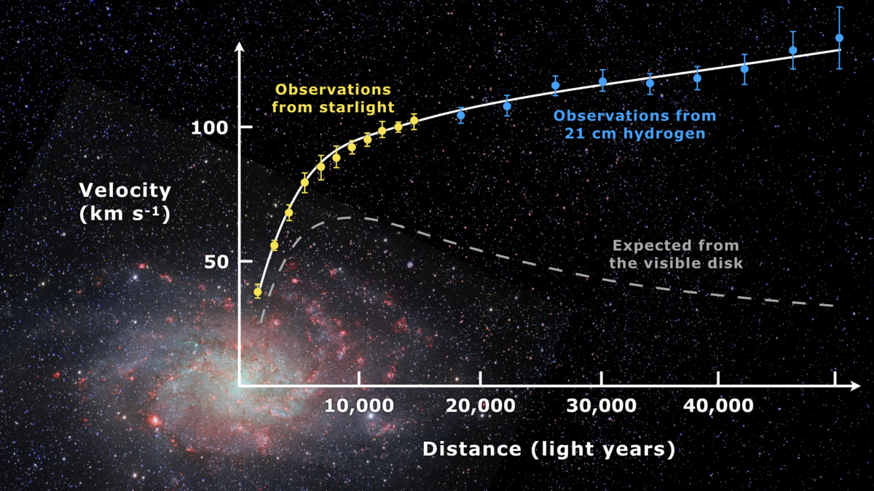
Dark matter measurements
Rotation curves of stars in galaxies
The Bullet Cluster
Gravitational Lensing
CMB/Baryon Acoustic Oscillations
Simulations of galaxy and cluster
formation
Image Credit: Wikipedia
Christina Dorofeev (christina.dorofeev@cern.ch)

Slide 48
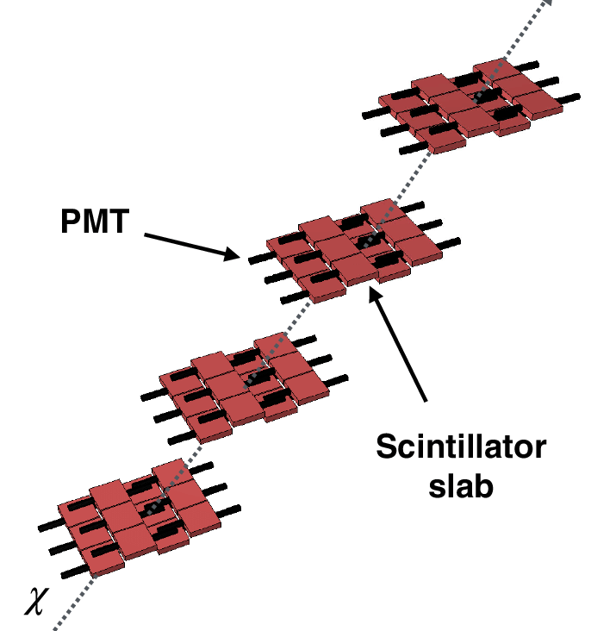
milliQan Slab Detector
Christina Dorofeev (christina.dorofeev@cern.ch)

Slide 49
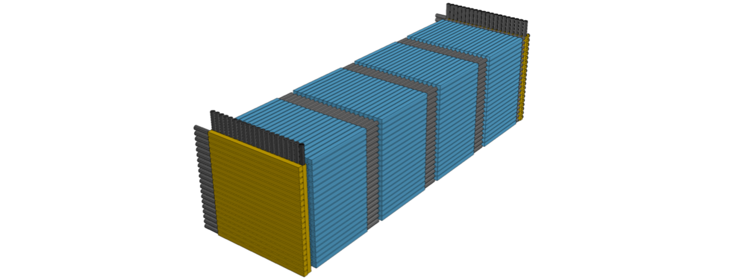
FORMOSA
Christina Dorofeev (christina.dorofeev@cern.ch)

Slide 50
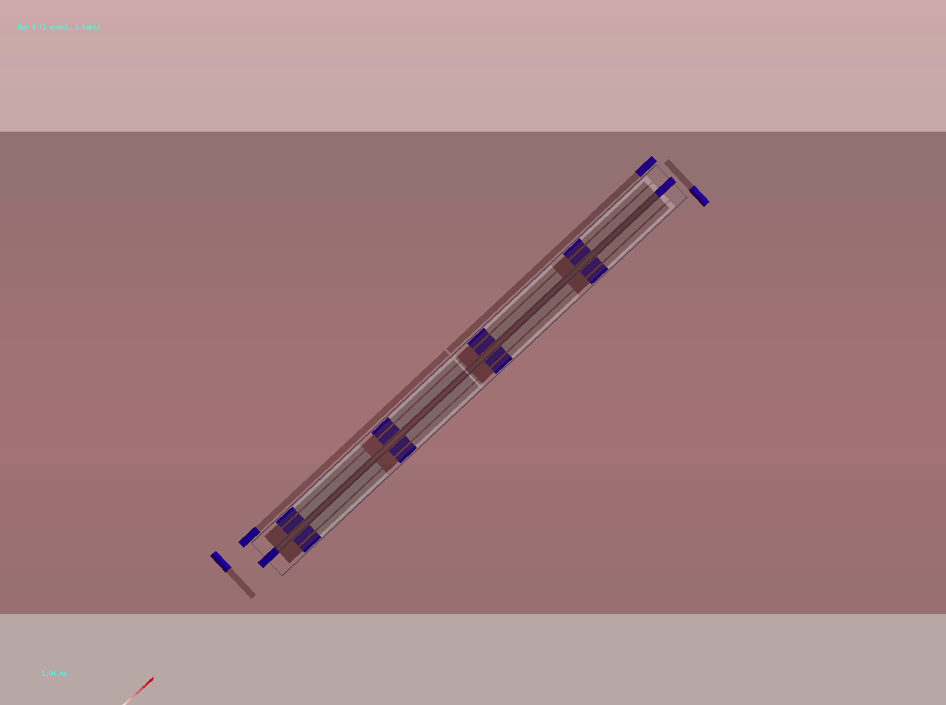
Simulation
Simulations made by R. Schmitz (LHCP talk)
Christina Dorofeev (christina.dorofeev@cern.ch)

Slide 51
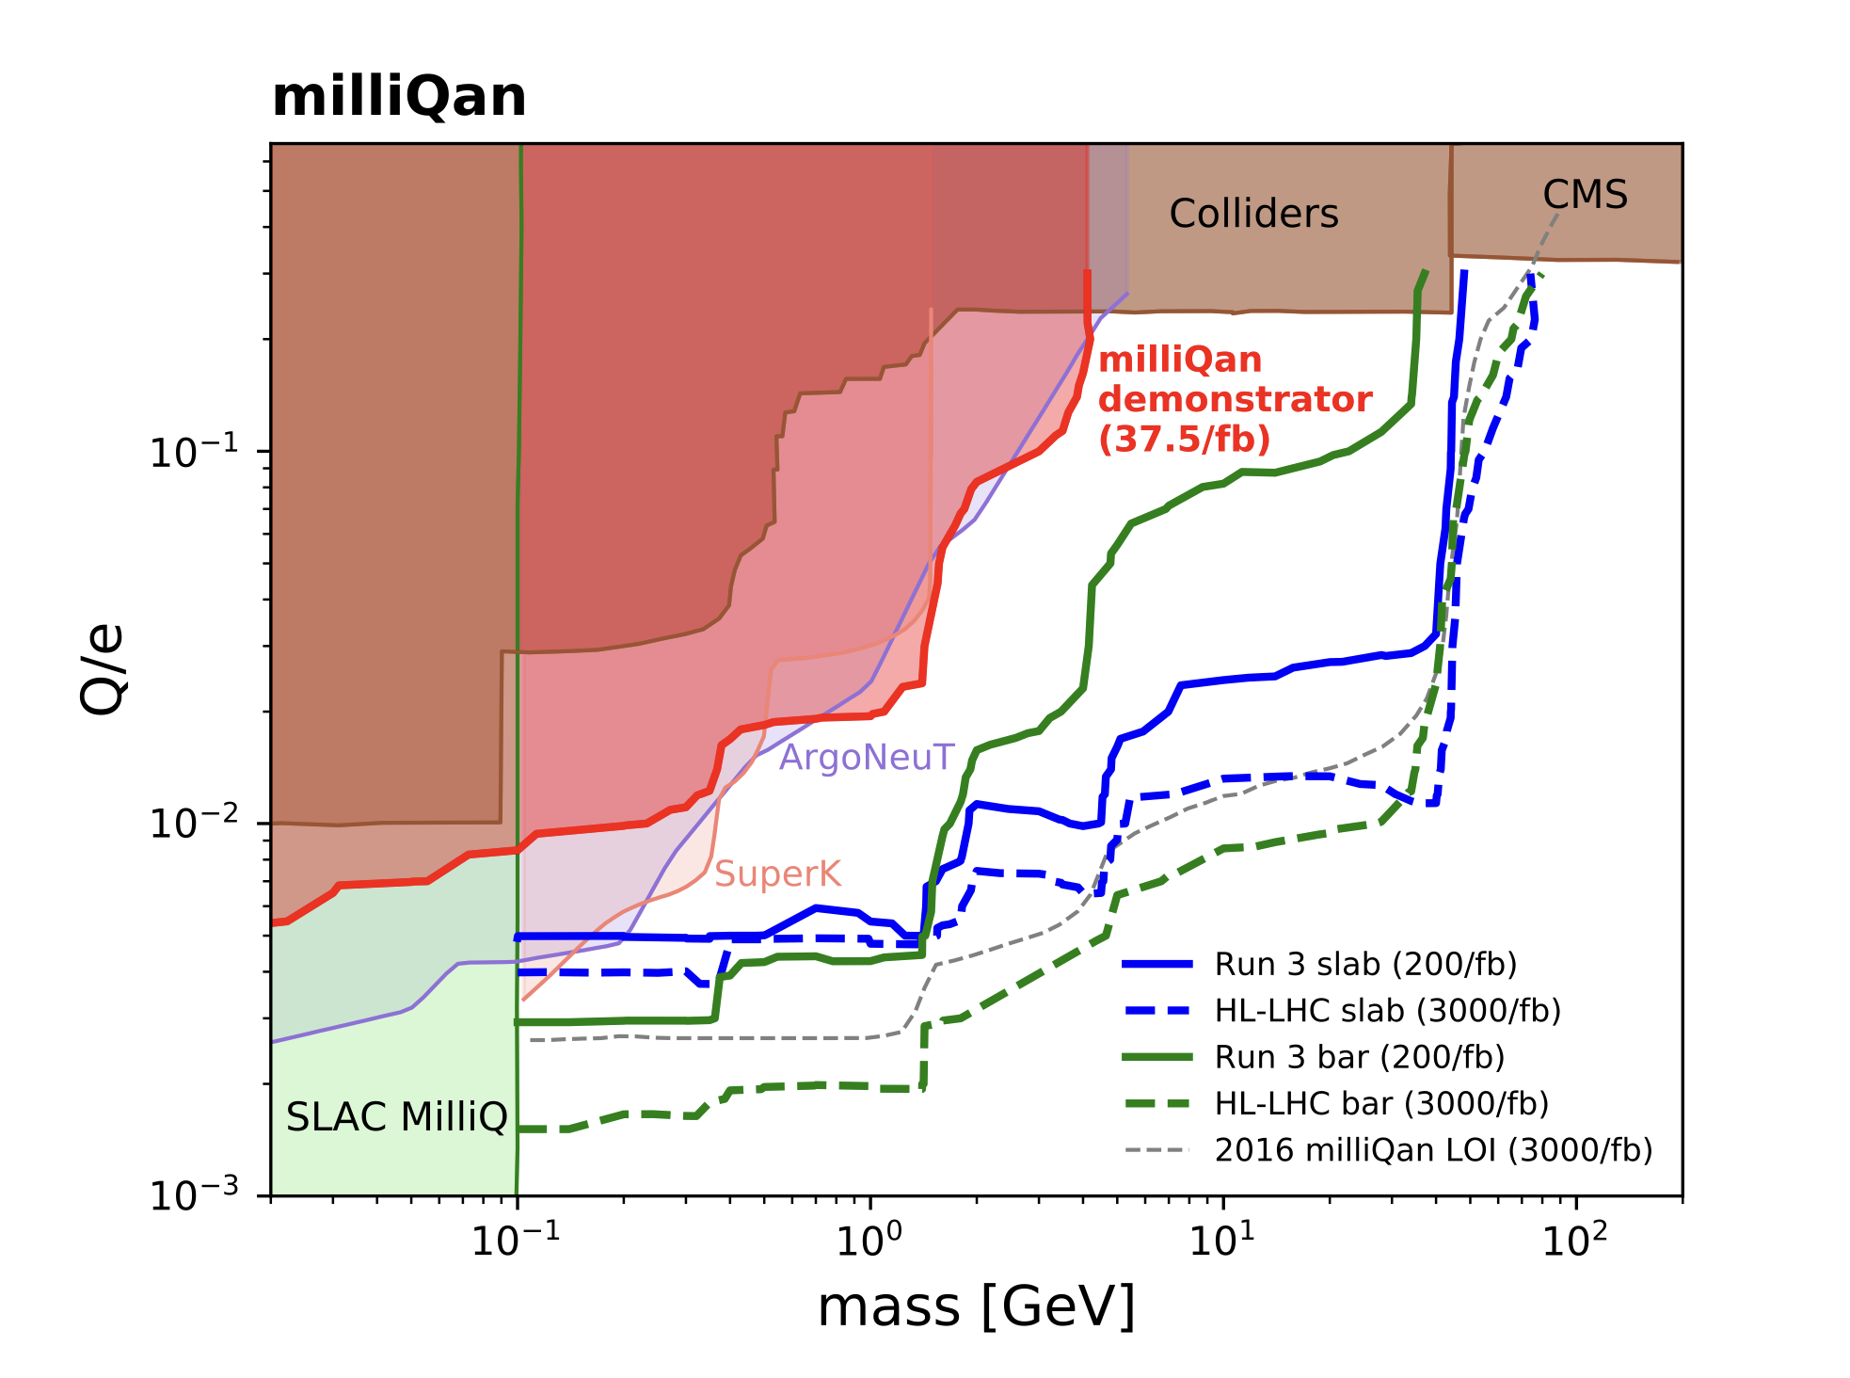
Sensitivity
Christina Dorofeev (christina.dorofeev@cern.ch)

Slide 52
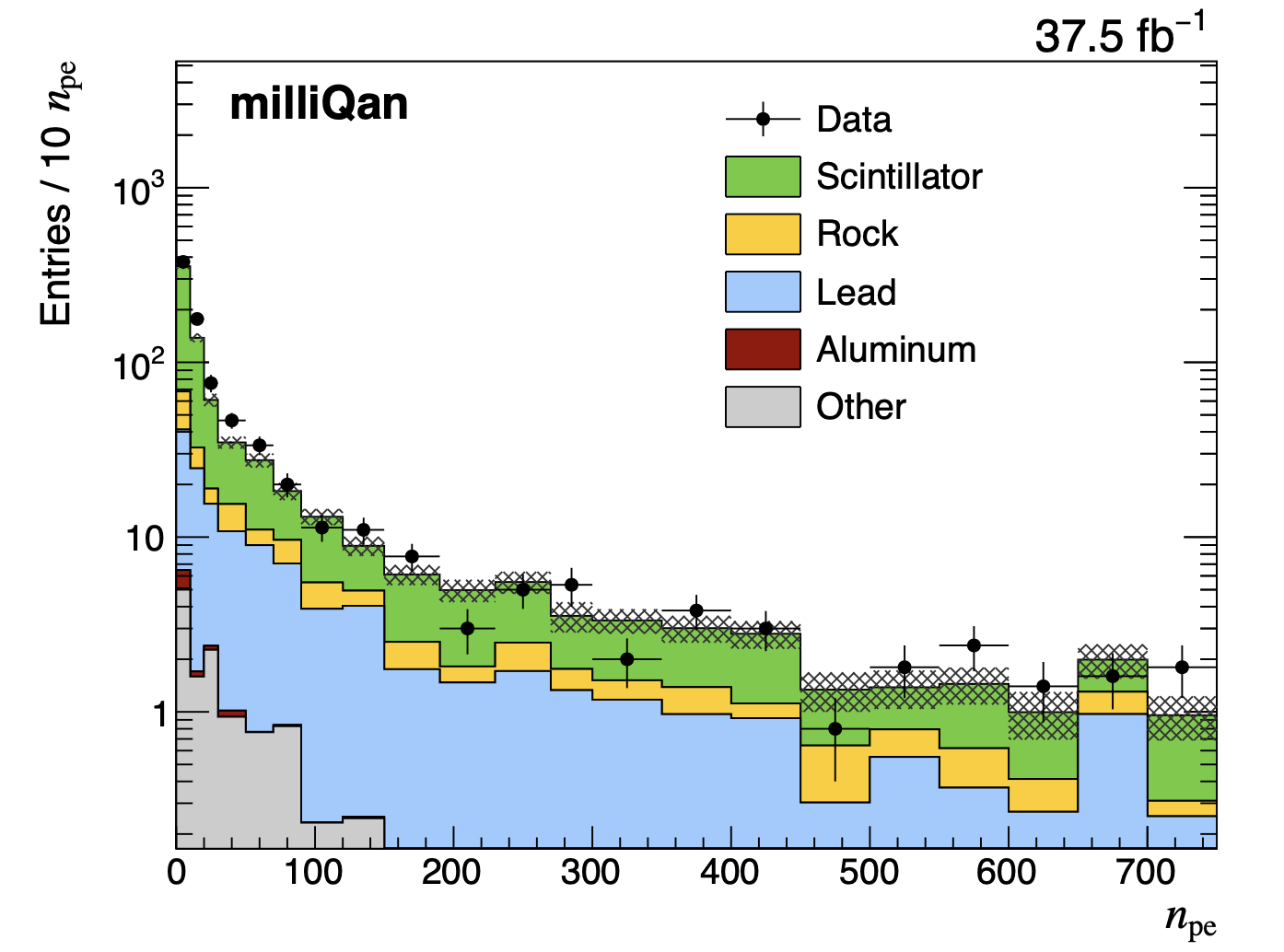
NPE distribution for tagged beam muon events
Christina Dorofeev (christina.dorofeev@cern.ch)

Slide 53
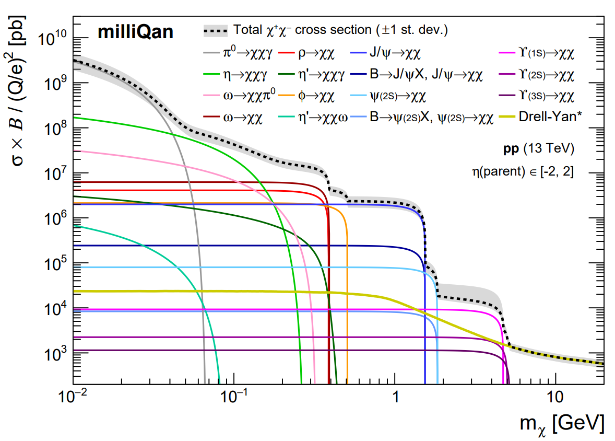
Dilepton pair production
Christina Dorofeev (christina.dorofeev@cern.ch)

Slide 54
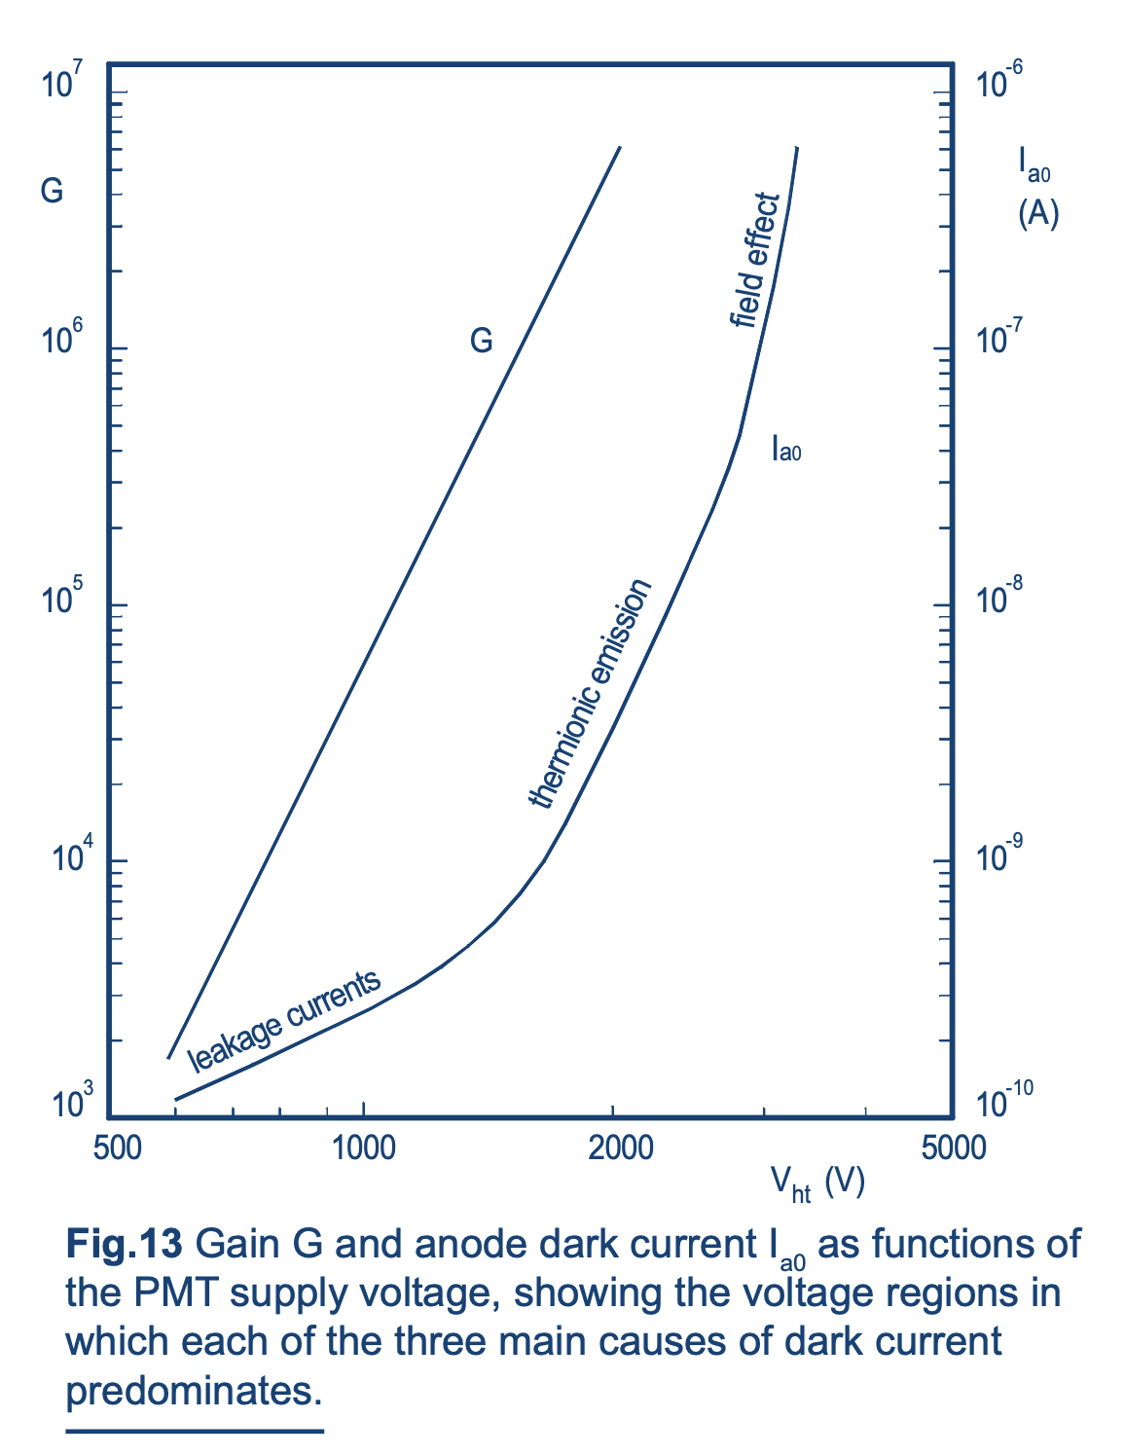
PMT dark rate
psec.uchicago.edu/library/photomultipliers/Photonis_PMT_basics.pdf
Christina Dorofeev (christina.dorofeev@cern.ch)

Slide 55
PMT mounts
Christina Dorofeev (christina.dorofeev@cern.ch)

