Slide 1
Post-Processing Images
to Detect and Characterize
Debris Disks
By Emma Davis,
Lab of Dr. Millar-Blanchaer,
with Graduate Student Mentor Connor Vancil
1/8

Slide 2
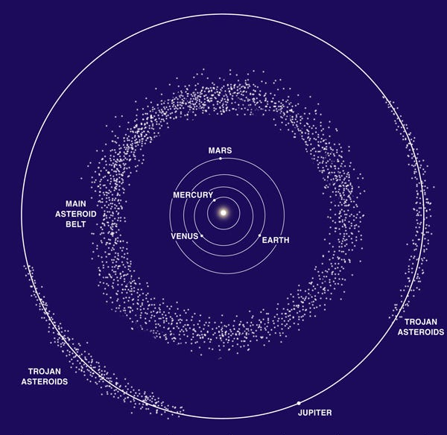
Our Solar System
← Inner Solar System
Asteroid & Kuiper Belts
Figure 1
Emma Davis (edavis@smith.edu)
Millar-Blanchaer Lab, UC Santa Barbara
Notes:
Disks in our solar system with asteroid and Kuiper belts
Know that planets such as Jupiter, as pictured, and Neptune impact the structure of these disks
See in Trojan asteroids
Also see gap in our Solar System’s disks where the terrestrial planets are
Is this structure unique, & can we use this information to determine information about extrasolar planetary systems?

Slide 3
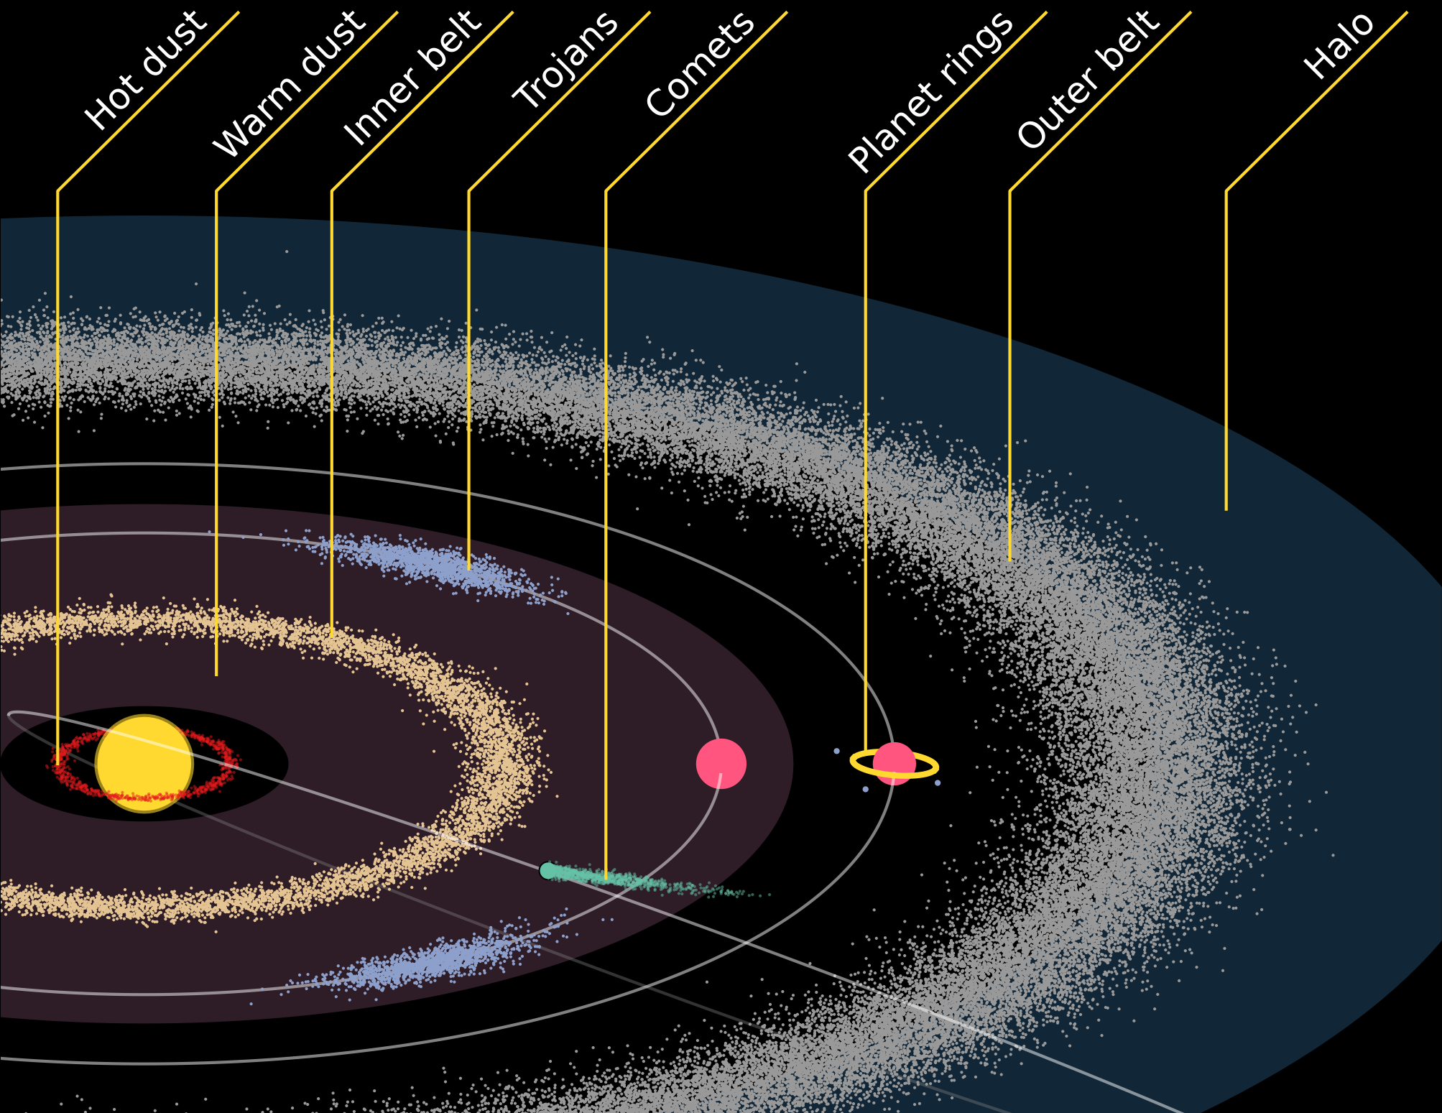
What are
Debris Disks?
Dust, Gas, & Minor Bodies
Collisions
Figure 2
Emma Davis (edavis@smith.edu)
Millar-Blanchaer Lab, UC Santa Barbara
Notes:
Debris disks are not unique to our solar system, with the first observed in 1984 around Vega; mainly discovered through ‘infrared excess’
Small bodies in a planetary system
Dust and gas → we mostly see carbon monoxide
dust → warms up like blackbody, see in infrared
Collisions & other processes break these bodies apart over time
Dust replenished by stirring processes…

Slide 4
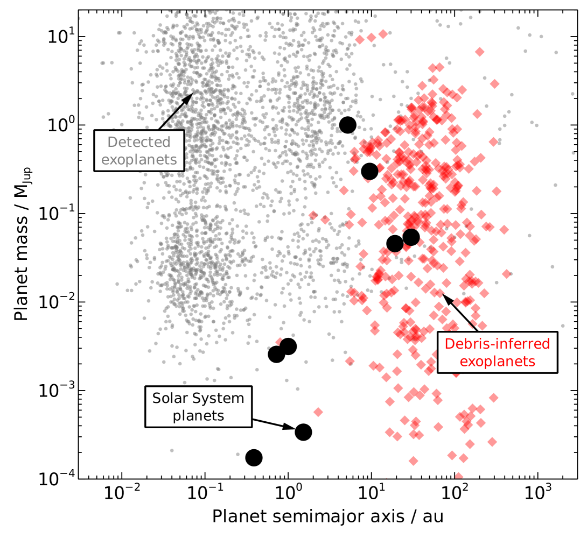
Debris Disks & Exoplanets
Scattered light & thermal emission
Exoplanets
Figure 3
Emma Davis (edavis@smith.edu)
Millar-Blanchaer Lab, UC Santa Barbara
Notes:
Dust seen in scattered light and thermal emission
Light waves proportional to size of dust
Features of disks that hint towards exoplanets → “chaotic zone”
Current methods of determining exoplanets are biased to high mass, close-in planets
Debris disks tell us more, can look in gaps, for example, and through our working methods of imaging see small structures
FROM CONNOR:
Here's why (I think) Figure 2 is important. Current exoplanet detection methods all have their biases. Radial velocity and transit ( i can explain these if necessary) are biased towards closer-in (smaller star-planet separation) orbits and higher mass planets. That's why the scatter of detected exoplanets is mostly contained to the high-mass, low separation quadrant.
Debris disks extend very far (10-100s of AUs), and there are certain features that would hint towards the existence of exoplanets within them. One such feature would be a gap. At some radius, there might be a break up of the disk (ie absence of dust/debris) and this could be an indicator that a planet has formed at that radius and has, through gravitational interactions, carved out a piece of the debris disk.
The hope then is that NMF provides better images of disks, allowing us to examine small structures like those gap. And if we find planets exist in these gaps, we effectively have more exoplanet parameter-space to explore (higher separation and lower mass) that is inaccessible to us through the other detection methods like transit and radial velocity.
At least, that's how I understand it

Slide 5
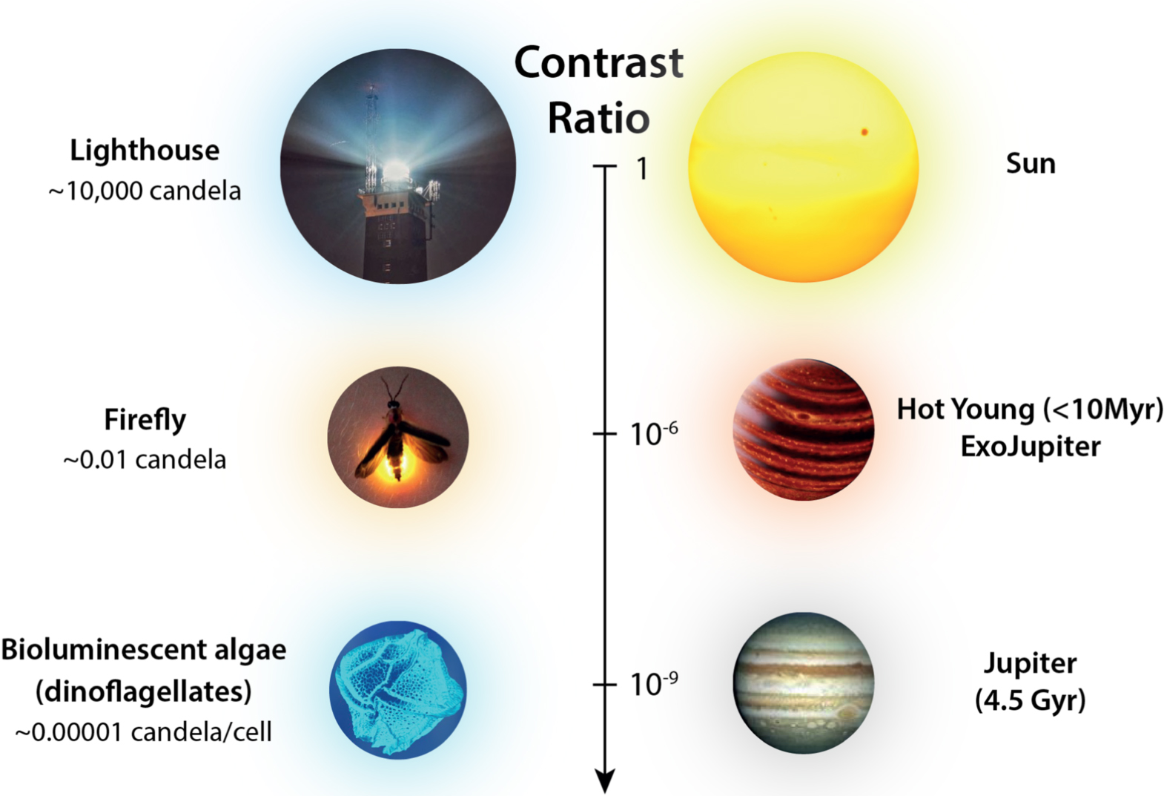
High Contrast Imaging
Debris Disks, ~10⁻⁴
Wax Candle, ~ 1 candela
Figure 4
Emma Davis (edavis@smith.edu)
Millar-Blanchaer Lab, UC Santa Barbara
Notes:
High Contrast Imaging → contrast & the necessity of image processing
High contrast (Fsource/Fstar) dim in comparison to host star
Debris disks on the order of 10^-4, which on this scale is like a candle compared to a lighthouse
Requires special techniques to see → HCI

Slide 6
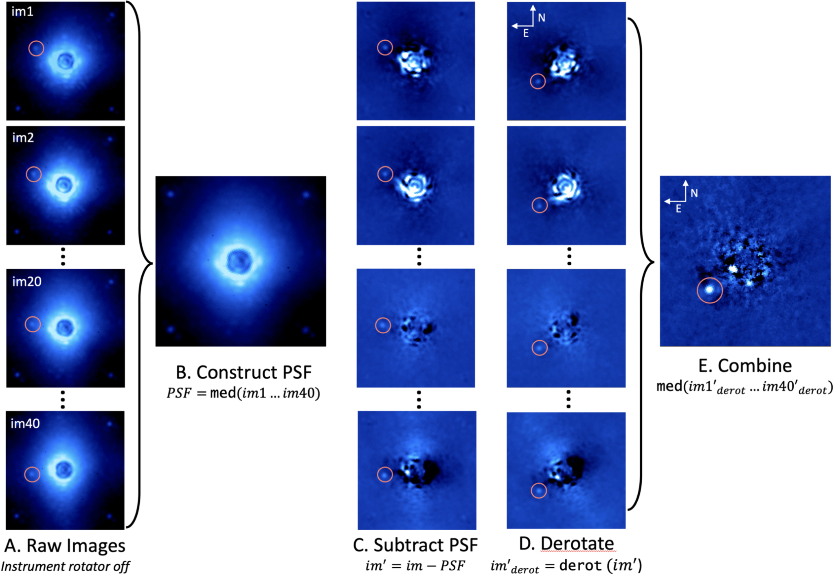
Processing with Differential Imaging
Figure 5
Emma Davis (edavis@smith.edu)
Millar-Blanchaer Lab, UC Santa Barbara
Notes:
Angular Differential Imaging (ADI) & Reference Differential Imaging (RDI):
Point Spread Functions
ADI & RDI alone aren’t enough

Slide 7
Post-processing Images
with Karhunen-Loeve Image Processing (KLIP)
“Weights”
Figure 6
Emma Davis (edavis@smith.edu)
Millar-Blanchaer Lab, UC Santa Barbara
Notes:
KLIP
Images are converted to 1d vectors & cross-correlated with all other images in the time sequence → application of Principal Component Analysis; helps identify common patterns
Modes measure variance in data; more modes = more aggressive
In application, there is self-subtraction
Position of disk changes each frame

Slide 8
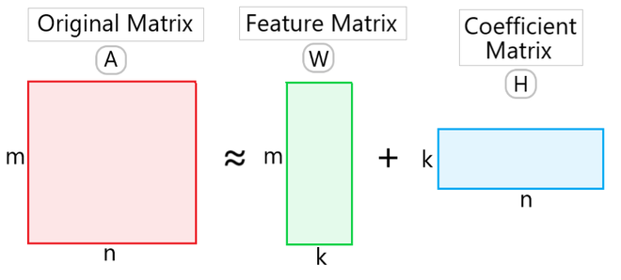
Post-processing Images
with Non-Negative Matrix Factorization
Figure 7
8
Emma Davis (edavis@smith.edu)
Millar-Blanchaer Lab, UC Santa Barbara
Notes:
Looking at image, W is the feature/component matrix, H is coefficient matrix (Weights associated with W)
Steps of NMF:
Define # of features
Decompose image into product of two non-negative matrices
Iterate until approach image → Model target with components
Linearly subtract the disk, since we have different components

Slide 9
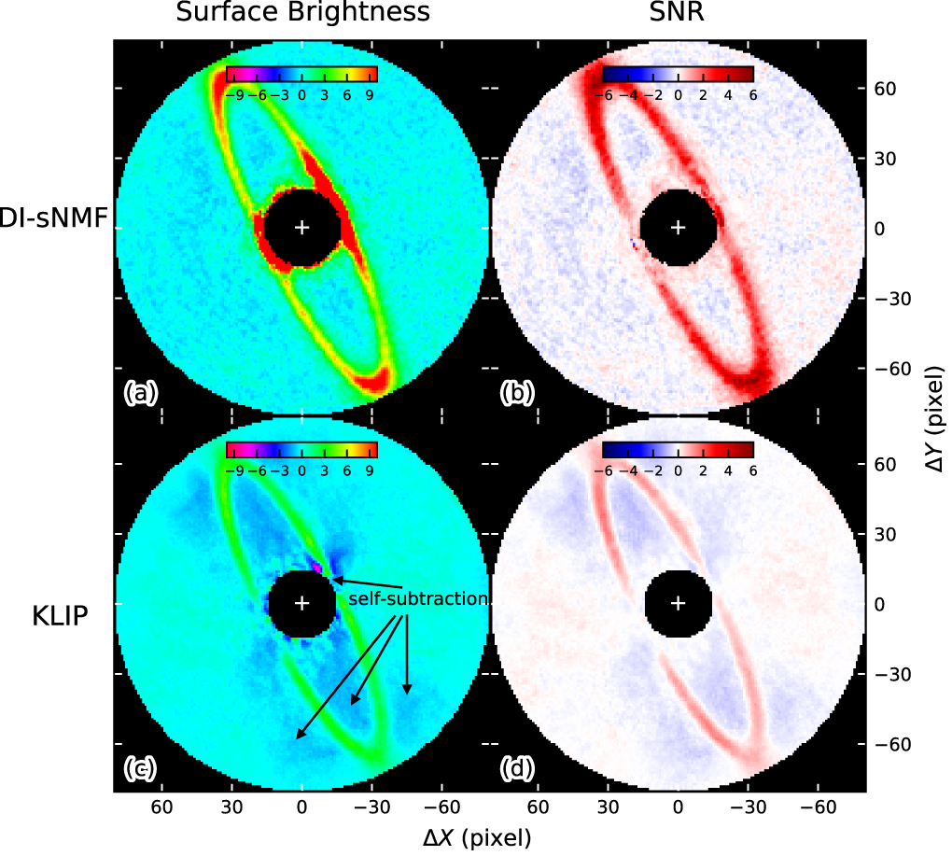
Preference of NMF
Over-subtraction
Noise removal
Figure 8
Emma Davis (edavis@smith.edu)
Millar-Blanchaer Lab, UC Santa Barbara
Notes:
The difference is the nonnegativity, which is better for noise and over subtraction
Implement this into pyKLIP code
NMF JAX allows for parallelized running of array-oriented processes on a GPU, graphics processing unit (GPU)

Slide 10
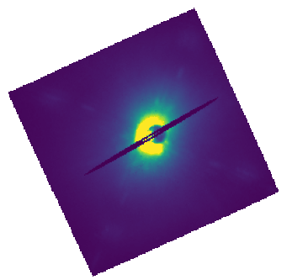
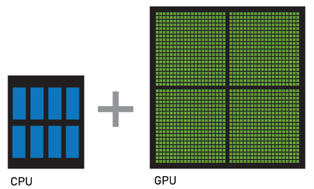
Improving NMF
JAX
Data Imputation
HD 111520
Figure 9a
Figure 9b
Emma Davis (edavis@smith.edu)
Millar-Blanchaer Lab, UC Santa Barbara

Slide 11
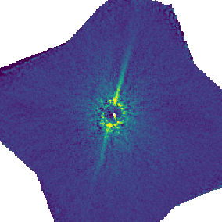
Results
Esposito et al. 2020
pyKLIP’s NMF JAX + data imputation
Emma Davis (edavis@smith.edu)
Millar-Blanchaer Lab, UC Santa Barbara
Notes:
The difference is the nonnegativity, which is better for noise and over subtraction
Implement this into pyKLIP code
NMF JAX allows for parallelized running of array-oriented processes on a GPU, graphics processing unit (GPU)

Slide 12
Results - Total Intensity
KLIP vs. {NMF JAX + masks} in pyKLIP
HD 111520
HD 106906
Emma Davis (edavis@smith.edu)
Millar-Blanchaer Lab, UC Santa Barbara
Notes:
The difference is the nonnegativity, which is better for noise and over subtraction
Implement this into pyKLIP code
NMF JAX allows for parallelized running of array-oriented processes on a GPU, graphics processing unit (GPU)

Slide 13
Results - Total Intensity
KLIP vs. {NMF JAX + masks} in pyKLIP
HD 146897
HD 32297
Emma Davis (edavis@smith.edu)
Millar-Blanchaer Lab, UC Santa Barbara
Notes:
The difference is the nonnegativity, which is better for noise and over subtraction
Implement this into pyKLIP code
NMF JAX allows for parallelized running of array-oriented processes on a GPU, graphics processing unit (GPU)

Slide 14
Results - Total Intensity
KLIP vs. {NMF JAX + masks} in pyKLIP
HD 110058
HD 143675
More to come…
Emma Davis (edavis@smith.edu)
Millar-Blanchaer Lab, UC Santa Barbara
Notes:
The difference is the nonnegativity, which is better for noise and over subtraction
Implement this into pyKLIP code
NMF JAX allows for parallelized running of array-oriented processes on a GPU, graphics processing unit (GPU)

Slide 15
Special thanks to…
Professor Max Millar-Blanchaer, Connor Vancil, and Professor Sathya Guruswamy
This work was supported by NSF REU grant PHY-2349677
Notes:
Implement this into pyKLIP code
NMF JAX allows for parallelized running of array-oriented processes on a GPU, graphics processing unit (GPU)

Slide 16
Image References
Figure 1: ESA/Hubble, M. Kornmesser. https://public.nrao.edu/blogs/what-is-a-debris-disk/
Figure 2: Pearce, Tim D. "Debris disks around main-sequence stars." arXiv preprint arXiv:2403.11804 (2024).
Figure 3: Pearce, Tim D. "Debris disks around main-sequence stars." arXiv preprint arXiv:2403.11804 (2024).
Figure 4: Photo by Anandya Permatasari on Unsplash & Follette, Katherine B. "An introduction to high contrast differential imaging of exoplanets and disks." Publications of the Astronomical Society of the Pacific 135, no. 1051 (2023): 093001.
Figure 5: Follette, Katherine B. "An introduction to high contrast differential imaging of exoplanets and disks." Publications of the Astronomical Society of the Pacific 135, no. 1051 (2023): 093001.
Figure 6: Sandrine Juillard, University of Liège
Figure 7: https://www.geeksforgeeks.org/non-negative-matrix-factorization/
Figure 8: B. Ren, Bin, Laurent Pueyo, Christine Chen, Élodie Choquet, John H. Debes, Gaspard Duchêne, François Ménard, and Marshall D. Perrin. "Using data imputation for signal separation in high-contrast imaging." The Astrophysical Journal 892, no. 2 (2020): 74.
Figure 9a: https://www.liquidweb.com/blog/gpu-vs-cpu/
Figure 9b: Gemini South GPI Data, from recipe written by Tom on mimas.dyn.berkeley.edu
Figure 10: Pearce, Tim D. "Debris disks around main-sequence stars." arXiv preprint arXiv:2403.11804 (2024).
Emma Davis (edavis@smith.edu)
Millar-Blanchaer Lab, UC Santa Barbara

Slide 17
Extra Slides
Emma Davis (edavis@smith.edu)
Millar-Blanchaer Lab, UC Santa Barbara

Slide 18
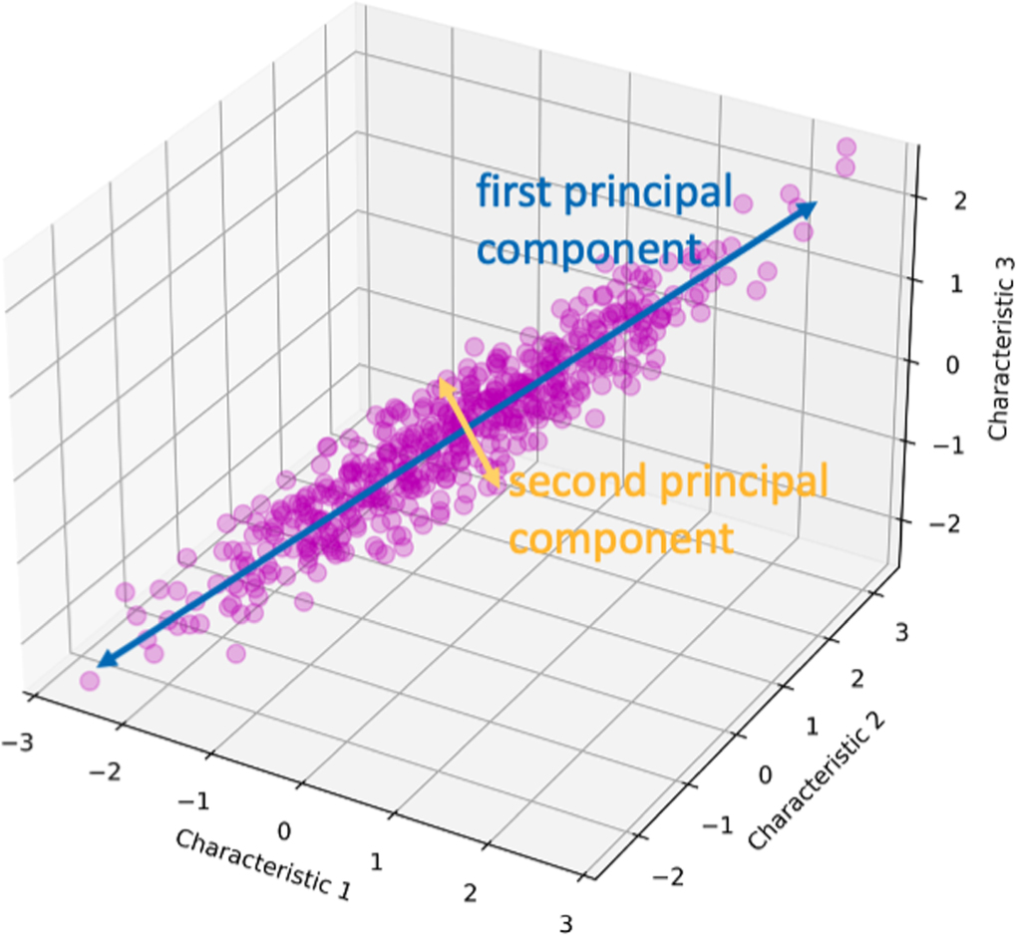
Principal Component Analysis
Emma Davis (edavis@smith.edu)
Millar-Blanchaer Lab, UC Santa Barbara

Slide 19
Non-negative Matrix Factorization Algorithm
Component Construction
Target Modeling (‘Projection’)
Best Factor Finding
Emma Davis (edavis@smith.edu)
Millar-Blanchaer Lab, UC Santa Barbara

Slide 20
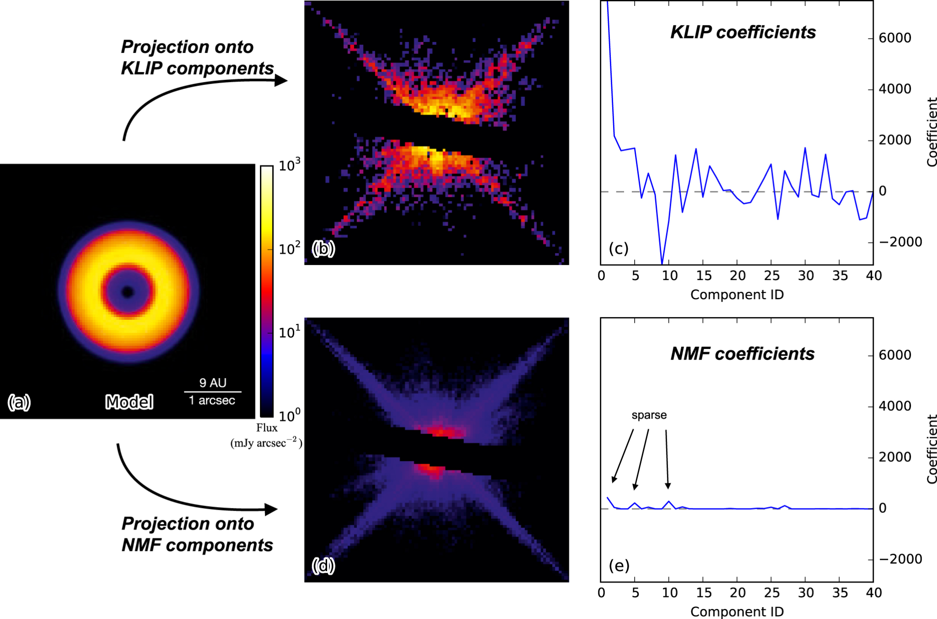
NMF vs KLIP
B. Ren et al. "Using data imputation for signal separation in high-contrast imaging." The Astrophysical Journal 892, no. 2 (2020): 74.
Emma Davis (edavis@smith.edu)
Millar-Blanchaer Lab, UC Santa Barbara

