Slide 1
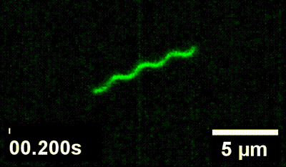
Spiraling Out of Control: Fun with Helical Colloids
Claire Atkinson
Dogic Lab
10 um
Notes:
Human hair is about 100 microns (micrometers)

Slide 2
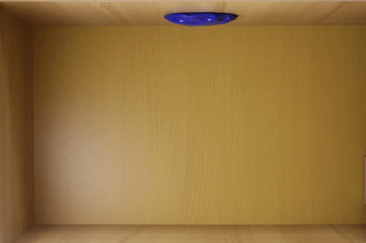
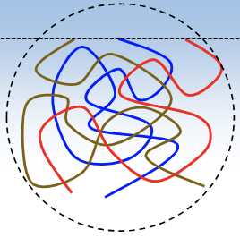
Viscoelasticity in the Everyday
Gif: hasan62. (2016). Silly putty drips from ceiling on make a GIF. MakeAGif. https://makeagif.com/gif/silly-putty-drips-from-ceiling-WKDnlz
Image: Cuccia, N. L., Pothineni, S., Wu, B., Méndez Harper, J., & Burton, J. C. (2020). Pore-size dependence and slow relaxation of hydrogel friction on Smooth Surfaces. Proceedings of the National Academy of Sciences, 117(21), 11247–11256. https://doi.org/10.1073/pnas.1922364117
Notes:
Talk about examples (shampoo, silly putty, toothpaste). Bonding energy on scale of thermal energy. Create materials with exotic properties - mix of solid and liquid
Same result with geometric system

Slide 3
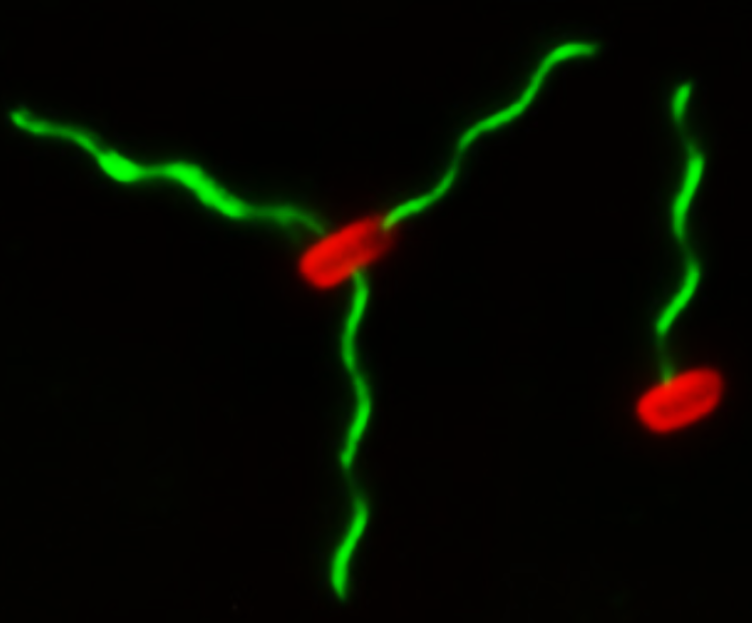
Focus on Flagella
We can get uniform “mini springs” from a biological system
2 μm
2 μm
Image: T. T. Renault, A. O. Abraham, T. Bergmiller, G. Paradis, S. Rainville, E. Charpentier, C. C. Guet, Y. Tu, K. Namba, J. P. Keener, T. Minamino, and M. Erhardt, Bacterial flagella growth through an injection-diffusion mechanism, eLife6, e23136 (2017).

Slide 4
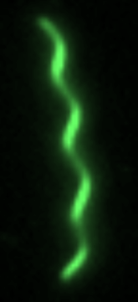
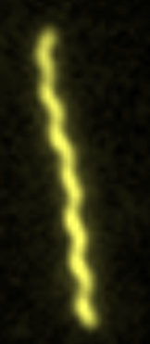
Different Shapes
Straight
Normal
Curly
Semi-Coiled
Coiled
1 μm
1 μm
1 μm
1 μm
1 μm
11 distinct conformational states
Notes:
Can alter helicity – unique material

Slide 5
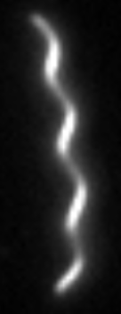
Visualizing Material Properties
1 um
1 um
Notes:
A perfect geometric system - deeply controlled

Slide 6
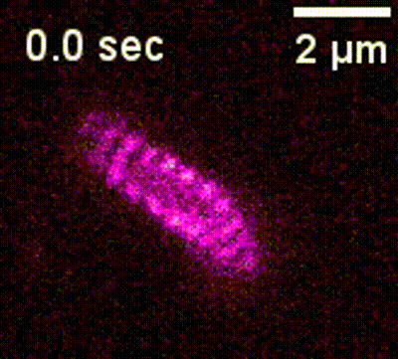
Coiled Flagella – Molecular Slinky
This shape is the most flexible (has the lowest “spring constant”)
Notes:
Molecular slinky – so tightly wound

Slide 7
Microscopic Motion

Slide 8
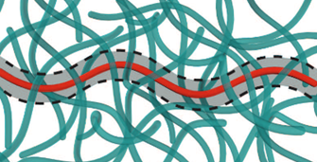
Connecting Big and Small
Viscoelasticity results from constrained microscopic motion
Image: S. Yardimci, T. Gibaud, W. Schwenger, M. R. Sartucci, P. D. Olmsted, J. S. Urbach, and Z. Dogic, Bonded straight and helical flagellar filaments form ultra-low-density glasses, Proc. Natl. Acad. Sci. 120 (2023).
Notes:
Einstein got his Nobel for Brownian motion

Slide 9
Building an Intuition

Slide 10
Coiled Flagella Diffusion
Coils diffuse on short time scales by rotating about their center
3 μm
1 μm

Slide 11
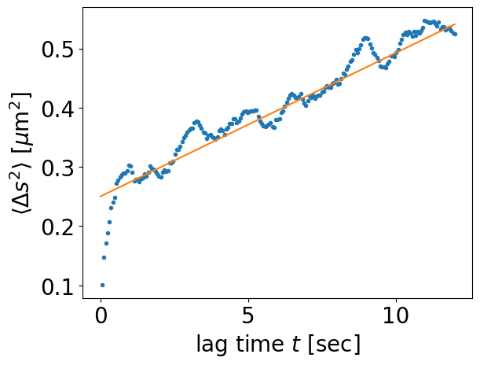
Mean Squared Displacement
Linear regime
Δs
Noise in the data

Slide 12
Macroscopic Flow Properties

Slide 13
The Science of Rheology
Apply Strain Measure Stress
Sinusoidal strain
Oscillating stress
Notes:
Storage ~ solid; Loss ~ liquid
Viscoelastic = solid + liquid
Solid = in phase
Liquid = out of phase (delay from viscosity)

Slide 14
The Science of Rheology
Measured stress
Solid response
Liquid response
Notes:
Break signal down into solid and liquid response

Slide 15
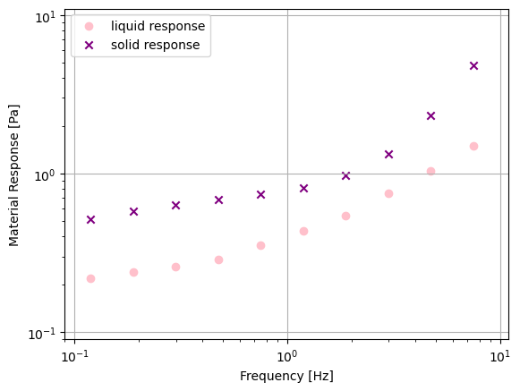
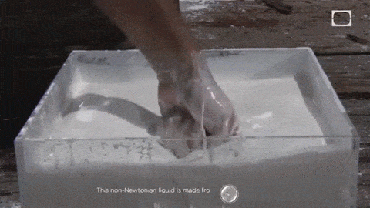
The Science of Rheology
Gif: Sciteachers. (2015, August 28). For teaching: Physics/fluid dynamics. Tumblr. https://sciteachers.tumblr.com/post/127752338182/meet-oobleck-corn-starch-a-non-newtonian
Notes:
Storage ~ solid; Loss ~ liquid
Viscoelastic = solid + liquid

Slide 16
Coiled Suspension Response
Both solid and liquid properties
Solid response predominates
No chemical linkages
This material behaves as a physical gel
Notes:
Storage ~ solid; Loss ~ liquid
Viscoelastic = solid + liquid

Slide 17
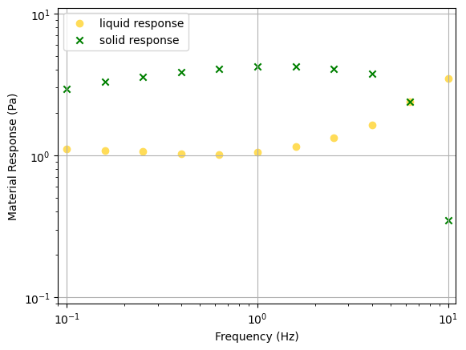
Coiled Suspension Comparison
Notes:
Storage ~ solid; Loss ~ liquid
Viscoelastic = solid + liquid

Slide 18
What does this mean?
Entanglements lead to viscoelasticity
Coil properties cause softness
3 μm
Observed gel-like properties likely result from limited center of mass translation

Slide 19
Acknowledgements
This work is supported by NSF REU grant PHY-2349677
I am also immensely grateful to my graduate mentor Nicholas Cuccia and faculty advisor Zvonimir Dogic as well as the entire Dogic Lab for creating a welcoming, fun, and inquisitive research environment. Lastly, a huge thanks to program director Sathya Guruswamy for making this whole experience possible

Slide 20
Bonus Material

Slide 21
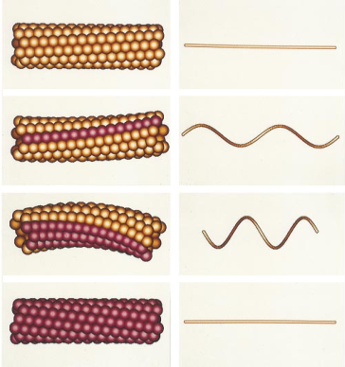
Bonus Material
NAMBA, K., & VONDERVISZT, F. (1997). Molecular architecture of bacterial flagellum. Quarterly Reviews of Biophysics, 30(1), 1–65. https://doi.org/10.1017/S0033583596003319
Aizawa, S.-I. (2015). Flagella. In Molecular Medical Microbiology (Vol. 1–3, pp. 125–146). https://doi.org/10.1016/B978-0-12-397169-2.00007-X

Slide 22
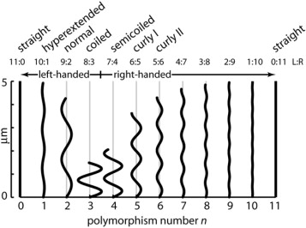
Bonus Material
NAMBA, K., & VONDERVISZT, F. (1997). Molecular architecture of bacterial flagellum. Quarterly Reviews of Biophysics, 30(1), 1–65. https://doi.org/10.1017/S0033583596003319

Slide 23
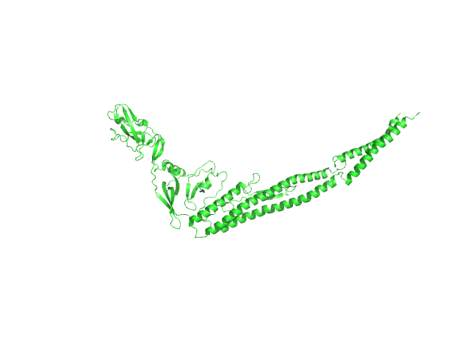
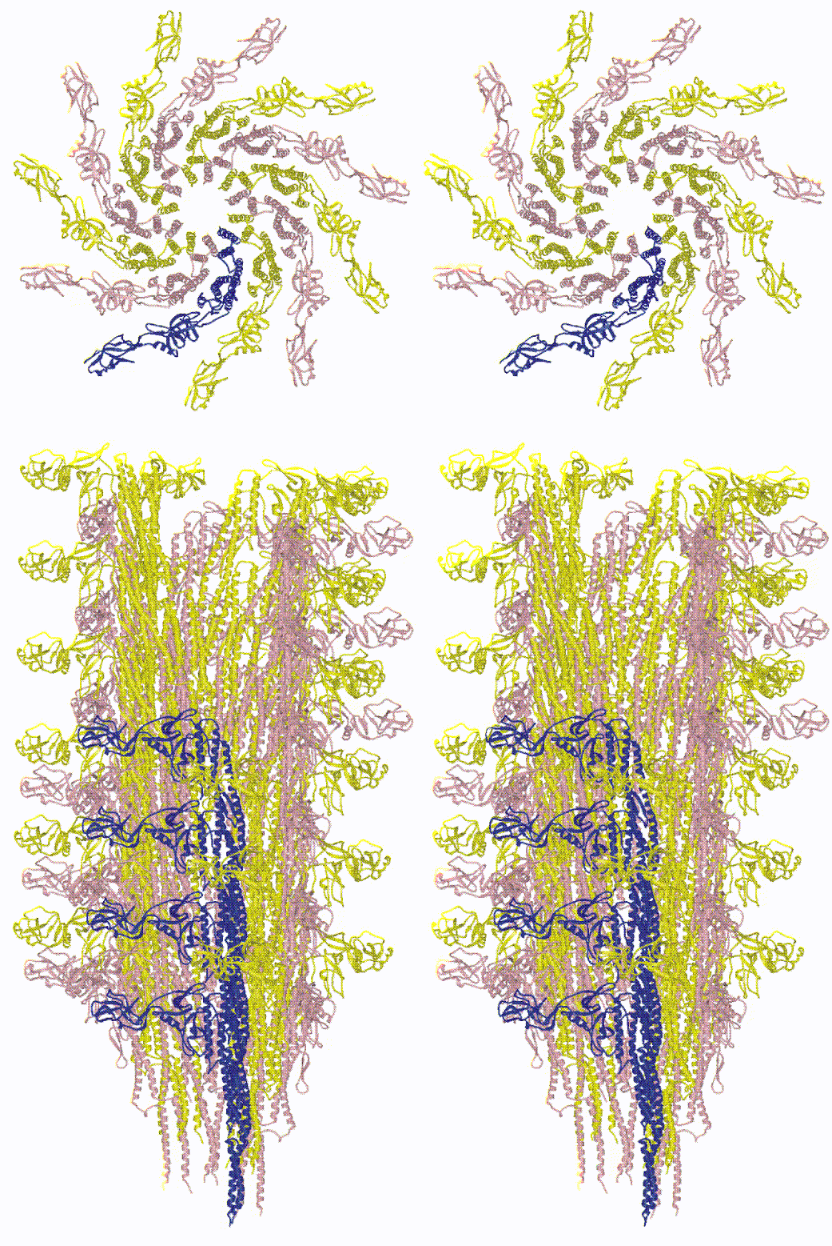
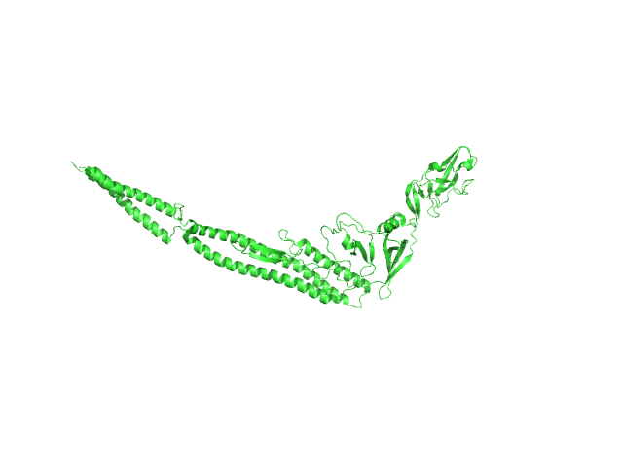
Bonus Material
“L-type” flagellin
“R-type” flagellin
Maki-Yonekura, S., Yonekura, K. & Namba, K. Conformational change of flagellin for polymorphic supercoiling of the flagellar filament. Nat Struct Mol Biol 17, 417–422 (2010). https://doi.org/10.1038/nsmb.1774

