Slide 1
Applying Non-negative Matrix Factorization to investigate the nature of Fomalhaut b
Ivan Abreu Paniagua
Dr. Max Millar-Blanchaer
Connor Vancil

Slide 2
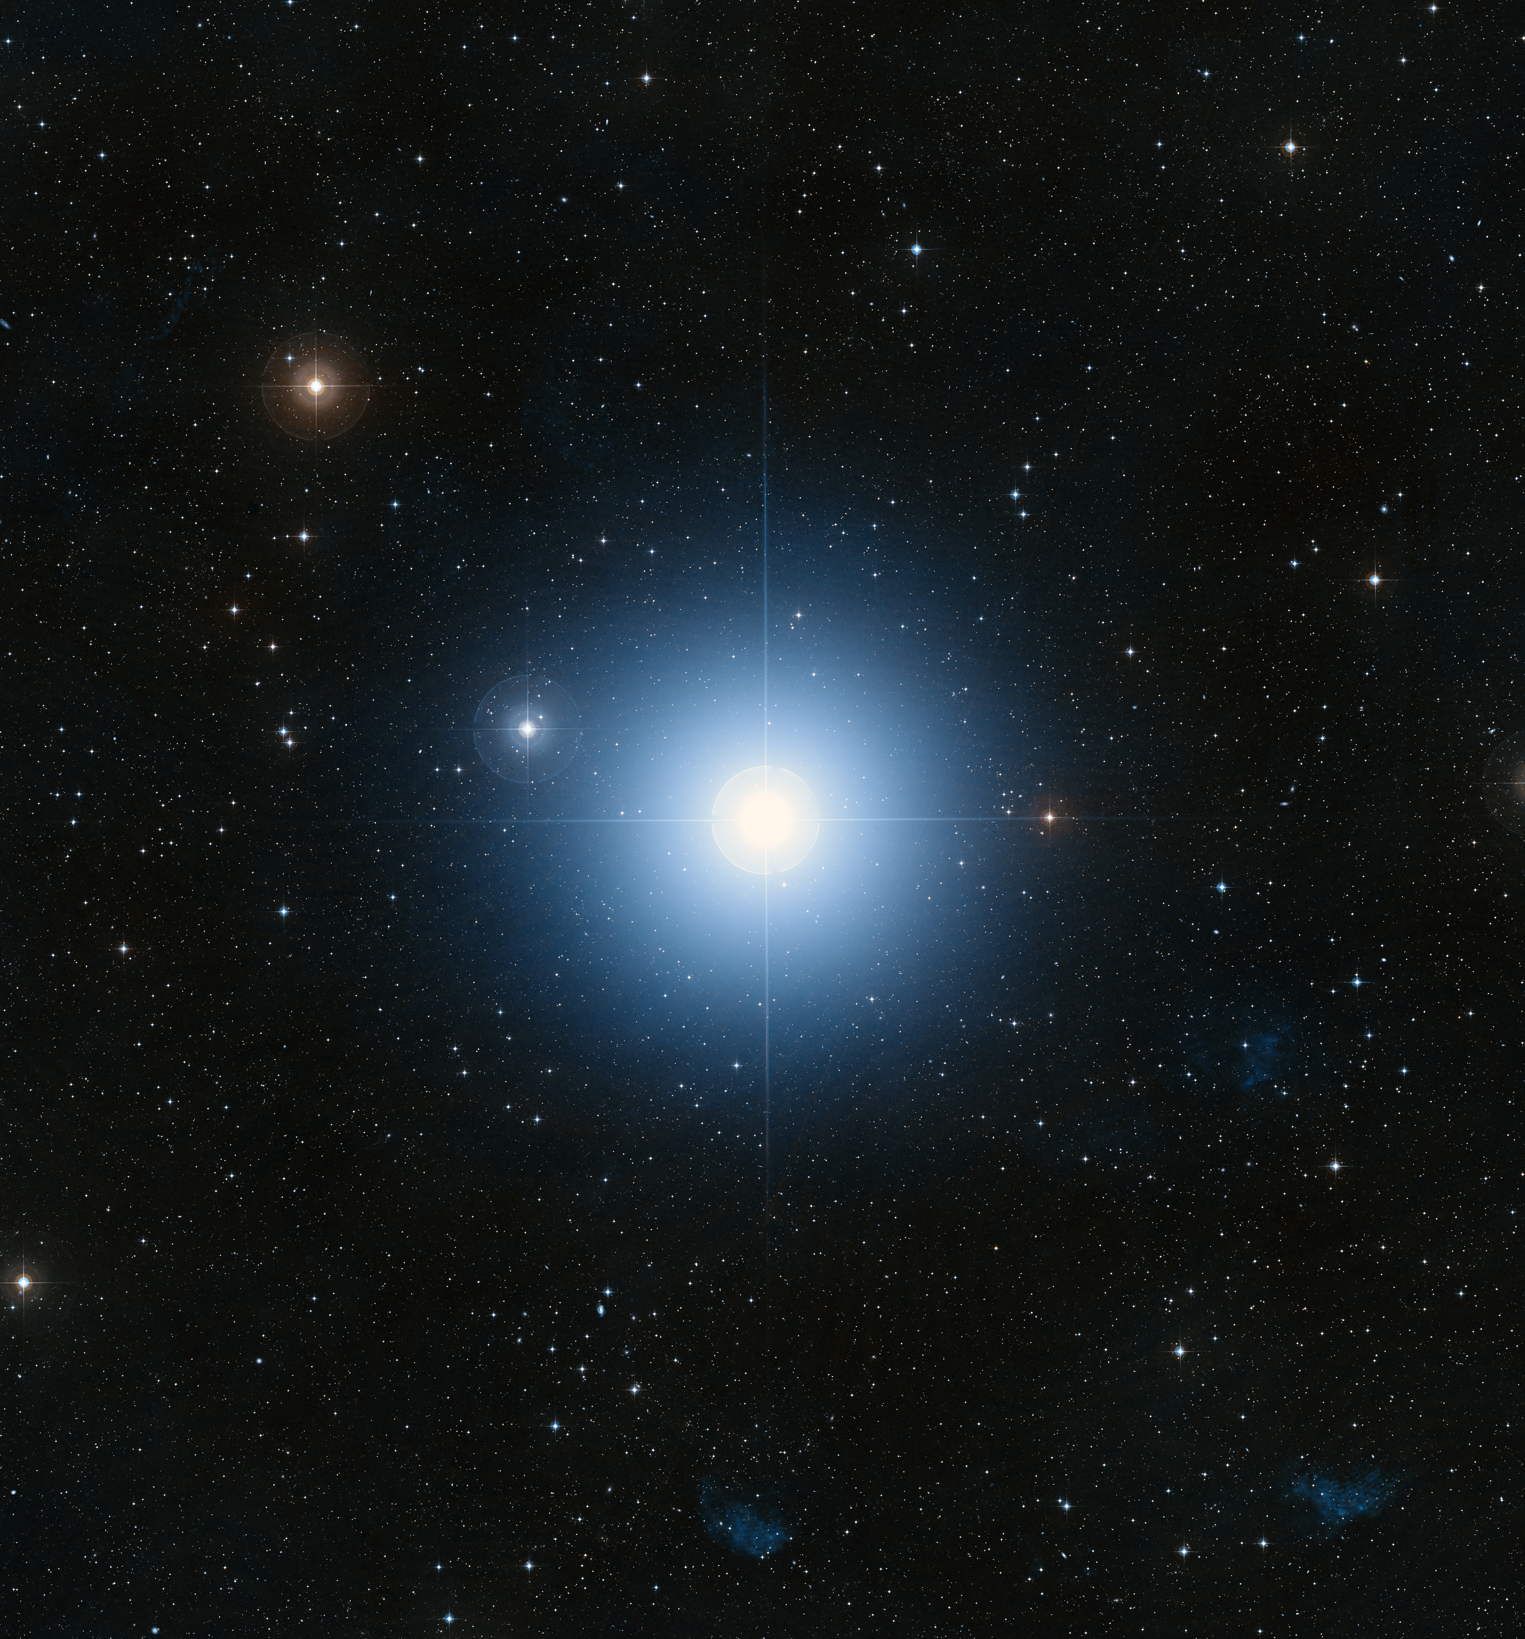
DI:
Direct Imaging
spacetelescope.org

Slide 3
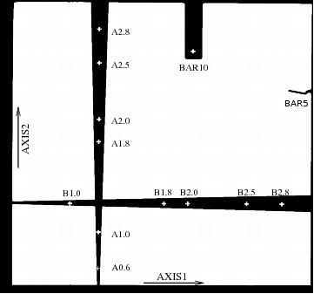
merope.as.arizona.edu

Slide 4
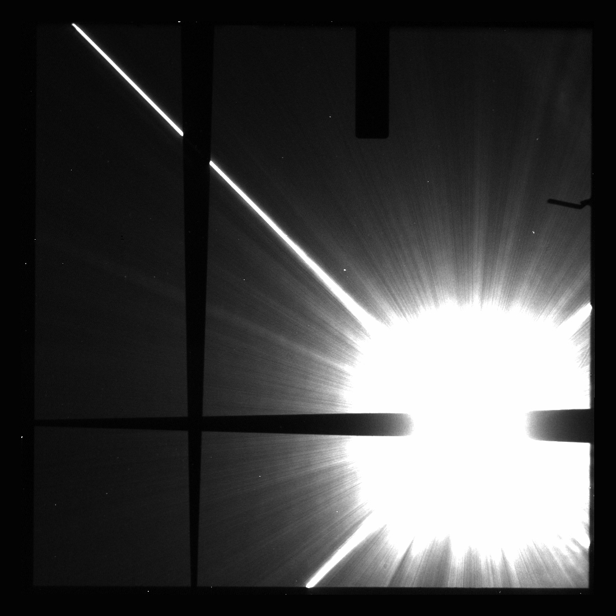
Kalas et al. 2013

Slide 5
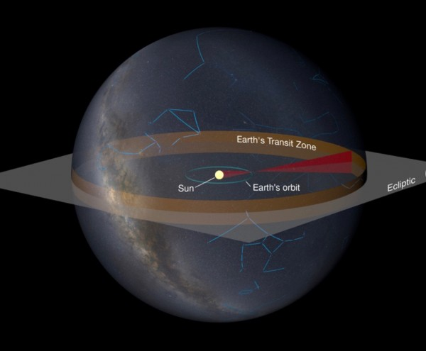
Why Use Direct Imaging?
Limited orbits where other methods are useful
Gather more data on the system/planet
Quetz A., Mellinger A.

Slide 6
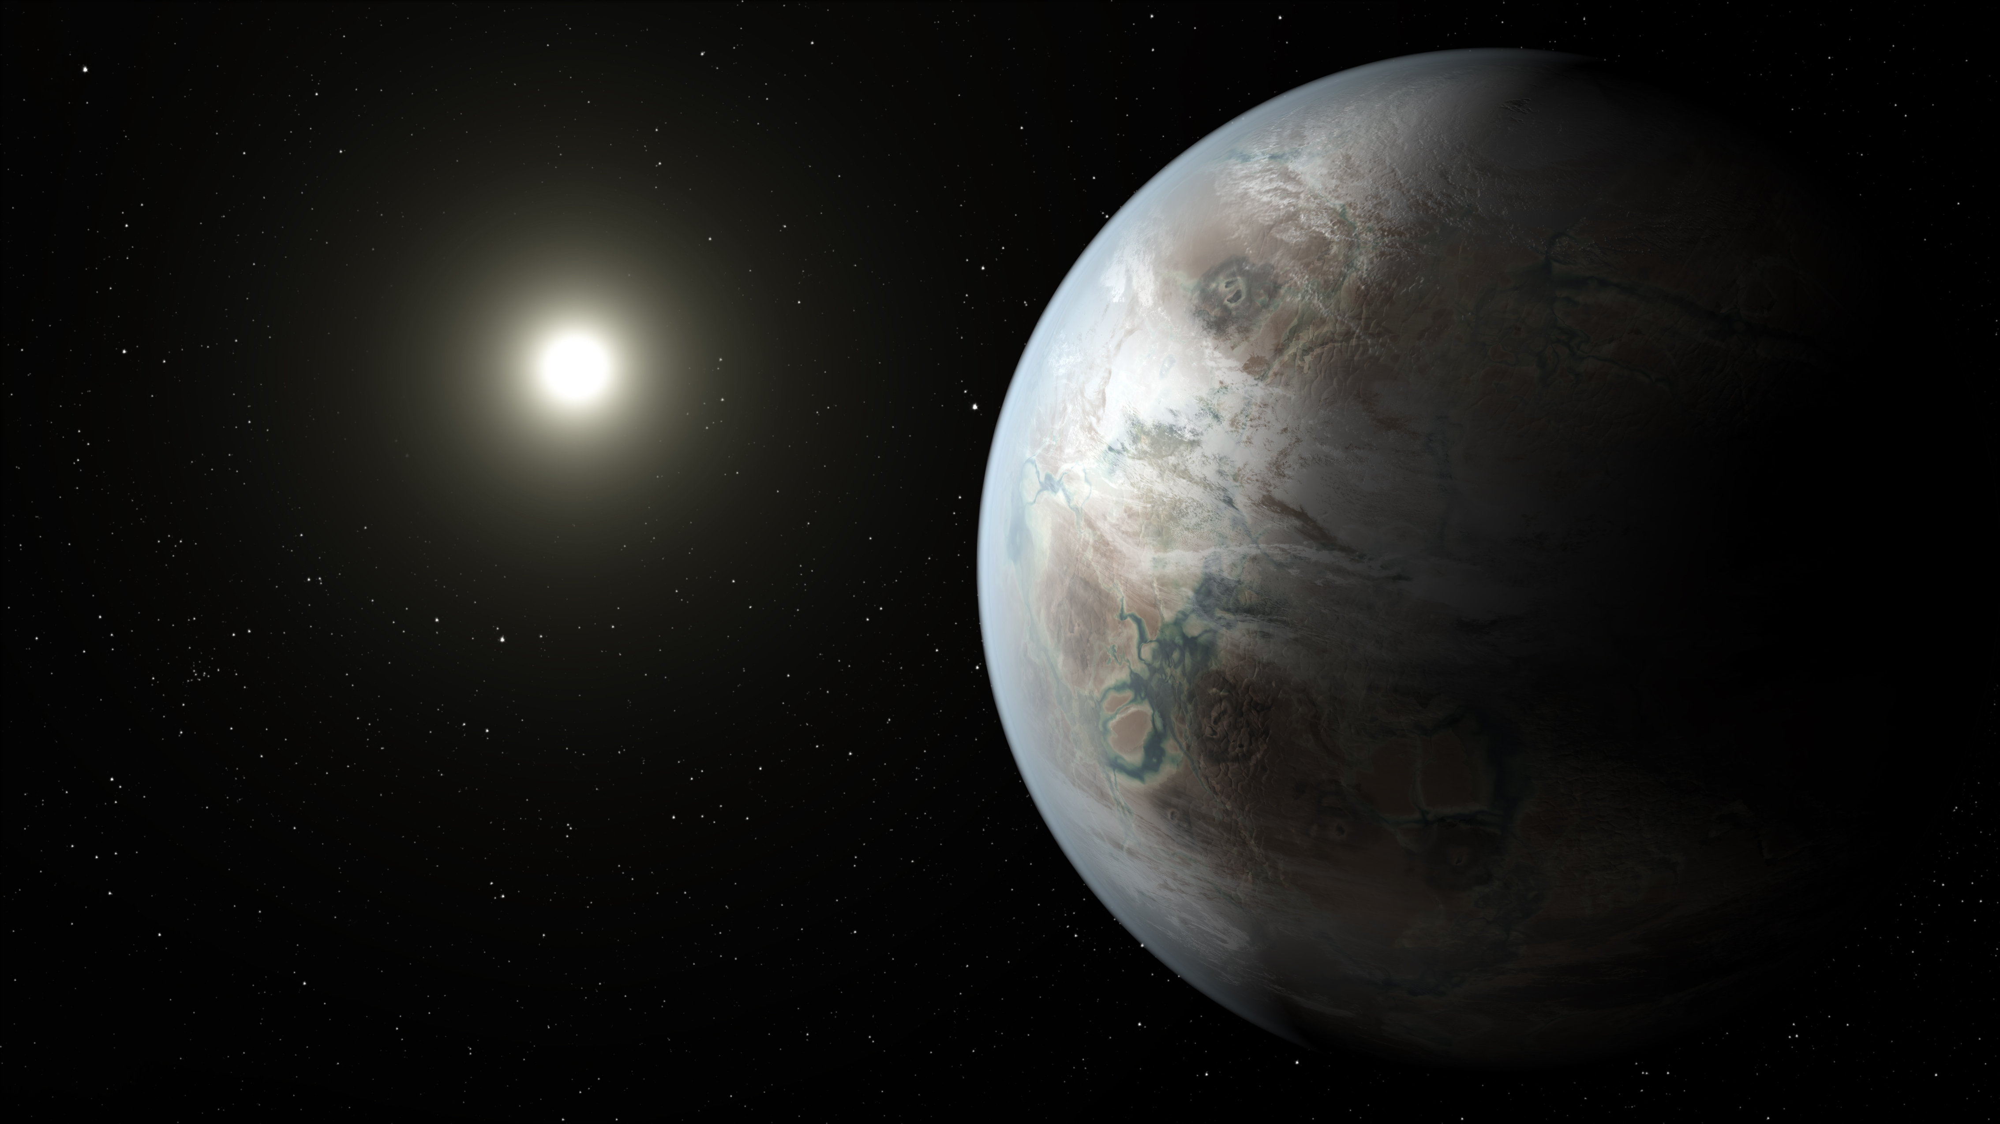
Earth-like planet
Sun-like star
Currently impossible to DI one
Baby steps-
Work with big and bright planets
Planetary Science
nasa.gov

Slide 7
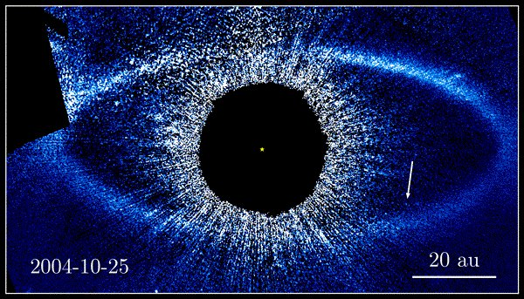
Fomalhaut b
“Exoplanetary” system 25 ly away
First imaged by HST in 2004
Dust/collision cloud theory is incomplete
hubblesite.org
Notes:
“Exoplanetary” system 25 ly away
Includes debris disk
First imaged by HST in 2004
Believed to be an exoplanet at first
New research (Galicher et al. 2013) suggested dust cloud
Dust/collision cloud theory is incomplete
Simulations do not match data
Unlikely for this event to be observed

Slide 8
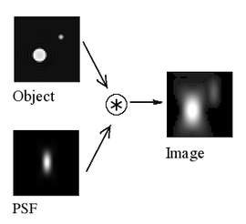
A couple of problems
Quasi-static Features
Point Spread Function (PSF)
commons.wikimedia.org/wiki/File:Convolution_Illustrated
Notes:
Direct Imaging of Exoplanetary systems
Problems with gathering data
Noise, telescope imperfections (Quasi-static features, aka, Speckles)
Point Spread Function (PSF)

Slide 9
spacetelescope.org

Slide 10
How to Account for Complications
Methods to account for problems
ADI (Angular Differential Imaging)
RDI (Reference Differential Imaging)
SDI (Spectral Differential Imaging)
LOCI (Locally Optimized Combination of Images)
KLIP (Karhunen-Loeve Image Projection)

Slide 11
Non-negative Matrix Factorization (NMF)
Newer processing method
Works well with expanded/broad sources of light
Iterative operations
Long computing times!

Slide 12
Target
Kalas et al. 2013

Slide 13
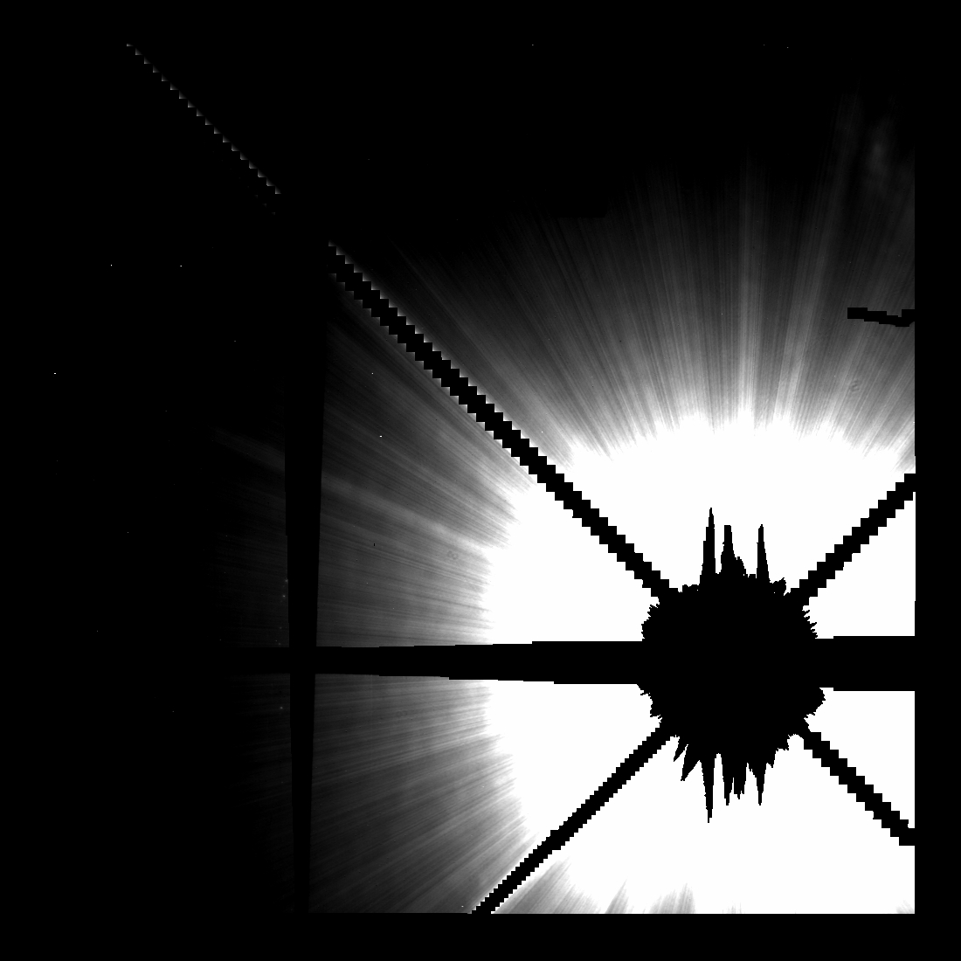
Components (Built from references)

Slide 14
Modelling

Slide 15
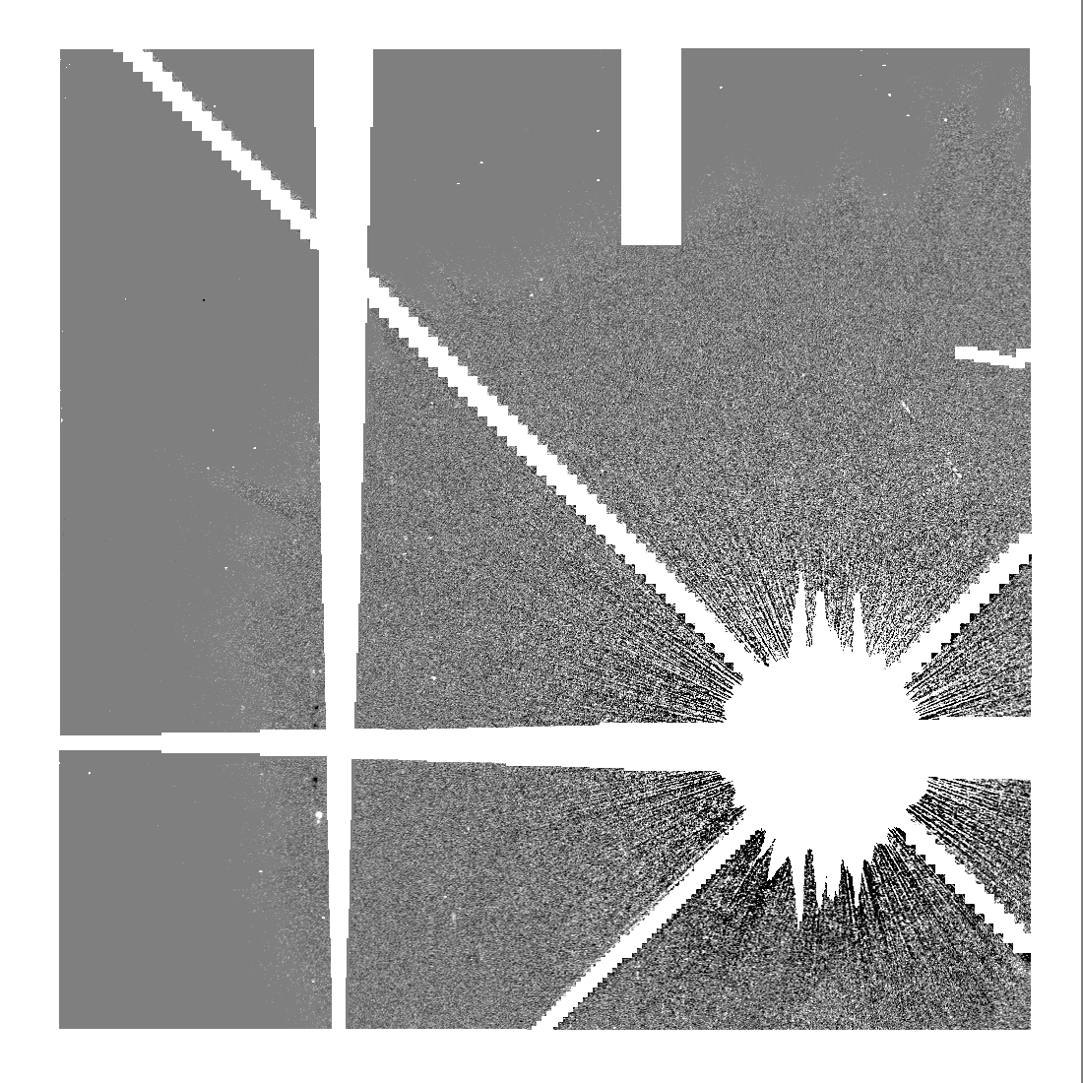
Subtraction

Slide 16
How to Improve on NMF
NMF is iterative, long computing for bigger data sets
JAX JIT to speed up vector operations
github.com/google/jax
Notes:
Utilize NMF on exoplanetary data
Modify NMF algorithm to run on GPUs
Apply new algorithm to previous data from Fomalhaut b
Goals:
Use algorithm to analyze data from the next HST observation
Possibly solve the mystery behind Fomalhaut b

Slide 17
On my Mac
1080 sec
(18 min)
vs
1160 sec
(19.3min)
vs
60 sec
+1800%
+1900%
On Mueller
On Mueller w/ JAX JIT*

Slide 18
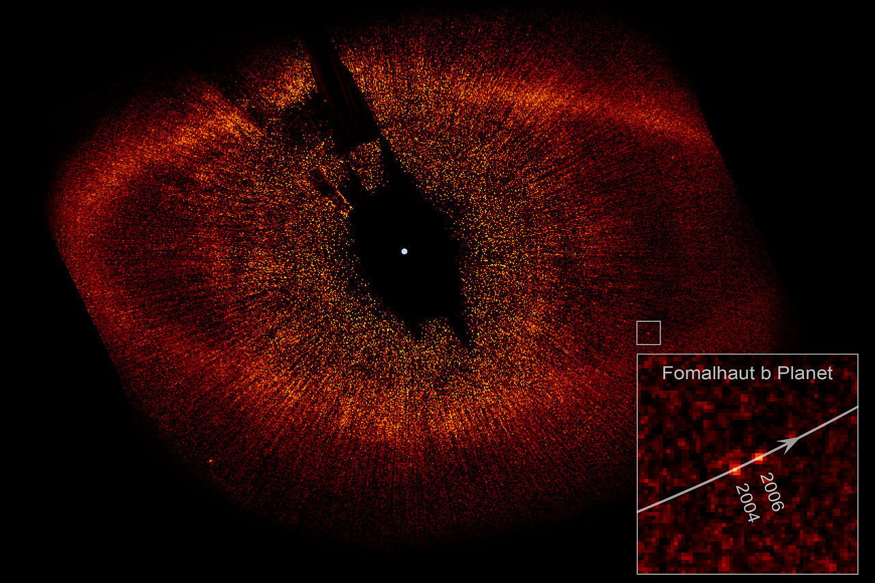
Kalas et al. 2008

Slide 19
Rotate image
Re-center to common point
Stack them all together (Get the median)

Slide 20
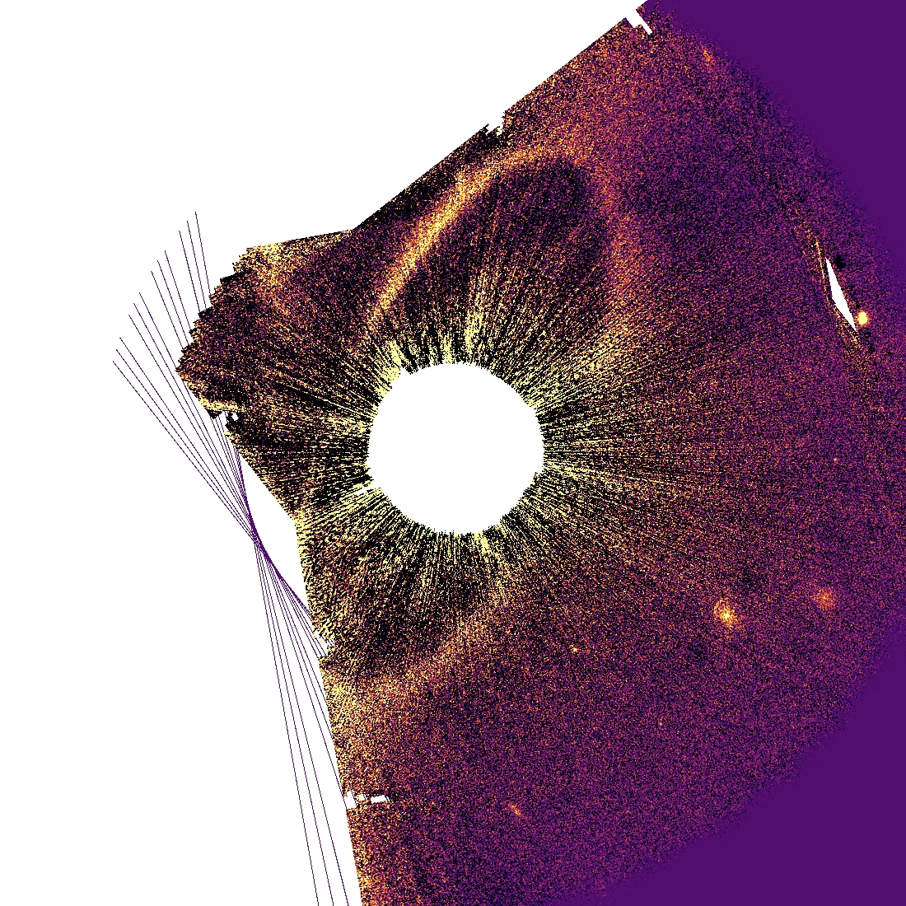

Slide 21
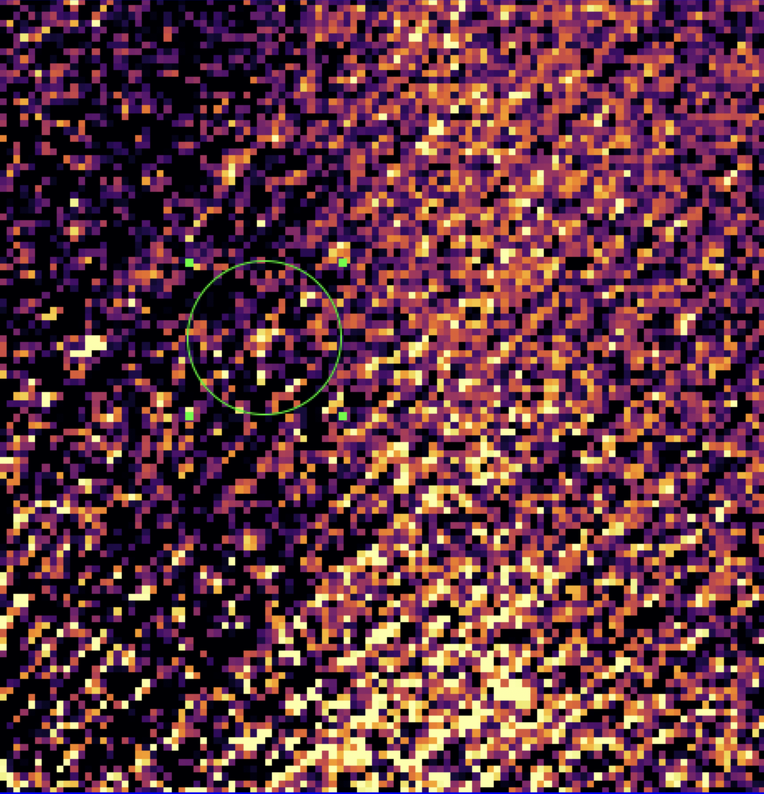

Slide 22
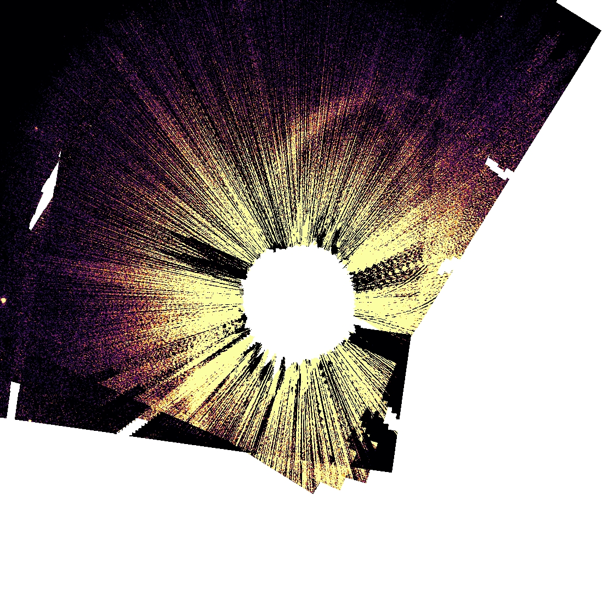
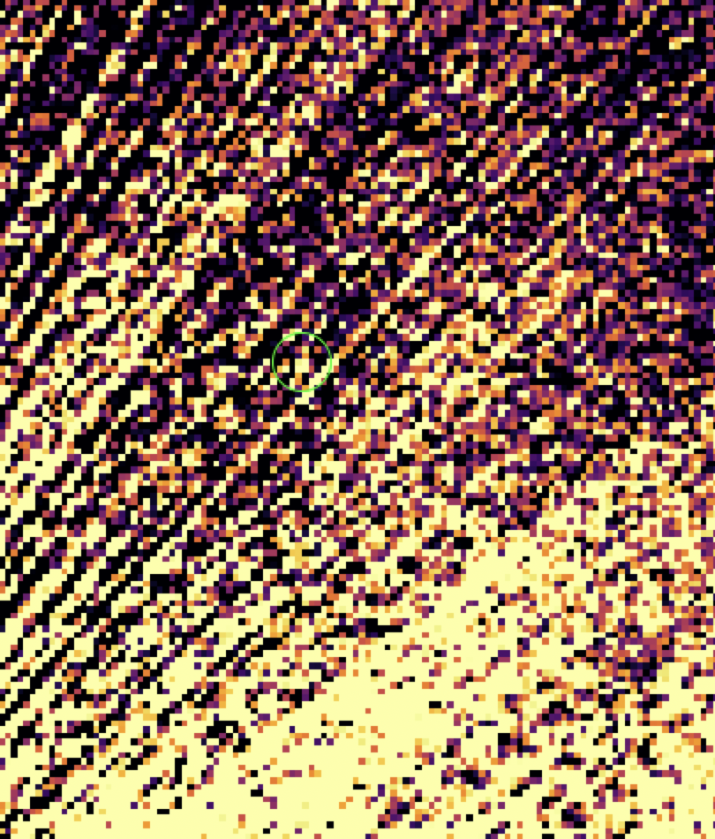

Slide 23
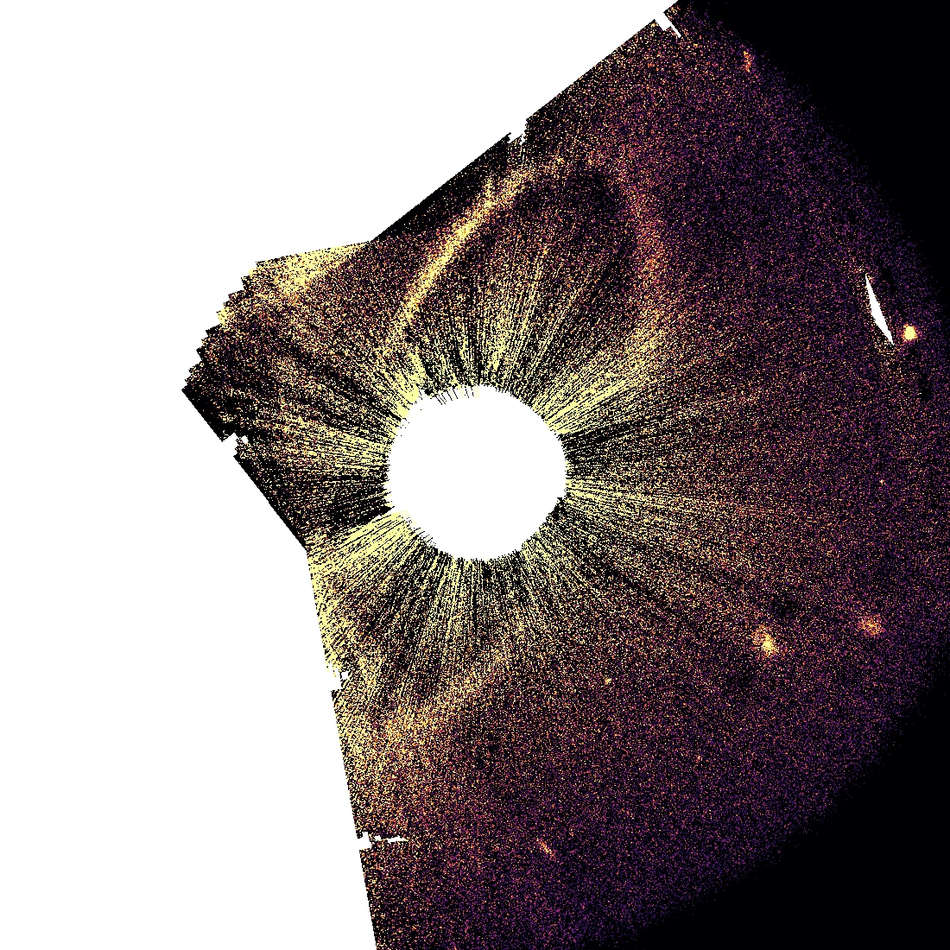
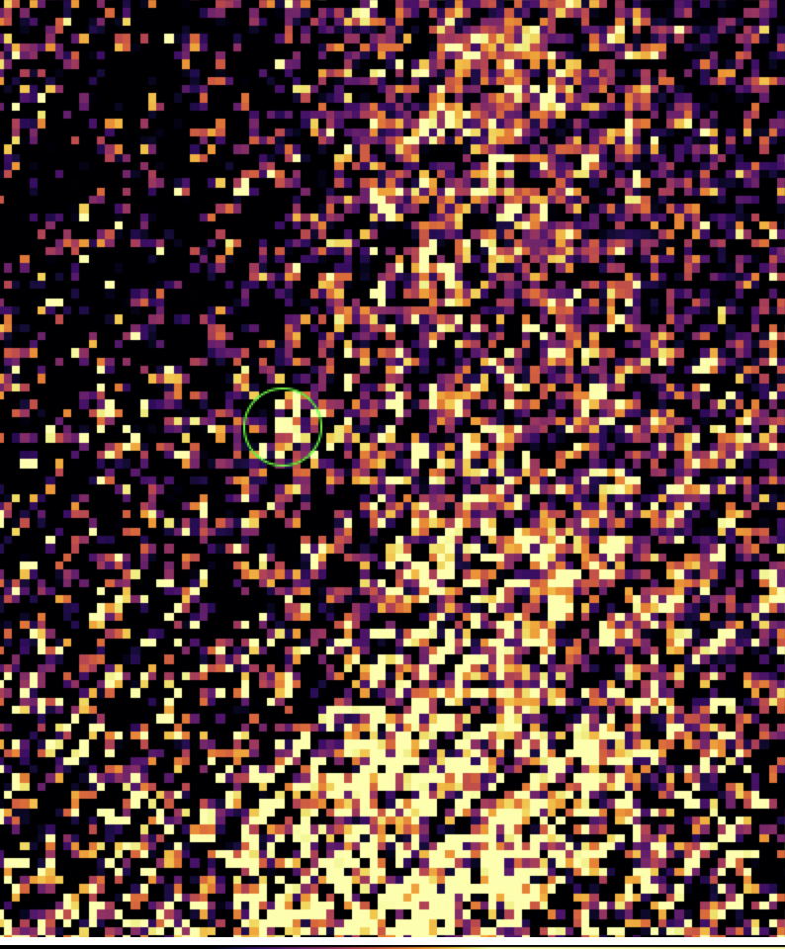

Slide 24
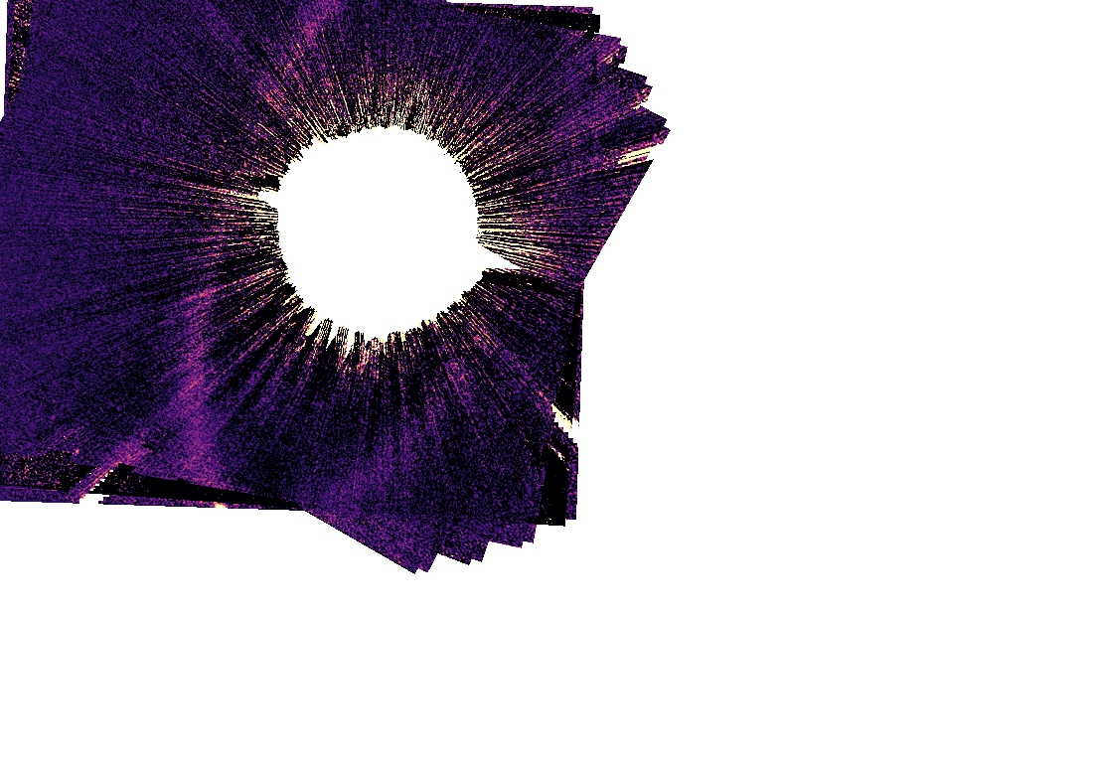

Slide 25
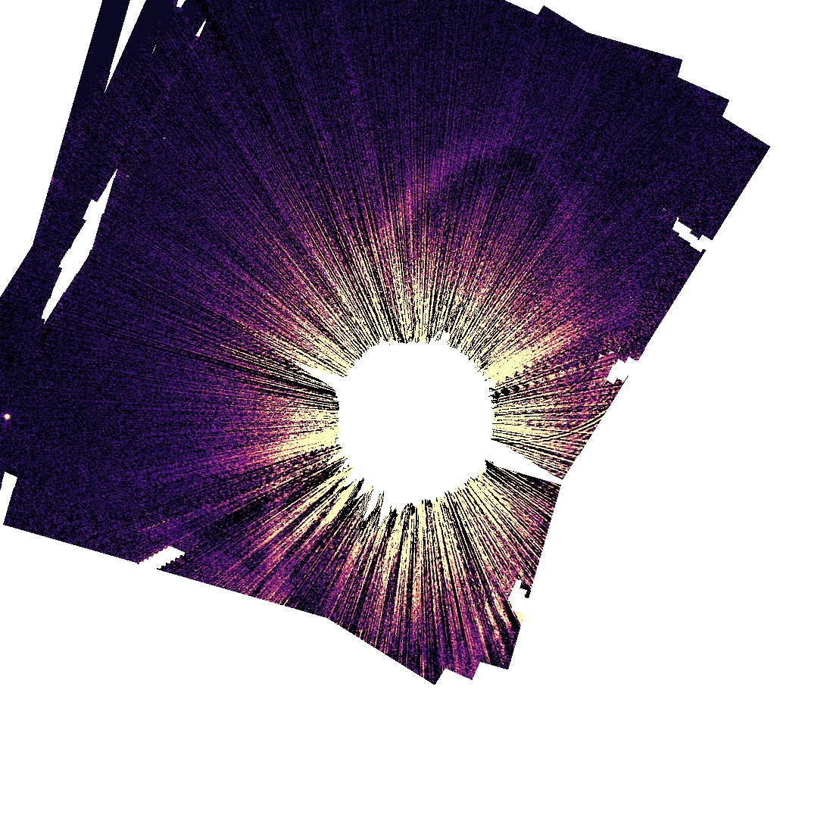

Slide 26
Next steps
Continue to tweak parameters for better image
Examine the size and flux of Fomalhaut b
Process data from the September HST run

Slide 27
A Special Thanks
This opportunity would not have happened without the help of
My advisor, Dr. Max Millar-Blanchaer
My graduate student mentor, Connor Vancil
The UCSB REU Program Director, Dr. Sathya Guruswamy
And the funding and support from the National Science Foundation
This project was funded by NSF Grant PHY-1852574

