Slide 1
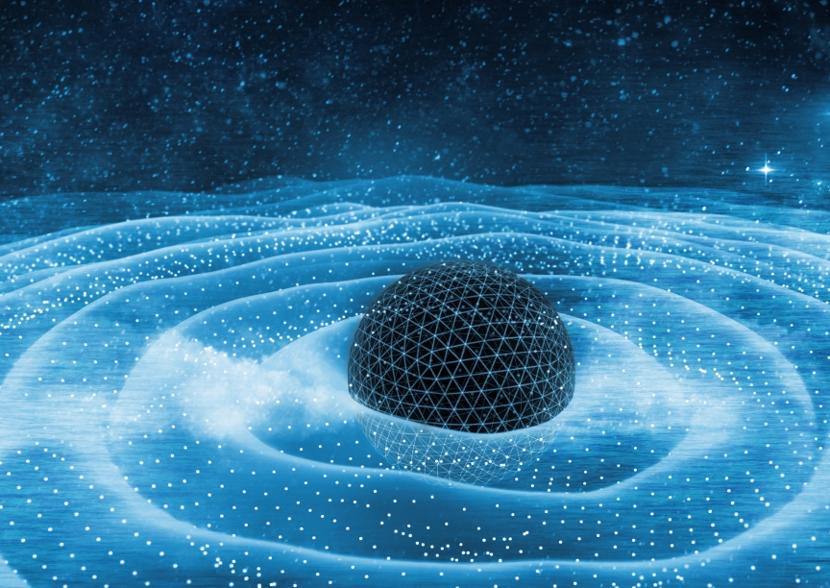
Uncovering the Secrets of Gravity
Drew Rosenblum
Mentor: Zhencheng Wang
Advisor: Don Marolf

Slide 2
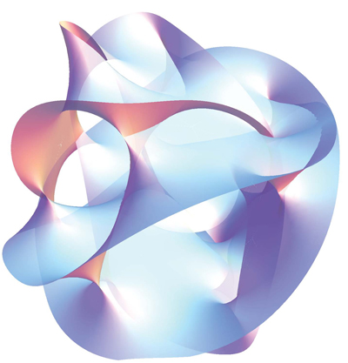
Overview of Research
Construct a theory of gravity consistent with the rules of quantum mechanics (extremely difficult)
Testable predictions do not exist yet
(N.d.). PlusMath. Retrieved August 12, 2023, from https://plus.maths.org/content/hidden-dimensions.

Slide 3

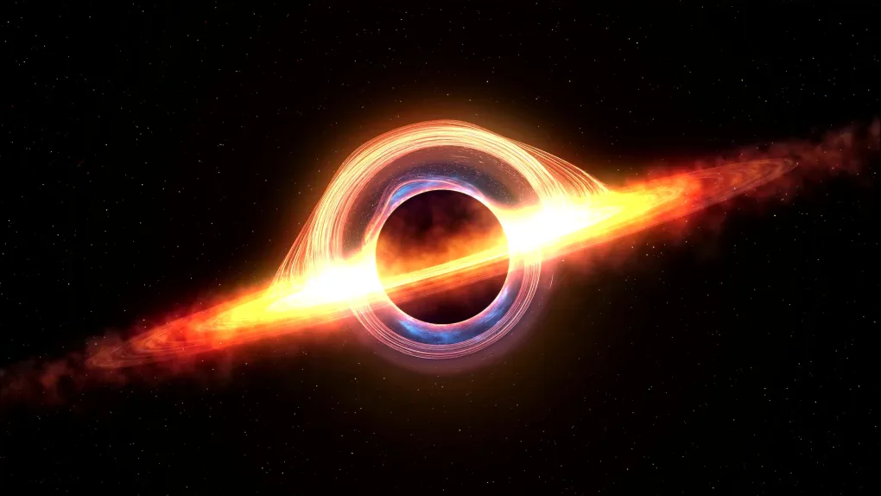
The Importance of Entropy
Black holes have entropy
This entropy is extremely large
Classical gravity breaks down at small distances, so microscopic understanding is lacking
(N.d.). Lab Manager. Retrieved August 12, 2023, from https://www.labmanager.com/astronomers-reveal-new-features-of-galactic-black-holes-30666.

Slide 4
AdS/CFT as a tool for understanding gravity
Consider quantum gravity theories in a certain spacetime (AdS) and a class of pure quantum theories (CFTs)
Energy levels are identical in both theories!

Slide 5
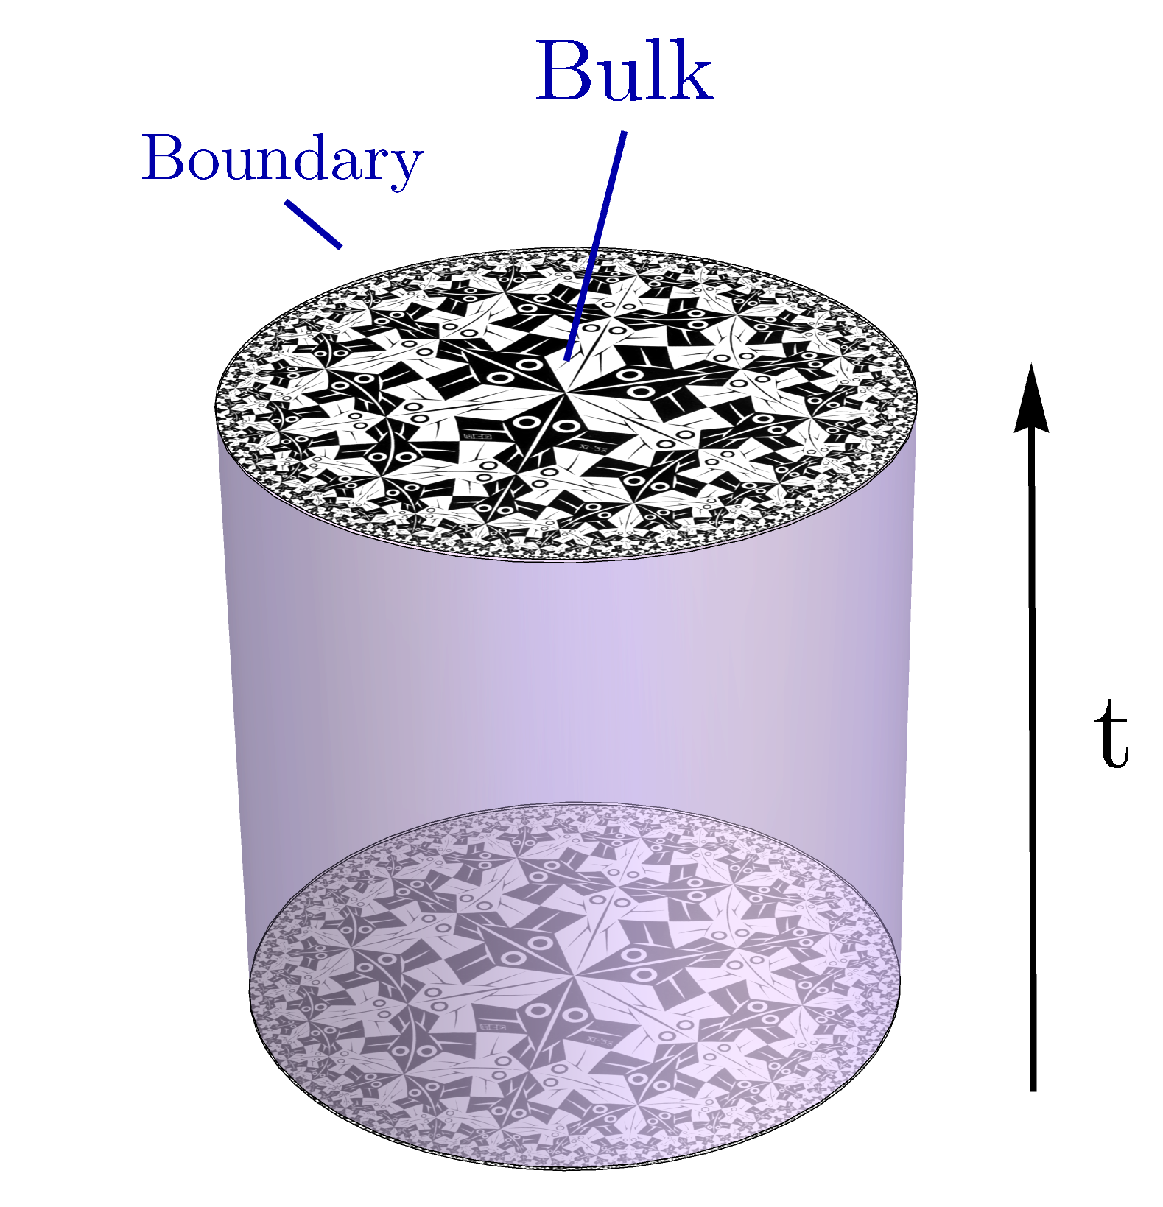
AdS/CFT as a tool for understanding gravity (cont.)
Other observables have similar relations, but more complex
Important correspondence: fields at boundary of quantum gravity theory
(N.d.). arXiv Vanity. Retrieved from https://www.arxiv-vanity.com/papers/2102.02619/.

Slide 6
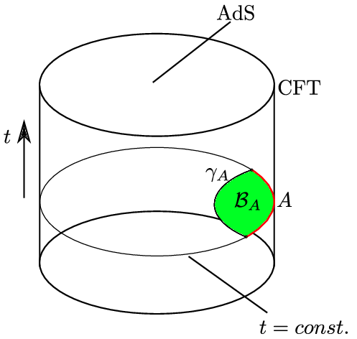
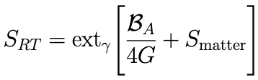
Calculating Entropy
Subregion of CFT has a space of states and therefore entropy
RT formula: entropy of purely quantum theory related to minimal surface in the bulk
How do we interpret the RT formula in the QG theory?
(N.d.). ResearchGate. Retrieved August 12, 2023, from https://www.researchgate.net/figure/The-AdS-CFT-correspondence-The-AdS-CFT-correspondence-states-a-duality-between-a_fig2_336218056.

Slide 7
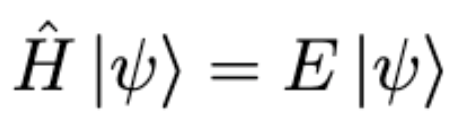
Operators and States in Quantum Mechanics
Quantum states as vectors
Hilbert spaces
Observables as operators

Slide 8
Operators and States in Quantum Mechanics
Quantum states as vectors
Hilbert spaces
Observables as operators
State

Slide 9
Operators and States in Quantum Mechanics
Quantum states as vectors
Hilbert spaces
Observables as operators
Operator
Scalar

Slide 10
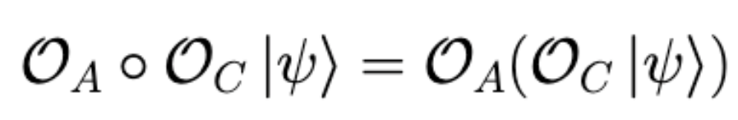

Formalizing Observables through von Neumann Algebras
Ingredients of von Neumann Algebra
  Algebra of bounded operators (v.s. with multiplication)
  Defining a *-operation
  Closed under weak operator topology
Classifying von Neumann Algebras
We can calculate entropy using this viewpoint

Slide 11
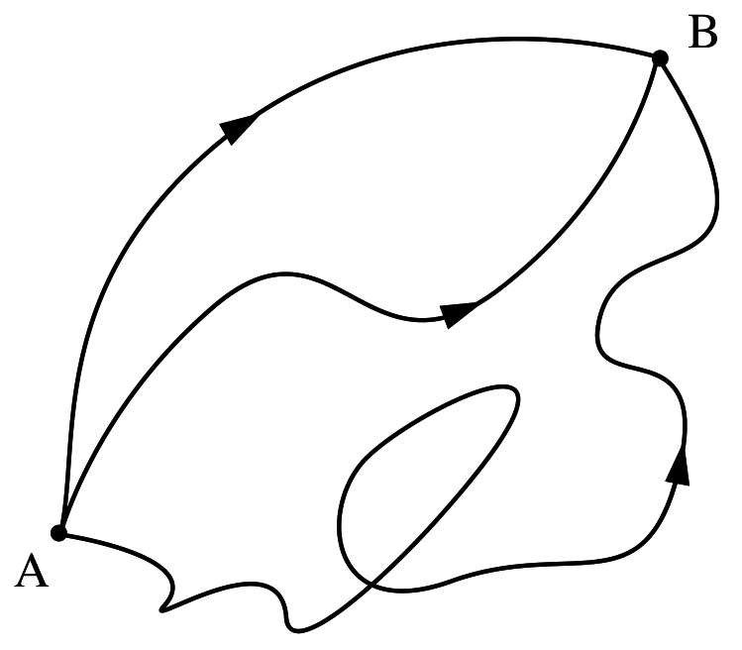
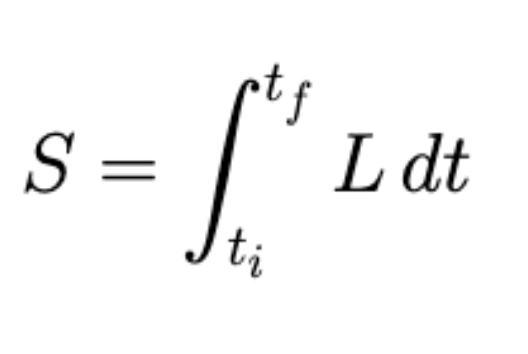
Why Do (Classical) Particles Move the way they do?
The action of a certain trajectory through space is a function of energy that returns a number
The stationary point of the action corresponds to the physical path of the particle
(N.d.). WikiQuote. Retrieved from https://en.wikiquote.org/wiki/Path_integral_formulation.

Slide 12
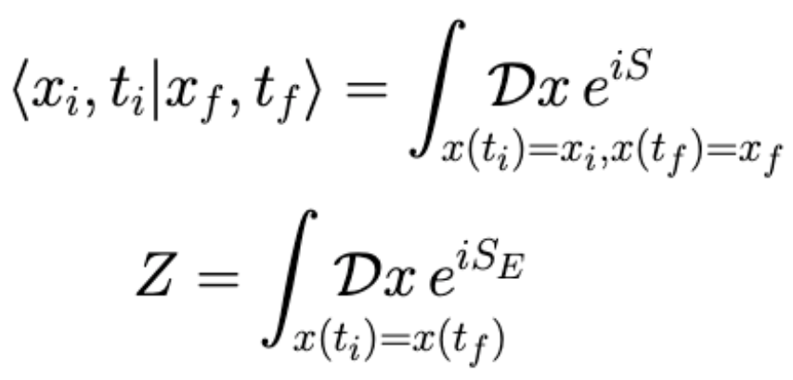
Generalizing to Quantum Mechanics
Particles aren’t localized to a point in QM, what is the trajectory of a particle in a probabilistic theory?
Feynman’s insight: every trajectory has a probability of occurring, distribution related to classical path
Role of boundary conditions

Slide 13
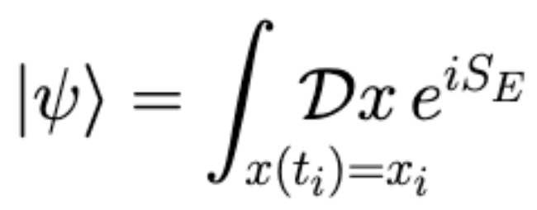
More on QM Path Integrals
=
=

Slide 14
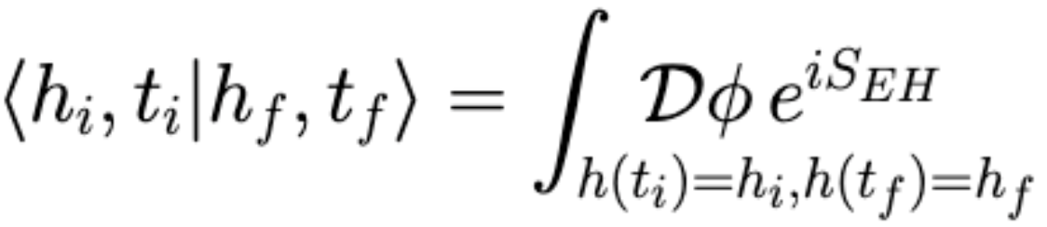
Introducing Gravitational Path Integrals

Slide 15
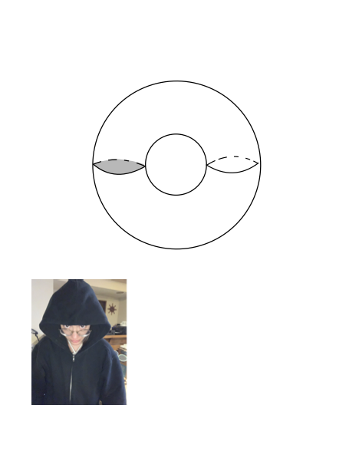
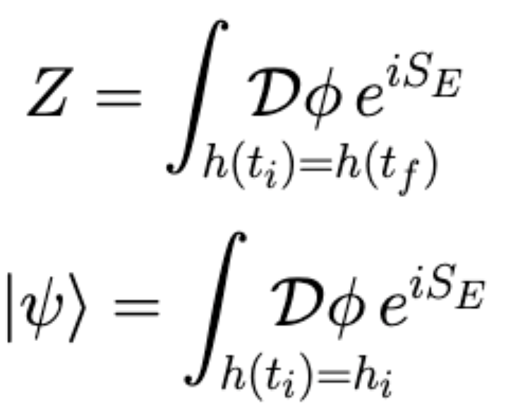
States in Quantum Gravity
=
=

Slide 16
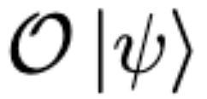
Bringing It All Together
Generalizing to one boundary case
Goal: construct von Neumann algebra, compute entropy, and compare to RT formula
=
=

Slide 17
Constructing the von Neumann Algebra
The set of operators with “gluing operation” is an algebra
Proving operators are bounded
Other properties straightforward

Slide 18


Acknowledgements
Don Marolf, Faculty Advisor
Zhencheng Wang, Graduate Mentor
Sathya Guruswamy, REU Program Director
This project was funded by NSF REU grant PHY-1852574

Slide 19
Abstract
Title: Uncovering the Secrets of Gravity
Abstract: The unification of quantum mechanics and gravity remains one of the great unsolved problems in physics. Gravitational entropy turns out to be a particularly mysterious piece of this puzzle

Slide 20
Introducing Gravitational Path Integrals
Role of geometry in gravity
Gravitational boundary conditions
Quantum gravity states

Slide 21
Constructing States and Operators
Just as before, “slicing open” path integral gives states
States → Operators
Graphic on partition function PI photo

Slide 22
Bringing it All Together
Goal for summer
  Find von Neumann algebra of gravitational path integral
  Calculate its entropy
  See how this relates back to RT formula
This could give insight into the microscopic degrees of freedom of gravity
What do the states of a quantum gravity theory look like? What about the total Hilbert space?

Slide 23
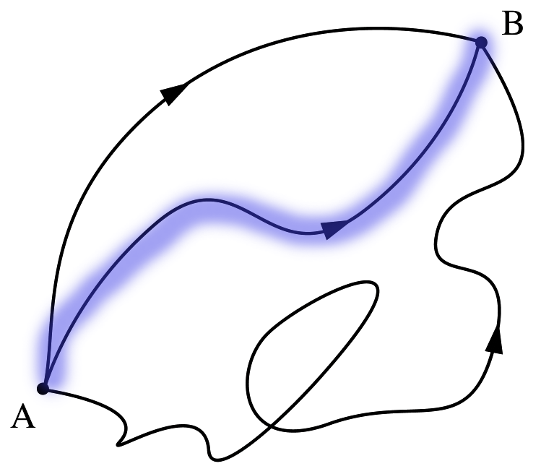
Semiclassical Gravity
With catastrophic issues, QG can be done with a path integral
To avoid said issues, only look at classical trajectories in path integral
Extremely Useful Tool

Slide 24
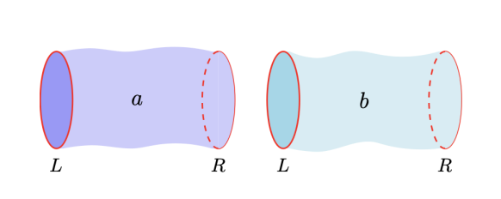
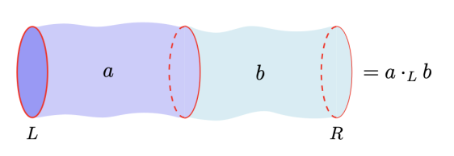
Bringing it All Together: The Two Boundary Case
Consider states that have two boundaries
Associate operator with each state
Define “gluing operation”
The set of states with the gluing operation is an algebra

Slide 25
Outline
Add extra slides on GPI
Slide connecting

Slide 26
Issues with Entropy Calculations
von Neumann algebra is type III
Divergent entropy
Possible workaround: split property?
Split property photo and statement of inclusion of type I factor

