Slide 1




Low Temperature Superconductor Growth for Quantum Computation
Manisha Parthasarathy
Palmstrøm Group
Graduate Advisor: Teun van Schijndel

Slide 2
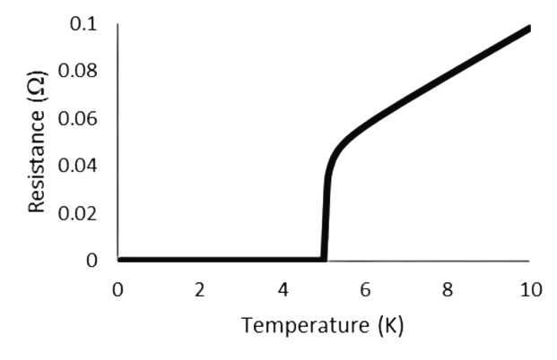
What is a superconductor?
[1]
41
73
Nb
Ta
T_{C}

Slide 3
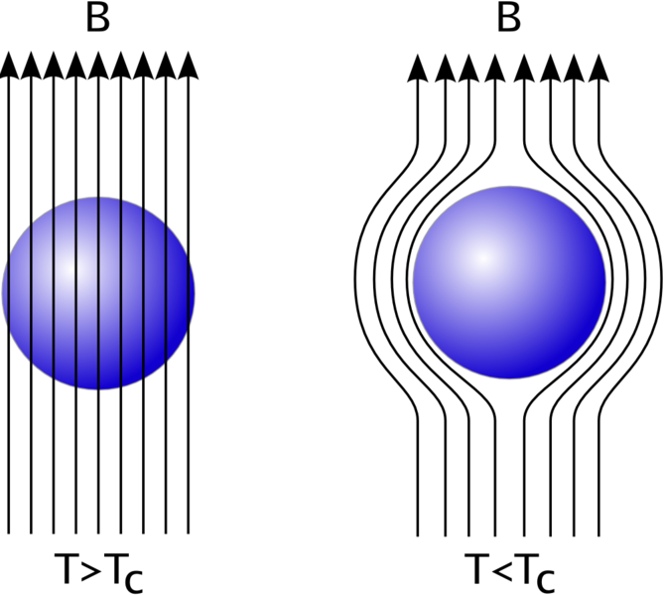
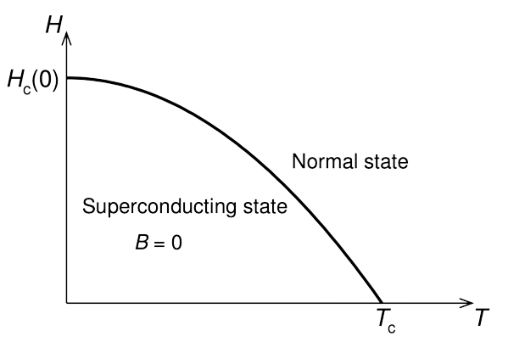
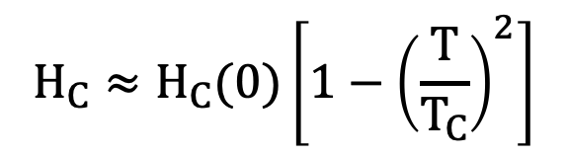
The Meissner Effect
[2]
[3]
$$H_{C}≈H_{C}(0)\left[1−{\left(\frac{T}{T_{C}}\right)}^{2}\right]$$
Superconducting state broken!

Slide 4
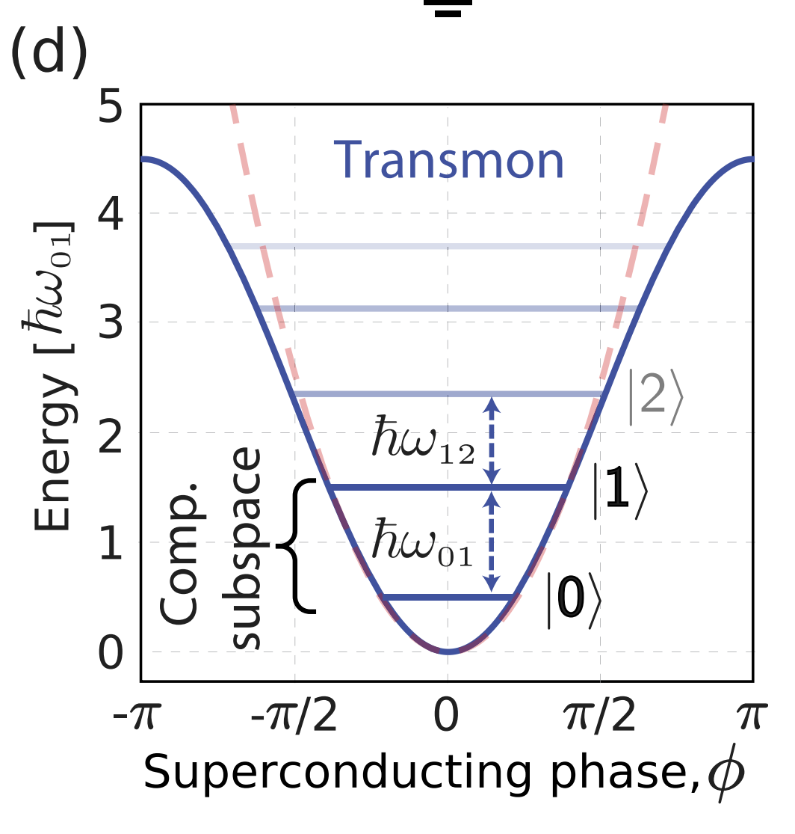
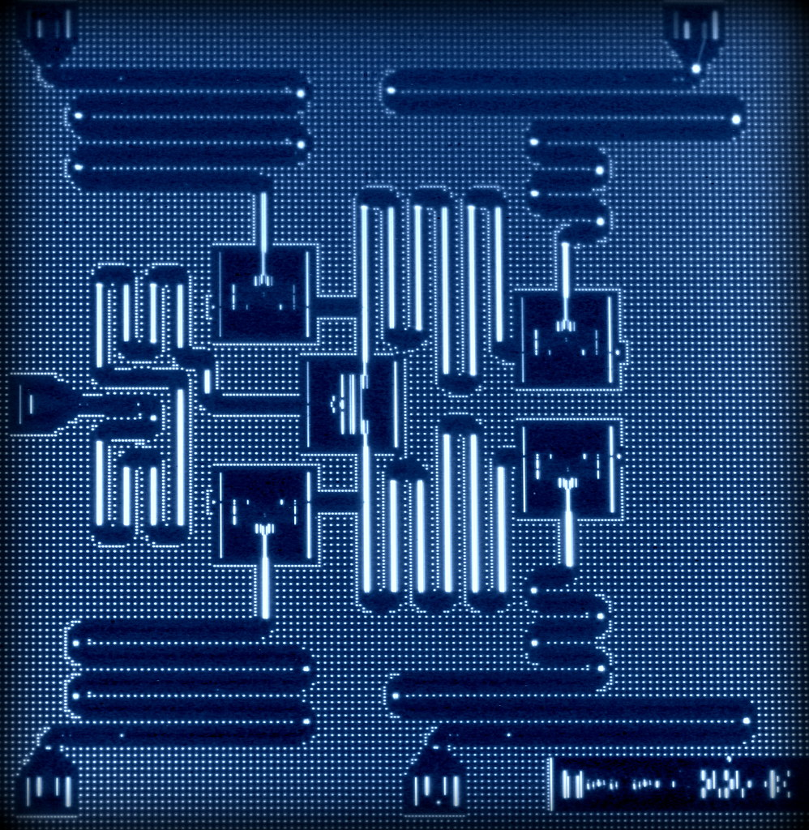
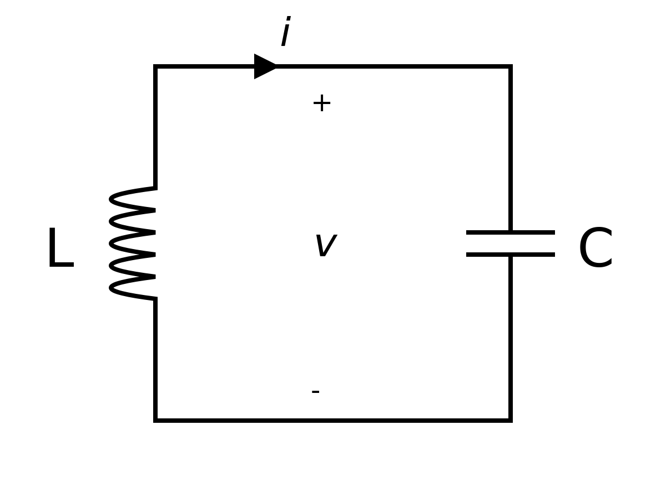
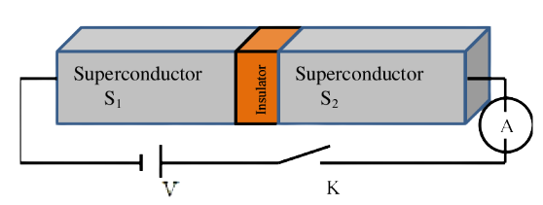
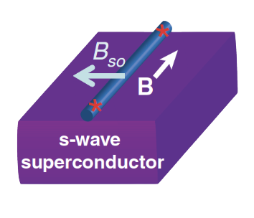
Superconductors in Qubits
Superconducting qubits
[5]
[8]
[4]
[6]
Topological qubits

Slide 5
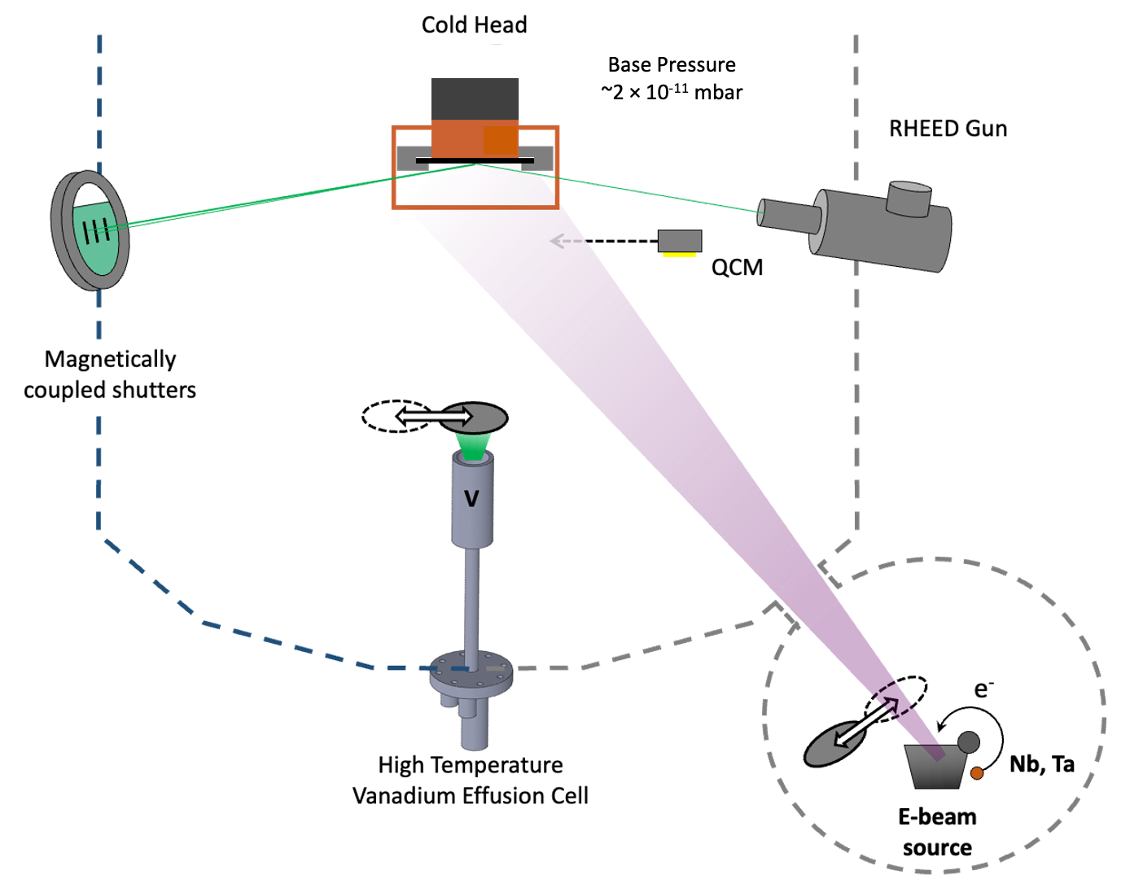
Growing Superconductors: Molecular Beam Epitaxy
Substrate
Source Material

Slide 6
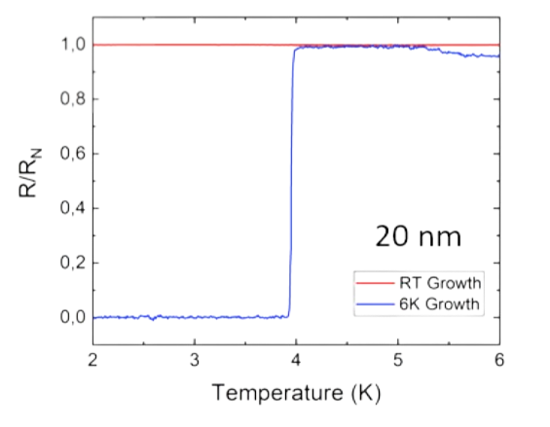
Low Temperature Superconductor Growth
How does LT growth affect…
T_{C}
H_{C}
Qubit quality

Slide 7
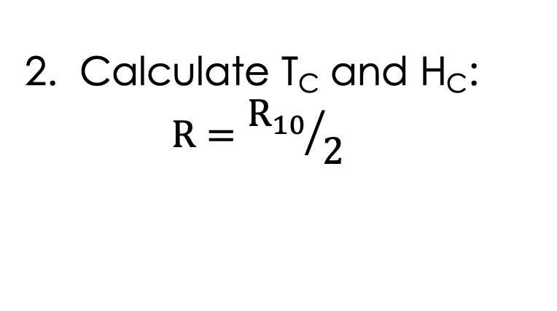
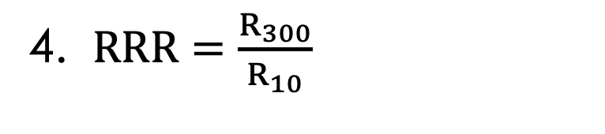
Methods
For RT and LT growth:
1. R vs. T and R vs. H plots
Ta/Nb
50 nm
2. Calculate T_{C} and H_{C}:
  $$R={R_{10}}/2$$
Al₂O₃
3. AFM scans
300 K / 4 K
4. $RRR=\frac{R_{300}}{R_{10}}$

Slide 8
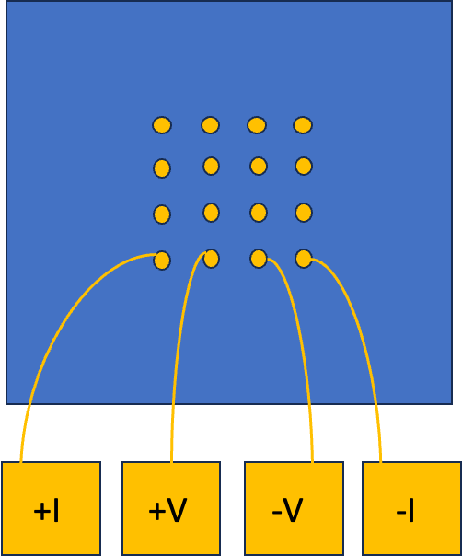
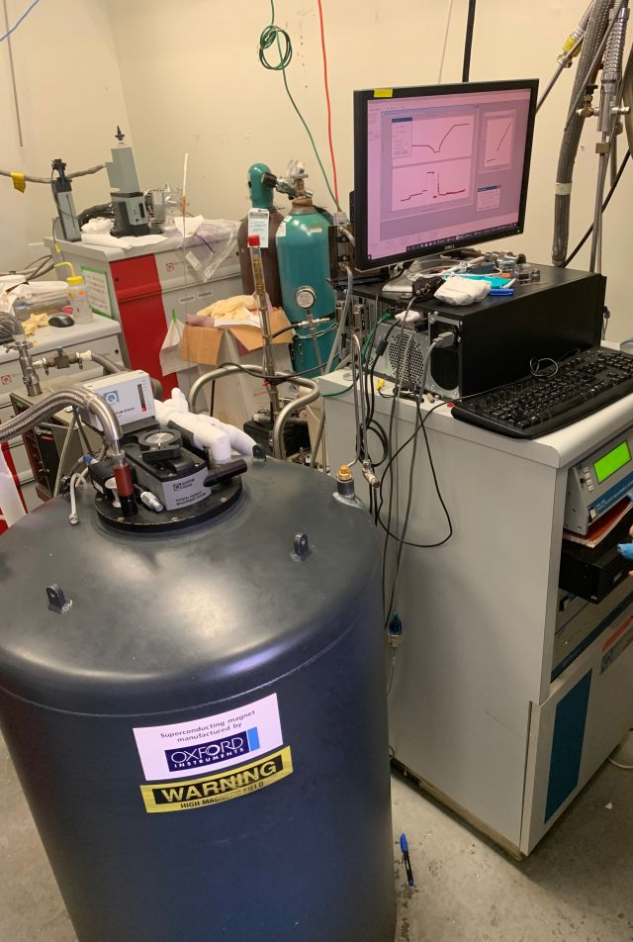
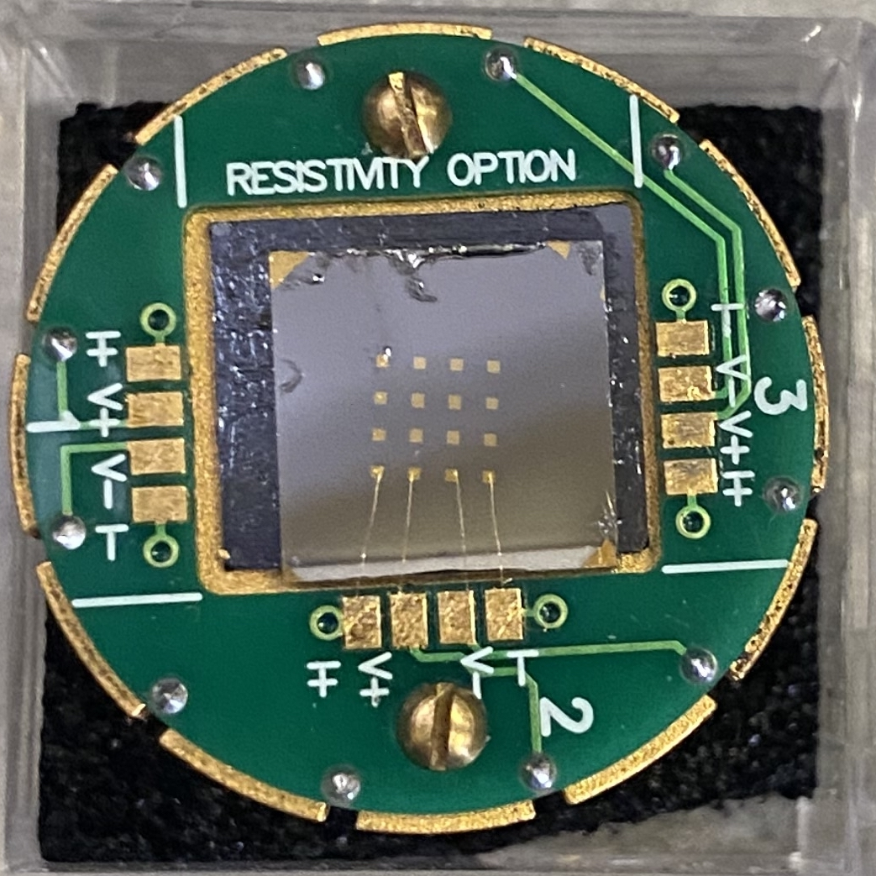

Resistance Measurements
[7]
Physical Property Measurement System (PPMS)
Four Point Method

Slide 9
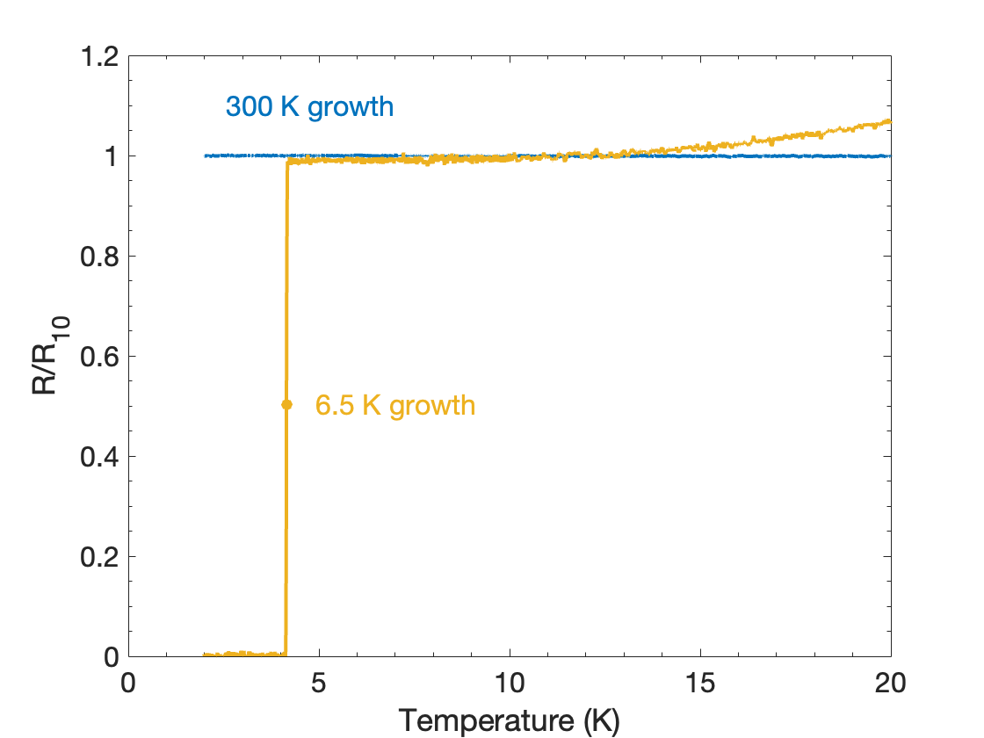
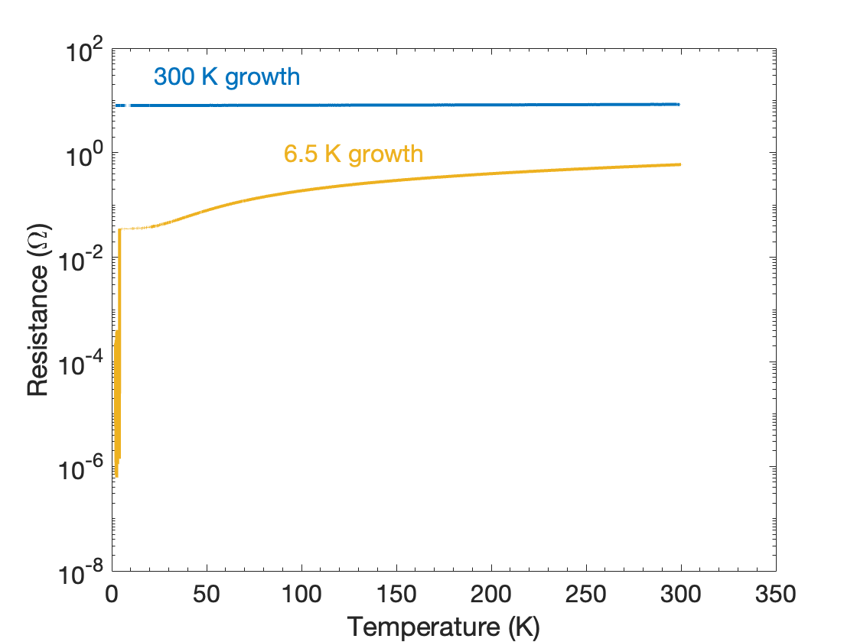
T_{C} Comparison: Tantalum
Film thickness: 50 nm
T_{C}:
RT Growth: < 2 K
LT Growth: 4.1 K
RRR:
RT Growth: 1.0
LT Growth: 16.8

Slide 10
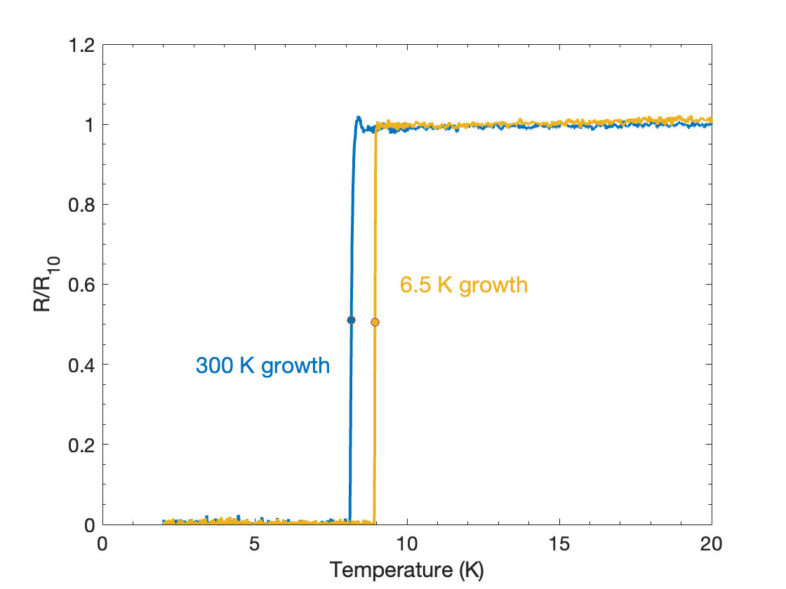
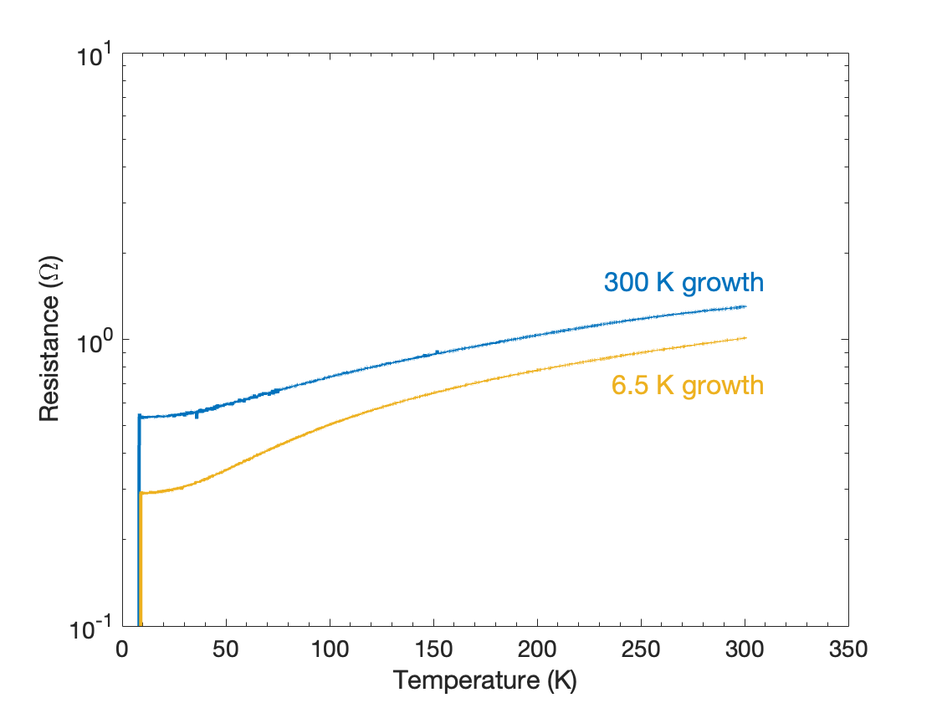
T_{C} Comparison: Niobium
Film thickness: 50 nm
T_{C}:
RT Growth: 8.2 K
LT Growth: 8.9 K
RRR:
RT Growth: 2.4
LT Growth: 3.5
Film thickness: 50 nm

Slide 11
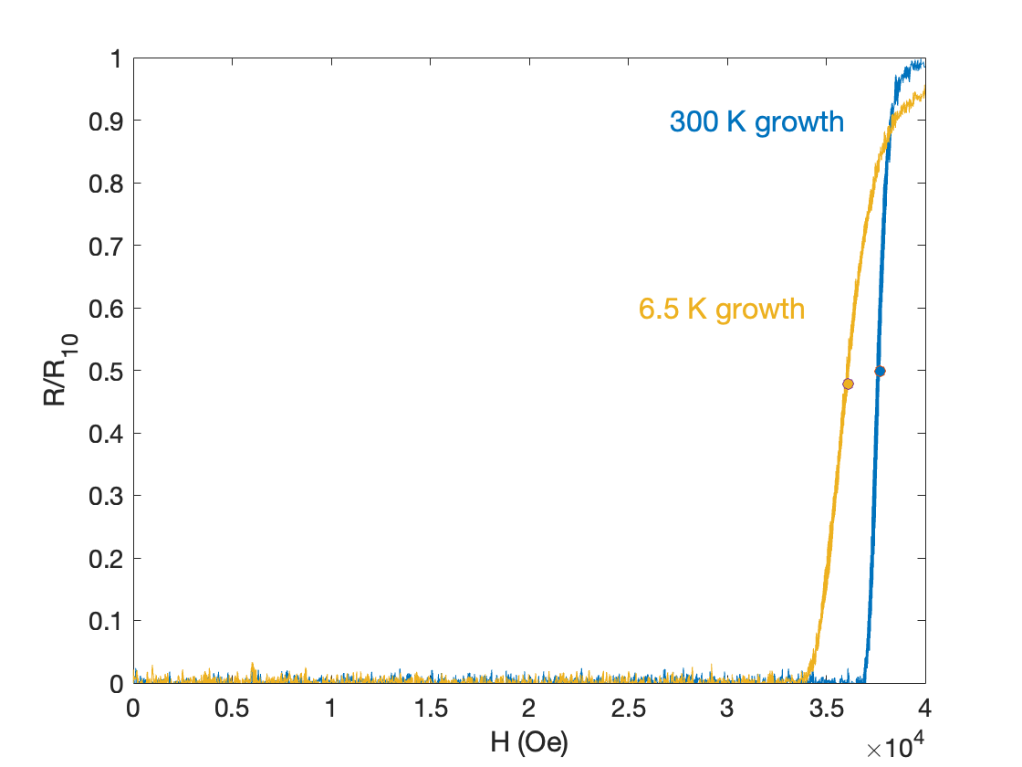
H_{C} Comparison: Niobium
Film thickness: 50 nm
T = 2 K
H
I
H_{C}:
RT Growth: 3.8 K
LT Growth: 3.6 K

Slide 12
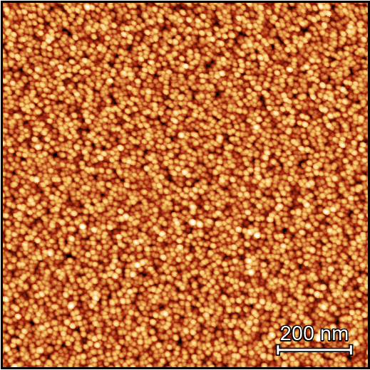
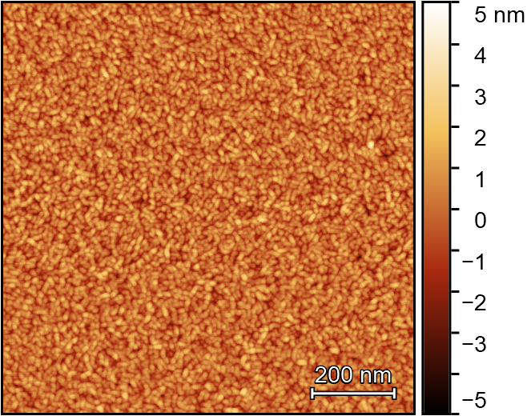
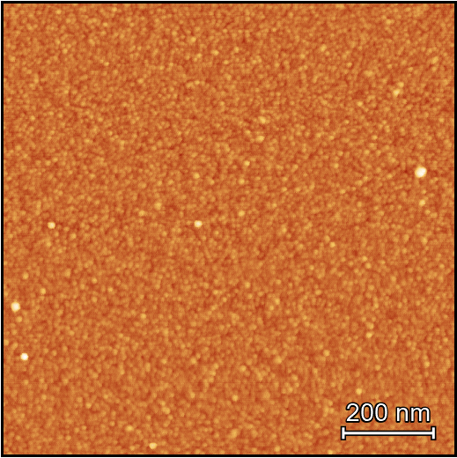
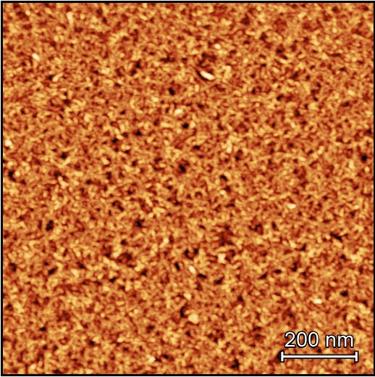
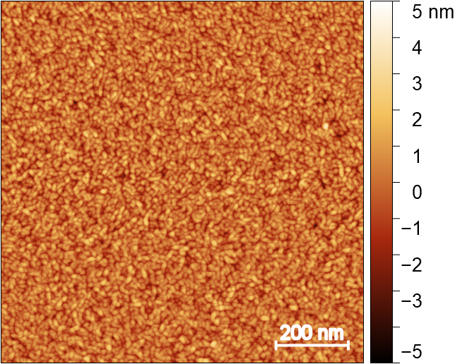
Structural Analysis: AFM Scans
Ta
Nb
Room Temperature
RMS: 1.6 nm
RMS: 0.8 nm
6.5 K
5.5 K
Low Temperature
RMS: 0.4 nm
RMS: 1.2 nm
Notes:
We saw great results with the increase in critical temperatures under low temperature growth, as opposed to room temperature. Now, we wanted to see exactly what changes structurally, in hopes of seeing the physical reasons behind why we observe such results. To do this, we performed atomic force microscopy to directly image the sample surface. From these images, we were able to calculate the root mean square roughness of the surfaces. For Tantalum, we saw a decrease in the RMS roughness, indicating that low temperature grown Ta samples are smoother than room temperature grown samples. However, for Nb, we saw an increase in roughness, suggesting that low temperature growth does not necessarily result in smoother or rougher samples. For further structural analysis, we must now use techniques such as scanning tunneling microscopy and x-ray diffraction, which could tell us more about the physics behind low temperature MBE growth.

Slide 13
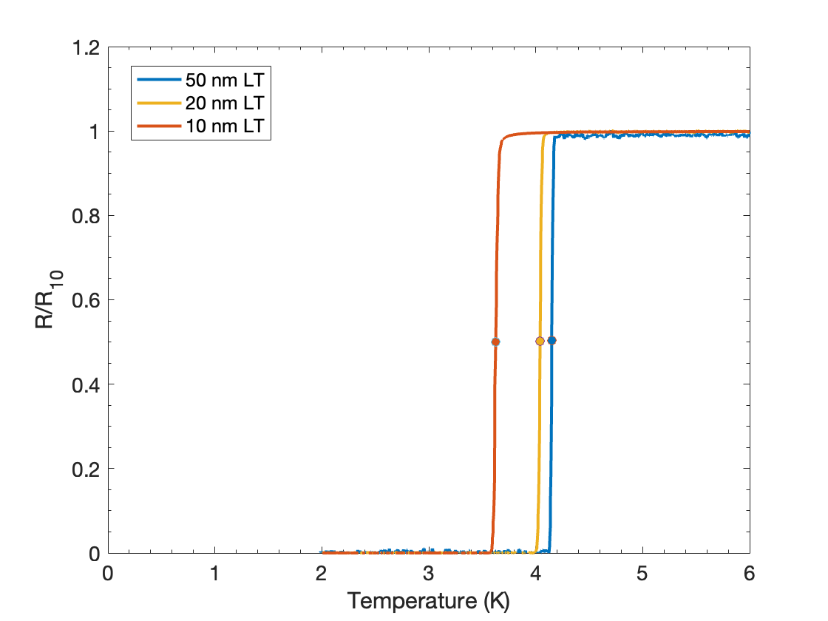
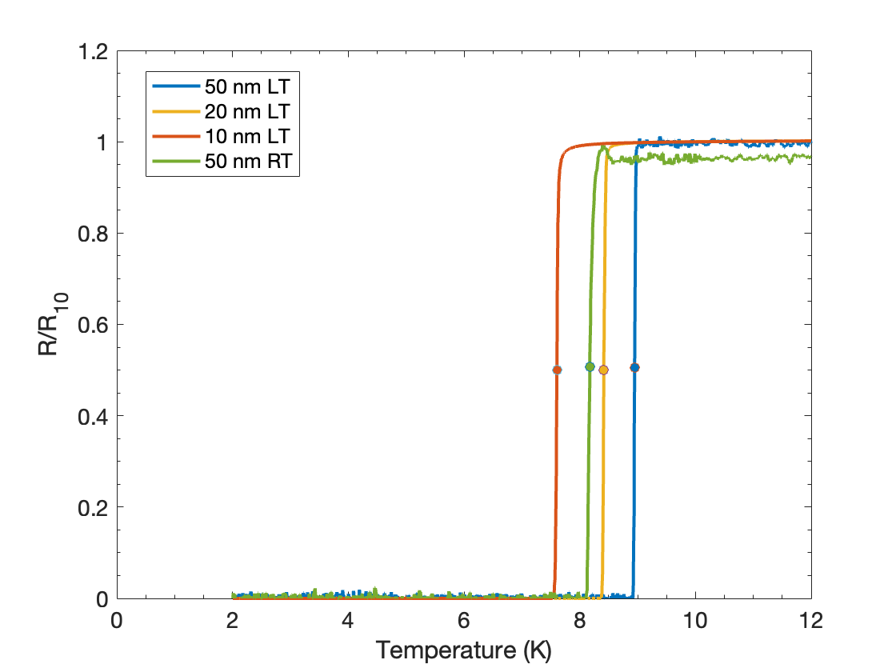
Sample Thickness: T_{C} Comparison
Tantalum
Niobium
Notes:
In topological qubits, it is advantageous to minimize the thickness of the superconducting thin films. However, it is known that by decreasing the thickness, you also decrease the critical temperature, affecting the quality of the thin film. To add on to our project, we wanted to see how the thickness of our thin films affects the critical temperatures of our samples when using low temperature MBE growth. For both Tantalum and niobium, we saw a decrease in the critical temperature when decreasing our film thickness from 50 nm, to 20 nm, to 10 nm, as expected. However, our critical temperatures for very thin samples under LT growth were still higher than those for thicker samples under room temperature MBE growth, which indicates that low temperature growth is better for making good quality superconducting thin films that can be used in qubits.

Slide 14
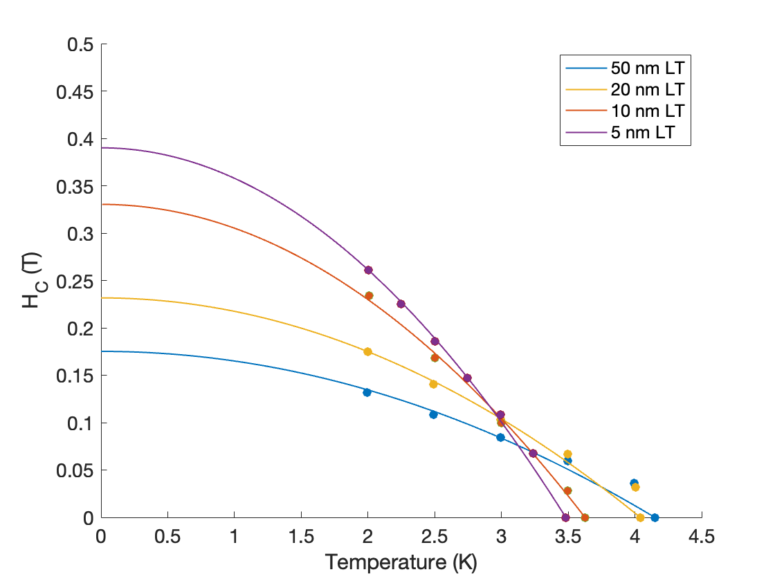
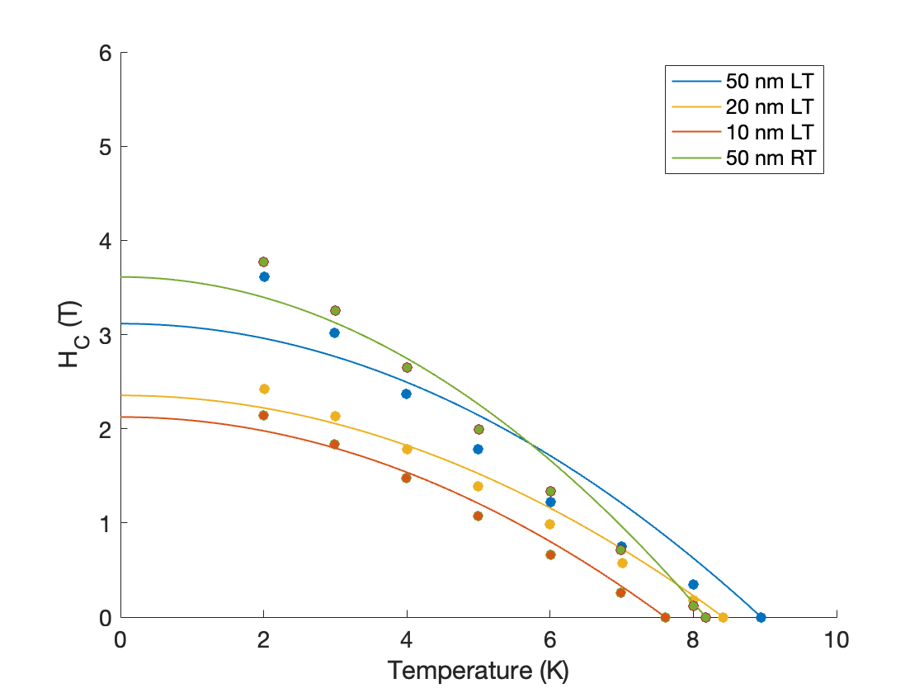

Sample Thickness: H_{C} Comparison
$$H_{C}≈H_{C}(0)\left[1−{\left(\frac{T}{T_{C}}\right)}^{2}\right]$$
Recall:
Tantalum
Niobium
H_{C} increases
Good fit
H_{C} decreases
Bad fit
Notes:
In addition to critical temperature, we studied how sample thickness affects the critical magnetic fields of our thin films. We expected H_C to scale with T_C – that is, if T_C decreases with sample thickness, so should H_C. To study this, we constructed H_C versus T plots and used the empirically determined relation between H_C and T as a fit. For our niobium samples, we saw exactly what we would expect – H_C decreased with sample thickness (50, 20, 10). However, for tantalum, we saw the opposite of what we would expect. We even measured a 5 nm sample to see if this trend still held, and it does. This fascinating result gives us even more motivation to figure out the structural difference between films grown at low temperature and room temperature, because it seems to defy what we know about superconductivity in thin films.

Slide 15
Summary: Low Temperature MBE Growth
Higher T_{C} values
Better quality thin films
Longer coherence times?
Notes:
Overall, we saw that thin films do not totally behave as we expected when grown at low temperature. However, at least one initial hypothesis holds true: Low temperature MBE growth results in higher T_C values for Ta and Nb films. This is an indication that LTMBE growth produces better quality thin film superconductors that can be used in qubits. Our next step is to send our thin films to our collaborators so that they can test them in superconducting qubits and measure the coherence times. Low temperature MBE growth presents as a promising technique to grow superconductors for qubits, and we hope our results may help improve the practicality of quantum computers in the future.

Slide 16
Acknowledgements
A special thanks to:
Professor Chris Palmstrøm, Teun van Schijndel, and Professor Sathya Guruswamy
This work was funded by NSF REU Grant PHY-1852574.
Notes:
I would like to thank Professor Chris Palmstrom and my graduate advisor Teun van Schijndel for all their work during this project. I would also like to thank the national science foundation for funding this work and giving me the incredible opportunity to do research at UCSB this summer. Thank you all so much.

Slide 17
References
[1] F. Lacy. Electrical Resistance of Superconductors, Proceedings of the World Conference (2019).
[2]P. Jaworski. PioM EN DE PL; POLAND/Poznań / Public domain from https://commons.wikimedia.org/wiki/File:EfektMeisnera.svg accessed February 25th, 2020.
[3] D. Yoshioka, Meissner effect cannot be explained classically, arXiv 1203 (2012).
[4] H.M.A.R. Maruf. M.R. Islam, F.U.Z. Chowdhury, Analogy between AC Josephson junction effects and optical phenomena in superconductors, Bangladesh Journal of Physics 23 & 24, 105-113 (2018).
[5]J. Knuutinen (2022, May 2). Why superconducting qubits might be the path to quantum advantage. Quanscient. https://quanscient.com/blog/why-superconducting-qubits-might-be-the-path-to-quantum-advantage
[6] R. M. Lutchyn, J. D. Sau, and S. Das Sarma, Majorana fermions and a topological phase transition in Semiconductor - superconductor heterostructures, Physical Review Letters 105, 077001 (2010)
[7]Ex-situ characterization. Ex-Situ Characterization | Chris Palmstrøm Research Group | UC Santa Barbara. (2022). https://palmstrom.cnsi.ucsb.edu/facilities/ex-situ
[8] P. Krantz, M. Kjaergaard, F. Yan, T. P. Orlando, S. Gustavsson, and W. D. Oliver, Appl. Phys. Rev. 10.1063/1.5089550 (2019)

