Slide 1
Developing Simulation Techniques for Low Energy Neutrino Recoil Interactions
Joanne Kauffman
Advisor: David Caratelli
Mentor: Fan Gao

Slide 2
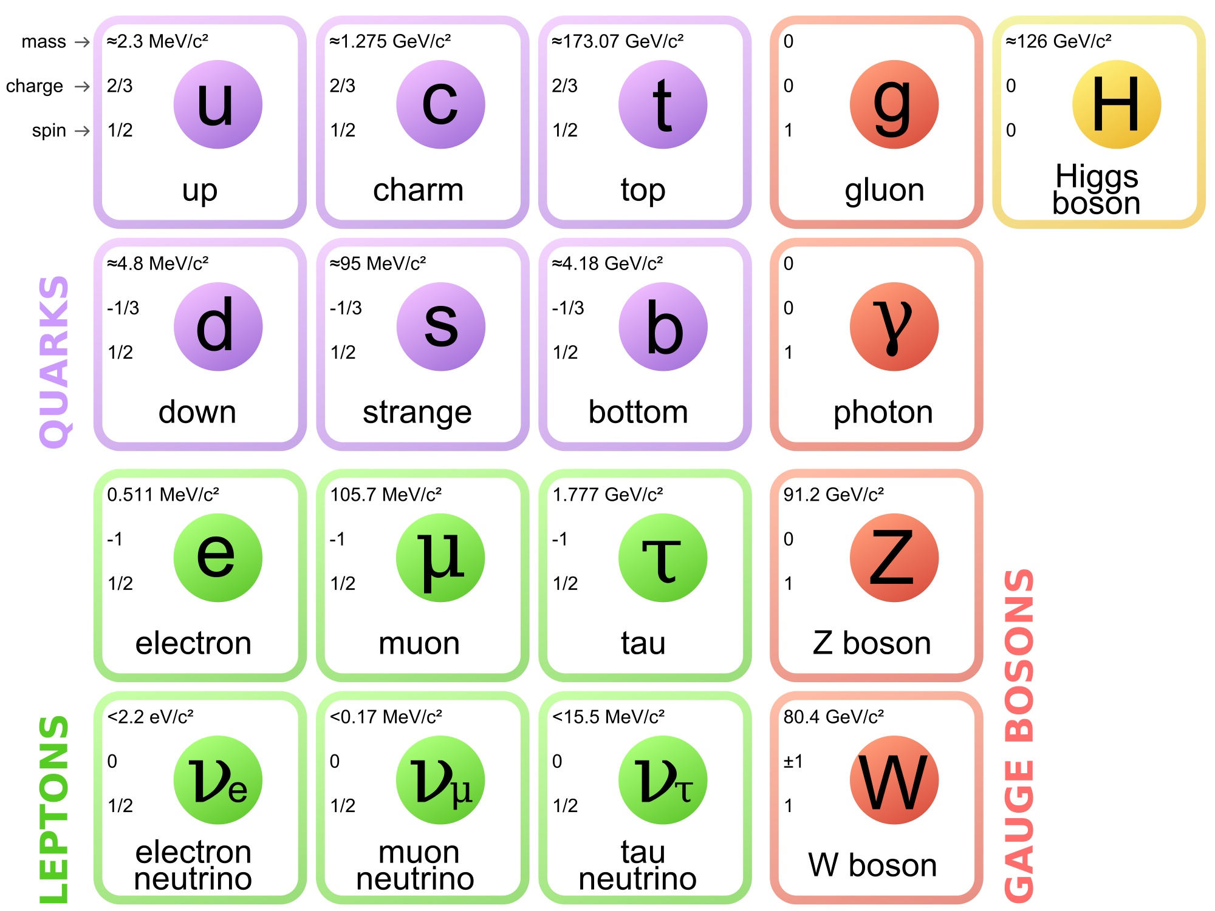
Introduction to Neutrinos
Neutral Partners to charged leptons
Smallest particle with mass
Mass of one neutrino < 1 eV
Interact via weak force and gravity
Rarely Interact with Matter
Source: http://www.quantumdiaries.org/2014/03/14/the-standard-model-a-beautiful-but-flawed-theory/

Slide 3
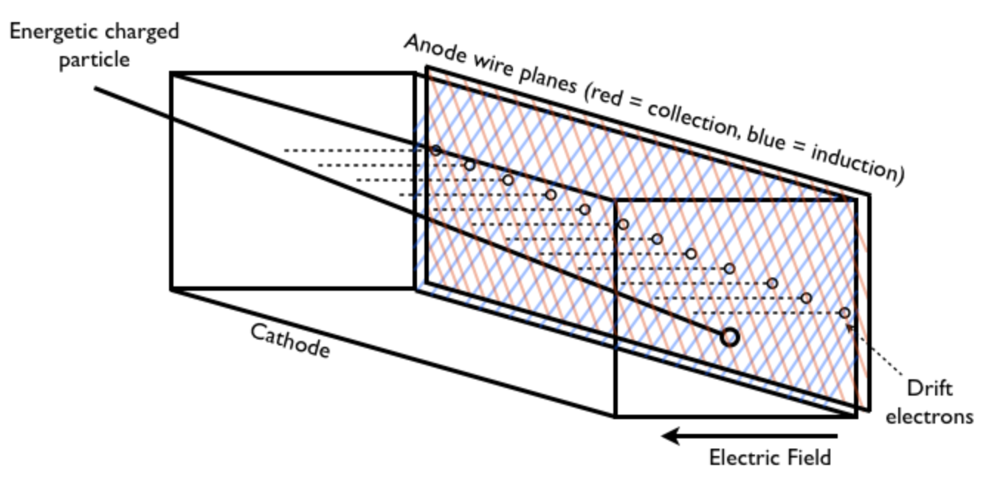
Argon as a Detection Method
Large Target Mass
Relatively cheap compared to other noble elements
Great Scintillation Properties
Pure for electrons to drift across TPC volume
Time Projection Chamber Design
Source: https://en.wikipedia.org/wiki/Time_projection_chamber

Slide 4
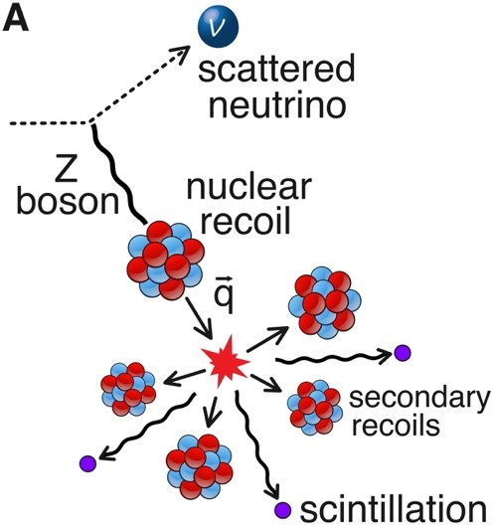
Coherent Elastic Neutrino-Nucleus Scattering (CE𝝂NS)
Low energy neutrino (MeV) scatters off an entire argon nucleus generating a nuclear recoil (10s of keV)
Entire nucleus leaves interaction
Low momentum transfer
Large Cross section
Source: https://sites.duke.edu/coherent/files/2020/06/nuint18.pdf

Slide 5
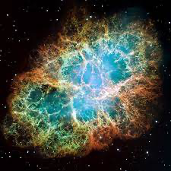
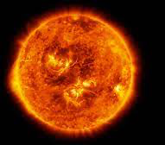
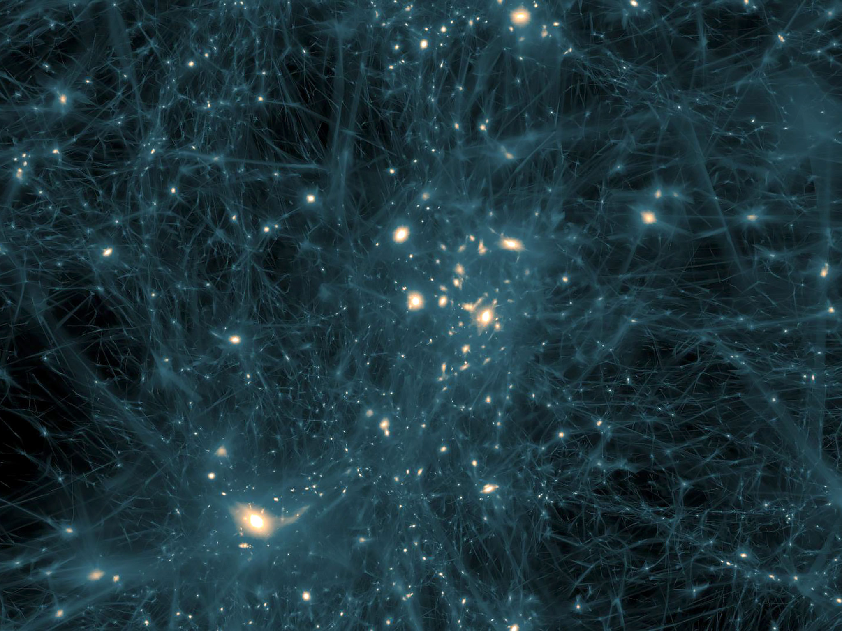
Why Study Nuclear Recoils?
Astrophysical Applications
Probe neutrino properties
New Physics beyond SM
NASA, ESA, J. Hester and A. Loll (Arizona State University) - HubbleSite: gallery, release.
NASA / SDO / Seán Doran
Directionality is an important tool in determining the source of nuclear recoil signal
RALF KAEHLER, OLIVER HAHN AND TOM ABEL/KAVLI INSTITUTE FOR PARTICLE ASTROPHYSICS AND COSMOLOGY

Slide 6
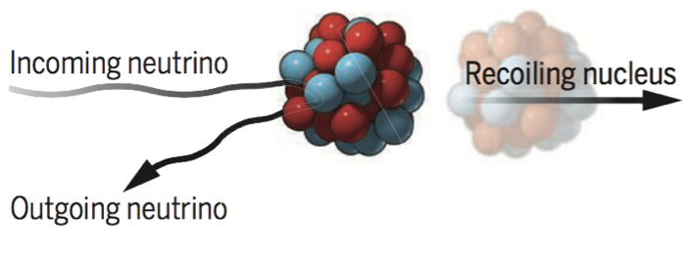
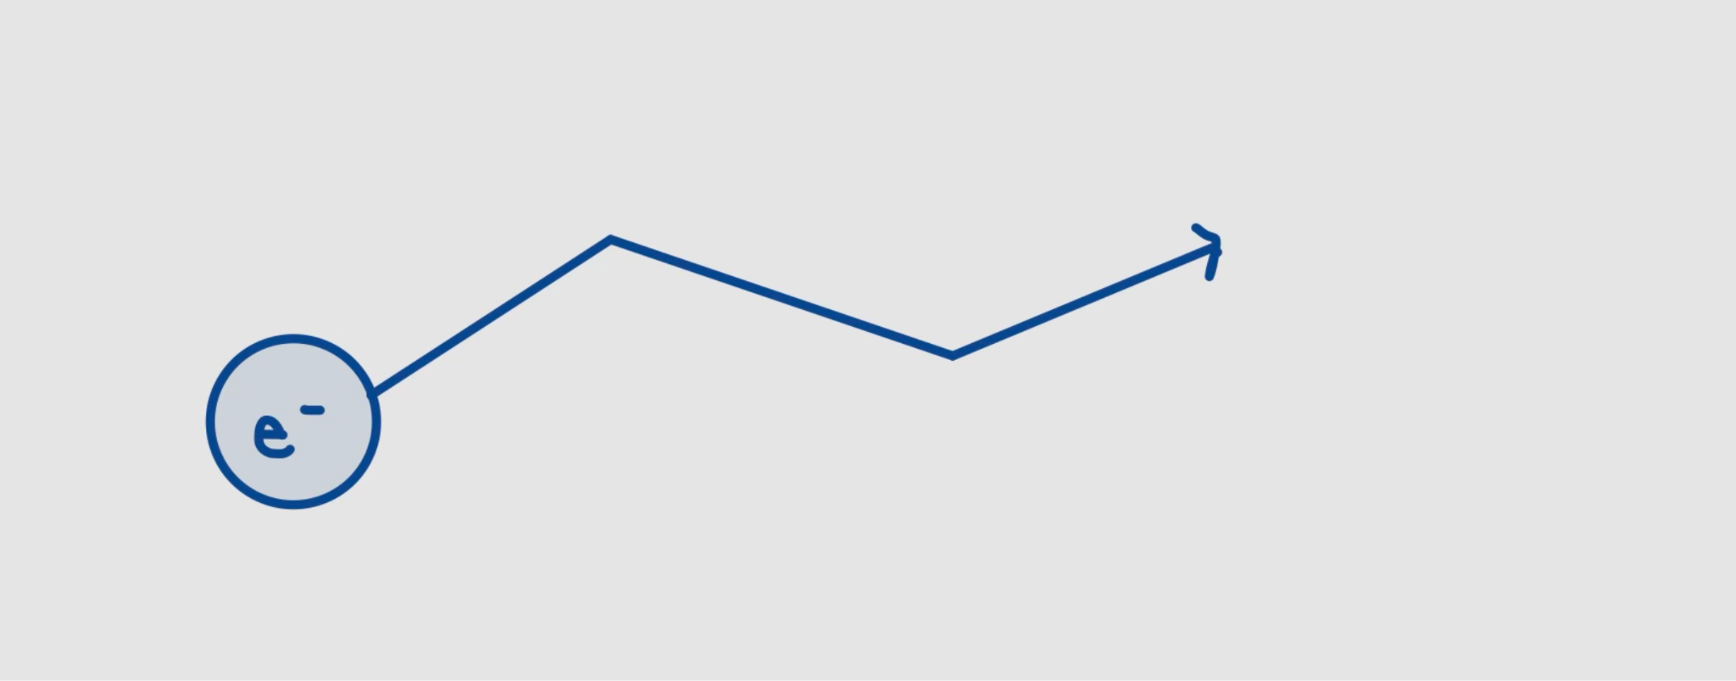
Interaction Summary
(1) Nuclear Recoil (2) Ionization Process
Image: J. Link Science Perspectives

Slide 7
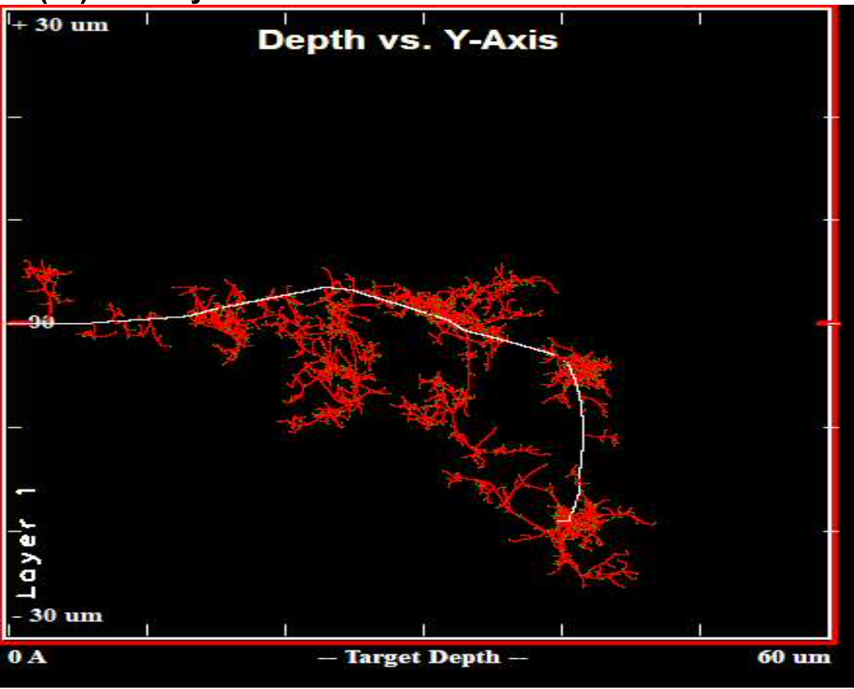
SRIM: Collision Plot
Simulating 1-100 keV nuclear recoils at 1 atm
= Primary Recoil
= Secondary Recoil
Energy can be lost due to ionization and to kinetic energy of the target atoms

Slide 8
Nuclear Recoil Simulation using SRIM
Collision Plot of 1 atm Argon Ion at Initial energy 1 kev vs 60 kev
1 kev: Total Energy Loss due to ionization: 20.88%
60 kev: Total Energy lost due to ionization: 36.04%

Slide 9
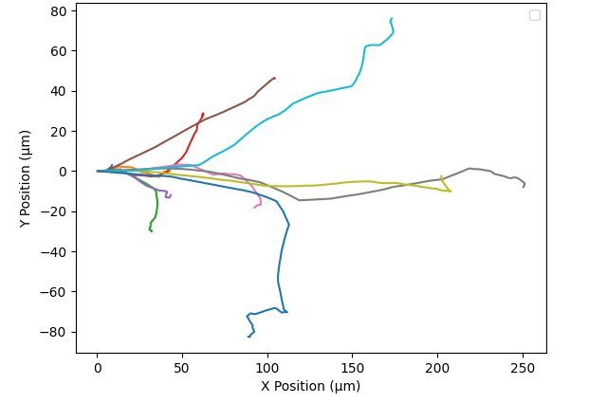
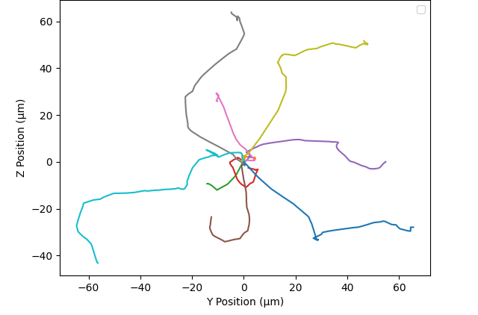
Propagation of Nuclear Recoils at Different Initial Energies
Nuclear Recoil Trajectories 1-100 keV
Nuclear Recoil Trajectories 1-100 keV (Lateral View)

Slide 10
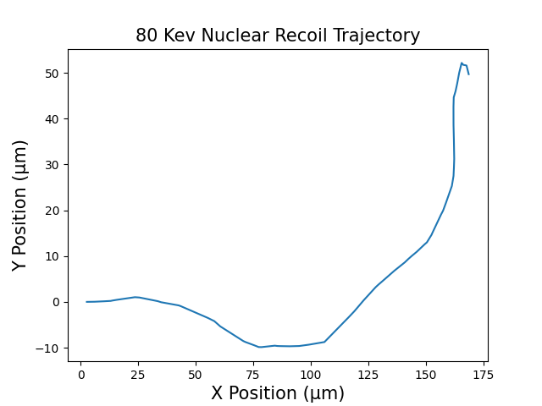
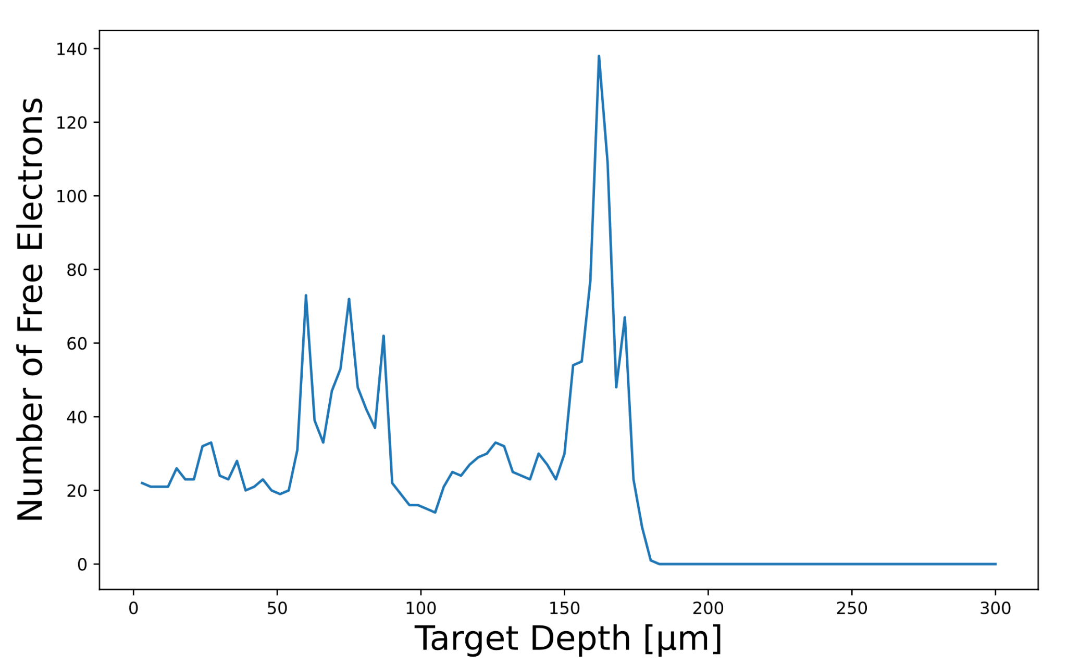
80 keV Nuclear Recoil Trajectory
80 keV Nuclear Recoil Ionization distribution
Ionization energy for argon gas = ~15eV
We want to see how many free electrons form as a result of the energy deposited

Slide 11
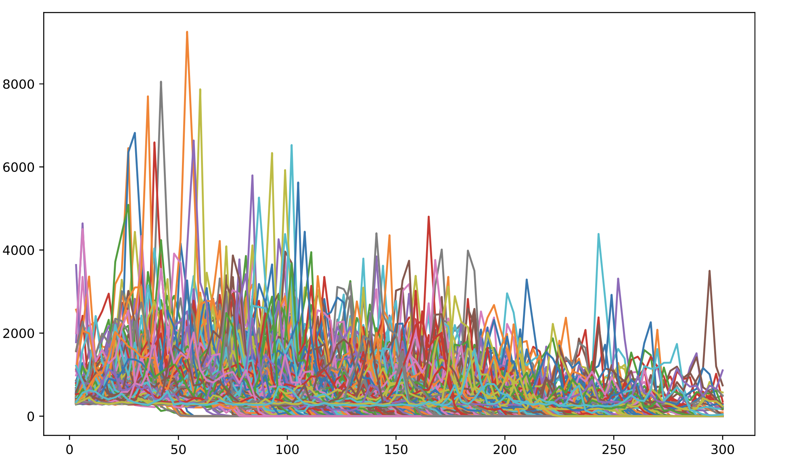
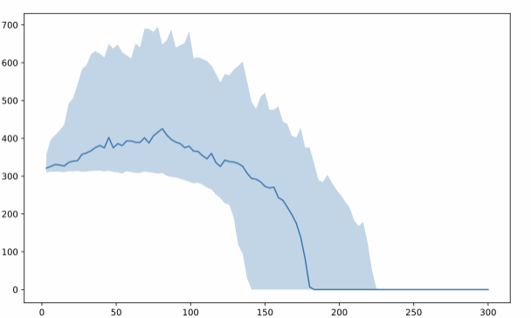
Ionization Energy Distribution for 500 Simulations
Ionization Distribution for 500 Simulation at an Initial Nuclear Recoil Energy of 80 keV
Median Ionization at Initial Nuclear Recoil Energy of 80 keV
Ionization Energy (eV)
Ionization Energy (eV)
Target Depth (µm)
Target Depth (µm)

Slide 12
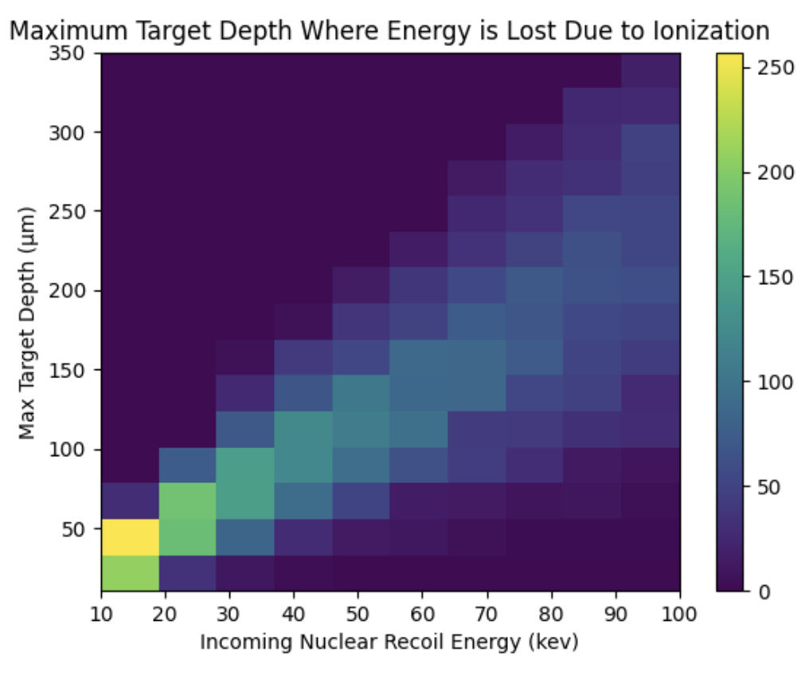
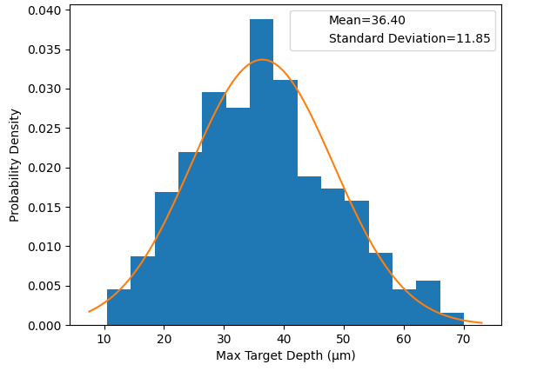
Spatial resolution Calculations

Slide 13
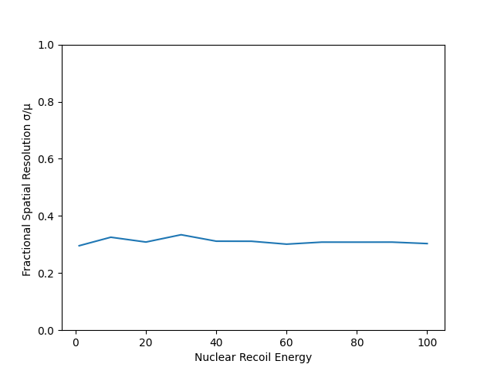
Spatial resolution Calculations

Slide 14
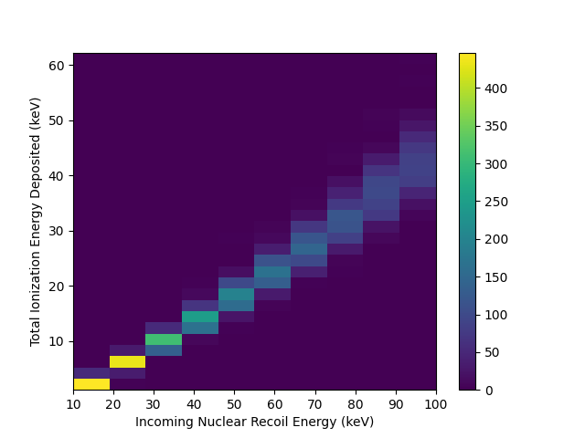
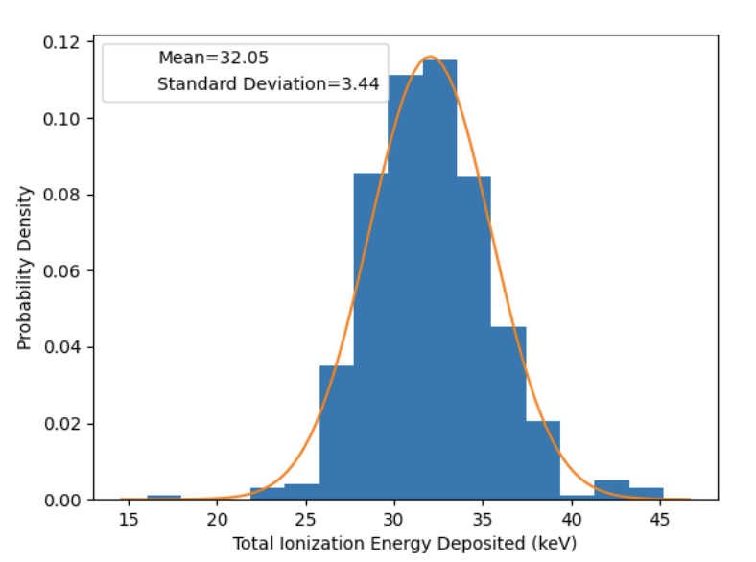
Energy Resolution Calculations

Slide 15
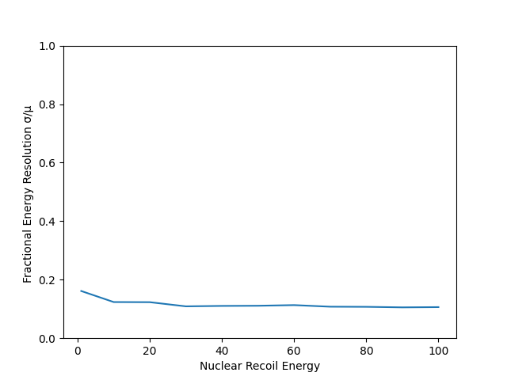
Energy Resolution Calculations

Slide 16
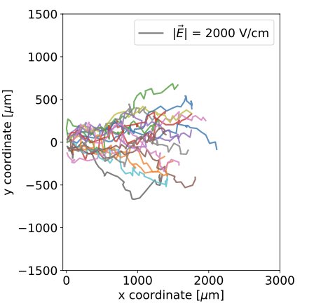
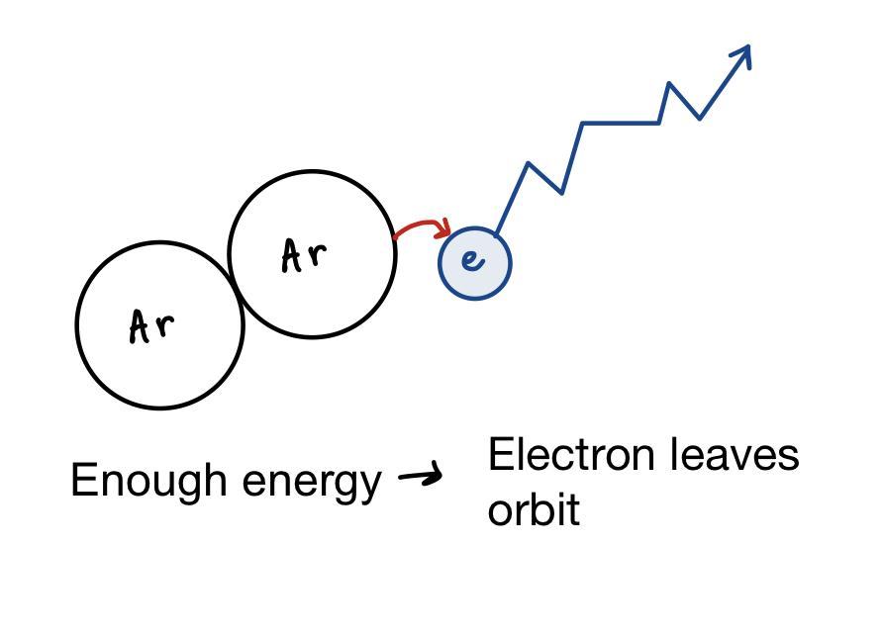
Phase 2 of Simulation: Drift Electrons From Ionization Process
Nuclear Recoil simulation will provide valuable data to input to electron simulation
Complex Microphysics
Nuclear recoil- Argon Atom Collision
Ionized Electrons Propagating from TRANSLATE Simulation

Slide 17
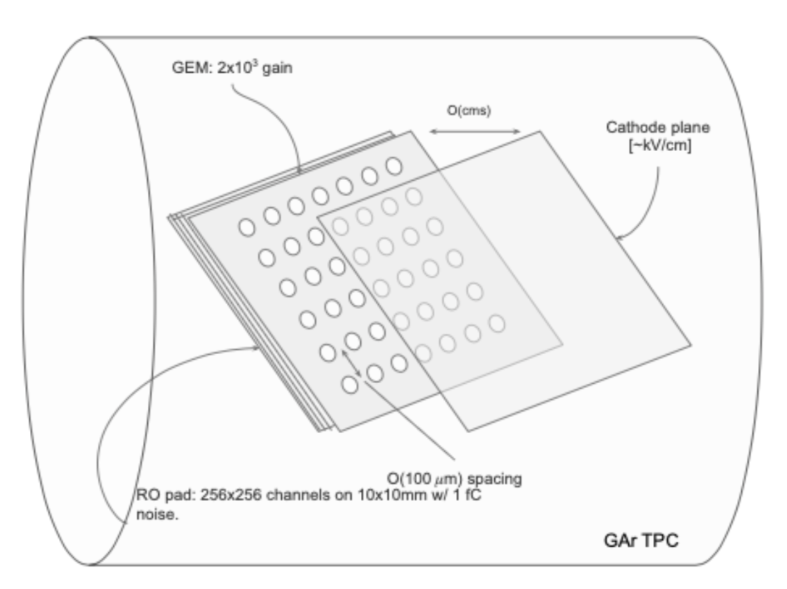
Results and Detector R&D
Resolution calculations will guide GEM detector design to improve nuclear recoil tracking capabilities and determine the required energy thresholds
Gaseous Electron Multiplier (GEM) : a type of gaseous ionization detector capable µm tracking and signal amplification
GEM Detector Design

Slide 18
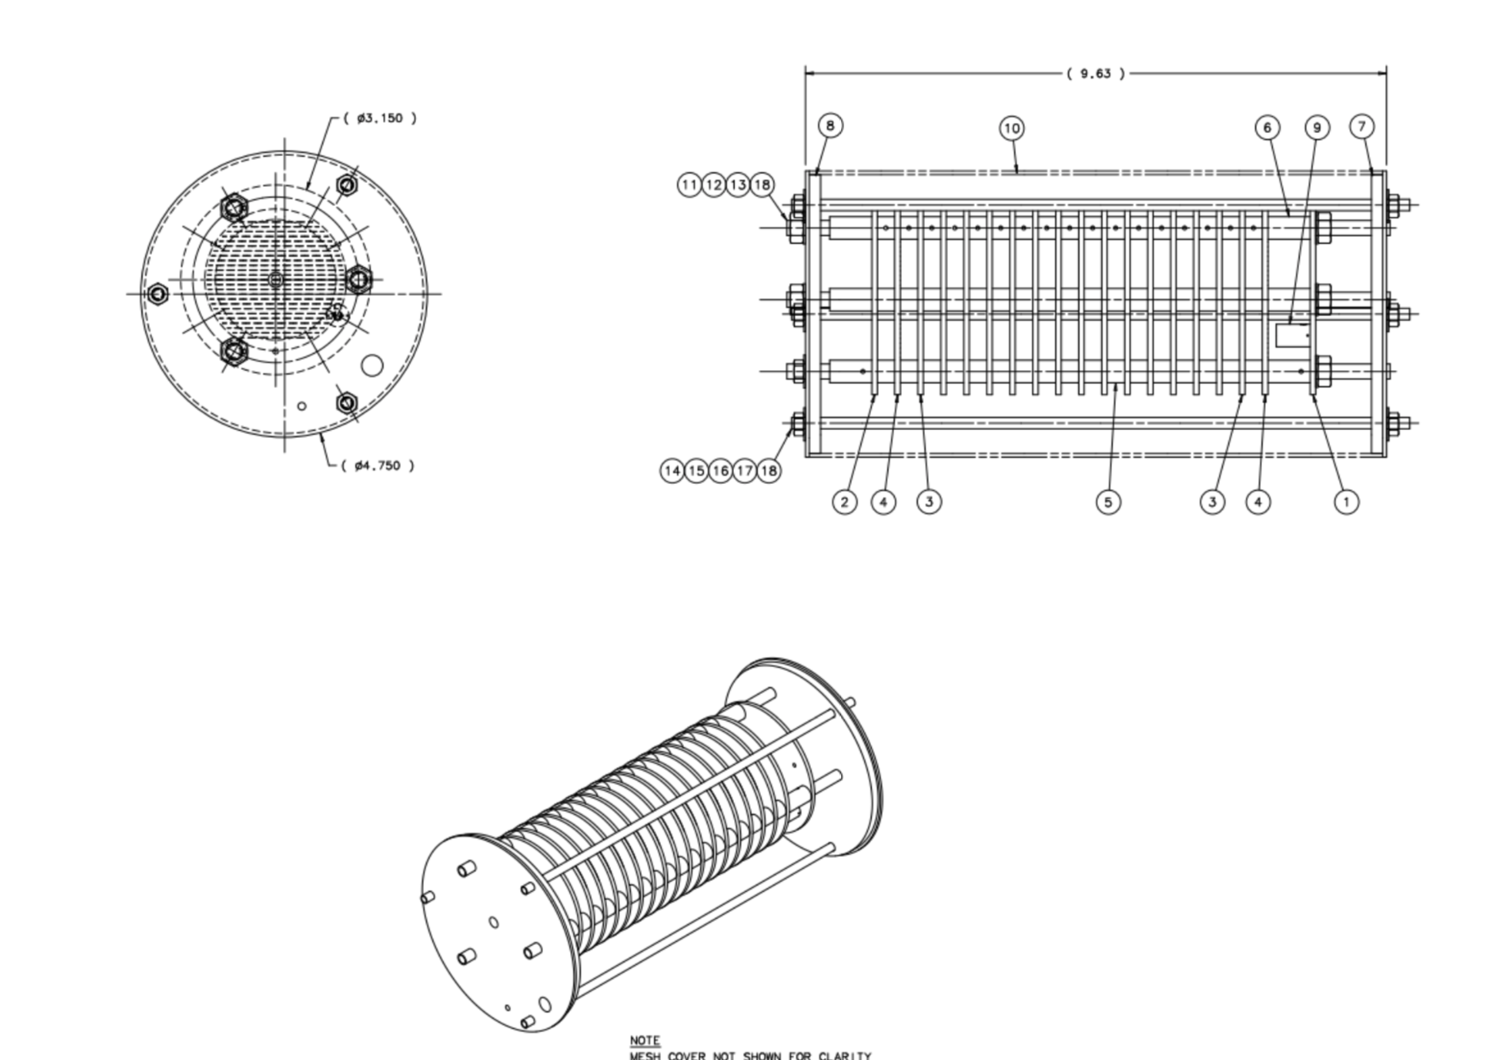
Continued Work in the Fall
Hardware Development: Purity monitor for testing impurities in argon

Slide 19
Acknowledgments
Professor David Caratelli, Faculty Advisor
Fan Gao, Post Doctoral Mentor
Dr. Sathya Guruswamy, UCSB Physics REU Site Director
National Science Foundation (NSF), REU Grant NSF PHY-1852574

