Slide 1
Roof Mirror Automation:
Quasioptical Sample Holder Improvement for Increased SNR in High-Field EPR Spectroscopy
Lillia Hammond
Advisors: Dr. Antonín Sojka and Prof. Mark Sherwin

Slide 2
EPR Spectroscopy Overview and Applications
Signal
Materials with unpaired electrons
1 meter
Material’s parameters
EPR Spectroscopy
Batteries
etc.
Tagged proteins
Beer

Slide 3
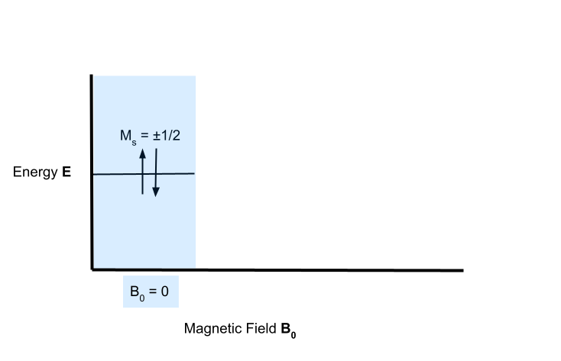
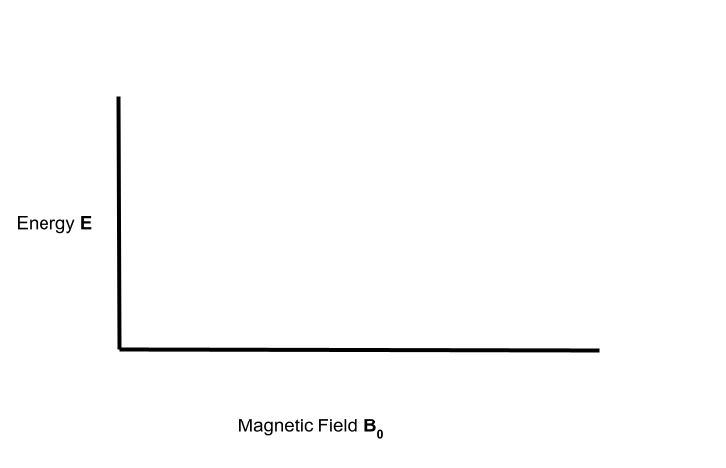
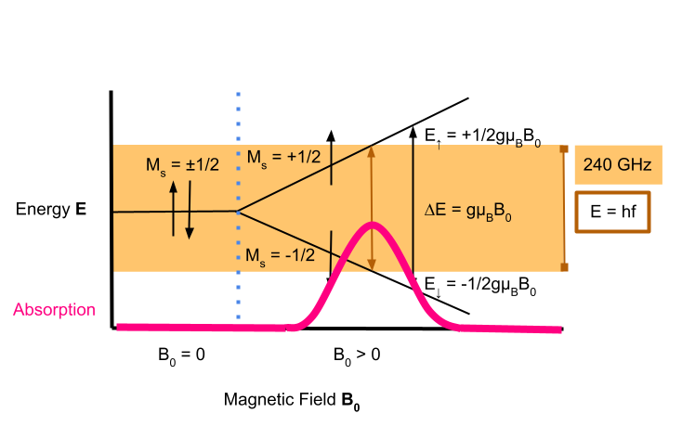
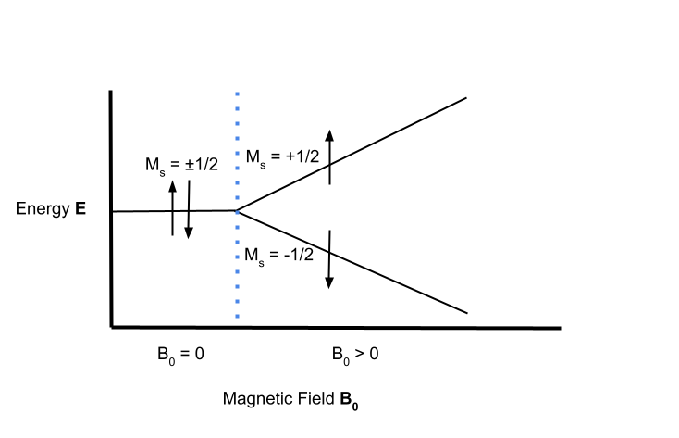
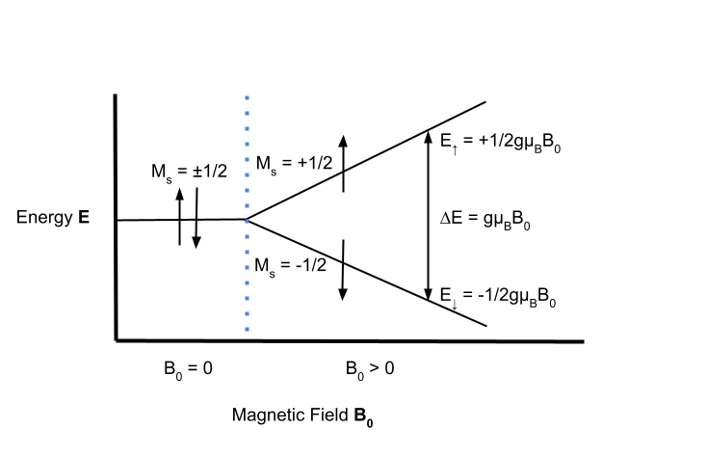
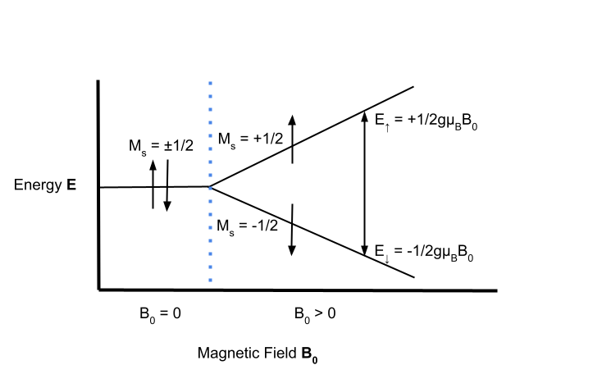
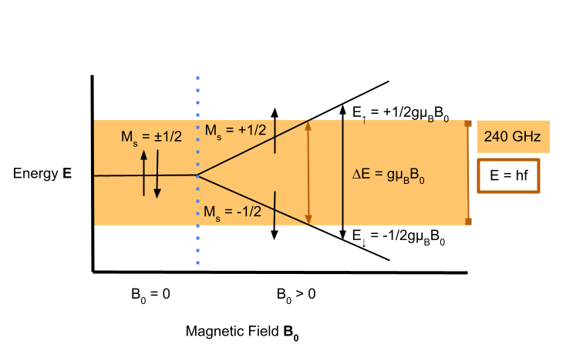
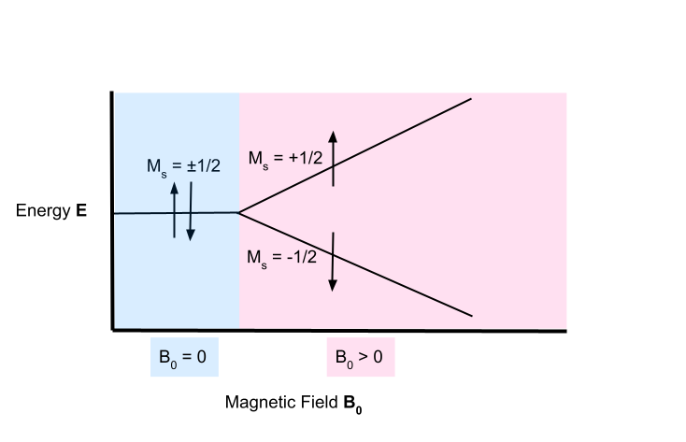
Zeeman Effect

Slide 4
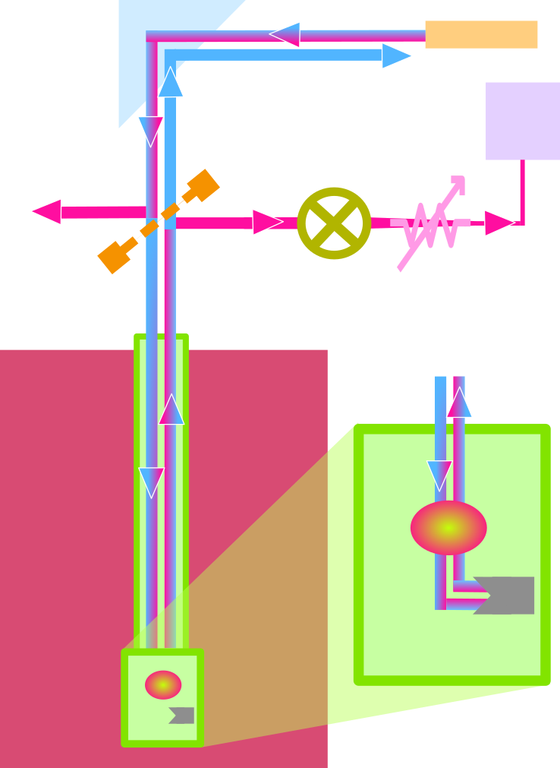
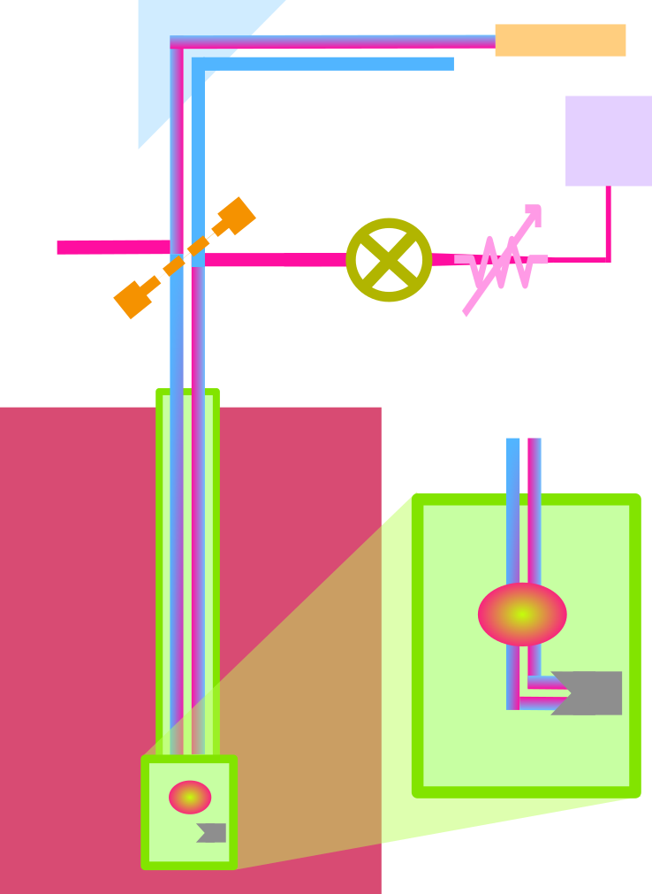
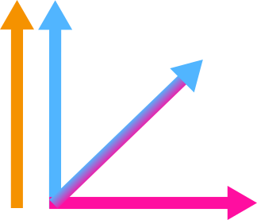
EPR Apparatus Design
Polarization changed by:
Sample absorption
Optical imperfections
Microwave Source
Microwaves
Digitized
Wire Grid
Mixer
Goal: Minimize Crosspolar Signal
Polarization by Wire Grid
Probe
Attenuator
Sample
Copolar
Sample Holder
Combination
Rooftop Mirror
Crosspolar
Magnet

Slide 5
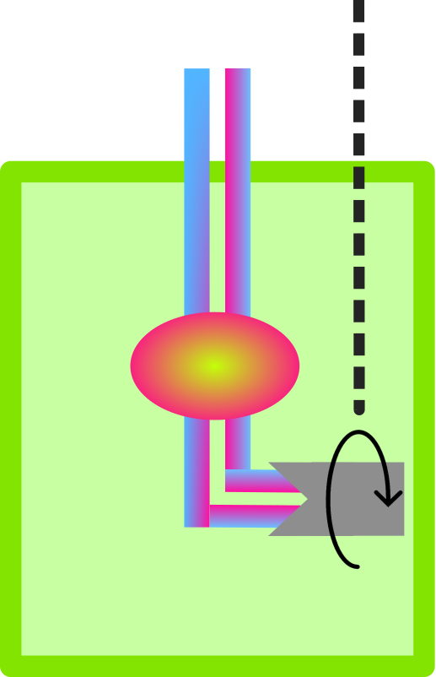
Sample Holder Design

Slide 6
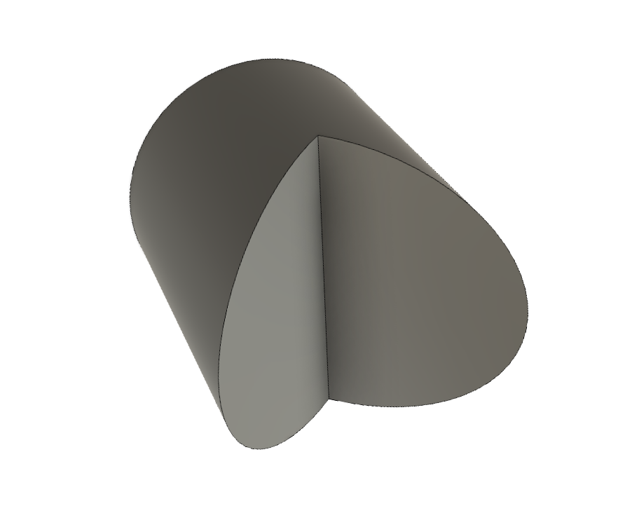
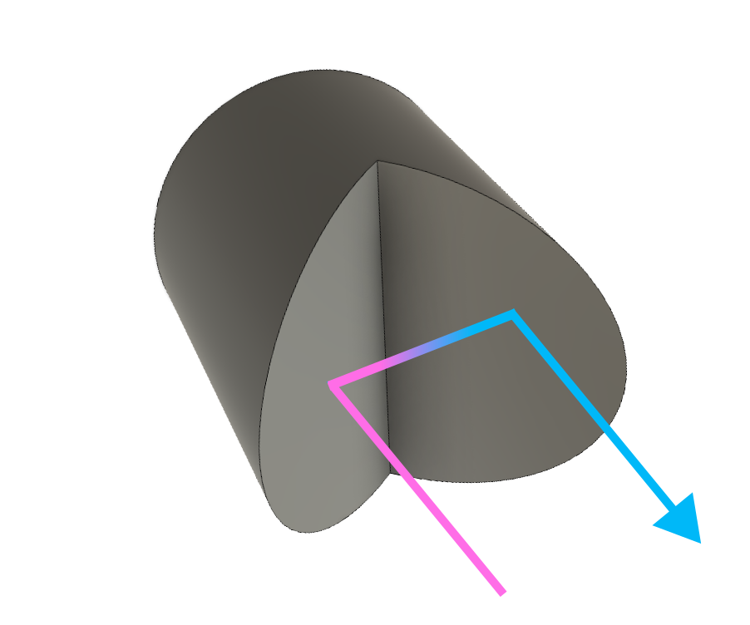
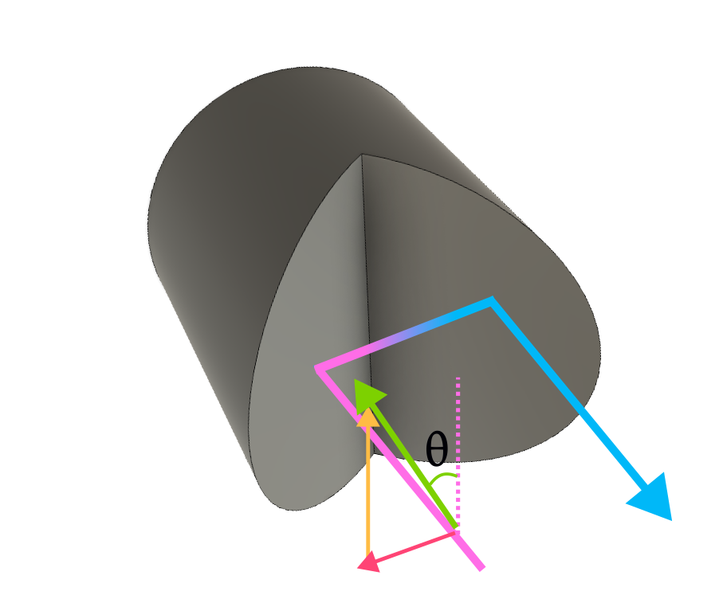
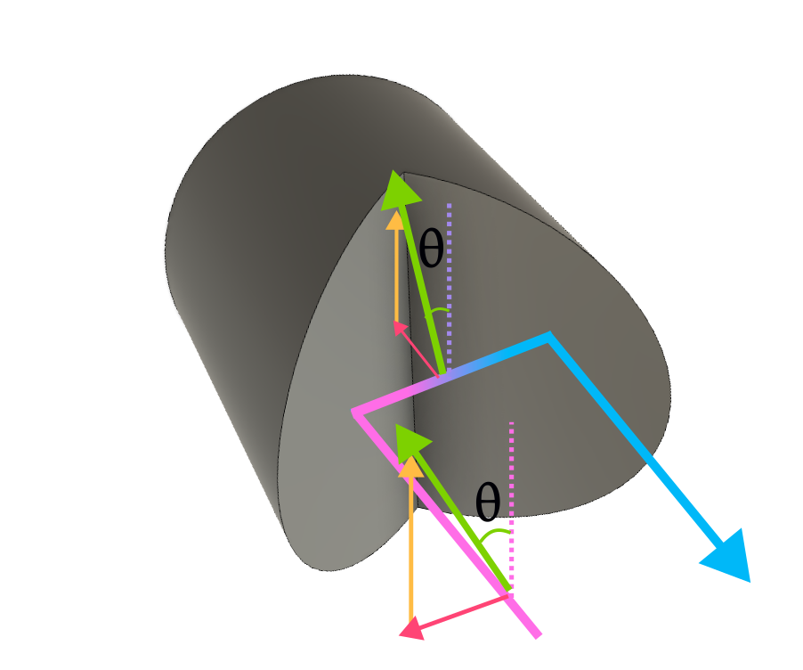
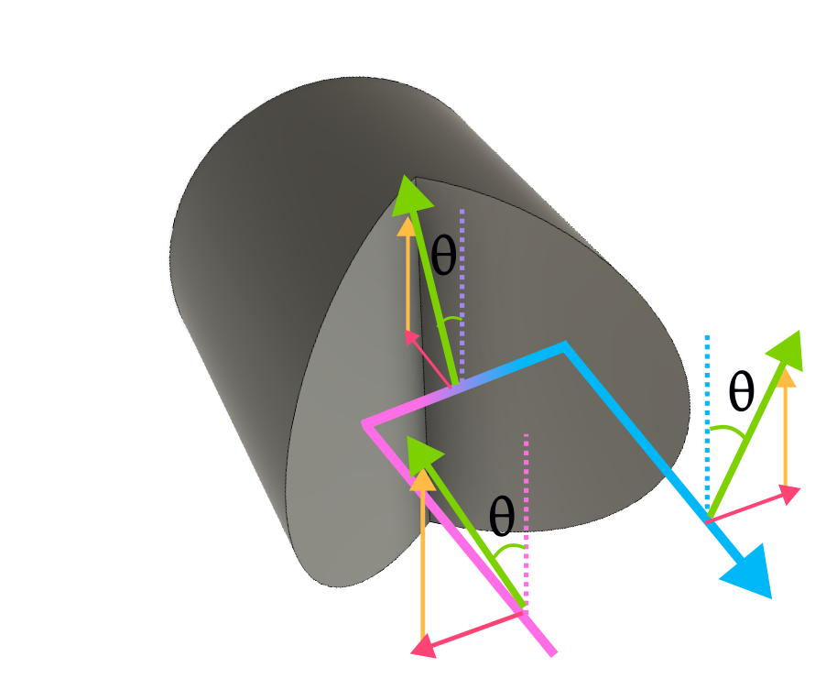
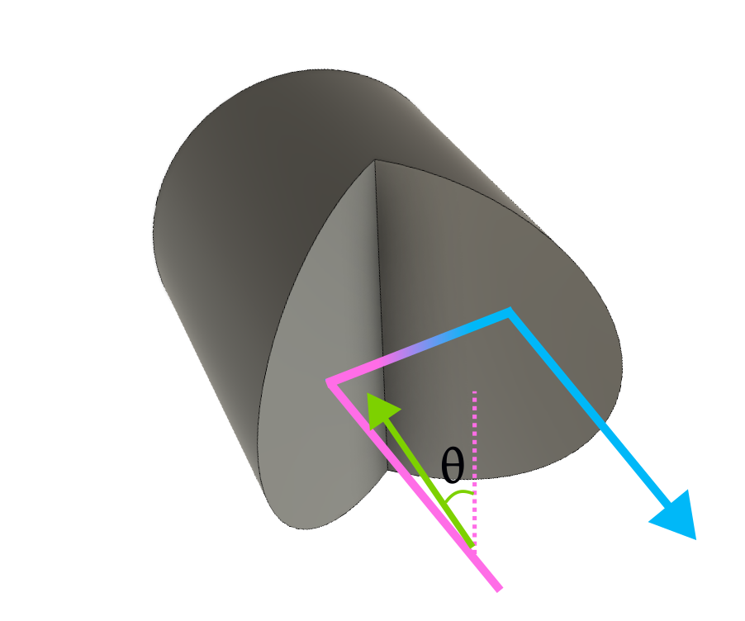
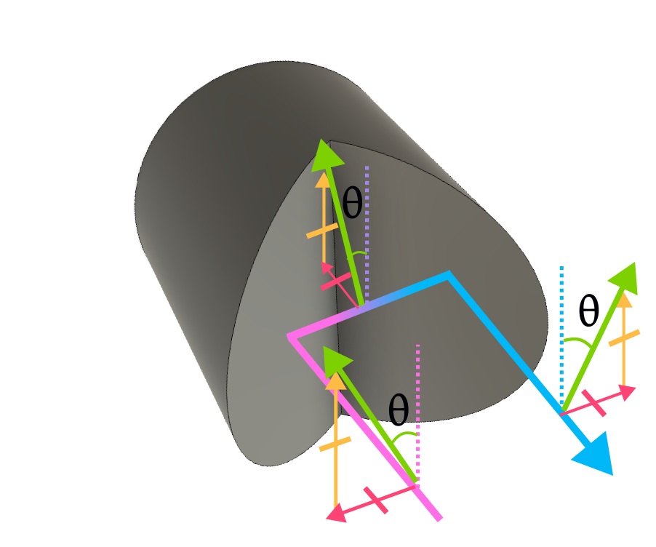
Rooftop End Mirror
Tune θ to optimize polarization change.
θ
θ
Rotating roof mirror corrects for polarization changes from optical imperfections.

Slide 7
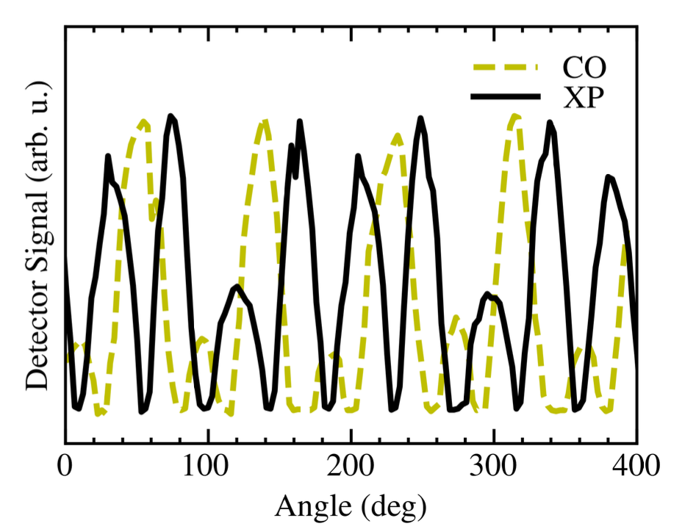
Imprecise Angle Optimization with Manual Knob
Goal: Minimize Crosspolar Signal
Copolar
Crosspolar
Order-of-Magnitude SNR Improvement for High-Field EPR Spectrometers via 3D-Printed Quasioptical Sample Holders. Antonin Sojka, Brad D. Price, Mark S. Sherwin

Slide 8
Project Stages
Stage 1
Stage 2
Stage 3
Stage 4
Control servo using LabView
Engineer servo-mirror connector
Automate with signal feedback
Integrate into EPR apparatus

Slide 9
Stage 1: Driver
Commands
Serial Communication
Step-Servo
Enable motor
Set Acceleration
Set Deceleration
Set Velocity
Advance by N Steps
Read Position
Disable motor

Slide 10
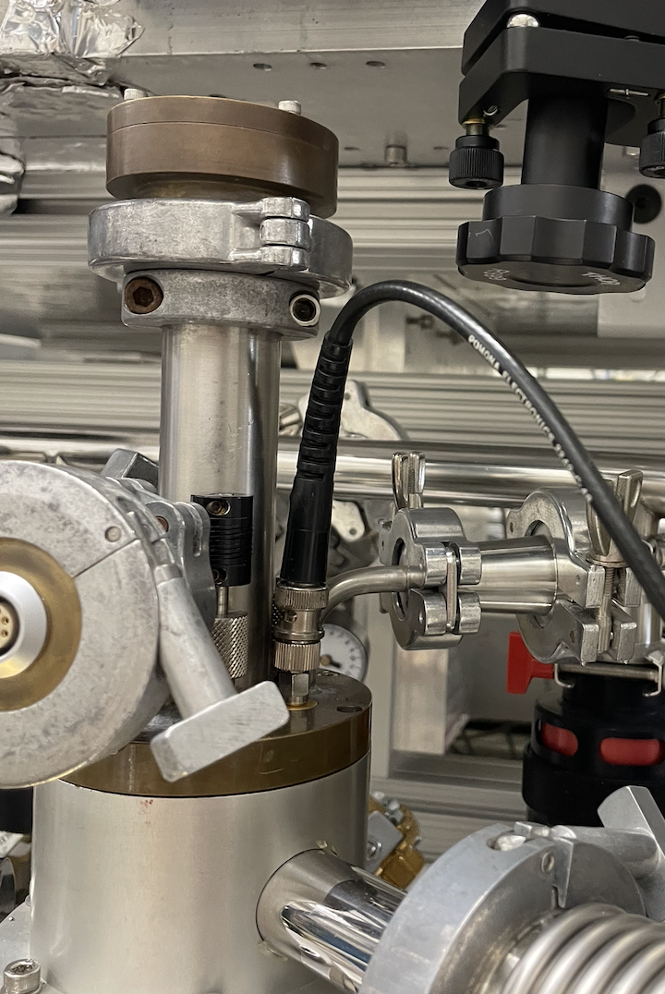
Stage 2: Build
1 m
Goal:
Use Step Servo to Rotate Knob
Criteria:
Works with Existing Setup
Compact
Easily Removable
Non-magnetic Materials

Slide 11
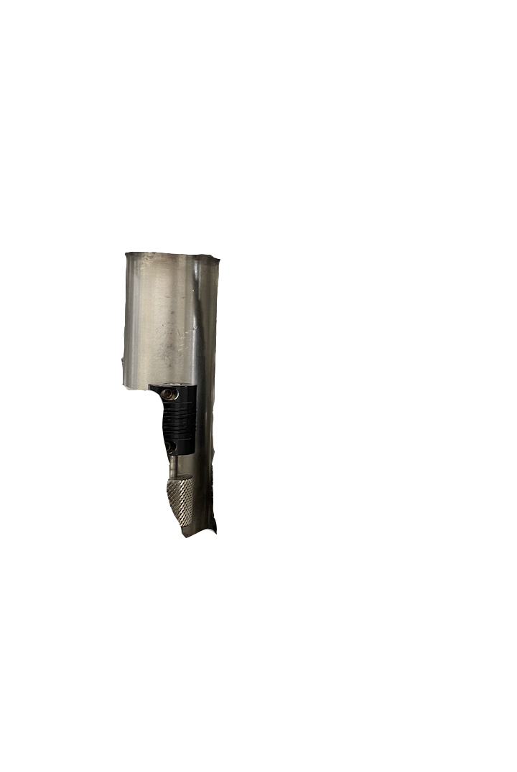
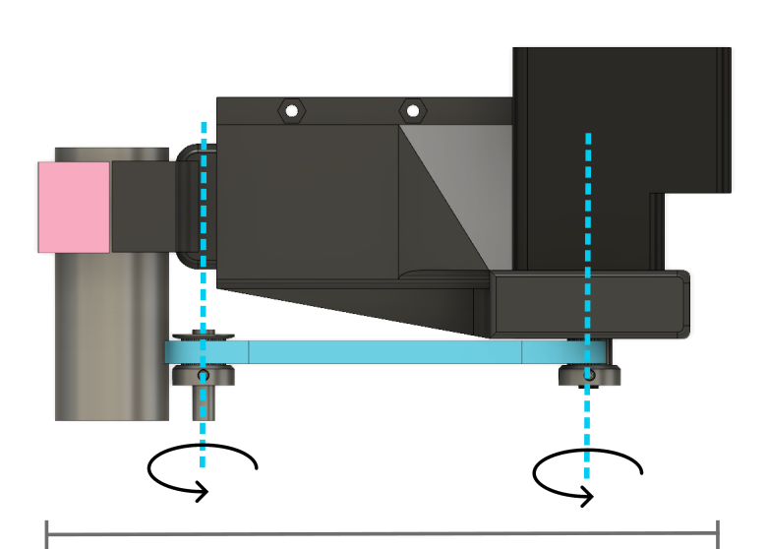
Stage 2: Build
~7” (extendable)

Slide 12
Stage 3: Automate
Goals:
Method:
Obstacles:
Minimize Crosspolar Signal
Gear backlash
Voltage
Detector Sensitivity
Rotation
Must attenuate during rotation
Automatic Rotation with Signal Feedback

Slide 13
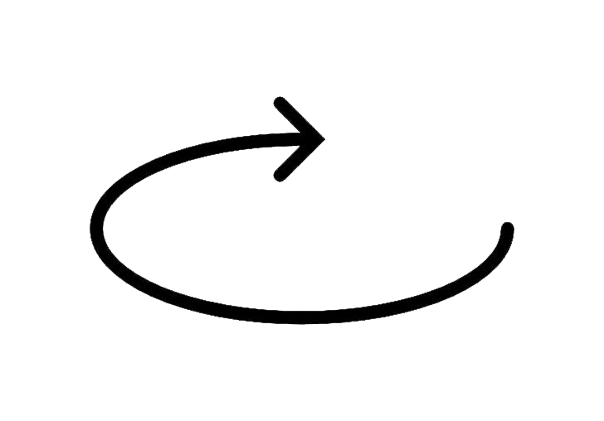
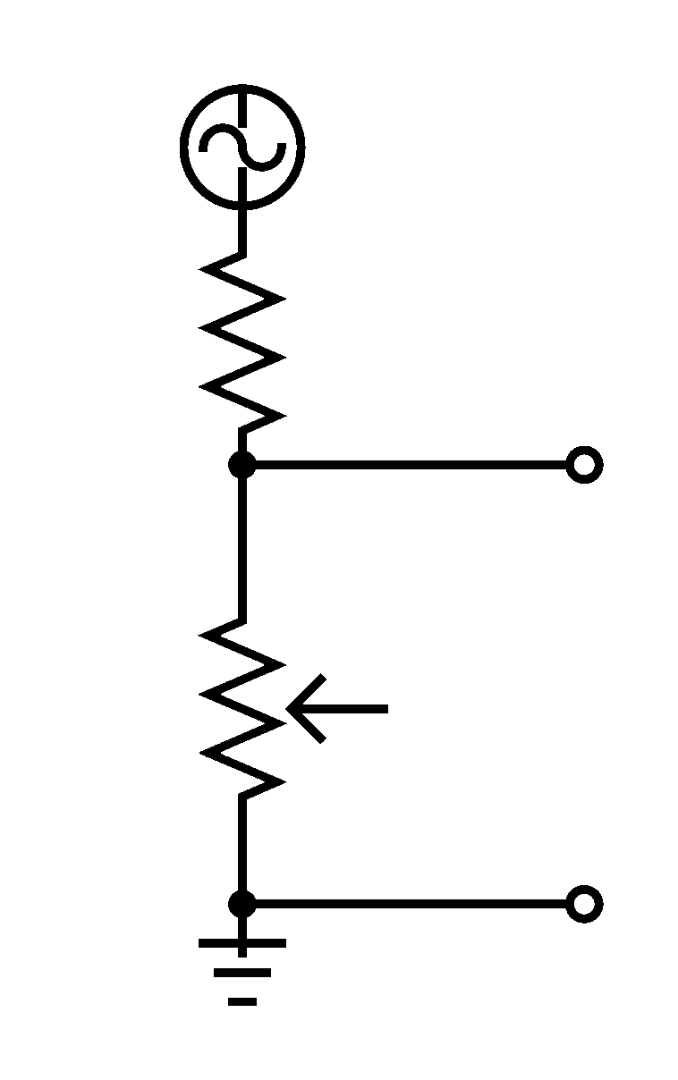
Stage 3: Automate
Step 1:
Find a Goal Voltage
V_{out}
Voltage is a function of rotation

Slide 14
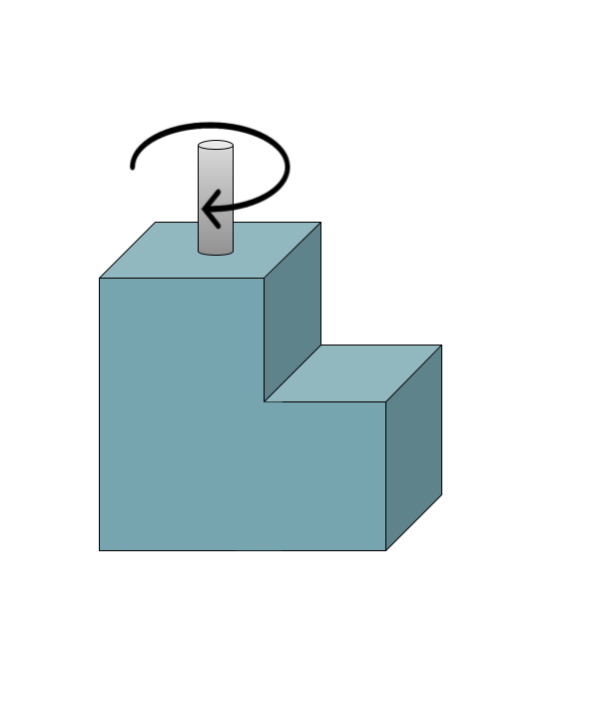
Stage 3: Automate
V_{out}
Step 1:
Find a Goal Voltage
Until Voltage = Goal Voltage
If Voltage < Goal Voltage
If Voltage > Goal Voltage
CW Step
CCW Step
Voltage is a function of rotation

Slide 15
Stage 3: Automate
Step 2:
Find Global Minimum
Voltage is a function of rotation
Rough Scan
Find
Fine Scan
Into the apparatus!
Detector Voltage Limits
Must attenuate during rotation

Slide 16
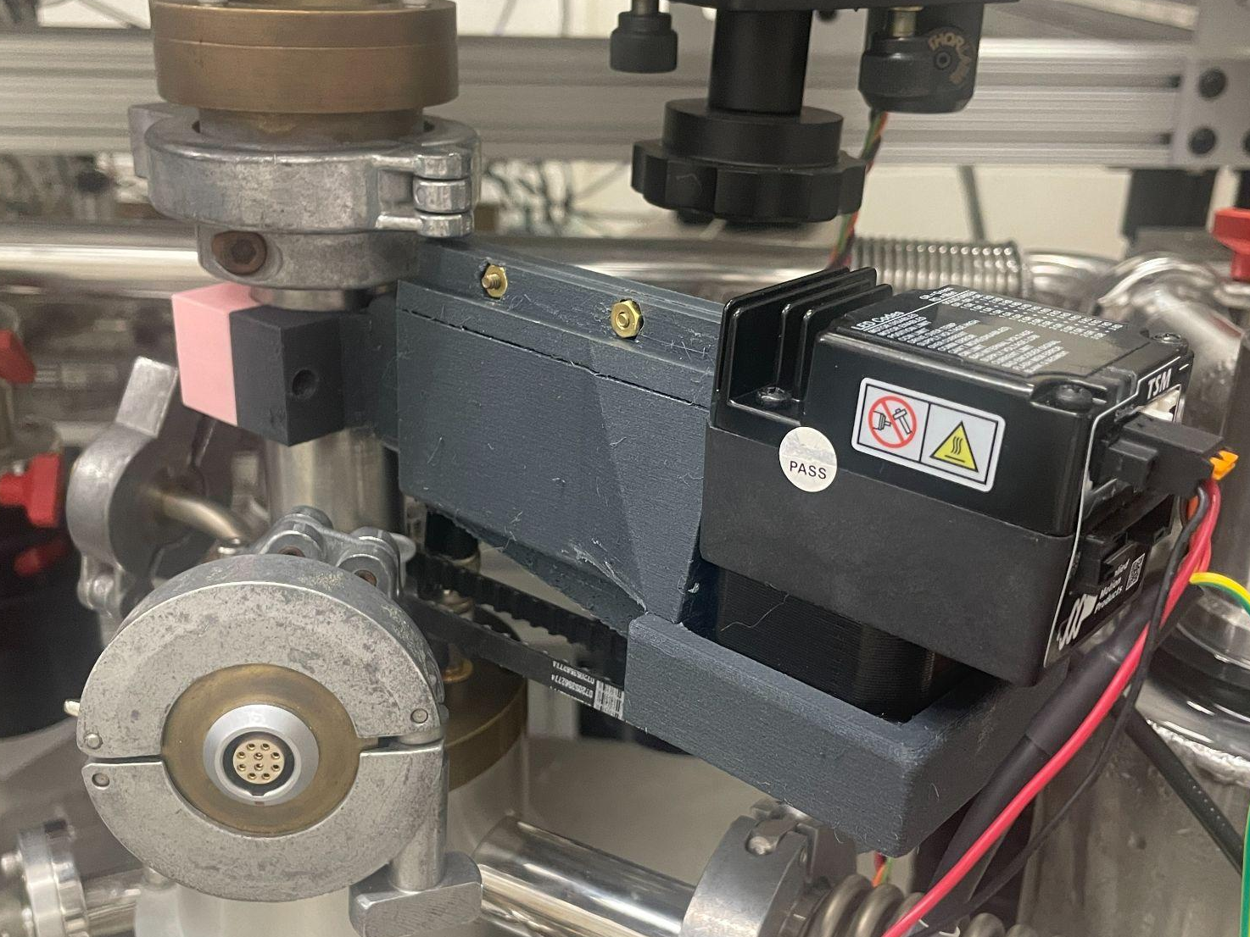
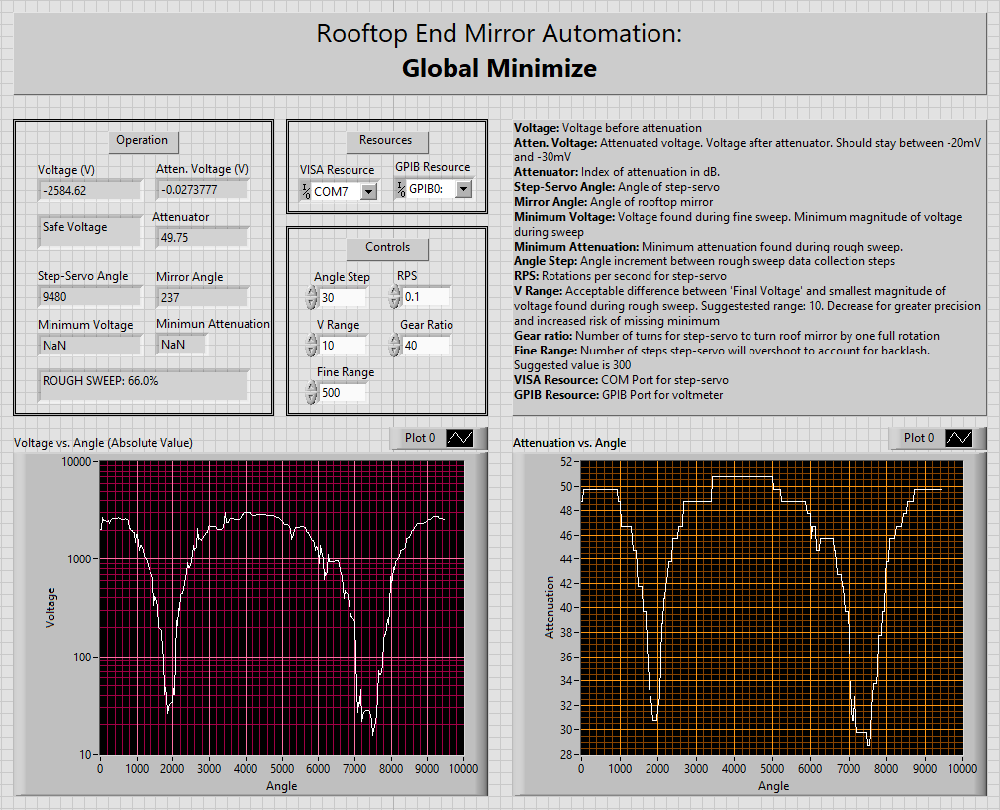
Stage 4: Integrate

Slide 17
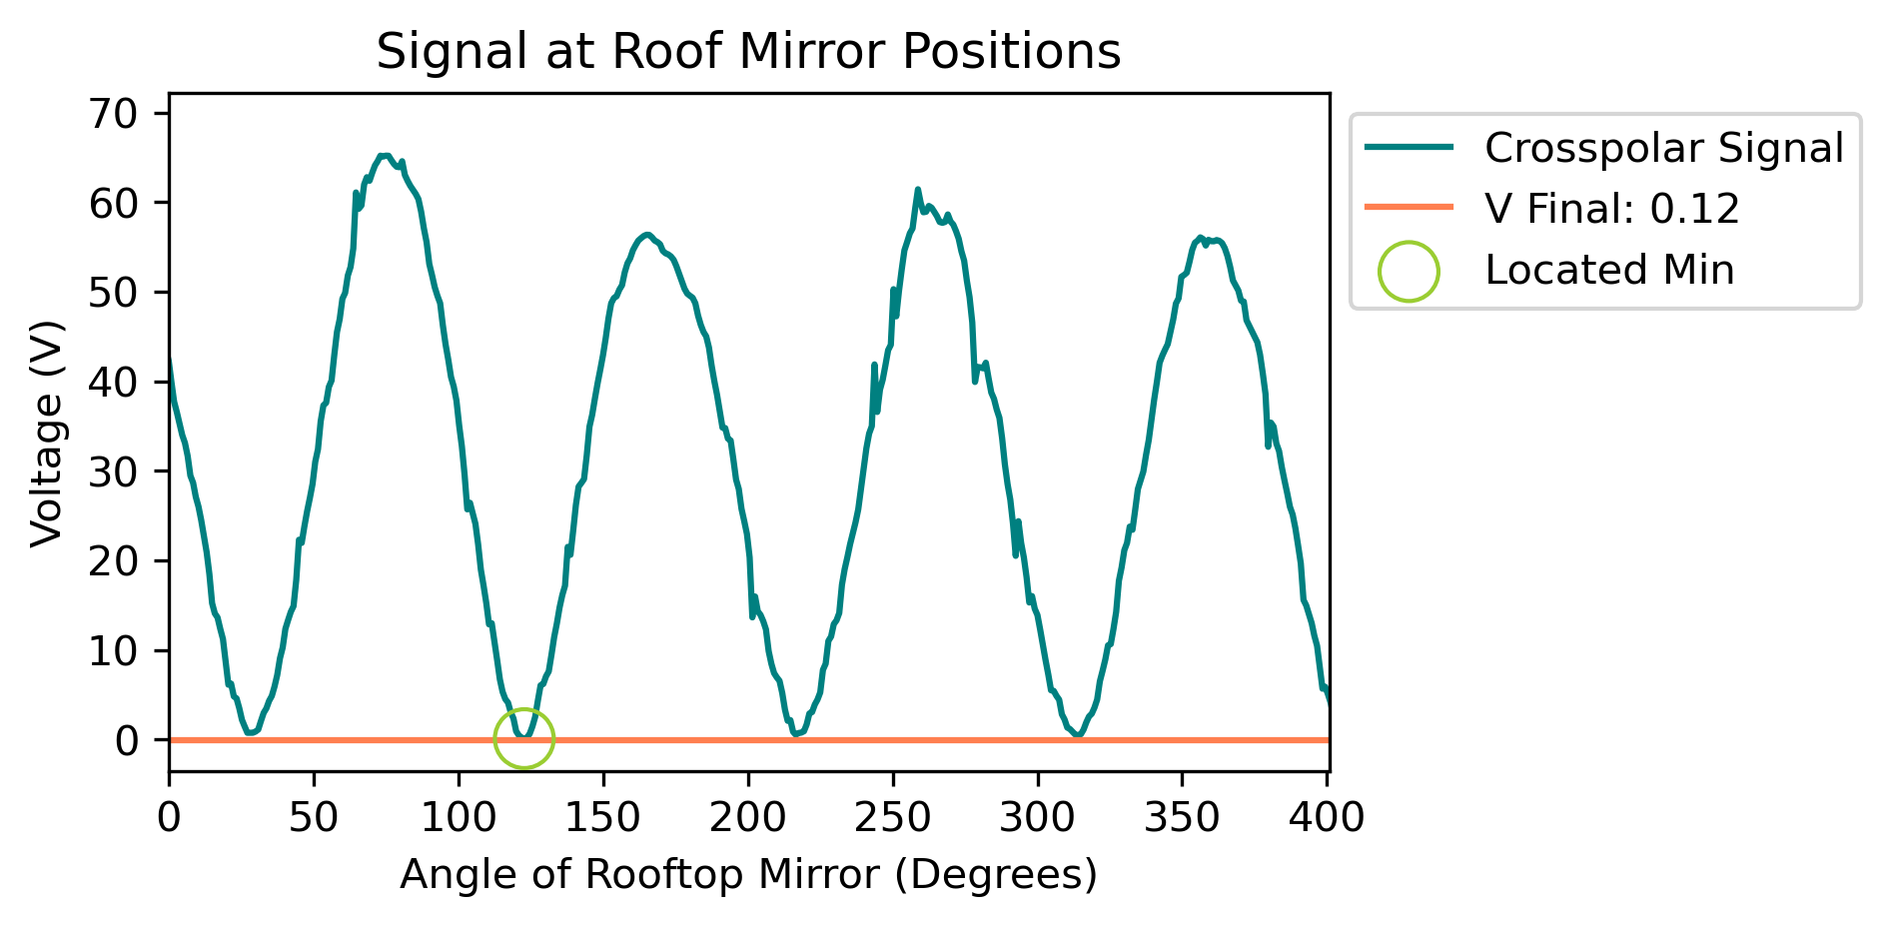
Evidence of Improvement

Slide 18
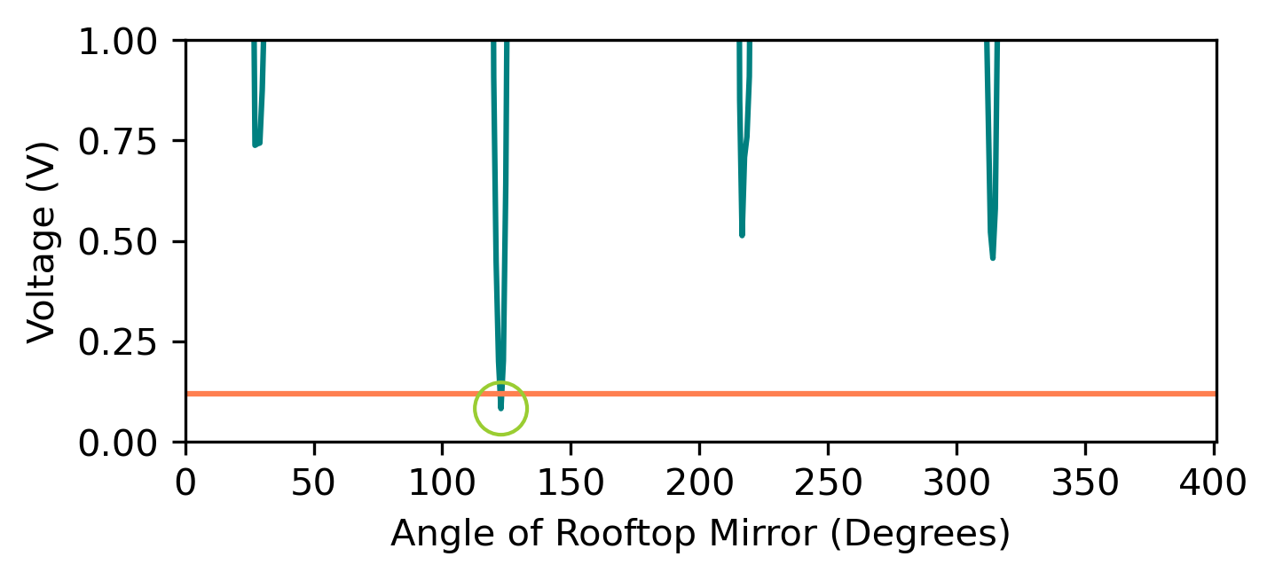
Evidence of Improvement

Slide 19
Evidence of Improvement
1% of Baseline Signal
Decreased DAQ Time
Copolar
Crosspolar
Order-of-Magnitude SNR Improvement for High-Field EPR Spectrometers via 3D-Printed Quasioptical Sample Holders. Antonin Sojka, Brad D. Price, Mark S. Sherwin

Slide 20
Thank you to everyone who made this project possible including Dr. Antonín Sojka, Prof. Mark Sherwin, Brad Price, Prof. Sathya Guruswamy, and my fellow undergrads: Lucas, Miranda & Robert.
Project funded by NSF Grant PHY-1852574.

