Slide 1
“Dipolar Filming” of Protein Motion Using Electron Paramagnetic Resonance
Johanna Schubert
Grad Mentor: Brad Price
Supervisor: Dr. Mark Sherwin, UCSB Driven Quantum and Biological Matter
UCSB Physics REU Symposium 2022
Notes:
Introduce myself, grad mentor, supervisor and department
State that I worked on two different projects this summer, and would like to talk about both today
Begin with “Dipolar Filming” of Protein Motion Using Electron Paramagnetic Resonance Spectroscopy

Slide 2
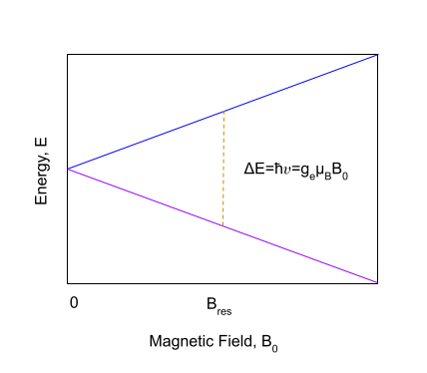
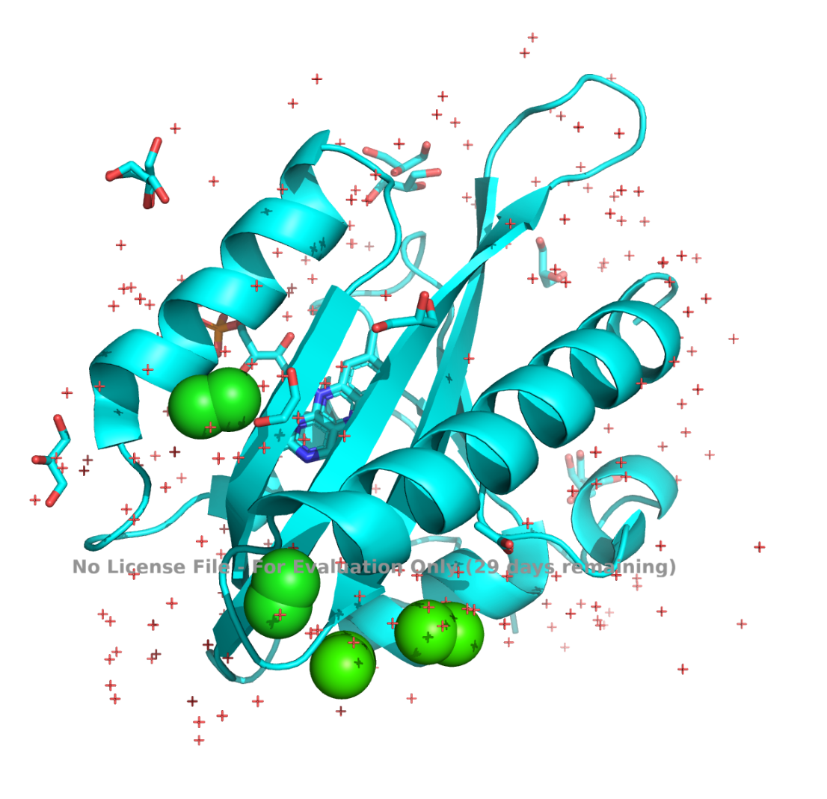
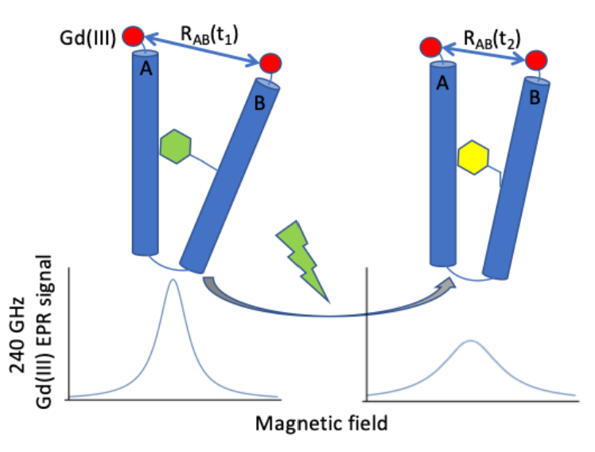
Background
Protein Dynamics
EPR Spectroscopy and Protein “Filming”
Unactivated dark state of light-adapted wild-type AsLOV2 mapped using x-ray crystallography. Retrieved from PDB using PyMOL.
EPR lineshape depends on spin-label separation. https://sherwingroup.itst.ucsb.edu/research/gd3/
Spins in a magnetic field.
Notes:
Protein dynamics
Proteins are nanoscale dynamic molecules that enable life
Protein structure is understood through x-ray crystallography, (solid-state) NMR, and cryo-electron microscopy
The protein data bank (PDB) contains over 190,000 structures
Protein structure does not illuminate the full picture of protein function
We need to understand how proteins physically move in response to external stimuli
AsLOV2 is a blue-light activated phototropin derived from oats
AsLOV2 Q513A has a glutamine to alanine point mutation at site 513
EPR Spectroscopy and Protein “Filming”
The Sherwin group uses EPR at high magnetic fields to “film” protein motion
EPR exploits the QM properties of materials that contain unpaired electrons
For field-swept EPR, we measure absorbance by sweeping the field near a resonant magnetic field value that depends on a chosen frequency (for us, 8.62 T and 240 GHz)
Electron spins are either up or down
Due to the Maxwell-Boltzmann distribution, most spins will be down near B_res
When we sweep the field near B_res, we measure a net absorption of energy which we can convert into a spectrum
Proteins are not paramagnetic → add paramagnetic spin-labels at different protein sites
EPR lineshape depends on the distance between spin labels

Slide 3
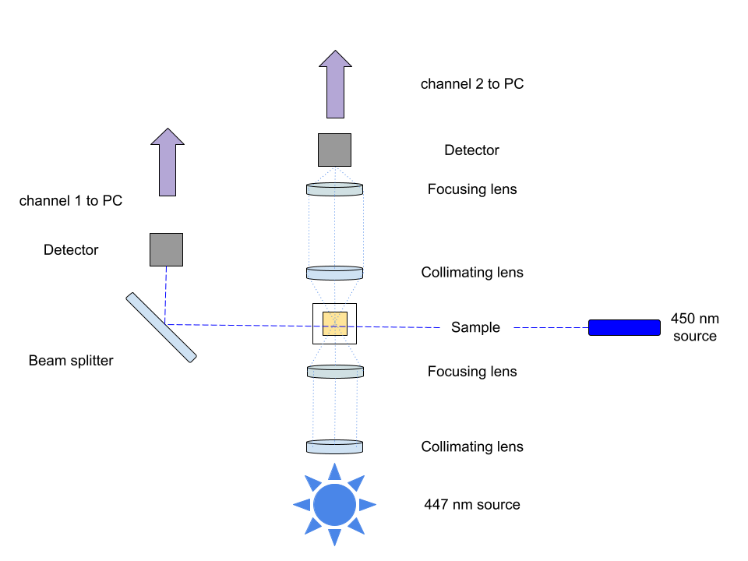
Quantifying Blue-Light (450 nm) Chromophore Activation
Measure transmission of 447 nm passed through the AsLOV2 sample after 450 nm activation.
Determine transient after short (~30 s) sample blue light exposure.
UV-Visible light set-up at Dr. Han’s Lab.
Notes:
AsLOV2 contains a molecule called a chromophore inside of its 3D-structure
When the chromophore absorbs blue light, the protein undergoes a conformational change
Quantify chromophore activation by measuring the transmission of 447 nm light passed through sample after being activated by a 450 nm blue light source
Measure the transient after a short blue light exposure
→ take a picture of cuvette

Slide 4
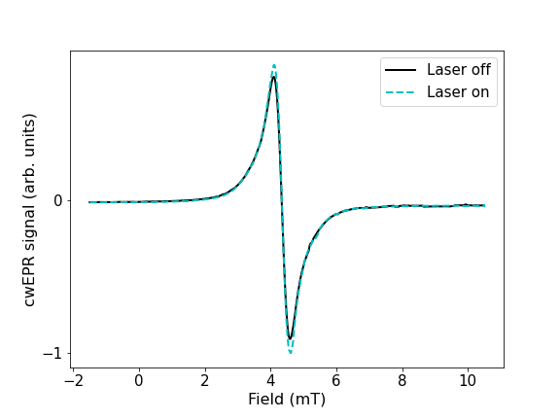
Field-Swept cwEPR Spectrum with and without Blue Light (450 nm)
Measure cwEPR of the AsLOV2 sample with and without 450 nm activation.
Determine transient of cwEPR at field of max amplitude after short (5 s) sample blue light exposure.
B₀=8.62 T
f=240 GHz
ΔB=0.001 mT
Field-swept EPR spectrum of AsLOV2 Q513A mutant.
Notes:
Our EPR set-up is equipped for both time-swept and field-swept measurements
To compare UV-Vis and EPR photocycles we want intensity versus time data
To determine the field value at which to conduct transient EPR, we perform field-swept EPR for the protein in its activated and ordered state
We can overlay the two EPR lineshapes and write code to determine the field value where they differ the most
Perform time-swept EPR at 4.62 mT added to baseline 8.62T magnetic field

Slide 5
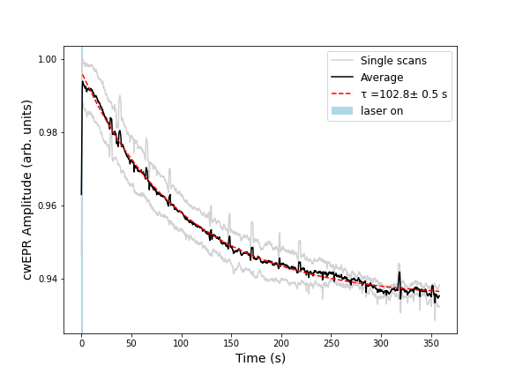
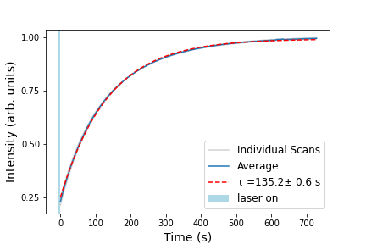
Comparing 447-nm-Transmission and cwEPR Transients
Δt=60 ms
Δt=1 s
Intensity vs. time at 447 nm for AsLOV2 Q513A mutant.
cwEPR amplitude vs. time at B₀+6.62 mT for AsLOV2 Q513A mutant.
Notes:
The 3D-protein structure returns to its unactivated configuration before the chromophore completely releases all absorbed light
Relaxation times are about half as long for wild type AsLOV2 (65s, 52s), which is expected because the 513 mutation disrupts the Hydrogen bonding that aids the folding process of one of the helices
The discrepancy in the UV-Vis and EPR photocycles is in agreement with wild type AsLOV2

Slide 6
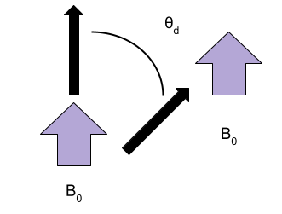
Future Work: Understanding Protein Tumbling in Solution
Problem: The time-average of the dipolar coupling term in the effective spin Hamiltonian goes to zero over long time-scales due to tumbling.
Solution #1: Try different gelling agents to see how close we are to the static limit.
Solution #2: Quantify AsLOV2 rotational correlation time by performing T1 and T2 relaxation measurements using room-temperature NMR.
Angle between spin labels.
Notes:
Project problems = Helium shortage due to war in Ukraine, timeline is too short (relying on grad student in biochem dept. for samples)
Tumbling:
Angle between spin labels changes constantly and randomly
Ergodic hypothesis: a system will access all microstates over long time scales
Time average of dipolar coupling term in spin Hamiltonian is zero for large t
Our type of EPR depends on the dipolar coupling term!
We can already see differences in EPR lineshape for ordered and activated protein structure w/o controlling for tumbling
However, it would be useful to know how close we are to the static limit
Option #1: Try using different gelling agents to physically inhibit protein motion and test to see if there are changes in the EPR lineshape
Option #2: Use room-temperature NMR to measure the rotational correlation time of AsLOV2 in solution
Can estimate this from T1:T2 relaxation ratio where T1 is the longitudinal magnetization recovery and T2 is the transverse magnetization decay
→ make own spin-label diagram

Slide 7
Development of Anti-Reflective Coating for Subterahertz Lens
Johanna Schubert
Grad Mentor: Brad Price
Supervisor: Dr. Mark Sherwin, UCSB Driven Quantum and Biological Matter
UCSB Physics REU Symposium 2022

Slide 8
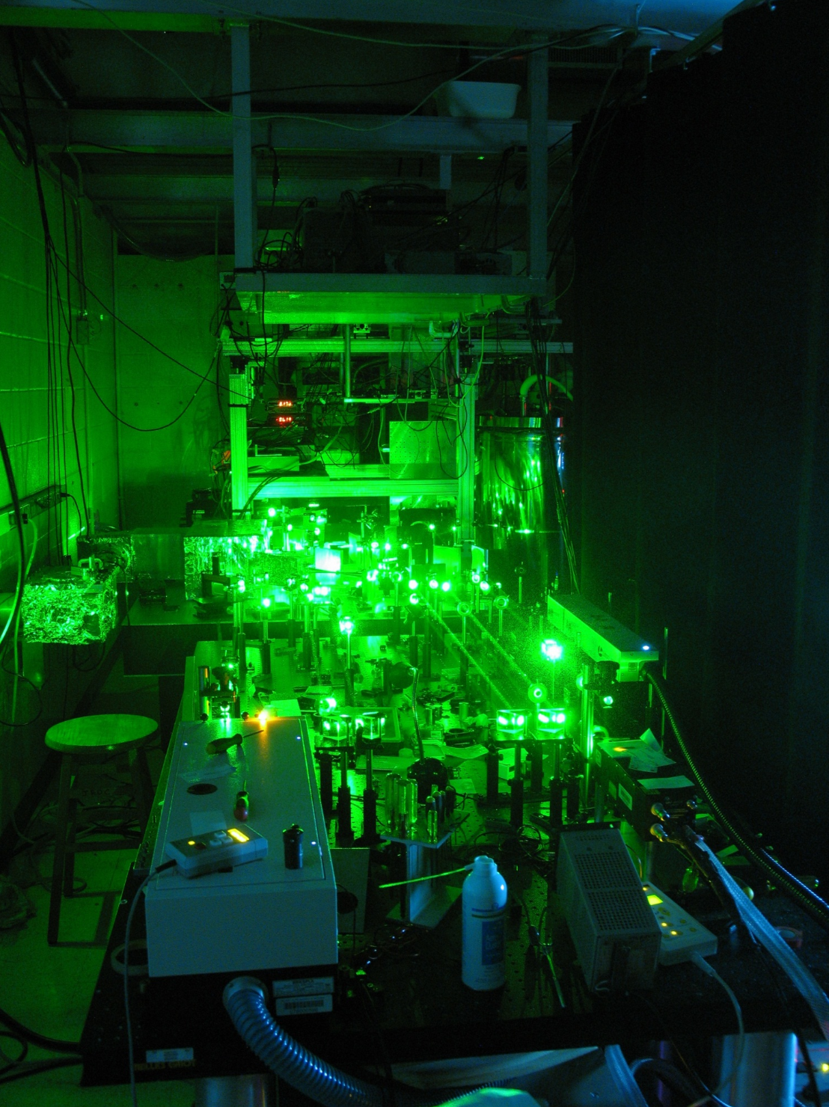
Terahertz Spectroscopy and EPR in Sherwin Lab
Problem: Backscattering from the three lenses in the EPR set-up introduces standing waves and causes a spectrometer dead time of ~70ns.
Solution: Develop a 3D-printed anti-reflective coating (ARC) to eliminate standing waves and reduce dead time.
Pulsed EPR set-up in Sherwin Lab. https://sherwingroup.itst.ucsb.edu/research/ultrafasthigh-field-electron-paramagnetic-resonance/
Notes:
THz range is located at far end of infrared region right before microwave region
Difficult to access because viable sources and detectors are incredibly expensive
For EPR measurements, higher applied magnetic fields are desirable but require high power sources
Sherwin lab EPR set-up is able to perform high-power, pulsed EPR at high magnetic fields by using quasioptics (depicted in image) to generate two pulses from the UCSB free-electron laser which in turn drive EPR
Backscattering is just reflection of waves back in the direction from which they came

Slide 9
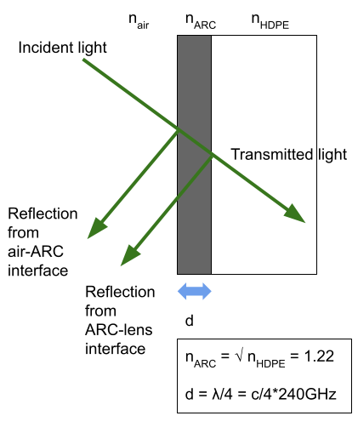
Anti-Reflective Optics
Problem: We cannot purchase 3D-printing material with the appropriate index of refraction (n).
Solution: We can manipulate the infill density of a 3D-printed polylactic acid (PLA) slab to obtain the desired effective n.
Schematic of backscattering optics.
Notes:
Optics are simple!
We are concerned with refractive index and thickness of ARC
Two interfaces: one between air and ARC, and one between ARC and lens
Ignoring thickness, some math tells us that the conditions for the maximum percent of transmitted light are when refractive index of ARC is the square root of the refractive index of the lens (derivation is on back-up slide)
We can also manipulate the thickness of ARC such that waves that reflect from the air-ARC and the ARC-lens interface have a pi phase shift and therefore deconstructively interfere (thickness must be some integer multiple of lambda/4)

Slide 10
Effective Medium Approximations
Materials science modeling
Definition: Average properties of constituent materials to estimate macroscopic properties of composite materials
Bruggeman’s model:
Agladze (1996).
Notes:
Bruggeman’s model relates fill fraction, the dielectric function of 100% infill material (epsilon omega) and the dielectric function of the composite structure (epsilon omega f)
Technically, the dielectric constant can be represented as a complex number where the real part is related to the index of refraction and the complex part is related to the absorption coefficient
However, since absorption is negligible for a thin enough plate, we can approximate the refractive index as the square root of the dielectric constant
Hence, if we know refractive index of 100% infill material and desired refractive index, can easily solve for percent infill to get desired effective n

Slide 11
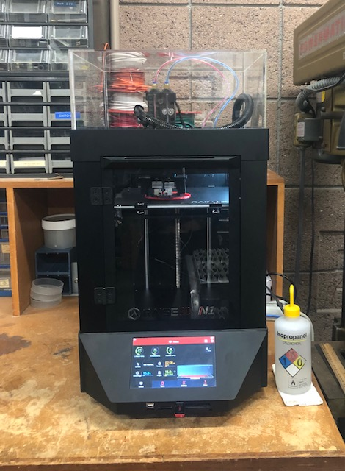
Long-Term Steps
1. Determine n of a 100% infill PLA slab.
2. Use Bruggeman’s model to determine the PLA infill density needed to obtain n_{effective}=√n_{HDPE}=1.22.
3. Print correct dimensions for the EPR lens.
3D-printer set-up in Sherwin Lab.
Notes:
HDPE is high-density polyethylene, the material used in the EPR lens

Slide 12
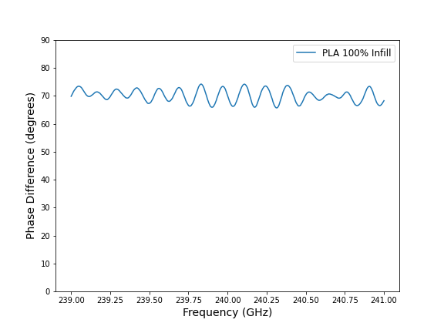
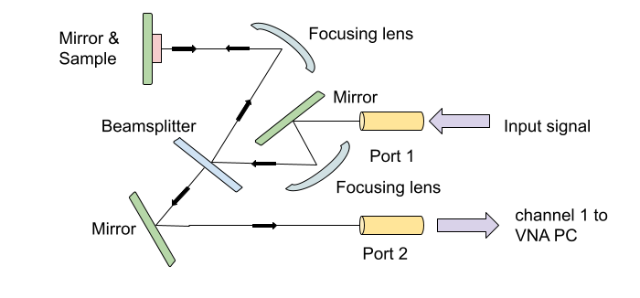
Refractive Index of 100% Infill PLA Slab
Left: VNA set-up for taking S11 phase measurements.
n_{100% measured} = 1.44
n_{100% expected} = 1.45 (internet cited value)
% difference = 0.7%
Right: VNA phase measurement of 100% infill PLA slab.
Notes:
Use vector network analyzer to take phase measurements
Isolate small frequency region around 240 GHz (span of 26 GHz) and use average phase difference in this region to find the refractive index
Here is the equation to find n: n = (c*theta)/(2*pi*d*f)+1 where c is speed of light, theta is phase difference, d is thickness and f is frequency
Measured refractive index of 100% infill slab is very close to expected value
Using the measured value for n, Bruggeman’s model tells us that we want a 52.5% infill PLA slab to obtain n_effective=1.22
→ phase should not shift w/ wavelength bc index of refraction is constant for every wavelength
→ see a variation b/c focus onto sample w/ multiple angles of incidence
→ variation is a tell-tale of the geometric separation that sample has
→ if look at intensity should see many minimal and maxima that should be proportional to n*thickness

Slide 13
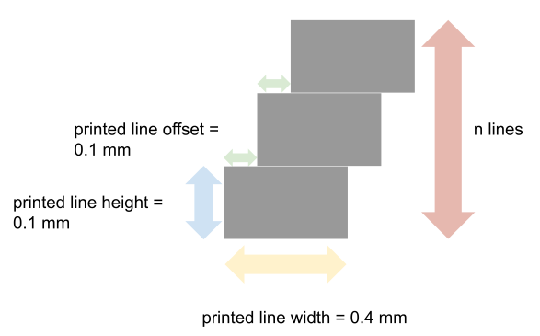
3D-Printing Thin Solid Slabs with Varying Density
Problem: The infill patterns in the 3D printing slicing software are crosshatch patterns that leave gaps in the overall structure.
Solution: Design the slab to have the desired density in the 3D printing design software, then tell the slicing software to print at 100% density.
Notes:
Infill patterns in 3D printer slicing software are typically used to change the infill density of solid structures
The strategy: “step” pattern taking advantage of intrinsic 3D-printer constraints
The minimum layer height the 3D printer can print is 0.1mm, and the minimum width of a single 3D-printed line is 0.4mm
Each layer has 0.1mm offset (this is kind of arbitrary, just need to make sure the number of layers is sufficient to cover entire surface)

Slide 14
3D-Printing Thin Solid Slabs with Varying Density
Problem: The infill patterns in the 3D printer slicing software are crosshatch patterns that leave gaps in the overall structure.
Solution: Design the slab to have the desired density in the 3D printing design software, then tell the slicing software to print at 100% density.
z
x
Notes:
Changing the distance between the step structures allows us to easily change the infill density
We put as many step structures as we want to in the x-direction and extrude all of them in the y-direction to obtain the desired base dimensions
We put n layers in the z-direction to obtain the desired thickness

Slide 15
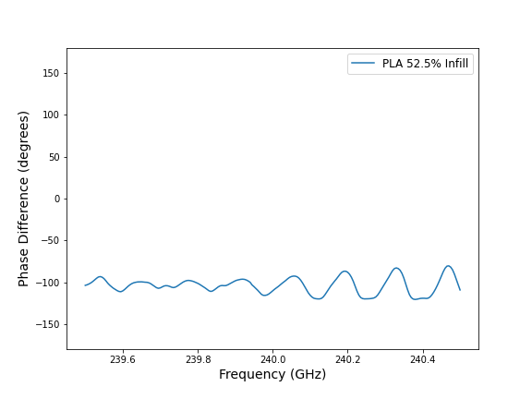
Refractive Index of 52.5% Infill PLA Slab
n_{52.5% measured} = 1.28
n_{52.5% expected} = 1.22 (using Bruggeman’s model)
% difference = 4.9%
Left: Example of “step” infill 3D-printed PLA slab.
Right: VNA phase measurement of 52.5% infill PLA slab.
Notes:
Pass around the pretty step infill PLA slab
Several key takeaways:
1. We can manipulate the effective n by changing the percent infill
2. The “step” infill design seems to approximate a solid structure relatively well
3. Bruggeman’s model will give us a ballpark infill value, but we will need to test slabs with % infills near that value and optimize to get as close to the desired effective n as we can
→ make a beautiful polarizer
→ make phase measurements as a function of rotation and observe changes in phase difference data
→ vector source uses waveguide; source is always polarized

Slide 16
Future Work
1. Optimize infill density of “step” infill PLA slabs.
2. Take VNA power measurements and use Fabry-Perot standing waves as an alternative method for measuring the refractive index.
3. Incorporate step infill design into a robust 3D-printed structure that fits EPR lens dimensions.
4. Explore polarization properties of THz source and 3D-printed sheets.
Front (left) and back (right) side of EPR lens.
Notes:
I did not have a lot of time!
1. Need to optimize infill density by testing some percent infill values just below 52.5% infill
2. Compare refractive index measurements using both phase difference and power measurements:
Fabry Perot standing waves will have a frequency spacing that is related to the optical path length
Need to print thicker slabs
Initial measurements showed there are standing waves in the system that are covering up the standing waves from the PLA slab
Will need to change the VNA set-up to try to remove the intrinsic standing waves using absorbers and a different sample holder
3. 3D-printing the actual ARC will involve some additional features:
Strengthen the “step” infill by having a single cross-hatch layer on the top and bottom to hold the infill in place
Plan on fitting dimensions to back side of EPR lens, which has only minimal curvature
4. Explore polarization

Slide 17
Acknowledgements
Dr. Sathya Guruswamy, UCSB Physics REU Site Director
NSF REU grant PHY-1852574
Brad Price, Grad mentor
Dr. Mark Sherwin, PI
Sherwin Lab Group
REU group
Swarthmore College Physics Department

Slide 18
Anti-Reflective Optics Derivation
→ reflection coefficient
→ transmission coefficient
→ total transmission is product of air-ARC and ARC-lens transmission → can find this numerically
→ refractive index of air
R = ((n₀-n₁)/(n₀+n₁))²
T = 1-R
T_{total}=T₁*T₂
T_{max} when T₁=T₂
Solve (n₀-n₁)/(n₀+n₁)=(n₁-n₂)/(n₁+n₂)
Get n₁=√(n₀*n₂)
Since n₀ ≈ 0
n₁=√n₂

Slide 19
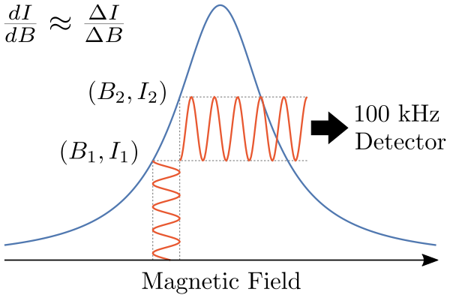
Field Modulation
The recorded EPR spectrum is the first-derivative of absorption!
https://upload.wikimedia.org/wikipedia/commons/thumb/e/ea/EPR_Field_Modulation.svg/600px-EPR_Field_Modulation.svg.png

