Slide 1
Exploring Electron Environments in Semiconductor Superlattices
Amelia Schaeffer - Reed College
Faculty Advisor: Dr. Christopher Palmstrøm - Materials and ECE
Graduate Advisors: Jason Dong and Aaron Engel
Notes:
Hello, to anyone who doesn’t know me, my name is Amelia and this summer I worked in the Palmstrøm lab on exploring and characterizing the electron environments in semiconductor superlattices

Slide 2
Image based on Brookhaven National Lab, https://www.bnl.gov/newsroom/news.php?a=217396
e-
e-
e-
e-
e-
𝛾
Electron beams for are important for probing the structure of matter
Notes:
Before I jump into my specific project, I want to give you some background and motivation for this work
In particle accelerator facilities, electron beams are important for probing the structure of matter, particularly atomic nuclei
In recent years, there has been increasing interest in reliably generating spin-polarized electron beams, where all of the electrons spins are aligned, as this allows for the same experimental setup to give much more information about the sub-atomic interactions, including parity violations
However, this research has been limited by the difficulty of creating materials that are good sources of spin-polarized electron beams, otherwise known as photocathodes
Presently, there is also very little supply for facilities that need them
So, how this works is light liberates electrons from a photocathode via the photoelectric effect
While metals are traditionally used to demonstrate this effect, semiconductors are better materials for controlling polarization

Slide 3
Image based on Polarized Electron Sources, https://accelconf.web.cern.ch/p95/ARTICLES/MPE/MPE08.PDF
+1/2
-1/2
+1/2
-1/2
3
1
Crystal Strain
e-
e-
e-
+3/2
+1/2
+3/2
e-
+1/2
We can use circularly-polarized light to liberate electrons out of certain spin states
Notes:
Why do we use semiconductors? Specifically, why do we use GaAs?
This energy gap here is characteristic of semiconductors – in a metal, we would have an essentially continuous distribution of states in here, so we couldn’t actually control what state our electrons are in
The circularly polarized light we provide is of a specific energy and with quantum mechanical selection rules, we can selectively excite electrons into states of certain spins
In GaAs, this happens with a 3:1 ratio
It’s from these states that electrons are actually liberated
However, if we introduce strain into the crystal lattice, we can break the energy degeneracy of these starting states and now we could, theoretically, excite electrons into a single spin state
There are some physical limits on realizing a 100% spin polarization, but we want to get as close as we can in our design
This means maintaining relatively thin layers otherwise we can’t maintain this strain
In our system, we have added some In and Al based on previous studies showing high polarization

Slide 4
6 nm GaAs
25 nm AlGaAs
2.3 nm AlGaAs
10 $⨉$
5.1 nm InAlGaAs
500 nm AlGaAs
500 nm GaAs
GaAs wafer
Schematic of a photocathode composed of GaAs, AlGaAs, and InAlGaAs
4
Notes:
Keeping all of this in mind, this is what we have
Thin layers to maintain this strain
To give you a picture of the samples I’m studying, here is a general schematic of a sample composed of GaAs, AlGaAs, and InAlGaAs (this is a cross-section)
While there’s a lot to see in this structure, I want to point out this middle part where we have thin layers InAlGaAs and AlGaAs alternating to create our active region
This is where our electrons are conducting electricity and where we would be liberating them from
This structure of alternating layers is called a superlattice and is designed so that the two materials can line up their crystal lattices well to create smooth interfaces but provide very different electron potentials over a larger periodic scale
This confines the electrons to 2-D motion, which in turn concentrates their energies around certain values, meaning laser light tuned to liberating electrons of those energies now has more electrons to potentially liberate, increasing efficiency
We want to know whether or not this system will be a potentially better spin polarized photocathode material that other GaAs-based photocathodes in use now, but we want to have the best quality samples we can

Slide 5
Lots of slightly different conditions
This project
Best conditions
Notes:
You can think of this project like a funnel, where the goal is to take lots of possible samples with slightly different conditions and find the best one so that can go on to future study
Particularly, the conditions I looked at included

Slide 6
Sample Description | Electron Density (x10¹² cm⁻²) | Transport Mobility (cm²/V·s) | Quantum Mobility (cm²/V·s) | Effective Mass (x m_{e})
Grown at 505°C | ? | ? | ? | ?
Grown at 520°C (control) | ? | ? | ? | ?
Grown at 535°C | ? | ? | ? | ?
Slightly Higher Aluminum | ? | ? | ? | ?
Digital Alloy AlGaAs | ? | ? | ? | ?
Digital Alloy AlGaAs, Much Higher Aluminum | ? | ? | ? | ?
Thicker AlGaAs Layers | ? | ? | ? | ?
Only 6 Layers (not 10) | ? | ? | ? | ?
Notes:
First off, we have different temperatures at which the active region is grown
Then, we have a sample with a slightly higher aluminum content throughout
Next, we have a sample with what we call a digital alloy where instead of mixing aluminum and gallium and arsenic all together when we grow it, we do very thin layers of aluminun arsenide, then gallium arsenide, so that overall it has the same composition but it’s stratified out into layers
We have another digital alloy sample with significantly more aluminum
Then we have one where it has thicker AlGaAs layers
Lastly, we have one with fewer layers in our superlattice
With all of this, we want to measure electron
Density in the material
Transport mobility, which describes how well an electron moves through a material in an applied electric field, and this is really the parameter we want to optimize
Quantum mobility, which is weighted more towards different scattering mechanisms and can give us a more complete picture of how electrons are being scattered
Effective mass – a parameter we use to describe how the electron moves through the electrostatic potential of the material and is important for modelling
I also measured some other parameters related to these, but these are the big ones
Our goal is to fill in this table

Slide 7
Images based on The Hall Effect, https://www.nist.gov/pml/nanoscale-device-characterization-division/popular-links/hall-effect/hall-effect.
Hall resistance
Longitudinal resistance
V
V
e-
I
I
+
B
B
7
Notes:
In order to measure these parameters, we measure the Hall and longitudinal resistances
To measure Hall resistance, we run a current one direction and apply a magnetic field perpendicular so that, by the Lorentz force, we deflect charge carriers to the other sides
We can measure the magnitude of this to learn about this charge carriers
We also take longitudinal resistance measurements where the voltage is measured parallel to the current path

Slide 8
Hall resistance at 2 K
8
Notes:
Here are some examples of how this data actually looks from a sample I measured
As you can see, there is a very clear linear relationship between the magnetic field and the Hall resistance
Extract electron density from slope – great, that’s one of four of our parameters
Pairing this with measurements of the longitudinal resistance at zero field, we are able to calculate one version our mobility and lifetime that tells us about some of the electrons in the sample
But what about the quantum mobility and effective mass? This is where we look at the longitudinal resistances at different magnetic fields

Slide 9
Longitudinal resistance at 2 K
9
Notes:
As you can see, the shape is much different
This big peak is due to a quantum effect called weak localization that isn’t of interest to us for this work, but is an expected feature
We focus less on the overall shape and care particularly about these “wiggles” at high magnetic fields
These are called Shubnikov-de Haas oscillations

Slide 10
Image based on Quantum Hall Effect by Alba Cazorla, https://en.wikipedia.org/wiki/Quantum_Hall_effect#/media/File:Densidadestadossinspin.jpg
E_{F}
E_{F}
Increase Field Strength
Number of states
Number of states
E₁
E₂
E₃
E₁
E₂
Energy
Energy
10
Notes:
Why this matters is that the electrons that are conducting electricity are all at one energy, that we call the Fermi energy, and say that’s right here so we have this number of states that can conduct electricity
If we crank up the magnetic field, our peaks spread out and sharpen such that we now have a different number of states that can conduct electricity, so as we increase the field strength, we’re essentially having these peaks and troughs pass our Fermi energy

Slide 11
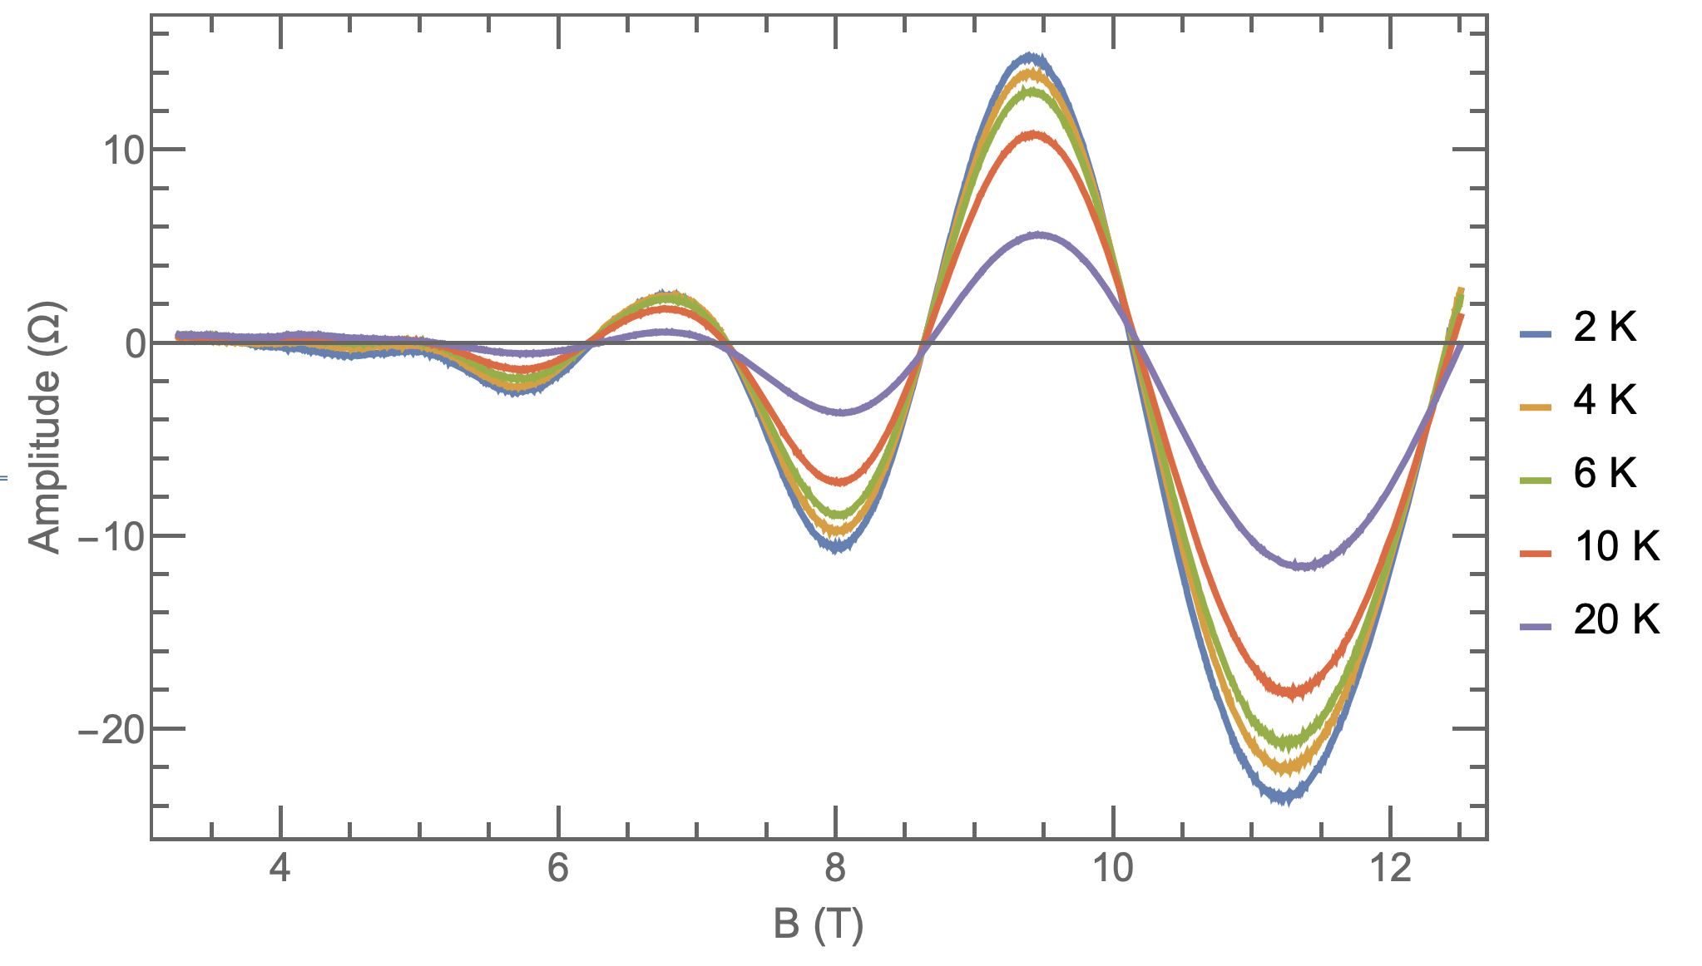
Shubnikov-de Haas Oscillations
11
Notes:
And if we isolate these from background they look like this
All of the measurements we’re making are of electrons at the Fermi energy and when we increase the magnetic field, we’re actually changing the number of states at that energy
Here, we can clearly see that the oscillation gets bigger at higher fields
As we can see, the amplitude of these oscillations also decreases with increasing temperature and if we take a single oscillation and normalize these amplitudes to the highest amplitude, then plot that as a function of temperature, we get something that looks like this

Slide 12
Sample Description | Electron Density (x10¹² cm⁻²) | Transport Mobility (cm²/V·s) | Quantum Mobility (cm²/V·s) | Effective Mass (x m_{e})
Grown at 505°C | 2.84 | 649 | 1418 | 0.088
Grown at 520°C (control) | 4.65 | 417 | 1176 | 0.087
Grown at 535°C | 4.45 | 536 | 865 | 0.087
Slightly Higher Aluminum | 2.12 | 408 | 2088 | 0.100
Digital Alloy AlGaAs | 1.54 | 213 | 1459 | 0.116
Digital Alloy AlGaAs, Much Higher Aluminum | N/A | N/A | N/A | N/A
Thicker AlGaAs Layers | 9.17 | 387 | 1036 | 0.081
Only 6 Layers (not 10) | 1.89 | 166 | 1128 | 0.091
Notes:
So what did we learn from taking all of these measurements?
Here’s that table from earlier, but all filled in where the darker squares have higher values and I’ve highlighted the two samples that showed better mobility values than our default, which is our one at 520
505 showed better transport mobility, and therefore overall quality
Slightly higher aluminum showed significantly higher quantum mobility
As you can see, the much higher aluminum didn’t dope effectively, so I was unable to take measurements
I’ve separated effective mass visually because this isn’t a parameter we’re looking to maximize or minimize, just measure
The rest of the samples did not generally have better quality
Of note, our digital alloys did work, just not super well, but it is a slightly different application than normal

Slide 13
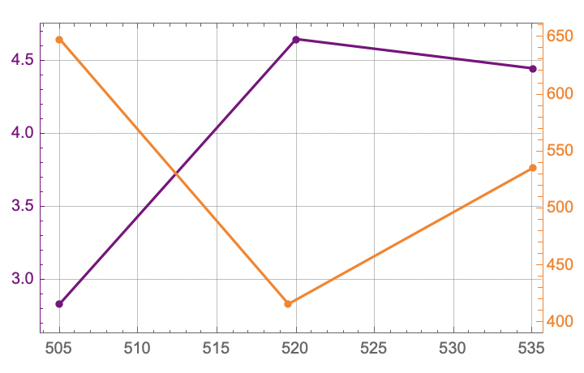
Electron Density (x10¹² cm⁻²)
Transport Mobility (cm²/V·s)
Temperature (°C)
Notes:
The more we ionize our dopant atoms, the higher our electron density but also the more charged atoms to impede mobility
Since doping is less of a concern in the device design, the cooler growth is what we want

Slide 14
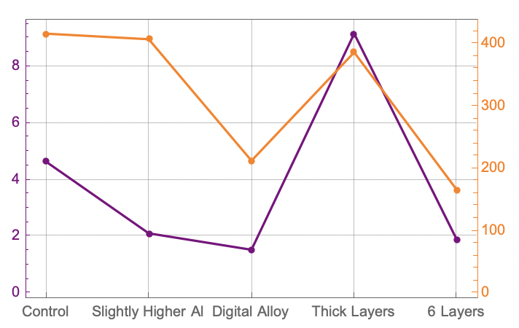
Electron Density (x10¹² cm⁻²)
Transport Mobility (cm²/V·s)
Sample Description
Notes:
When we change the structures, gets more complicated, and these two things tend to track together more
This is due to a variety of complicated factors

Slide 15
Summary
AlGaAs/InAlGaAs photocathode superlattice
Hall measuremnts
Cooler growing temperature
Future work
Polarization
Efficiency
15
Notes:
So, in summary,
I investigated several samples of an AlGaAs/InAlGaAs photocathode superlattice with different growing temperatures and compositions
I used Hall measurements to study the electronic environments, specifically the transport mobility
I found that a cooler growing temperature improvedthis key metrics of material quality
Future work will focus on measuring the polarization that is able to be achieved by this structure as well as the quantum efficiency (how many electrons out per photon in)
From there, can potentially go on to be implemented in particle accelerators and advance our understanding of sub-atomic structure and interactions

Slide 16
Acknowledgements
Dr. Sathya Guruswamy, Physics REU Site Director
Dr. Christopher Palmstrøm, Faculty Advisor
Jason Dong and Aaron Engel, Graduate Advisors
Palmstrøm Lab
Physics REU Cohort
National Science Foundation REU Grant PHY-1852574
16
Notes:
Special thanks to Dr. Sathya Guruswamy who made this program possible and has been a constant support throughout the summer
As well as Dr. Chris Palmstrom for his insight and guidance throughout the summer
And Jason and Aaron for answering many of my questions and teaching me how to do so much of what I did
As well as the entire Palmstrom lab who have welcomed me in this summer
And the NSF funding that made this entire opportunity possible

Slide 17
Image: D. A. B. Miller, Optical Physics of Quantum Wells.
Finite quantum well
Multiple quantum well system
17
Notes:
In the structures I am studying this summer, materials are layered in a way such that what a single electron “sees” locally is very similar to the finite quantum well picture from introductory quantum mechanics
In a system like this, the electrons will have discrete energy states but are able to tunnel into the finite barrier
If that finite barrier is small enough, they can tunnel through it into other states
Thus, we design systems with multiple quantum wells next to each other so that we get electrons gathered in these energy states called minibands
More electrons being around the same energy means for a laser of a certain wavelength, you can excite more electrons out of the material

Slide 18
B
E
e-
We measure the Hall voltage of the sample to learn about its charge carriers
18
Notes:
In order to measure these things, I am measuring Hall voltages of my samples, as this lets me learn a multitude of things about the charge carriers
How this works is that we start with a sample and apply an electric field in one direction, which we can do by running a current through it
As we know, electrons will flow the opposite direction
If we then apply an external magnetic field, this will exert a force on the electron deflect it as such

Slide 19
B
e-
e-
e-
E
e-
+
+
+
V
We measure the Hall voltage of the sample to learn about its charge carriers
R= V/I
19
Notes:
Then, the electrons in the material will quickly reach a steady-state where we have some buildup of charge as shown that we can then measure as a voltage
Using the known current flowing, we convert this to a resistance which is what we call our Hall resistance

Slide 20
Image based on Quantum Hall Effect by Alba Cazorla, https://en.wikipedia.org/wiki/Quantum_Hall_effect#/media/File:Densidadestadossinspin.jpg
Model High Field
Real High Field
Number of states
Number of states
E₁
E₂
E₁
E₂
E₃
Energy
Energy
20
Notes:
Ideally, in a high magnetic field, there would be very few energies where electrons could be and all of the electron states would be condensed into these delta-like spikes
But, due to physical realities like scattering and the fact that we can’t get to fields that would even approximate this, what we actually get to is an uneven distribution of states at different energies

Slide 21
Image based on Quantum Hall Effect by Alba Cazorla, https://en.wikipedia.org/wiki/Quantum_Hall_effect#/media/File:Densidadestadossinspin.jpg
E_{F}
E_{F}
Increase Field Strength
Number of states
Number of states
E₁
E₂
E₃
E₁
E₂
Energy
Energy
21
Notes:
Why this matters is that the electrons that are conducting electricity are all at one energy, that we call the Fermi energy, and say that’s right here so we have this number of states that can conduct electricity
If we crank up the magnetic field, our peaks spread out and sharpen such that we now have a different number of states that can conduct electricity, so as we increase the field strength, we’re essentially having these peaks and troughs pass our Fermi energy

